Slide 1
WAP
CSE334
Md. Ferdouse Ahmed Foysal
Daffodil International University

Slide 2
WAP
In lune 1997, Ericsson, Motorola, Nokia, and Phone.com (formerly know as Unwired Planet) founded the Wireless Application Protocol (WAP) Forum as an industry group for the purpose of extending the existing Internet standards for the use with wireless communication. By summer 2000, the WAP Forum had more than 240 companies from all parts of the industry, including network operators, device manufacturers, service providers and software vendors.

Slide 3
The WAP Architecture
The Wireless Application Protocol (WAP) defines specifications for the communication with wireless devices, like mobile phones or personal digital assistants (PDAs). The specifications of the protocol are based on existing Internet and network technologies and extend or optimize them for the use in a wireless environment.

Slide 4
WAP Infrastructure
Figure shows the usual infrastructure far a connection from a wireless WAP -enabled device to a standard Internet HTTP server. W AP protocols are used between the WAP client and the W AP gateway. Between the WAP gateway and the HTTP server, TCP/IP and HTTP are used. It is the responsibility of the WAP gateway to translate requests from the WAP protocol stack to the WWW protocol stack (TCP/IP and HTTP) and to decode requests sent from the WAP client to the server. The responses from the server are encoded by the gateway into a compact binary format, which the client is able to interpret.

Slide 5
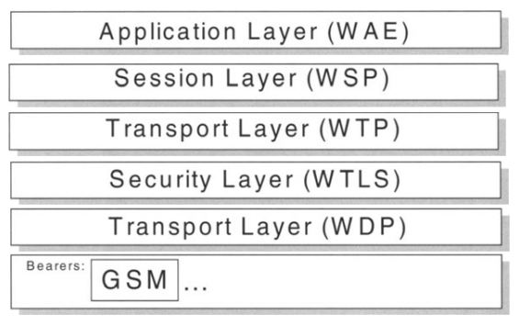
WAP Architecture
Transaction

Slide 6
WAP Architecture
WAP uses a layered model similar to the ISO OSI Reference Model. On top of the bearers, which are not in the scope of WAP, the WAP Forum has defined protocols for the following layers
Transport Layer: Wireless Datagram Protocol (WDP);
Security Layer: Wireless Transport Layer Security (WTLS);
Transaction Layer: Wireless Transaction Protocol (WTP);
Session Layer: Wireless Session Protocol (WSP);
Application Layer: Wireless Application Environment (WAE).

Slide 7
Wireless Datagram Protocol
The Wireless Datagram Protocol (WDP) layer sits on top of the transport layer and offers a consistent interface to the security layer. To do so, WDP has to handle the differences between the carriers and to define which carrier services are supported by WAP. This ensures the independence of the upper WAP layers.

Slide 8
Wireless Transport Layer Security
The Wireless Transport Layer Security (WTLS) specification is derived from the Transport Layer Security (TLS) , formerly known as Secure Socket Layer (SSL) , and is optimized for use on low bandwidth communication channels. Applications have the possibility of using WTLS depending on the security requirements and capabilities of the underlying network layer.

Slide 9
Wireless Transaction Protocol
The Wireless Transaction Protocol (WTP) provides a transaction-oriented interface to the upper layers. WTP supports unreliable one-way requests as well as reliable one- and two-way requests.

Slide 10
Wireless Session Protocol
The Wireless Session Protocol (WSP) provides a connection-oriented service on top of WTP. In addition, it provides a second connection-less service that is directly based on WDP. WSP currently supports services for browsing, like HTTP 1.1 functionality and semantics in a compact format for wireless connections, long-lived session state, session suspend and resume with session migration, and protocol negotiation. Data push will come with WAP 1.2.

Slide 11
Wireless Application Environment
The Wireless Application Environment (WAE) enables the operators and service providers to develop interoperable applications for all WAP-compatible environments. WAE is based on the World Wide Web (WWW) as well as on mobile telephony technology. WAE is, from an application provider's and developer's point of view.

Slide 12
Wireless Application Environment
The following specifications are part of the WAE:
Wireless Markup Language (WML) - a markup language optimized for wireless communication channels and based on HTML as well as Unwired Planet's Hand Held Markup Language (HDML).
WAP Binary XML Format (WBXML) - a specification for the binary encoding and transfer of XML documents in a W AP environment with the goal of reducing the actual amount of data transferred over the wireless connection.
WMLScript - a scripting language based on JavaScript, which allows the execution of commands on the client to reduce the number of necessary turnarounds over the network. In the WMLScript Standard Libraries Specification, WAE also defines a set of standard functions available on the client.
Wireless Telephony Application (WTA) - a collection of telephony specific features for call and feature control mechanisms. The corresponding interfaces are defined in the Wireless Telephony Application Interface (WTAI) specification.
Content formats - the data formats supported by a W AP environment, like calendar entries, images, and address book records.

Slide 13
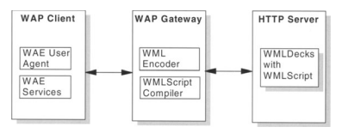
Distribution of Components in o WAP System
The interaction between a client and a server is described in Figure. The client contains a so-called WAE User Agent, like for example a micro browser, which is used to display the content and to enter information requested by the application. The User Agent is capable of displaying documents received in WML and executing procedures written using WMLScript. A WML document is called a WML deck, which can consist of several cards. A card should contain the amount of information, which fits on the display of a device. A card could also contain WMLScripts to perform actions on the client. To request data from a server, the user navigates through menus, which ultimately results into a WSP request to the W AP Gateway. The W AP Gateway receives the request, transforms it into an HTTP request, and forwards it to the HTTP server.

Slide 14
WML Encoder
The server performs the requested action and returns the deck to the WAP Gateway. If the server is not able to generate WML directly, it could also reply sending plain text to the gateway. In this case, the gateway transforms the plain text into WML decks. Now the gateway binary encodes the deck into WBXML to reduce the number of bytes to be transferred to the client.

Slide 15
WMLScript compiler
WMLScript contained in the decks is also compiled into byte code. First, this reduces the number of bytes to transfer and secondly takes workload away from the client. Performing work on the gateway instead of on the client also allows mobile devices with less computing power to be compliant with WAP.

Slide 16
Wireless Markup Language
The WAP Forum has defined WML as an Markup Language optimized for mobile devices. WML is based on the Extensible Markup Language (XML). It is also very similar to HTML.

Slide 17
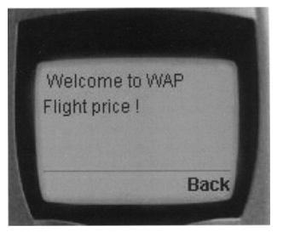
WML Example

Slide 18
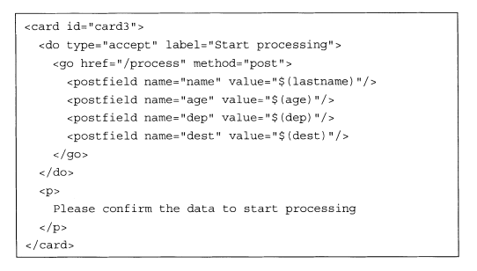
WML Example

Slide 19
WAP Binary XML Content Format
WAP Binary XML Content Format (WBXML) is used to reduce the amount of data to be transferred by binary encoding WML documents. During the encoding, the document is tokenized. This means that each tag is represented by a number and instead of transferring four bytes for a card tag, only one byte is transferred for the token. The same happens with attributes and entities.

Slide 20
WMLScript
WMLScript was defined to enable the execution of scripts on WAP for scripting devices. The goal of using scripts on WAP devices is to reduce the number of turnarounds between the client and the server, thus improving the performance of a WAP application. WMLScript could for example be used to validate data entered by the user before transmitting it over the network and to execute functions locally on the client. It could also be used to access local functions of a phone or an organizer, like retrieving an entry from the local address book or generating and sending a message. Updating the device configuration or the device software is also possible.

Slide 21
A WMLScript Sample

Slide 22
WMLScript Standard libraries
The WMLScript Standard Libraries provide client-side functionality, which are accessible by WAP applications. The following libraries are available:
Lang - contains a set of functions that are closely related to the WMLScript language, like creating a random number or converting a string to an integer or float.
String - provides a set of operations on strings, like comparing two strings or replacing apart of it.
URL - contains functions for handling absolute and relative URLs, like getting the port or the path or checking if a URL is valid.
WMLBrowser - provides WMLScript with functions to access the WML context of the browser. These functions can be used to set or get variables of a WML card, go to another URL or to refresh the context, for example.
Dialogs - this library provides typical user interface functions like prompting the user or sending an alert.
Float - provides floating-point arithmetic functions.

Slide 23
Acknowledgment
These slides contain material developed and copyright by:
Pervasive Computing Handbook - Uwe Hansmann

