Slide 1
Basic Electronics CSE 212
Md. Zakir Hasan Lecturer DIU

Slide 2
Semiconductor Diode

Slide 3
Crystal Diode as a Rectifier

Slide 4
Crystal Diode Equivalent Circuits

Slide 5
Half-Wave Rectifier

Slide 6
Efficiency of Half-Wave Rectifier

Slide 8
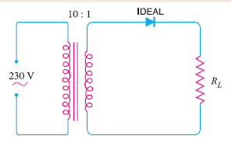
Problems

Slide 9
Problems

