Slide 1
Rules and Guidelines for Genetically Modified Foods

Slide 2
What are these?

Slide 3
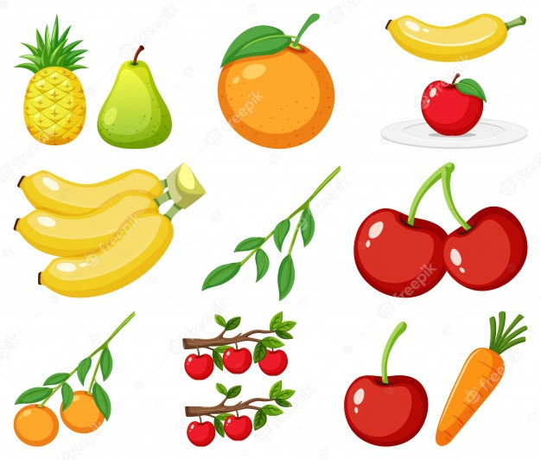
Are all the foods we eat genetically modified?

Slide 7
What is Genetically modified foods or GM foods?
Genetically modified food (or GM food) is food produced from plants or animals whose DNA has been altered through genetic engineering. These genetically modified organisms are often called GMOs for short.

Slide 8
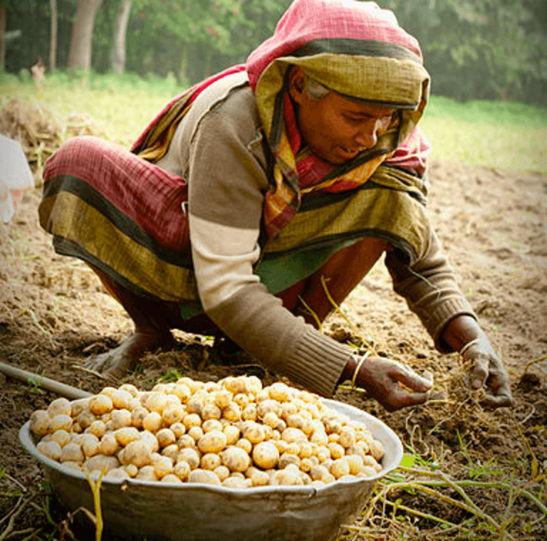
Bangladesh field testing three GMO crops: potato, cotton, rice
Inspired by the success of the country’s first commercially released biotech crop — Bt brinjal — in 2013, Bangladesh is now field testing three more crops developed through applications of agro-biotechnology.
These are: late blight resistant potato, Bt cotton and vitamin-A enriched Golden Rice.
The International Service for the Acquisition of Agri-biotech Applications (ISAAA), a non-profit international organization that keeps watch on production and expansion of biotech crops worldwide, said this in its latest report titled “Global Status of Commercialized Biotech/GM Crops: 2015.”

Slide 9
Characteristics of GM food
GM foods are genetically modified such that it will benefit mankind in term of what we eat
There are two aspects that can be improved by genetic modification :
Alteration of input traits :
Alteration of output trait :
Resistance to pests and harmful factors
Resistance to pesticide, herbicide
Resistance to disease and virus
Increased health and Medical benefits
Increased nutritional value
Increased duration of shelf life
Increased output of crops

Slide 10
Hybrid food
Hybrid food is the result of cross-breeding plants under controlled pollination.
The hybrid seed will produce a plant with characteristics from both plants that were crossed.
The purpose of cross-breeding is to produce a plant with desirable characteristics such as ………..
higher productivity,
resistance to insects or
improved nutrition

Slide 11
CHARACTERISTICS OF HYBRIDISED PLANTS
• Hybridised plants have high resistance.
• Hybridised plants have high yielding capacity.
• Hybridised plants have high productivity.
• Hybridised plants have lifelongness.
• Example: Brinjal, Ladyfinger, Chilli,Paddy, Tomato etc

Slide 12
Hybrid Food In Bangladesh
Chilli • Chillies widely used as vegetable and spice is an often cross pollinated crop. • It is also known as hot pepper.
Paddy • Hybridised rice is any genealogy of rice produced by cross breeding different kinds of rice. • As with other types of hybrids , hybrids rice are typically displays heterosis such that when it grown under the same conditions as comparable high yielding inbred rice varieties it can produce up to 30% more rice.
Tomato • Tomato production is increased considerably in the recent past with green house production. • The tomato is popular with both small and large scale farmers for its edible fruits both for export and consumption.

Slide 13
Are GMOs safe to eat?
So far, there's no good evidence that the foods on the market containing GMOs are any less safe than regular foods.
The mainstream view on safety: At this point, billions of people around the world have been eating GM foods for decades without any noticeable ill effects.
And numerous scientific studies have concluded that the GM crops currently on the market pose no more of a health risk than conventional crops.

Slide 14
Can GMOs be patented?
Yes. In 1980, the US Supreme Court ruled in Diamond v. Chakrabarty that genetically altered life can be patented.
Anyone who buys GM seeds typically has to abide by certain restrictions.
For instance, farmers who buy soybeans that have been modified to be resistant to Roundup herbicide sign an agreement saying they will use the seeds for only one planting and won't save the seeds from the beans they grow for a second planting.

Slide 15
Are GMOs labeled?
Sixty-four countries around the world, including Australia, Japan, and all of the countries in the European Union, require genetically modified foods to be labeled. Canada does not require any GMO labeling.

Slide 16
Bangladesh Packaged Food Labelling Act 2017

Slide 17
Bangladesh Biosafety Rules 2012
no person or institution can import, export, buy, sell or commercially use the Genetically Modified Organism and products thereof, without prior permission from the Ministry of Environment and Forest'.
This Rules also provides for mandatory provision for identification or labeling of GMOs in rule as 'any box or cover, which carries Genetically Modified Organism or Products thereof, shall have detail identification or labeling on it relating to the nature of Genetically Modified Organism or products.

Slide 18
Crimes and punishment.

Slide 19
Regulatory Framework
GOVERNMENT RULES FOR GMOs
The Bangladesh Environment Conservation Act, 1995
Bangladesh Biosafety Rules 2012
Bangladesh issues Packaged Food Labelling Act 2017

Slide 20
Additionally
Kindly check the next slides.

Slide 21
Regulatory Framework
GOVERNMENT RULES FOR GMos
1. Recombinant DNA guidelines, 1990
2. Guidelines for research in transgenic plants, 1998
3. Seed policy, 2002
4. Prevention of food adulteration act
5. The food safety and standards bill, 2005

Slide 22
Continue
6. Plant quarantine order 2003
7. Task force on application of agricultural
8. Biotechnology
9. Draft national environment policy, 2004
10. Draft national biotechnology strategy 2005

Slide 23
Thank you……………

