Slide 1
HEAT
TRANSFER

Slide 2
Content
Modes of heat transfer?
Fourier Law of heat conduction
Convective heat coefficient
•
•
•

Slide 3
Temperature
A measure of energy due to level
– Freezing point of water is 0 ˚ C
– Boiling point of water is 100 ˚ C
•
of heat

Slide 4
Common Temperature Scales

Slide 5
What is Heat?
is the total internal kinetic energy
Heat
due to
molecular motion in an object
Quantity of heat is BTU or Kilo Joule (kJ)
•
One BTU is the amount of heat required to raise
lb of water by 1 ˚ F
1
•
One calorie is required
C
1 cal = 4.187 J
1 BTU= 1.055 kJ= 1055
to raise 1 g of water by 1
˚
•
J

Slide 6
Heat Vs Temperature
Heat energy depends on mass. Temperature is
independent of mass.
– 2 litres of boiling water has more heat energy than
1 litre of boiling water
Temperature is not energy, but a measure of it
Heat is energy
•
•
•

Slide 7
Heat is Energy
When heat (ie energy) goes into a substance,
one of two things can happen:
1.
2.
Temperature goes up
Change of state

Slide 8
Temperature Goes Up
Heat that causes a rise in temperature e.g.
heating water before boiling
The heat energy is used to increase the kinetic energy of the molecules in the substance
This is also known as the sensible heat
•
•
•

Slide 9
Change Of State
Heat that brings about a change in potential energy of the molecules (temperature remains constant). Also called the latent heat.
•

Slide 10
Specific Heat
It is the heat required to the temperature
kg (lb) a substance by 1 ˚ K (F)
Example:
•
of 1
•
water’s specific heat is 1 btu/ lb F (4.2 kJ/kg K)
air’s specific heat is 0.24 btu/ lb F (1.0 kJ/kg K)

Slide 11
Sizing Heating Capacity
Quantity of heat required $=$ mass x specific heat x $∆$T
Example:
What quantity of heat is required to raise the temperature of 450 grams of water from 15°C to 85°C? The specific heat capacity of water is 4.18 J/g/°C

Slide 12
Heat Transfer
If there is a temperature difference in a system, heat will always move from higher lower temperatures
•
to
What is actually flowing?

Slide 13
Application of Heat Transfer

Slide 14
Heat Transfer
Modes
There are 3 modes
of heat transfer.
1.
2.
3.
Conduction
Convection
Radiation

Slide 15
Conduction
Heat transfer through a solid medium
direct contact
Expressed by Fourier’s Law
•
via
•

Slide 16
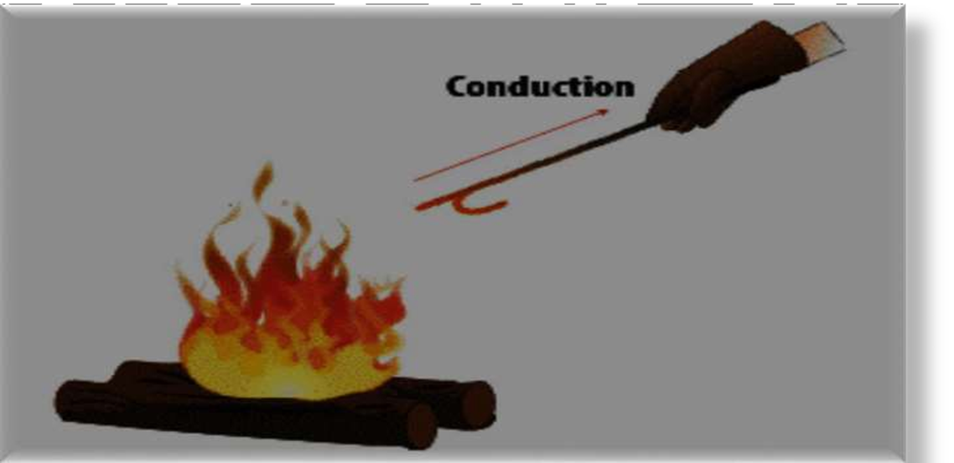
For example, flow of heat through the metal shell of a boiler takes place by conduction as far as solid wall or shell is considered. No mixing is involved. Conduction is limited to solids and fluids whose movement is restricted.

Slide 17
Convection
When heat flow is achieved by actual mixing of warmer portions with cooler portions of the same material, the process is known as convection.
For example, heating of water by a hot surface (coil type water heater) is mainly by convection. Convection is restricted to the flow of heat in fluids (i.e. liquid and gases). Convection is restricted to the flow of up almost daily in the atmosphere. These are responsible for winds, land and sea breezes, ocean current etc.

Slide 18
Convection
Energy transfer by fluid
motion
Two kinds of convection
– Forced convection: Fluid is
Forced
This forcing can be done with a ceiling fan, a pump, suction device , etc.
– Natural or free convection: fluid is induced by temperature difference

Slide 19
Heat Radiation
Energy carried by electromagnetic waves
Light, microwaves, radio waves, x-rays
Wavelength is related to vibrational frequency

Slide 20
CONDUCTION
Heat can flow only when there is a temperature gradient, i.e. heat flows from a hot surface to a cold surface.
The rate of conduction through solid can be studied easily, since it is the sole phenomenon. The basic law of heat transfer by conduction can be written in the form of rate equation as follow:
_{𝑅𝑎𝑡𝑒 =} 𝐷𝑟𝑖𝑣𝑖𝑛𝑔𝑓𝑜𝑟𝑐𝑒
𝑅𝑒𝑠𝑖𝑠𝑡𝑎𝑛𝑐𝑒
The driving force is the temperature drop across the solid surface. The greater the temperature drop, the greater will be the rate of heat flow.
The flow of heat will also depend on the conductivity of the materials through which it is flowing. For example, conduction of heat is faster through an iron rod than through a wooden log. This factor is represented by the team resistance, which can be quantitatively expressed by Fourier’s law.
𝑤

Slide 21
Fourier’s Law of Heat Conduction
Fourier’s law states that the rate of heat flow through a uniform material is proportional to the area and the temperature drop and inversely proportional to the length of the path of flow.
Rate of heat transfer by conduction (through a solid) in a given direction is proportional to the area normal to the direction of heat flow and the temp gradient in that direction. Mathematically ;
Q ∝ A ^{ΔT} Watt
Q = −kA ^{dT} Watt (J / s)
OR
Δx
dx
where Q = heat flow rate,Watt (J/s)
A = area normal to heat flow direction,m²
k = conductivity of material (property),W/mK dT/dx = temp gradient in x direction
ΔT = temp difference across Δx
Δx = thickness of material in heat flow direction

Slide 22
Thermal
Conductivity, k (W/m
K)
Thermal conductivity can be defined as the rate at which heat is transferred by conduction through a unit cross-section area of a material, when a temperature gradient exits perpendicular to the area.
Common Metals
Copper: 385
Aluminum: 221
Liquids
Water: 0.556
Ammonia: 0.54
Gases
Air : 0.024
Water vapor: 0.021
Steel:
50
Non-metals
Common brick: 0.6
Mineral wool: 0.04
Ceiling board: 0.06

Slide 23
Variation of Thermal Conductivity
It is the property of material; defined as ability of material to conduct heat through it.
Thermal conductivity in decreasing order :
Metals » Non-metallic Solids » Liquids » Gases

