Slide 1
What is Tech Savvy
Well informed about or proficient in the use of modern technology, especially various device like Computer, Smartphone, Laptop and are able to connect these devices with important applications (apps).

Slide 2
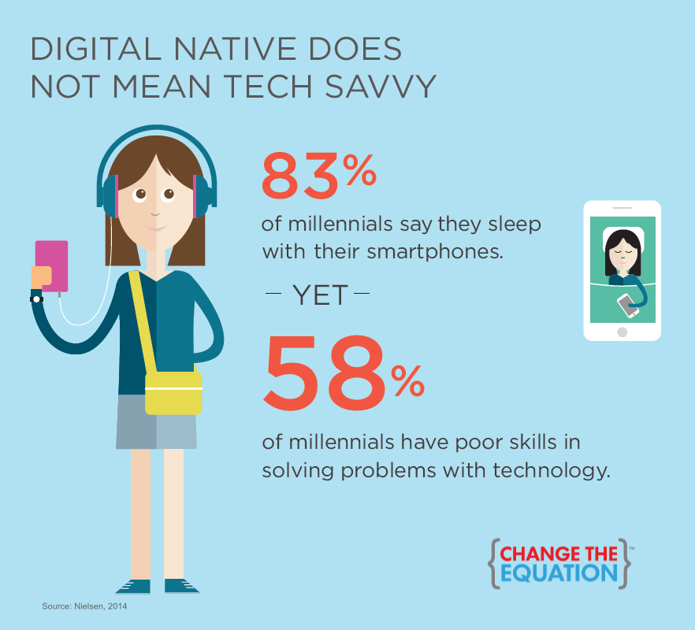
স্মার্টফোন বা ল্যাপটপ সাথে নিয়ে চলাচল করলেই প্রযুক্তি জ্ঞান সম্পর্কিত মানুষ বলা যাবে না।
ডিভাইসগুলোর সাথে প্রয়োজনীয় এ্যাপ্লিকেশনের সংযোগ এবং ব্যবহার সম্পর্কে ভালভাবে অবহিত বা দক্ষ হবার নামই হচ্ছে টেকসেভী

Slide 3
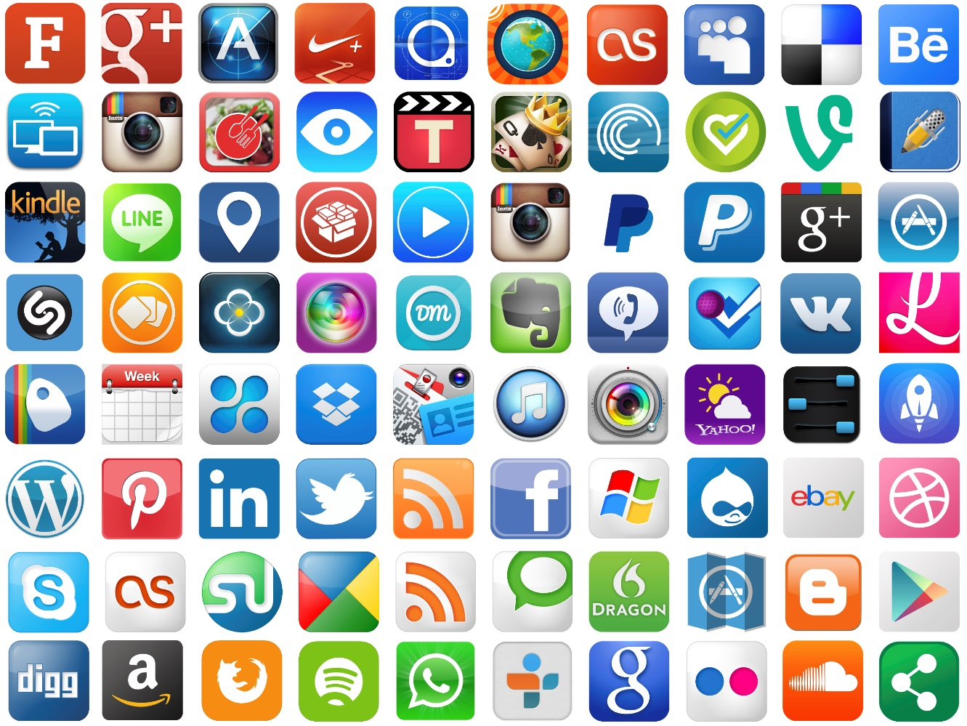
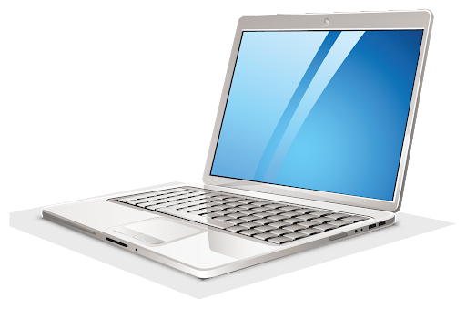
Who is a Digitally Transformed Person?
Who can make a link between Devices & Apps
Who can solve problems with the link

Slide 4
To make creating, sharing, playing, and working efficient and fun.
When you become efficient and skilled with tech you can save yourself lots of time, which allows you to focus more energy on your priorities and enjoy life more.
Being technology savvy increases your productivity and efficiency since you are able to achieve more in less time.
Instead of taking out time from busy schedule to go and have a meeting with someone, you can choose teleconferencing or even text messages in case there is someone you aren't able to contact.
The two biggest benefits to using tech confidently and easily are:

Slide 5
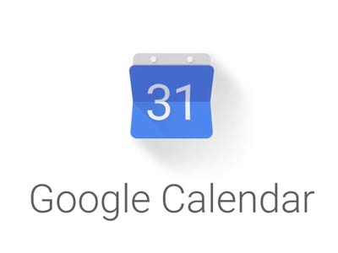
Online Class/
Meeting
Group Study/ Discussion/ Brainstorming
Group Work Sharing/Managing
Promotional Apps
Communication Apps
Editing Apps
Tech ‍Savvy students know how to make life easier and get into the workplace easily.
Reminder Apps
Learning Apps

