Slide 1
Week1:Lecture 1
Nuray Jannat

Slide 2
Topics
Structured programming vs Object Oriented Programming
Motivation behind OOP
OOP principles
OOP languages
Real time problem with OOP
How java works

Slide 3
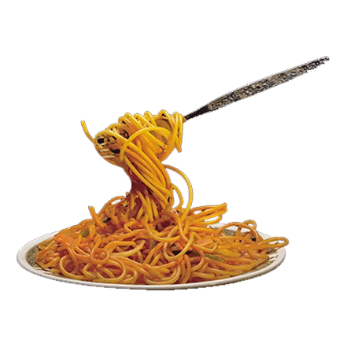
Structured Programming Language
Let’s think of a example:
Steps for making tea:
Step1: Boil water
Step 2: Add ginger
Step 3: Add suger
Step 4: Add Tea
Step 5: is suger enough? If No, go to step 3
Step 6: is liquor enough? If no, go to step 4
Step 7: is ginger taste balanced? If no, go to step 2
Step 8: Enjoy your tea
In structured language:
void Tea() {
boil_water();
add_suger();
add_ginger();
add_tea();
while( tea_okay() == 0){
if( suger_okay() == 0 )
add_suger();
if( ginger_okay() == 0 )
add_ginger();
if( liquor_okay() == 0 )
add_tea();
}
}
Speghetti code!

Slide 4
Structured Programming Language
A programming paradigm that aims at:
structured control flow constructs with
selection (if/then/else)
Sequence
repetition (while and for)
block structures, and subroutines
Programs are divided into small parts: Function
Main concern is: “readability and reusability”

Slide 5
Motivation behind OOP
Limitation of Structured Programming Language to handle complexity
Structured Programming Language can’t hide data or impose “access restrictions”.
From whom? Different part of same program…
Failure to maintain functions with similar activities but different name, parameters
Doesn’t support Inheritance

Slide 6
Object Oriented Programming
In Object Oriented Programming, programs are divided into small parts named “object”
In OOP, Data hiding from different part of same program is possible
Functions with same name and different parameters (both in number and type)
Code is more reusable with inheritance concept

Slide 7
Explanation
int main()
{
int i,fact=1,number;
scanf("%d",&number);
for(i=1;i<=number;i++){
fact=fact*i;
}
printf("Factorial of %d is: %d",number,fact);
return 0;
}

Slide 8
Data abstraction
A car has many individual parts such as headlight, bumper, steering wheel etc
We don’t think of a car as a collection of different hardware parts
We see it as a car. We refer it with a name only
But along with different hardware parts, it has different actions:
Drive
Brake
Turn on headlights
Turn off headlights
Taking U-turn etc
But we refer all these hardware parts and action
as simply “car”. That is data abstraction.

Slide 9
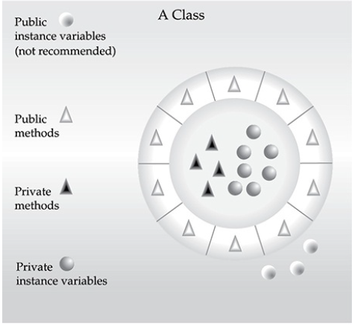
OOP principles
i. Encapsulation:
a mechanism that binds together code and the data to keep safe from outside interference and misuse.
It prevents the code and data from being arbitrarily
accessed by other code
An example of driving car.

Slide 10
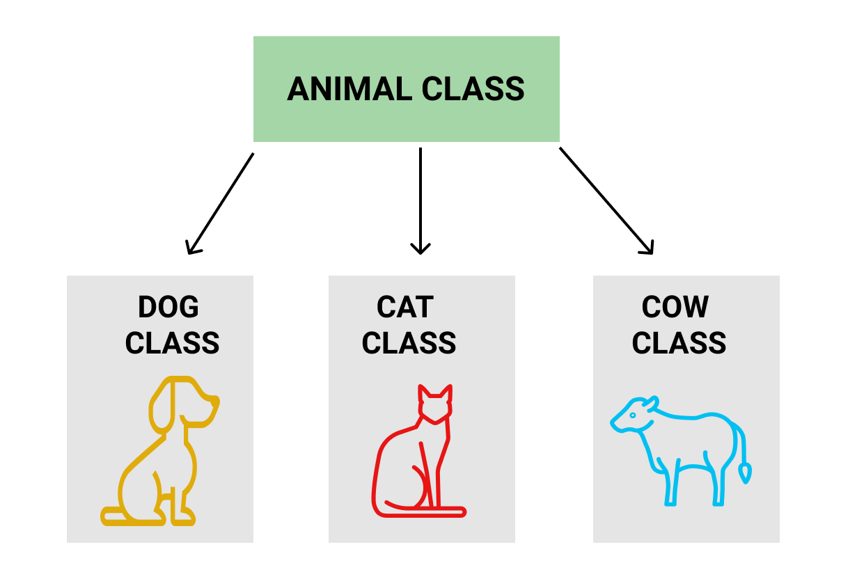
OOP Principles
Inheritance:
It is the process by which one part of the code acquires the properties of another part of the code.
Main focus is reusability of code

Slide 11
OOP Principles
Polymorphism:
A feature that allows one interface to be used for a general class of action.
Example: a function that adds two numbers
for three data types (int, float, double), we need three different function
For Structured Programming Language:
int add_int(int a, int b), float add_float(float a, float b), double add_d(double a, double b)
For OOP:
int add(int a, int b), float add(float a, float b), double add(double a, double b)

Slide 12
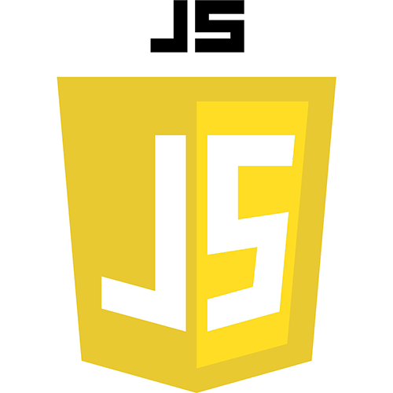
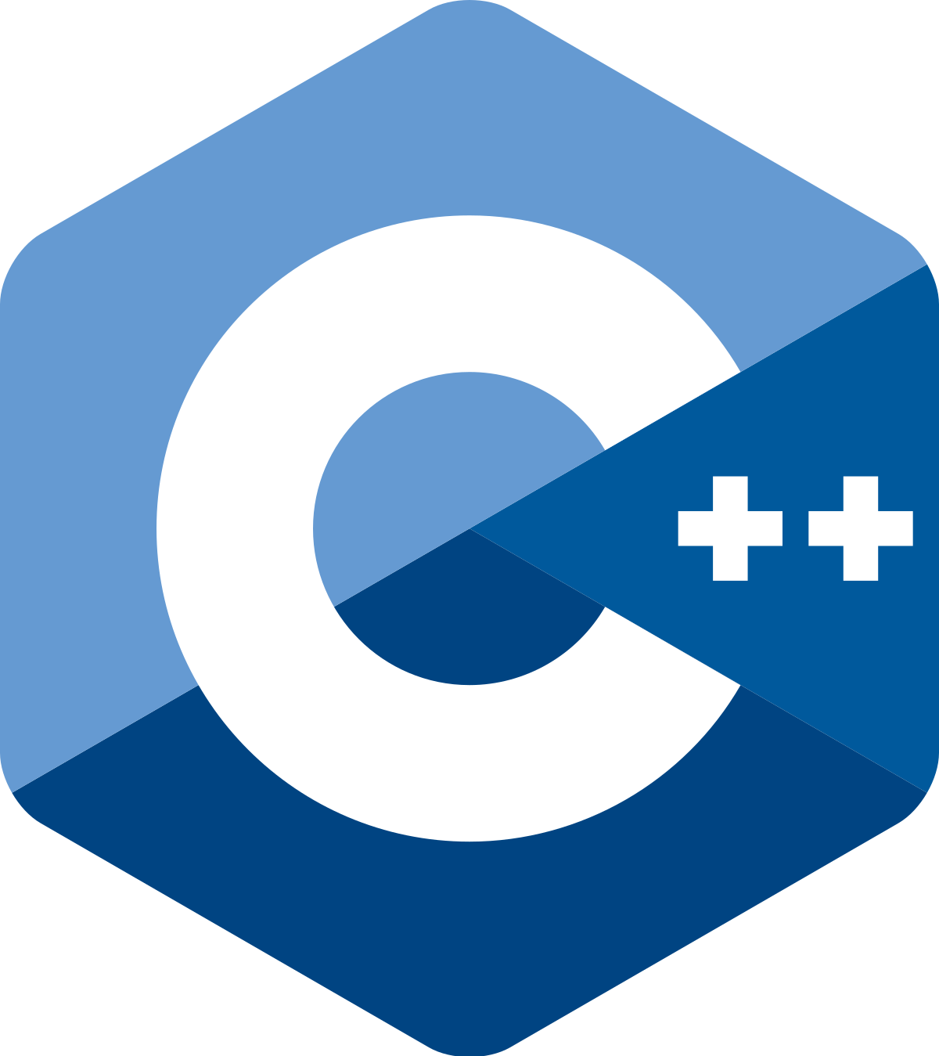
Languages For OOP

Slide 13
OOP: real time example
Learning management system. Ex: DIU Blended Learning Center
Office management System.
A air fighter game where a friend plan fights enemy planes
Television and remote control
When to choose OOP over Structured Programming Language?
…

Slide 14
How Java works
JVM(Java Virtual Machine) acts as a run-time engine to run Java applications.
JVM is the one that actually calls the main method present in a java code.
JVM is a part of JRE(Java Runtime Environment).
Java code developed on one system, can be expected to run on any other Java enabled system without any adjustment.
This is all possible because of JVM.

Slide 15
EOL
END OF LECTURE

