Slide 1
Brand
Brand,
identity
and design

Slide 2
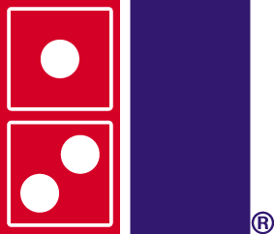
Brands are much more than logos

Slide 3
Brand
Love + Emotion
Brand =
X
Value (Proposition)
Price
Dr. Rima
Demha

Slide 4
What is a brand ?
A traditional scenario of market
Company A
Product / services
Consumer
Company B
Company C
In a traditional market scenario, the company is catering to the consumer.
The number of competitors are small.
In these markets the companies can come with advanced technologies and other strategies to capture more market share.
(The size and power of the players is important.)

Slide 5
What is a brand ?
Company A
Product / services
Company B
Consumer
Company C
In complex markets, the differences between companies are not much.
The companies can not differentiate much themselves from others on the basis of quality and technology etc. factors as all the companies are competent enough.
This scenario explains the need for the differentiation for the companies.

Slide 6
What is a brand ?
Branding is an effort to give a unique identity to the company’s products and create emotional associations with consumers.
It is a form of marketing.
A brand is a set of associations that are linked to a product range, a division, or company.
These associations reside in the memory of customers.
These associations help customers understand
what the brand or company is,
why it is potentially relevant to them,
how it is different or similar to other products made by the company,
and how it is similar or different from competitor’s products.

Slide 7
What is a brand ?
Branding is a combined effort of the company which is projected to the consumer.
Brand
Marketing
Company
Consumer
Design

Slide 8
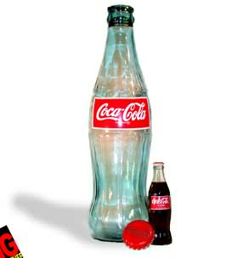
What is a brand ?
What a brand means to common person ?
In 'blind' taste tests, people prefer the taste of Pepsi over the taste of Coke. However, if the test is not 'blind' and the tasters know which beverage is which, they prefer the taste of Coke over Pepsi! That is the emotional power of a brand. The Coca-Cola brand has the power to actually change an individual's taste!
Coca-cola is the no.1 brand in the world.
The first shape that was registered is the coca cola bottle.

Slide 9
What is a brand ?
(1) Products and services have become so alike that they fail to distinguish themselves by their quality, efficacy, reliability, assurance and care. Brands add emotion and trust to these products and services, thus providing clues that simplify consumers’ choice.
(2) These added emotions and trust help create a relationship between brands and consumers, which ensures consumers’ loyalty to the brands.
(3) Brands create aspirational lifestyles based on these consumer relationships. Associating oneself with a brand transfers these lifestyles onto consumers.
(4) The branded lifestyles extol values over and above the brands’ product or service category that allow the brands to be extended into other product and service categories. Thus saving companies the trouble and costs of developing new brands, while entering new lucrative markets.
(5) The combination of emotions, relationships, lifestyles and values allows brand owners to charge a price premium for their products and services, which otherwise are barely distinguishable from generics.

Slide 10
Integrity of Brand
Product Packaging
Websites
logo
Company
Product A
Product B
Advertisements
A brand is a promise. A promise to achieve certain results, deliver a certain experience, or act in a certain way. A promise that is conveyed by everything people see, hear, touch, taste or smell about your business.

Slide 11
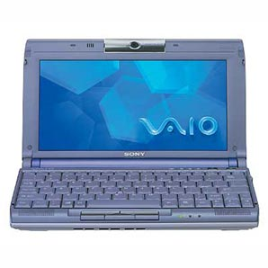
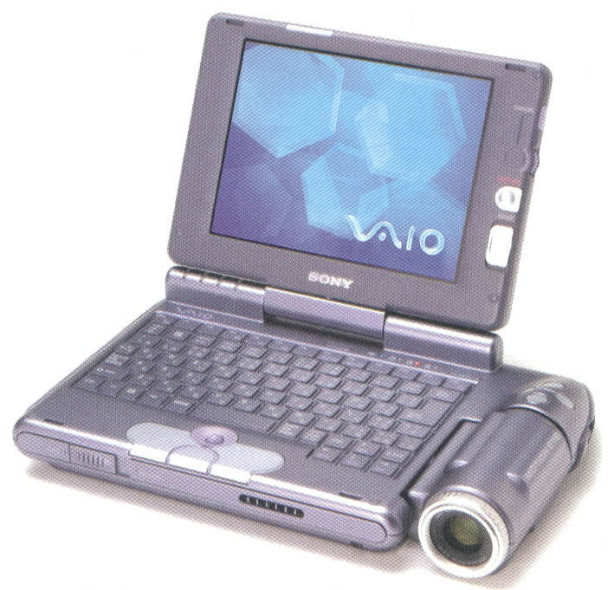
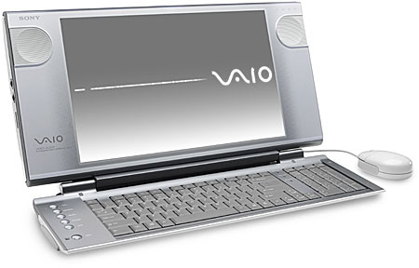
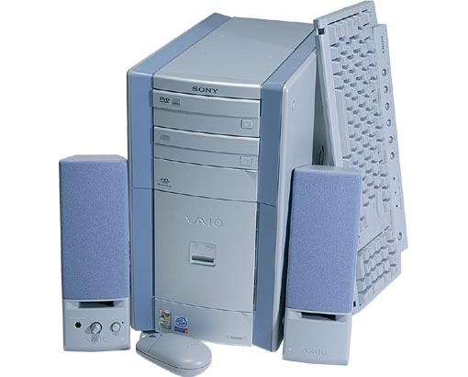
Sony
* Aesthetics – integrated family look. All products bear some common elements.
* Style of use – interface design – unique way of operating a product.
* Some functions special to the brand
The Sony Vaio series – one voice by Sony

Slide 12
Company / Service
People
BRAND
The market
A traditional market scenario is in market a company or service is catering to consumers
After there are plenty of players who are competing against each other, the market becomes complex
At this time companies start fighting against each other to capture a large market share with lot of
Efforts in various fields.
Like using advanced technology, giving quality products etc.
This all is possible when there is a lot of variation in sizes of the companies
But when all the companies are quite competitive this difference doest work.
Here advertising and branding comes as a major player.
Brand is associations of things in people’s mind.

Slide 13
Points
What is brand?
Why is it necessary?
What makes a brand?
What are the efforts
And a lot of examples
of each and every type of branding

Slide 14
Task Guide
WHO your TARGET MARKET is (age; gender; high or low income)
Suitable NAME for the product
Suitable SHAPE for the packaging
Suitable COLOUR for the packaging
Suitable Material that the packaging will be made of
Sketch the product.
Sketch the logo if you chose one.
Write up your Brand Specification JUSTIFYING the decisions that you made

Slide 15
Pros and Cons of Branding:
Advantages
Drawbacks
Can charge HIGHER PRICES
Cost of developing and establishing it
Can Launch complimentary products in same brand name – e.g. shampoo; conditioner; hairspray.
Could get a bad name as well as a good one if quality is not kept up
Increases loyalty
Successful brand names CAN link to product (e.g. a “Hoover”)
Can be copied/ near copied

Slide 16
Pros and Cons of Branding:
Advantages:
Increases loyalty
Can charge HIGHER PRICES
Successful brand names CAN link to product (e.g. a “Hoover”)
Can Launch complimentary products in same brand name – e.g. shampoo; conditioner; hairspray.
Drawbacks:
Cost of developing and establishing it
Can be copied/ near copied
Could get a bad name as well as a good one if quality is not kept up

Slide 17
Branding – Conclusions, Discussion and Write-Up:
Is branding simple or complex to design? Explain.
(3 marks Level 2 – Grade D)
Is branding time consuming or quick to set up?
Give reasons for your answer.
(Level 2 – Grade D - 3 marks)
How does market research help in the development of a new brand? Explain your answer clearly and give an example.
(Level 2 – Grade C – 5 marks)
To what extent does branding link to the price charged and the target market? Is there a strong or weak link between them? Explain your point with examples.
(10 marks -Level 3 – Grades B - A*)
Is branding essential or non essential for a product’s success? Discuss and explain your thoughts.
(8 marks – Level 3 – Grades B - A*)

Slide 18
Mark scheme - Question 3
How does market research help in the development of a new brand/ Explain your answer clearly and give an example? (Level 2 – Grade C – 5 marks)
Do they DEFINE what market research is OR do they DEFINE what a BRAND is? (1 mark)
Do they clearly and correctly explain market research helps the development of a new brand because it can be used to see if the target segment like the chosen name; packaging design and Price? (3 marks if ALL included)
Do they give a sensible example? (1 mark)

Slide 19
Mark scheme - Question 4
To what extent does branding link to the price charged and the target market? Is there a strong or weak link between them? Explain your point with examples (10 marks -Level 3 – Grades B - A*).
Do they DEFINE branding (1mark)? Do they Define TARGET market or Price? (1 mark)
Do they discuss the connection between brand and price? Explain how you can have economy brands; everyday brands and luxury brands BUT the NAME and packaging/ image of the brand has to link to the chosen brand image IF you are to charge the price you want (e.g. Radley handbags have an exclusive designer brand image with their famous little dog logo – this means they CAN charge a higher price for their handbags).
Do they discuss the importance of design, image and packaging in order to appeal to your target market? ( up to 5 marks)
Do they write a conclusion which gives a JUDGEMENT as to whether they feel there is a strong link between branding, the price charged and the target market, and JUSTIFY their views convincingly? ( up to 3marks)

