Slide 1
Sulfonic acid

Slide 2
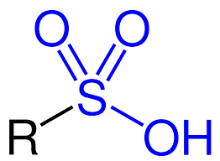
Introduction
Most important member of organ sulfur compound.
Contain sulfur.
Associated with foul odors.
Also derivative sweet compound.
Its salts and ester are called sulfonates.
Structure
General formula RSO2OH.
R ( organic alkyl and aryl group).
Alkyl-Alkane missing 1 hydrogen.
Aryl_ Aromatic hydrocarbon ring (Phenyl, naphthyl, Indolyl).
Sulfonyl (SO2OH) is functional group.

Slide 3
We can get sulfonic acid by replacing one OH group from H2SO4 by an organic substituent.
Types:
Different in category. They are 16 types. Important types are- 1.Avibactam: <>Complicated urinary tract and intra abdominal infection. <>Caused by antibiotic resistant pathogen. 2.Ensulizole: <>Sunscreen agent give UV protection. <>Water soluble so, use as moisturizer.

Slide 4
Types:
3.Homotaurise:
<>Effect on neurodegenerative disease.
4.Micafungia:
<>Antifungal drug, Inhibits fungal cell wall production, prevent candidemia.
5. Relebactam:
<>Treat infection caused by gram negative bacteria.
6.Seclofen:
<>Modest action or central nervous system.
7.Taurine:
<>Essential for_ cardiovascular system, development of skeletal muscles, retina and central nervous system.

Slide 5
Properties: Physicals & Chemicals
Physicals Properties:
Boiling point: 190’C
Melting point: 51’C
Molar mass: 158.15g/ mol
Density: 1.32g/cm3
Light yellow brown in viscous liquid.
Appearance form:Liquid
Colour:Clear amber
Odor:Characteristic
Soluble: Water & Alcohol
Slightly soluble: Benzene & Cold dilute HCl
Insoluble: Ether & Carbon disulfide

Slide 6
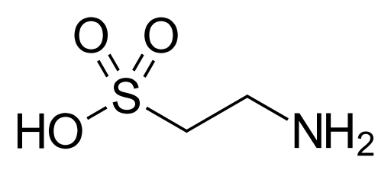
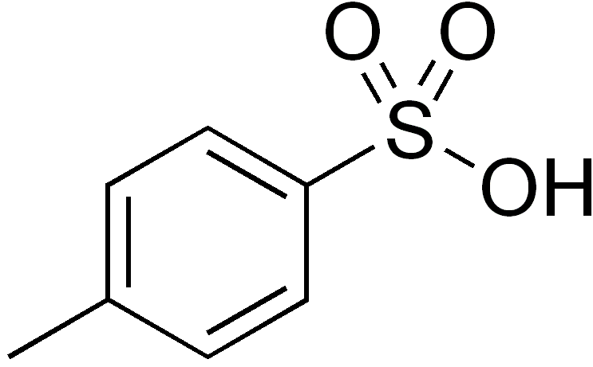
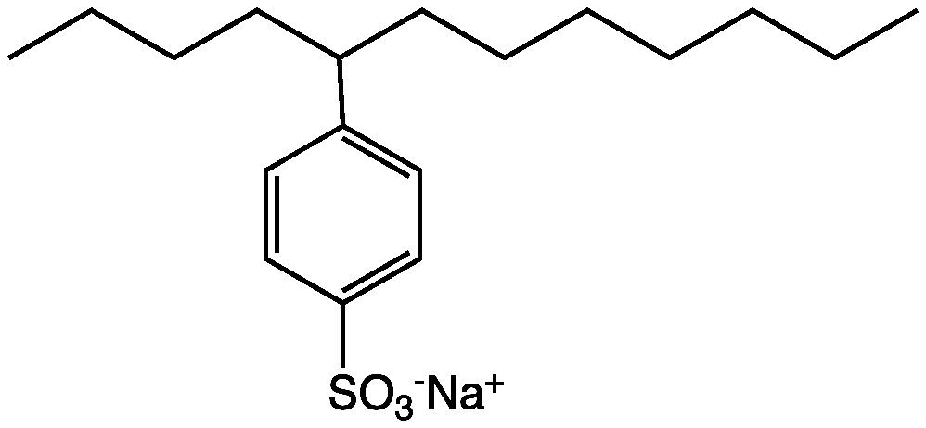
Properties: Physicals & Chemicals
Chemical Properties:
Sulfonic acids are much stronger acids than the corresponding carboxylic acids. p-Toluene sulfonic acid, with a pK_{a} of −2.8, is about a million times stronger acid than benzoic acid, with a pK_{a} of 4.2. Similarly, methane sulfonic acid, pK_{a} = −1.9, is also about one million times stronger acid than acetic acid. Because of their polarity, sulfonic acids tend to be crystalline solids.
The structure of sulfonic acids is illustrated by the prototype, methane sulfonic acid.
The sulfonic acid group, RSO₂OH features a tetrahedral sulfur Centre, meaning that sulfur is at the center of four atoms: three oxygen's and one carbon.
The overall geometry of the sulfur Centre is reminiscent of the shape of sulfuric acid
Etc.

Slide 7
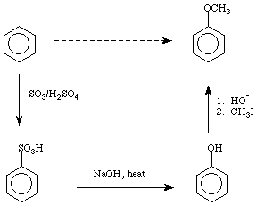
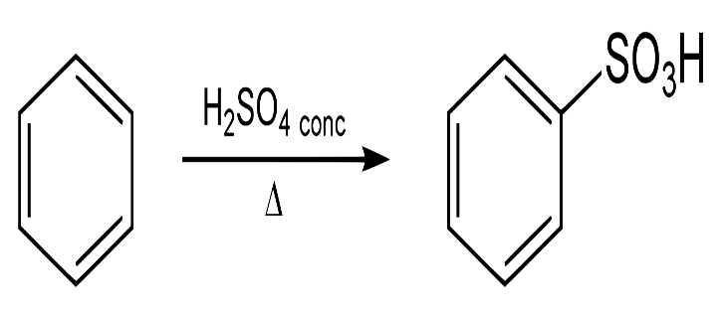
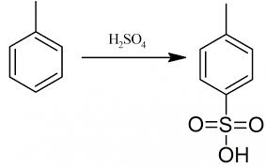
Preparation:
A sulfonic acid is produced by the process of sulfonation. Usually the sulfonating agent is sulfur trioxide. A particularly large scale application of this method is the production of alkylbenzenesulfonic acids:
RC6H5 + SO3 → RC6H4SO3H
In this reaction, sulfur trioxide is an electrophile and the arene undergoes electrophilic aromatic substitution. Thiols can be oxidized to sulfonic acids:
RSH + 3⁄2 O2 → RSO3H
Certain sulfonic acids, such as perfluorooctanesulfonic acid, are prepared by electrophilic fluorination of preformed sulfonic acids. The net conversion can be represented simplistically:
C8H17SO3H + 17 F2 → C8F17SO3H + 17 HF

Slide 8
Reactions:
Esterification:
Sulfonic acids can be converted to esters. This class of organic compounds has the general formula R−SO2−OR. Sulfonic esters such as methyl triflate are considered good alkylating agents in organic synthesis. Such sulfonate esters are often prepared by alcoholysis of the sulfonyl chlorides:
RSO2Cl + R′OH → RSO2OR′ + HCl
Halogenation:
Sulfonyl halide groups occur when a sulfonyl functional group is singly bonded to a halogen atom. They have the general formula R−SO2−X where X is a halide, almost invariably chloride. They are produced by chlorination of sulfonic acids using thionyl chloride and related reagents.
Displacement:
Although the C−SO3H bond is strong, the (aryl)C−SO3 bond can be broken by certain nucleophiles. Of historic and continuing significance is the α-sulfonation of anthroquinone followed by displacement of the sulfonate group by other nucleophiles, which cannot be installed directly. An early method for producing phenol involved the base hydrolysis of sodium benzenesulfonate, which can be generated readily from benzene.
C6H5SO3Na + NaOH → C6H5OH + Na2SO3

Slide 9
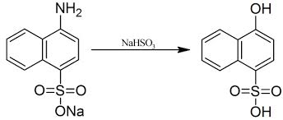
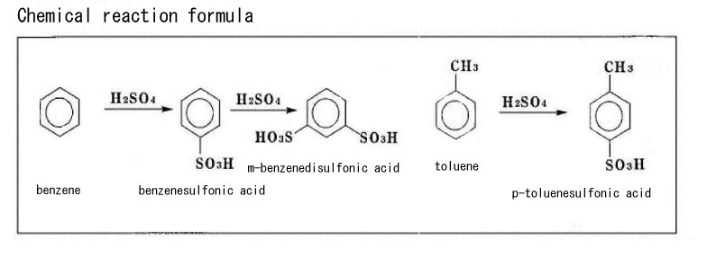
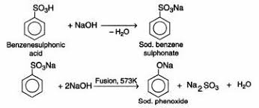
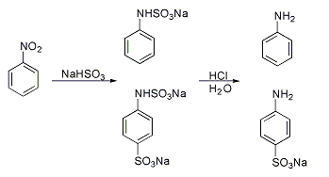
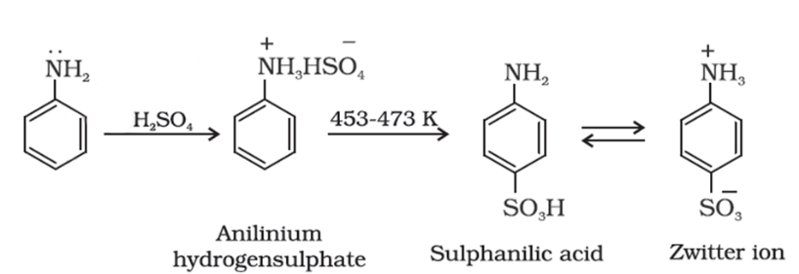
Reactions:
n n dimethyl p nitrosoaniline, Aromatic Sulfunation

Slide 10
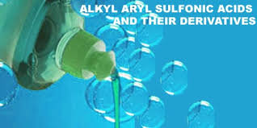
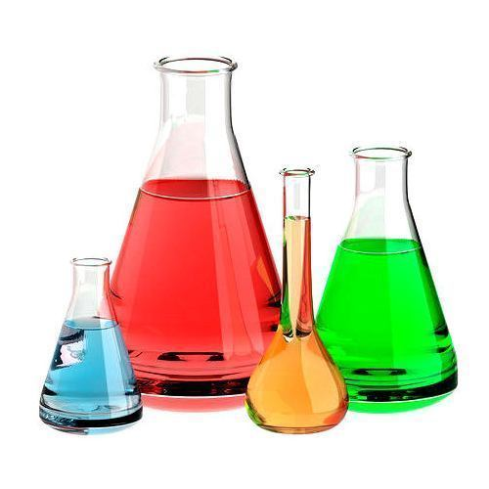
Applications/Uses:
Detergents and surfactants
Dyes
Acid catalysts
Drugs
Flow batteries
Antibacterial drugs ”sulfa drugs” are produced from sulfonic acids.

Slide 11
Different kinds:
Sulfonic acids are many different kinds of,
Benzenesulfonic acids.
Naphthalenesulfonic acids.
ABTA Sulfonic acids.
Camphorsulfonic acids.
Cefonicid.
2,3-Dimercapto-1-propanesulfonic acid
Ethanedisulfonic acid.
Glutaurine
Hydroxylamine-O-sulfonic acid.
3-Mercapto-1-propanesulfonic acid

Slide 12
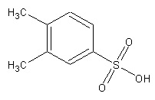
Products:
CIBSA: Flake Chlorobenzenesulfonic acid is commonly used as a catalyst and intermediate in pharmaceuticals and organic synthesis.
TSA 94: Liquid Toluenesulfonic acid 94% has wide application as an organic acid catalyst in resin and organic reactions.
P- TSA powder: p-Toluenesulfonic acid monohydrate is the leading high purity catalyst in organic syntheses of all kinds.
PSA: Liquid Phenolsulfonic acid is used principally in metal treatment and processing.
XSA: Liquid Xylenesulfonic acid is widely used in organic catalyst systems and electronic processing.

Slide 13
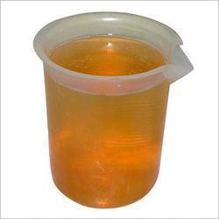
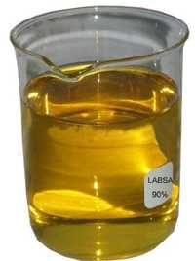
Side effects:
Bad for human skin.
Pain is a feeling triggered in the nervous system.
Burn eyes.
Conclusion:
Sulfonic acid is important part for making detergents, surfactants, drugs etc. LABSA 90% use for making detergents.

