Slide 1
Chapter 12
Global Marketing Management
Planning And Organizing
Farhana Noor
Assistant Professor
Daffodil International University

Slide 2
Exporting
Exporting accounts for some 10% of global activity
Direct exporting – the company sells to a customer in another country.
Indirect exporting – the company sells to a buyer (importer or distribution) in the home country, who in turn exports the product Customers include Wal-Mart and Sears.

Slide 3
Licensing
A means of establishing a foothold in foreign market without large capital outlays is licensing.
EXAMPLE : patent rights, trademark rights.

Slide 4
Advantage of licensing
Capital is scarce
Import restrictions forbid other means of entry
A country sensitive to foreign ownership , or patent and trade marks must be protected against cancellation for non use

Slide 5
Risk of licensing
Choosing the wrong partner
Quality and other production problems
Payment problems
Contract enforcement
Loss of marketing control

Slide 6
Forms of licensing
For production processes
For the use of trade name
For the distribution of imported products

Slide 7
Franchising
A rapid growing form of licensing. Franchiser provides a standard package of products, systems, and management services.
Franchise provides market knowledge, capital, and personal involvement in management
Expected to be the fastest-growing market-entry strategy as it provides an attractive form of corporate organization for companies wishing to expand quickly with low capital investment.
EXAMPLE: KFC, McDonalds)

Slide 8
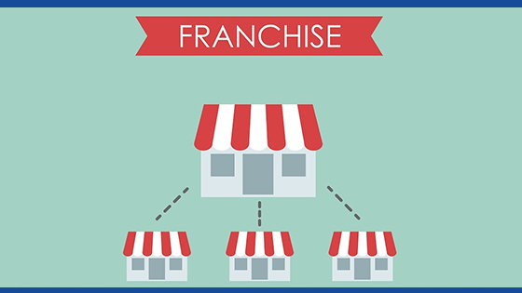
Advantages of franchising
The risk of business failure is reduced by franchising.
Products and services will have already established a market share.
Can using a recognized brand name and trade mark.
A franchise enables a small business to compete with big businesses.
Relationships with suppliers have already been established.

Slide 9
Disadvantages of franchising
Costs may be higher than expectation.
The franchise agreement usually includes restrictions.
The franchisor might go out of business.
All profits (a percentage of sales) are usually shared with the franchisor.
Other franchisees could give the brand a bad reputation

Slide 10
A strategic international alliance (SIA)
A business relationship established by two or more companies to cooperate out of mutual need
To share risk in achieving a common objective
SIAs are sought as a way to shore up weaknesses and increase competitive strengths
Firms enter SIAs for several reasons Opportunities for rapid expansion into new markets
Access to new technology More efficient production and innovation Reduced marketing costs Strategic competitive moves Access to additional sources of products and capital.
Example: In airline industry One world Alliance consists of British Airways, Japan Airlines etc.

Slide 11
International Joint Ventures
International joint ventures (IJVs) have been increasingly used since 1970s
IJVs are used as a means of lessening political and economic risks by the amount of the partner’s contribution to the venture
JVs provide a less risky way to enter markets that pose legal and cultural barriers than would be the case in an acquisition of an existing company
A joint venture is different from strategic alliances or collaborative relationships in that a joint venture is a partnership of two or more participating companies that have joined forces to create a separate legal entity
Joint ventures are different from minority holdings by an MNC in a local firm

Slide 12
Characteristics of international joint venture (IJV)
Four factors are associated with joint ventures:
JVs are established ,separate, legal entities .
They acknowledge intent by partners to share in the management JV
They partnership between legally incorporated entities .
Equity positions are held by each of the partners.

Slide 13
Direct foreign investment
A fourth means of foreign market development and entry is direct foreign investment.
Companies may manufacture locally to capitalize on low-cost labor, to avoid high import taxes, to reduce the high costs of transportation to market, to gain access to raw materials, or as a means of gaining market entry
Firms may either invest in or buy local companies or establish new operations facilities

Slide 14
Factors to influence of direct investment :
Timing --- First mover have advantages but are more risky
The growing complexity and contingencies of contracts
Transaction cost structures
Technology and knowledge transfer
Degree of product differentiation
The previous experiences and culture diversity of acquired farms
Advertising and reputation barriers

