Slide 1
Global Marketing
John L Graham
Farhana Noor
Assistant Professor
Daffodil International University

Slide 2
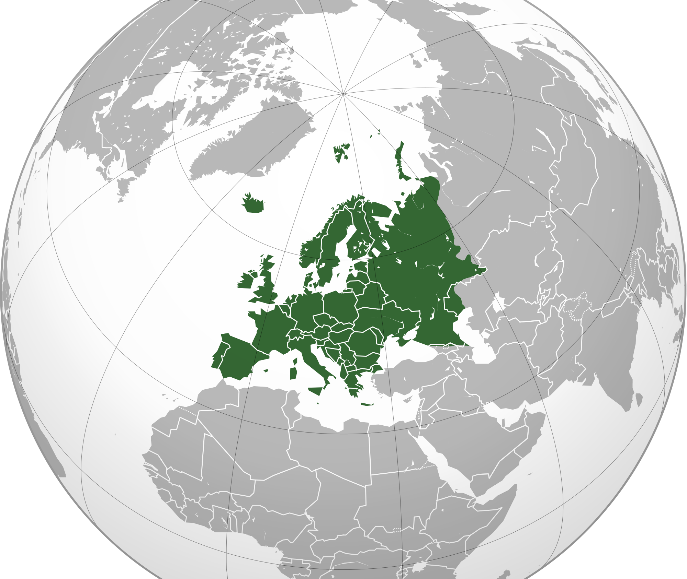
Chapter-1
The Scope & challenge of international marketing.

Slide 3
Definition:
Global Marketing:Global marketing is “marketing on a worldwide scale reconciling or taking commercial advantage of global operational differences, similarities and opportunities in order to meet global objectives.
International marketing:It is the performance of business activities designed to plan, price, promote and direct the flow of a company’s goods and services to users in more than one nation for a profit.

Slide 4
Process of global Marketing:
Global companies want to spread their vision, knowledge and capabilities to different countries. So they require in depth servey for getting knowledge of target market, competition, law and policies. They show respect to other country’s religious and communal(common) preference. They try to do necessary adjustments to maintain homogeneity. That’s why tie up with other local companies or obtain extra permit or licence. Global marketing require huge investment in research to know their customers liking and disliking's.

Slide 5
Objectives of Global Marketing:
To gain appeal and acceptance from other countries.
To create a platform for other markets through purchase and selling.
Enhance free trade.
To increase globalization through economic integration.
To promote social and cultural exchange among nations.
To achieve world peace by building trade relation.
To assure sustainable management of resources globally.
To invite developing countries to fill up the gap.

Slide 7
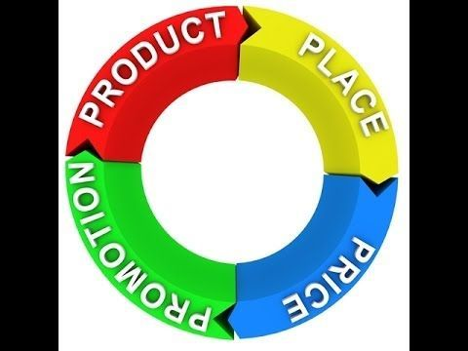
International marketing task
Marketing decision factors

Slide 8
International environmental forces
Marketing controllables: The successful manager
constructs a marketing program designed for optimal adjustment to the uncertainty of the business climate.
Domestic uncontrollables: This includes home country elements that can have a direct effect on the success of a foreign venture: political forces, legal structure, and economic climate.
Foreign uncontrollable: The problem of uncertainty is further complicated by a frequently imposed "alien status" that increases the difficulty of properly assessing and forecasting the dynamic international business climate.

Slide 9
Global awareness

Slide 10
Developing global awareness
.Tolerance of cultural differences:
- Understanding cultural differences and accepting and working with others whose behavior may be different.
· Knowledge of cultures, history, world market potential,global economic, social, and political trends.
• Approaches to global awareness:
- Select individual managers specifically for their demonstrated global awareness
- Develop personal relationships in other countries
- Have a culturally diverse senior executive staff.

Slide 11
Stages Of International Marketing Involvement

Slide 14
Environmental Adaptation Needed
Cultural adjustments: Be able to interpret effectively the influence and impact of the culture.
Establish a frame of reference:
-Cultural frame is socially shared assumptions of the meaning of particullar events and actions through which individuals come to understand,what is relevant for a particular time,place and community.It refers to how customers see your product in relation to other products of a similer type.
-Avoid measuring and assessing markets against the fixed values and assumptions of your own culture.
- We should listen and try to understand others,accept that nobody knows everything,do not assume that everything is either right or wrong.

Slide 15
Environmental Adaptation Needed
Cross cultural misunderstanding:
This reffers to when same behavior has different meaning in different culture. It can also occur when a simple hand gesture has a number of different meanings in different parts of the world.

Slide 16
Marketing relativism:
Marketing strategies sensitive to cultural complexities of foreign consumers. These should be based upon the sellers personal experience which are culturally practiced. Marketing relativism focuses on the linguistic, moral, cultural, local differences that arise in various international contexts.

Slide 17
Self-Reference Criterion (SRC)
Most international marketing research is hindered by the unconscious tendency to fall back on one's own cultural norms and values to interpret a given business situation'.
Worse than ethnocentrism; 4-step SRC correction mechanism:
1. Define the problem in home Country.
2. Define the problem in foreign Country.
3. Isolate the SRC effect and see how it interferes with the business problem.
4. Re-define the business problem without the SRC interference and identify the solution.

Slide 18
Self-Reference Criterion (SRC)
https://www.youtube.com/watch?v=ablixeCNYew
https://www.youtube.com/watch?v=Zq7mN8oi8ds
Surf Excel Adds Bangladesh Surf Excel Adds India

Slide 19
Thank You

