Slide 1
Understanding Rural Development
Md. Fouad Hossain Sarker
Associate Professor
Dept. of Development Studies
Daffodil International University

Slide 2
Learning Objectives
Make a sound understanding about the meaning of rural development
Learn different concepts of rural development
Understand the views of Robert Chambers and indicators of rural development
Discuss the basic elements of rural development and their relevance
Make debate on rural development and its importance

Slide 3
Where would you like to live – in a village or in a town?

Slide 4
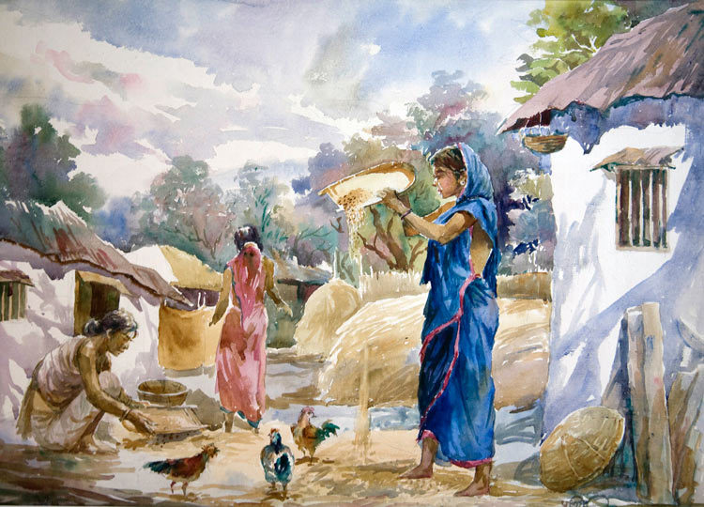

Slide 6
Curiosity Cures Everything
Why do you want to learn about rural development?
Why do you think rural development is important to the discipline of development studies?
In the 21st century, what is the relevance of rural development?
Why not just turn the rural areas into urban areas?
Does rural development mean only the transformation to urbanization?

Slide 7
The Meaning of the word ‘rural’: What Internet Tells Us!!
“in, relating to, or characteristic of the countryside rather than the town.”

Slide 8
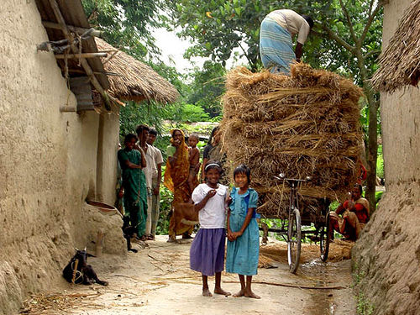
How can we define Rural Development?
Rural development is related with the overall development of rural areas with a view to improve the quality of life of rural people.
Rural development is a comprehensive and multi-dimensional concept.

Slide 9
How can we define Rural Development?
Rural Development encompasses –
The development of agriculture and allied activities
Village and cottage industries
Crafts
Socio-economic infrastructure
Community Services and Facilities
The human resources in rural areas

Slide 10
Conceptualizing Rural Development
Rural Development can be conceptualized as a process, a phenomenon, a strategy and a discipline.

Slide 11
Rural Development as a Process
As a process, it implies the engagement of individuals, communities and nations in pursuit of their cherished goals over time.

Slide 12
Rural Development as a Phenomenon
As a phenomenon, rural development is the end result of interactions between various physical, technological, economic, socio-cultural and institutional factors.

Slide 13
Rural Development as a Strategy
As a strategy, it is designed to improve the economic and social well-being of a specific group of people, that is, the rural poor.

Slide 14
Rural Development as a Discipline
As a discipline, it is multidisciplinary in nature, representing an intersection of agricultural, social, behavioral, engineering and management sciences.

Slide 15
Definition by Scholars
Robert Chamber defines, ‘Rural development as a strategy to enable a specific group of people (small scale farmers, the tenants, the landless, the poor men and women) to gain what they want and need for themselves and their children.’
Amerta Sen defines, ‘Rural development as the overall development of rural areas, which aims at improving quality of life of rural people. More specifically, by rural development, he means the development of agriculture and allied activities, village and cottage industries and crafts, socioeconomic infrastructure, human resources in rural areas.’

Slide 16
Rural Development
Rural development is the betterment in the totality of life for rural people. It is the process of improving the quality of life and economic well-being of people living in relatively isolated and sparsely populated areas. Its actions are mainly aimed to the social and economic development of the rural areas.
Indicators of Rural Development
Changes in agricultural productivity.
Changes in rural employment, unemployment and under employment
Changes in the income of different income groups
Changes in the distribution of power, influence and participation.
Changes in literacy, schooling, literacy rate and life expectancy
Changes in values, believes and attitudes of members of state agencies as well as the rural policymaking.

Slide 17
Basic Elements of Rural Development
There are three elements of Rural Development:
Basic Necessities of Life
Self-Respect
Freedom

Slide 18
Basic Necessities of Life
People have certain basic needs, without them it would be impossible (or very difficult) for them to survive.
The basic necessities include food, clothes, shelter, basic literacy, primary health care, and security of life and property.
When any one or all of them are absent or in critically short supply, we may state that a condition of ‘absolute underdevelopment’ exists.

Slide 19
Basic Necessities of Life
Provision of basic necessities of life to everybody is the primary responsibility of all economies, whether they are capitalist, socialist or mixed.
In this sense, we may claim that economic growth (increased per capita availability of basic necessities) is a necessary condition for improvement of the ‘quality of life’ of rural people, which is rural development.

Slide 20
Self-Respect
Every person and every nation seeks some sort of self-respect, dignity or honor. Absence or denial of self-respect indicates lack of development.

Slide 21
Freedom
In this context, freedom refers to political or ideological freedom, economic freedom and freedom from social servitude.
As long as a society is bound by the servitude of men to nature, ignorance, other men, institutions and dogmatic beliefs, it cannot claim to have achieved the goal of ‘development’.
Servitude in any form reflects a state of underdevelopment.

Slide 22
Learning Outcomes
Understand the meaning of rural development
Learn different concepts of rural development
Understand the views of Robert Chambers and indicators of rural development
Know the basic elements of rural development and their relevance
Make debate on rural development and its importance

Slide 23
References
Singh, K. (2009). Rural development: principles, policies and management. SAGE Publications India.
Jha, U. M., & Jha, N. (2008). Economics of rural development. International journal of rural studies (IJRS) vol, 15.
Chambers, R. (2014). Rural development: Putting the last first. Routledge.

