Slide 1
Topic 5
The Risk Takers

Slide 2
Risk Taker
Risk Takers are individuals or investors who see opportunity in the market volatility and risk a great deal in expectation of a high rate of return.
They have an inclination towards high-risk investments with a great potential of return as well as a loss at the same time.
By investing in high-risk investment options, they de-risk the market for more conservative investors.

Slide 3
Investment Option 1
Fixed-income security which will give 15 % of annual return on a fixed basis
Investment Option 2
Market-linked security which will provide the return as per the performance of the market

Slide 4
Characteristics of Risk Takers

Slide 5
Characteristics of Risk Takers
Market Fluctuations Interests Them: Risk takers are adventure lovers; they are intrigued with the market fluctuations and want to reap high benefit out of it even at the risk of the high potential of the loss.
Adaptive to Changes: They are good at embracing change and go with their gut-instinct for investing in the riskier alternatives.
Gambling Against the Odds: They love to gamble against the odds of risking everything to get the potentially high achievement or rate of return.
Learners: They are life-long learners; they would always research, test, or learn something to gather more information.

Slide 6
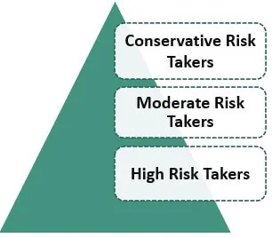
Types of Risk Taker

Slide 7
Types of Risk Taker
Conservative Risk Takers: These investors do not like taking the risk. They would like to have a lower but fixed and secured rate of return on their investment. There will be minimal opportunity for growth in the investment portfolio of these types of investors as there will be almost no risk involved.
Moderate Risk Takers: These types of investors would like to take reasonable risk, i.e. they like to go on a balanced approach. They would always like to grow their portfolio by taking some risks, but would not want the risk of losing everything.
High Risk Takers: These people are not scared of the potential of losing everything; they are even intrigued by the possibility of market volatility. They like speculating on the market fluctuation in expectation of getting a high rate of return.

Slide 8
Let’s Play the Risk Taking Game!

