Slide 1
Noise Analysis
Electrical Noise:
Electrical noise is defined as any unwanted electrical energy.
In audio signal generally 0-15 KHz unwanted audio signal is treated as noise.

Slide 2
Noise Correlated Noise Uncorrelated Noise Harmonics Inter modulation Distortion Distortion External Noise Internal Noise Atmosphere Solar Man-made Thermal Other noise noise noise noise

Slide 3
Thermal Noise: Thermal noise create due to random motion of free electron within a conductor which cause a thermal agitation N=KTB; where, N= Noise power in watt T= Absolute temperature in kelvin B= Band width K= Boltzman’s constant (${1.38×}^{−23}$ J/kelvin) Math Example1: If the room for a audio amplifier the room temperature is ${27}^{o}c.$The band with of audio signal is 5kHz. What will be the thermal noise power in watt and dBm? Solution: Here, B=5kHz we know, =5$×{10}^{3}$ N=KTB =${ 1.38×10}^{−23}×5×{10}^{3}×300$ T= 273+27 = ${2.07×}^{−17}$w =300k k= ${1.38×10}^{−23}$

Slide 4
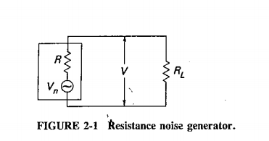
$$and$$ N=10 log $\frac{KTB}{0.001}$ = 10 log$\frac{2.07×{10}^{−17}}{0.001}$ = -136.84 dBm (ans) Noise Volt$a$ge From MPT Theory if $R_{i} and R_{L} same$ Output noise power, $N_{o}=\frac{V^{2}}{R_{L}}$ = $\frac{{(V}_{n/2})2 }{R_{L}}$ = $\frac{{Vn}^{2}}{4R_{l}}$ = N = KTB $V^{2}=4R_{L}KTB$ $V_{N}=$ $\sqrt{4R_{L}KTB}$ Noise voltage

Slide 5
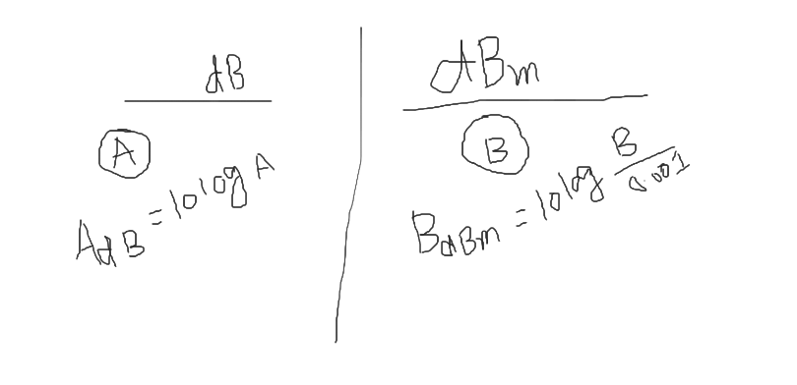

Slide 7
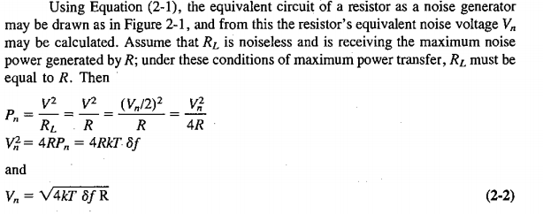

Slide 8
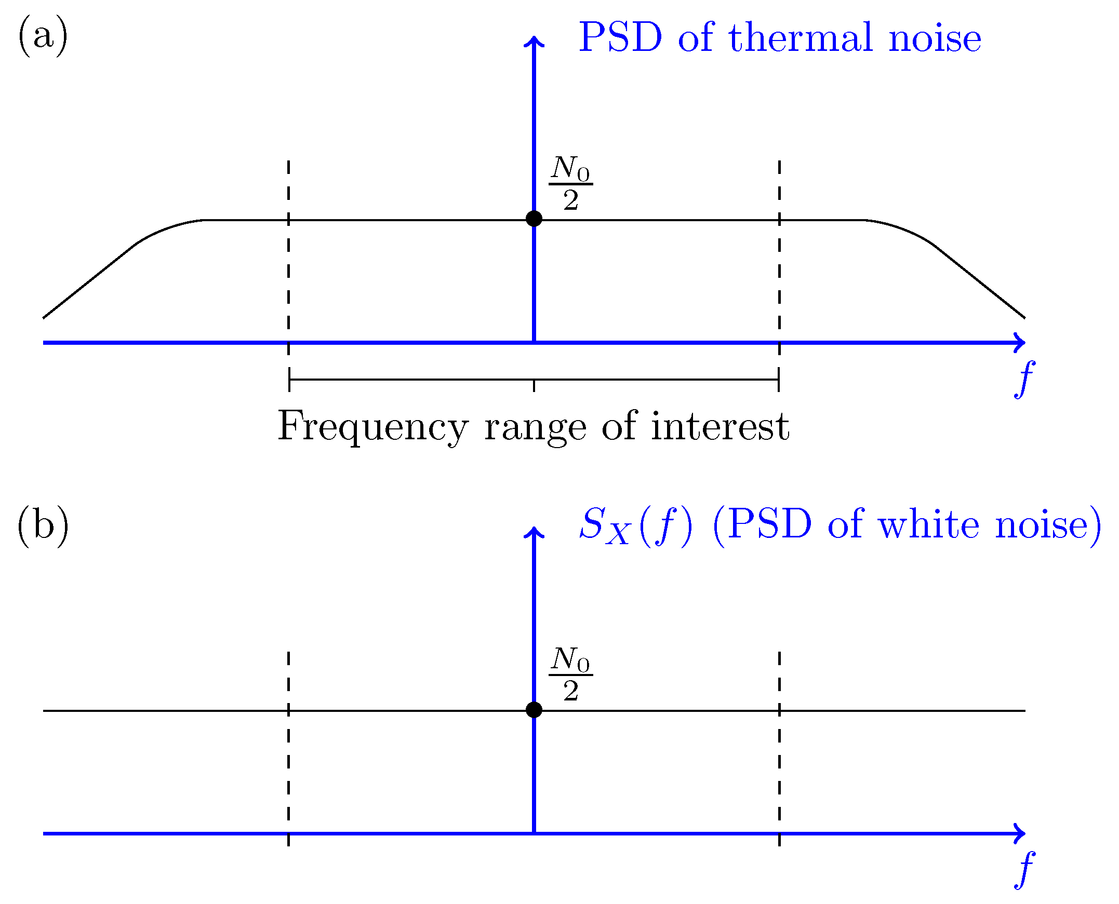
White Noise:
The Noise in which the Noise Power is Same for all frequencies is called White Noise.
Fig: Probable Spectrum Density (PSD)

Slide 9
Example:02 For an electron device operating at a temperature ${17}^{o}c$with a bandwidth of 10KHz, determine 1. Thermal noise power in watt and dBm 2. Determine rms noise voltage for a 100ohm internal and 100ohm load. Solution: i, N=KTB Here, = ${1.38×10}^{−23}×290×{10×10}^{3}$ k= 290k = ${4.002×10}^{−17}$w B= 10$×{10}^{3}$ N= 10 log $\frac{KTB}{0.001}$ $R_{L}=$ 100ohm = -133.98 dBm k= ${1.38×10}^{−23}$ ii, $V_{n}$= $\sqrt{4R_{L}KTB}$ =$\sqrt{4×100×1.38×{10}^{−23}×290×10×{10}^{3}}$ = 1.26$×{10}^{−7}$ Volt

Slide 10
Signal to Noise power Ratio (SNR) we know, SNR= $\frac{S}{N}$ = $\frac{P_{s}}{P_{n}}$ where, $P_{s}=$ signal power in watt $P_{n}=$ Noise power in watt Higher the SNR that means Lower Noise Power and Higher Signal Power is better for Communication. Our Expectation is Zero Noise Power that means infinite SNR. SNR(dB)= 10 log $\frac{P_{s}}{P_{n}}$ SNR in voltage: (${SNR)}_{dB}$ = 10 log $\frac{P_{s}}{P_{n}}$ = 10 log $\frac{{V_{s}}^{2}/R_{L}}{{V_{n}}^{2}/R_{L}}$ = 10 log ($\frac{V_{s}}{V_{n}}$)^2 = 20 log ($\frac{V_{s}}{V_{n}}$) dB where, $V_{s}$= signal voltage in volt $V_{n}=Noise voltage in volt$

Slide 11
Related Problems
If for a AM Radio Receiver the input signal power is 1Watt and input noise power is 1mW
find the input SNR normal unit and in dB .
2. If for a FM Radio Receiver the input signal power is 1Watt and input noise power is 30mW find the input SNR normal unit and in dB .
3. If for a TV Receiver the input signal voltage is 10 Volt and input noise voltage is .01 Volt
find the input SNR in dB .

Slide 12
Noise Factor and Noise Figure Noise Factor,F = $\frac{Input signal to noise ratio}{Output signal to noise ratio}$ Noise Figure = 10 log F signal+ Noise Amplifier Amplifier signal+ Noise SNR in SNR out

Slide 13

Ideal amplifier $A_{p}$ $\frac{S_{i}}{N_{i}}$ $\frac{A_{p}S_{i}}{A_{p}N_{i}}$ = $\frac{S_{i}}{N_{i}}$ Non ideal amplifier With $A_{p},N_{d}$ where, $A_{p}$= Amplifier power gain $N_{d}$=internal noise of Amplifier $\frac{S_{i}}{N_{i}}$ Output $\frac{A_{p}S_{i}}{A_{p}N_{i}+N_{d}}$

Slide 14
Exampole03: For an ideal amplifier the input signal power = ${2×10}^{−3}$watt ,input noise power = ${2×10}^{−8}$watt and Gain of the amplifier is 1000 Determine; i, Input SNR in dB ii, Output SNR in dB iii, Noise factor and noise figure

Slide 15
Exampole04: For a non ideal amplifier the following parameter input signal power = ${2×10}^{−10}$watt input noise power = ${2×10}^{−18}$watt, power gain of amplifier 10lakh internal noise of the amplifier = ${6×10}^{−12}$watt Determine; i, Input SNR in dB ii, Output SNR in dB iii, Noise factor and noise figure

Slide 16
Exampole04: For a non ideal amplifier the following parameter input signal power = ${2×10}^{−10}$watt input noise power = ${2×10}^{−18}$watt, power gain of amplifier 10lakh internal noise of the amplifier = ${6×10}^{−12}$watt Determine; i, Input SNR in dB ii, Output SNR in dB iii, Noise factor and noise figure Solution: I. SNR input = $\frac{P_{s}}{P_{n}}$ = $\frac{{2×10}^{−10}}{{2×10}^{−18}}$ = 100000000 SNR(dB) = 10 log (1000000000) = 80 dB

Slide 17

ii, $P_{o}=$A$×S_{i}$ = 1000000$×2×{10}^{−10}$ =2$×{10}^{−4}$ $N_{o}$= A$×S_{i}+N_{d}$= 1000000$×{2×10}^{−18}+{6×10}^{−12}$ = SNR(out)= 25000000 SNR(dB)= 10log (25000000) = 74dB iii, Noise factor= $\frac{1000000000}{25000000}$ = 4 and Noise figure, F= 10log F = 10log (4) = 6 dB ans.

