Slide 1
Full-Wave Rectifier

Slide 2
Efficiency of a full wave rectifier

Slide 5
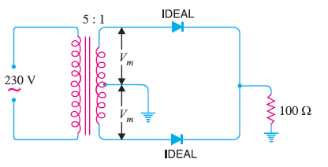
Problems

Slide 6
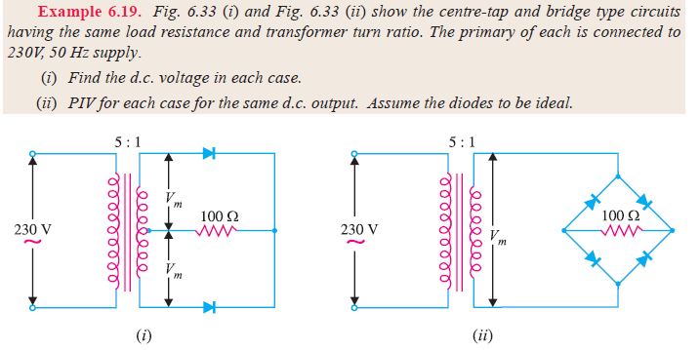

Slide 7
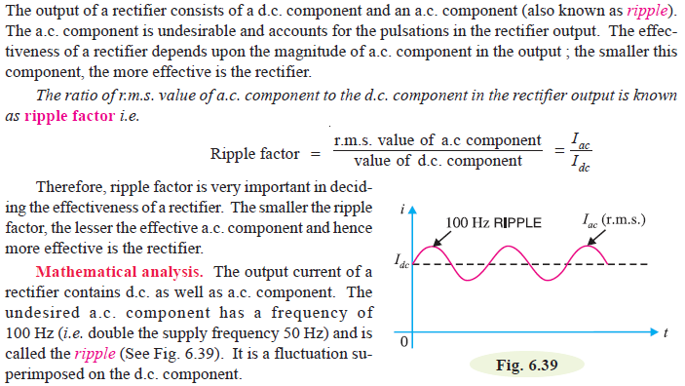
Ripple Factor

Slide 8
