Slide 1
Introduction to Modern Literary Theory
A discussion of theory, why we use it, and how it helps us understand what we read.

Slide 2
What is theory?
Theory is a way to approach a text to gain a better understanding of its meaning.
Theory changes with time and new theories are always being added to the traditional.
Theory tries to explain why authors and texts exist and what messages they are sending to readers.
Theory is a body of thinking and writing whose limits are exceedingly hard to define.
A theory is more than a hypothesis; it cannot be obvious; it involves complex relations of a systematic kind among a number of factors.

Slide 3
What is literary theory?
"Literary theory" is the body of ideas and methods we use in the practical reading of literature.
Literary theory is a description of the underlying principles, one might say the tools, by which we attempt to understand literature.
Literary theory refers to any principles derived from internal analysis of literary texts or from knowledge external to the text that can be applied in multiple interpretive situations.

Slide 4
Beginning of literary theory:
In one of the earliest developments of literary theory, German "higher criticism" subjected biblical texts to a radical historicizing that broke with traditional scriptural interpretation
"Higher," or "source criticism," analyzed biblical tales in light of comparable narratives from other cultures,.

Slide 5
Liberal Humanism
Formalism
New Criticism
Structuralism
Post-Structuralism
Deconstruction
Modernism
Post-Modernism
Psychoanalytic Criticism
Feminist Criticism
Lesbian/ Gay Criticism (Queer Theory) Reader-Response Theory Marxist Criticism New Historicism Cultural Materialism Postcolonial Criticism Ecocriticism

Slide 6
Liberal Humanism
Liberal humanism understands literature/poetry to be timeless. It must reveal a constant or universal truth about humanity. Also, it contains meaning without regard to other works.
The term 'liberal humanism' denotes the ruling assumptions, values and meanings of the modern epoch.
Liberal humanism, laying claim to be both natural and universal, was produced in the interests of the bourgeois class which came to power in the second half of the seventeenth century.

Slide 7
Liberal Humanism: View of Literature
Good literature is of timeless significance.
The literary text contains its own meaning within itself.
The best way to study the text is to study the words on the page, without any predefined agenda for what one wants to find there.
The text will reveal constants, universal truths, about human nature, because human nature itself is constant and unchanging.
Notes:
And this is THE CLASS MODERN VIEW OF LITERATURE
LITERATURE IS UNIVERSAL TRUTHS

Slide 8
Beliefs of Liberal Humanism
General
Absolute Truth
The world can be controlled and ordered
We can picture and represent the world
Belief in linear progress
Universal
Universality means text must be studied in isolation (context, personal ideologies)
Human nature is unchanging
People's individuality (personality) is transcendent
Purpose = humanist enhancement of life

Slide 9
Formalism or Russian Formalism
"Formalism" is, as the name implies, an interpretive approach that emphasizes literary form and the study of literary devices within the text.
"Formalism," sought to place the study of literature on a scientific basis through objective analysis of the motifs, devices, techniques, and other "functions" that comprise the literary work.
Neither author nor context was essential for the Formalists; it was the narrative that spoke.
Formalists focus on the study of poetic language.

Slide 10
New Criticism
"New Criticism" stressed close reading of the text itself, much like the French pedagogical precept "explication du texte.“
"New Criticism" viewed the work of literature as an aesthetic object independent of historical context and as a unified whole that reflected the unified sensibility of the artist

Slide 11
Takes a text as an autonomous object, non-related to the author, the culture, or the event it stems from
Explores the “world” within the text
Started in 1920’s and 1930’s

Slide 12
KEY TERMS:
Heresy of Paraphrase - assuming that an interpretation of a literary work could consist of a detailed summary or paraphrase.
Close reading "a close and detailed analysis of the text itself to arrive at an interpretation without referring to historical, authorial, or cultural concerns" (Bressler)
Intentional Fallacy - equating the meaning of a poem with the author's intentions.
Affective Fallacy - confusing the meaning of a text with how it makes the reader feel. A reader's emotional response to a text generally does not produce a reliable interpretation.

Slide 13
Advantages and Disadvantages
Advantages
- Do not have to know the author’s background
-Do not have to be familiar with historical context
-Can analyze language and imagery…
Disadvantages
-Text seen in isolation
-Cannot account for allusions
-Ignores context of work
-Reduces literature to a series of rhetorical devices

Slide 14
Structuralism (1950s)
In sociology, anthropology, and linguistics, structuralism is the methodology that implies elements of human culture must be understood by way of their relationship to a larger, overarching system or structure. It works to uncover the structures that underlie all the things that humans do, think, perceive, and feel.
Structuralist critics:
Analyse a text relating it to some larger containing structure
Interpret literature in terms of a range of underlying parallels with the structures of language

Slide 15
Post-structuralism (1960s)
A ‘rebellion against’ structuralism
A critical and comprehensive response to the basic assumptions of structuralism
Studies the underlying structures inherent in cultural products (such as texts)
Utilizes analytical concepts from linguistics, psychology, anthropology and other fields

Slide 16
To understand an object (e.g. one of the many meanings of a text), we need to study…
the object itself
the systems of knowledge which were coordinated to produce the object
Post-structuralism: a study of how knowledge is produced
Reader's culture = reader’s society (in the interpretation of a piece)

Slide 17
Deconstruction:
Sees literature as fluid parts and not one whole, with multiple meanings and ways to look at and not one large meaning.
Infinite number of signifiers

Slide 18
DECONSTRUCTION
Invites us to “unravel” the constructs around us and to re-examine appearance and reality
Seeks to show that a literary work is self-contradictory
In high school we teach that meanings are “fixed” there is an “answer” or meaning behind works of art. So how does this explain that people have different interpretations of what art is?
Most high school teachers would never teach this form of analysis

Slide 19
Example:
If you have ever listened to someone explain a book, a movie or any work
of art (poetry, painting – even a magazine article) and you wanted to
interrupt and say, “But I saw something that contradicts what you are
saying.” then you have practiced deconstruction.

Slide 20
Modernism
Modernism is a literary and cultural movement which flourished in the first decades of the 20th century. It reflects a sense of cultural crisis which was both exciting and disquieting, in that it opened up a whole new vista of human possibilities at the same time as putting into question any previously accepted means of grounding and evaluating new ideas. Modernism is marked by experimentation, particularly manipulation of form, and by the realization that knowledge is not absolute.

Slide 21
General Features
Modernism was built on a sense of lost community and civilization and was made up of a series of contradictions , embraced multiple features of modern sensibility
Revolution and conservatism
Loss of a sense of tradition
Mourning for the loss of tradition and fragmentation
Increasing dominance of technology

Slide 22
Thematic features
Intentional distortion of shapes
Focus on form rather than meaning
Breakdown of social norms and cultural values
Dislocation of meaning and sense from its normal context
Disillusionment
Rejection of history and the substitution of a mythical past
Need to reflect the complexity of modern urban life
Importance of the unconscious mind
Interest in the primitive and non-western cultures
Impossibility of an absolute interpretation of reality
Overwhelming technological changes

Slide 23
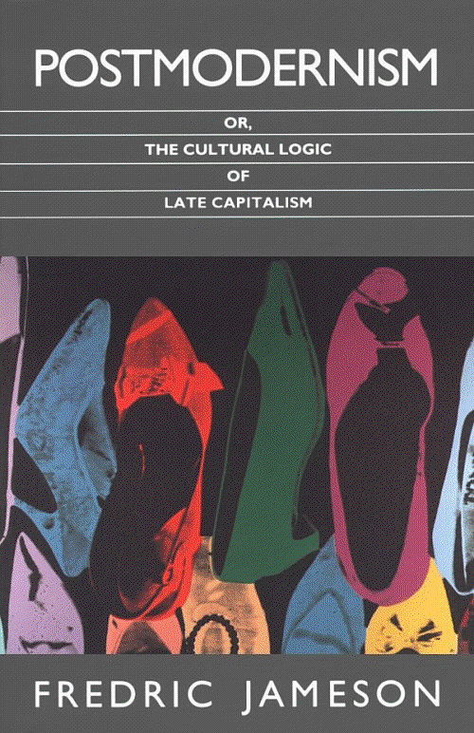
What is Postmodernism?
Continuation of modernist view
Does not mourn loss of history, self, religion, center
A term applied to all human sciences —anthropology, psychology, architecture, history, etc.
Reaction to modernism; systematic skepticism
Anti-foundational
Notes:
THAT IS THE MODERNIST VIEW OF THE WORLD
LESS REALISM AND NATURALISTIC INTERPRETATION
EMPHASIS ON THE SUBCONSCIOUSNESS
EXPERIMENTATION IN AESTHETICS
HOW DOES POSMODERNISM DIFFER?
Not opposite to--an extension of
BULLETS

Slide 24
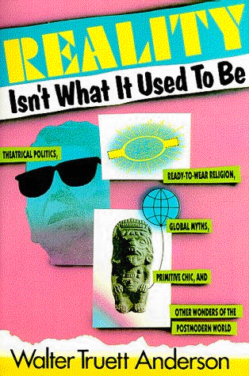
Postmodernism: Basic Concepts
Rejection of all master narratives
All “truths” are contingent cultural constructs
Skepticism of progress; anti-technology bias
Sense of fragmentation and decentered self
Multiple conflicting identities
Mass-mediated reality
Notes:
THESE ARE SOME BASIC CONCEPTS THAT CUT ACROSS ALL ASPECTS OF POSTMODERNISM
On objective essence, no central truths
Don’t mourn or worry about it--that’s just the way life is
BULLETS

Slide 25
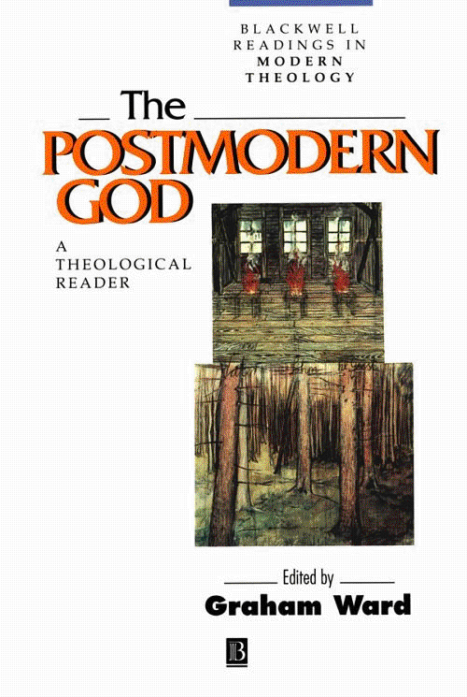
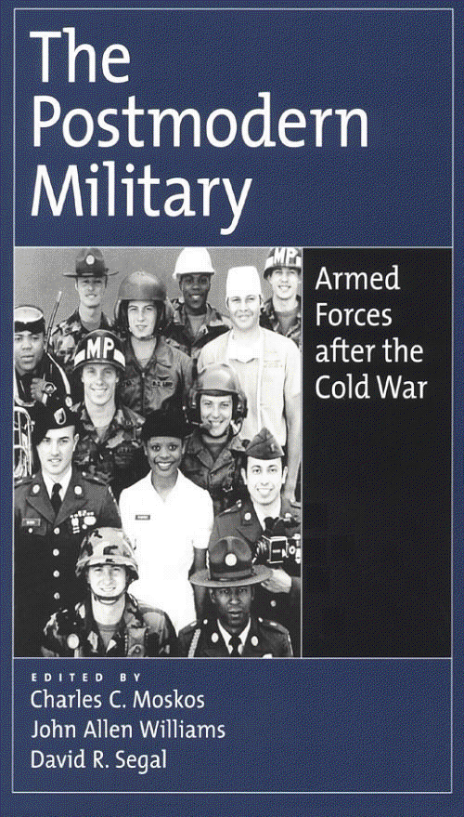
Postmodernism: Basic Concepts
Language is a social construct that “speaks” & identifies the subject
Knowledge is contingent, contextual and linked to POWER
Truth is pluralistic, dependent upon the frame of reference of the observer
Values are derived from ordinary social practices, which differ from culture to culture and change with time.
Values are determined by manipulation and domination
Notes:
THIS VIEW OF THE WORLD HAS A BIG IMPACT UPON KNOWLEDGE AND LANGUAGE THEORY
HOW DO WE KNOW WHAT WE KNOW?
HOW DOES LANGUAGE MEAN?
HERE ARE SOME KEY PRINCIPLES:
BULLETS
POSTMODERNISM CHANGES EVERYTHING
VIEW OF THEOLOGY
PSYCHOLOGY
MILITARY

Slide 26
Psychoanalytic Criticism
Applying the principles of psychologists like Sigmund Freud and Jung to a literary work
Analyzing characters within the work
Analyze writer’s psyche, writing process, or the influence of the writer’s thoughts on the novel
Effects of literature on readers

Slide 27
Key Terms:
Jungian Approach:
Three parts of self
-Shadow (dark part of self)
-Persona (social part of personality)
-Anima (man’s “soul image”)
Neurosis occurs when someone fails to assimilate one of these levels of unconsciousness into his or her conscious and projects it onto someone else.
Unconscious - the irrational part of the psyche unavailable to a person's consciousness except through dissociated acts or dreams.
Freud's model of the psyche:
• Id - completely unconscious part of the psyche that serves as a storehouse of our desires, wishes, and fears. The id houses the libido, the source of psychosexual energy.
Ego - mostly to partially conscious part of the psyche that processes experiences and operates as a mediator between the id and superego.
Superego - often thought of as one's "conscience"; the superego operates "like an internal censor [encouraging] moral judgments in light of social pressures" (Bressler)

Slide 28
Advantages and Disadvantages
Advantages
Can help understand works with characters who have obvious psychological issues
Helps us understand the writer’s mind and therefore his work
Disadvantages
Makes literature a scientific case study
Can we psychologically analyze dead writers?
Not all works allow for this approach
Sex is overdone

Slide 29
Feminist Criticism
A type of literary criticism that critiques how females are commonly represented in texts, and how insufficient these representations are as a categorizing device. They focus on how femininity is represented as being passive and emotional – the “caregiver,” and the male is associated with reason and action – the “doer.”

Slide 30
Concerned with impact of gender on writing and reading
Desire for a new literary canon (not men
Deals with conflicts between often dominate male and inferior female in traditional literature
Deals with female issues

Slide 31
Specifically, the feminist view attempts to:
Show that writers of traditional literature have ignored women and have presented misguided and prejudiced views of them
2. Create a critical landscape that reflects a balanced view of the nature and value of women

Slide 36
Reader-Response Theory
Analyzes reader’s role in production of meaning
Text itself means nothing until someone reads it
Reading is a function of personal identity
Authors use strategies to elicit responses from readers

Slide 37
Key Terms:
Interpretive communities - a concept, articulated by Stanley Fish, that readers within an "interpretive community" share reading strategies, values and interpretive assumptions
Transactional analysis - a concept developed by Louise Rosenblatt asserting that meaning is produced in a transaction of a reader with a text. As an approach, then, the critic would consider "how the reader interprets the text as well as how the text produces a response in her"
Horizons of expectations - a reader's "expectations" or frame of reference is based on the reader's past experience of literature and what preconceived notions about literature the reader possesses
Implied reader - the implied reader is "a hypothetical reader of a text”, a construct that is unrelated to the “real” reader
-Developed by Wolfgang Iser

Slide 38
Advantages and Disadvantages
Advantages
No one interpretation
Interpretations change over time
Disadvantages
Can be too subjective
No clear criteria to account for differences from one reader to the next
Highly personal at times

Slide 39
Marxism
Sees art and literature as forced by the conditions that existed in history
Deals with clash between classes
Articulation of dominant class
Art reflects age in which it was created

Slide 40
Key Terms:
Commodification – Wanting thing not for their use but their ability to impress others or to sell
Conspicuous consumption – Getting things merely for selling or trading
Dialectical materialism – the eternal struggle to find a solution among conflicting ideologies to bring about change
Material circumstances - the economic conditions underlying a society
Reflectionism - the superstructure of a society mirrors its economic base and, by extension, that a text reflects the society that produced it
Superstructure - The social, political, and ideological systems and institutions that are generated by the people

Slide 41
Advantages and Disadvantages
Advantages
Look at the work in the context it was written
Allows you to research and understand the culture more
Can see multiple perspectives from dominant and dependent classes
Disadvantages
Have to be aware of the culture and economic system in place when written
Have to assume “the man” was out to get the people
Has to be a class conflict, not race or gender (class matters most)

Slide 42
New Historicism

Slide 43
New Historicists approach to literature as just one more discourse that exists with interaction with other discourses at a given moment in history.

Slide 44
Cultural Materialism
Cultural materialism is “a politicized form of historiography.”
-Graham Holderness
Raymond Williams coined the term Cultural Materialism. Jonathan Dollimore and Allen Sinfield made current and defined Cultural materialism as “designating a critical method which has four characteristics:
Historical Context: what was happening at the time the text was written.
Theoretical Method: Incorporating older methods of theory—Structuralism, Post-structuralism etc.
Political Commitment: Incorporating non-conservative andnon-Christian frameworks—such as Feminist and Marxist theory.
Textual Analysis: building on theoretical analysis of mainly canonical texts that have become “prominent cultural icons.”

Slide 45
Culture: What does this term mean in the context of Cultural Materialism?
Culture in this sense does not limit itself to “high culture” but includes all forms of culture like TV and pop music.
Materialism: What does this term mean in the context of Cultural Materialism?
Materialism is at odds with idealism. Idealists believe in the transcendent ability of ideas while materialist believe that culture cannot transcend its material trappings.

Slide 46
In this way, Cultural Materialism is an offshoot of Marxist criticism.
History, to a cultural materialist, is what has happened and what is happening now. In other words, Cultural Materialists not only create criticism of a text by contextualizing it with its own time period, but with successive generations including our own. Cultural Materialism bridges the gap between Marxism and Post-Modernism.
Some things that Cultural Materialist might look at when analyzing Shakespeare:
Elizabethan Drama during its own time period
The publishing history of Shakespeare through the ages
That weird movie version of Romeo and Juliet with Leonardo D. in it
The tourism and kitsch surrounding Shakespeare today

Slide 47
Post-colonialism (1990s)
School of thought that existed in the post-European empire period, the body of theoretical literature that existed in that time
Takes us back to time and place to examine works (resurrect culture)
Free from modern constructs of history

Slide 48
Postcolonialism
Undermines universalist claims
Universal claims disregard difference
Regional
National
Cultural
Social
White Eurocentric norms should not be privileged

Slide 49
To Achieve Postcolonial Perspective
First step for the “colonized” is to reclaim their own past
i.e.. History did not begin with the Europeans
Second step is to erode colonialist ideology that devalued their past

Slide 50
Characteristics of Postcolonial Criticism
1. An awareness of representation of non-Europeans as exotic or ‘Other’
2. Concern with language
Some conclude the colonizer's language is permanently tainted, to write in it involves acquiescence in colonial structures
3. Emphasis on identity as doubled or unstable (identify with colonizer and colonized)
4. Stress on cross cultural interactions

Slide 51
Stages of Postcolonial Criticism
Phase 1: Analyze white representation of colonial countries…uncover bias
Phase 2: Postcolonial writers explore selves and society
(The empire writes back)

Slide 52
What Postcolonial Critics Do
Reject claims of universalism
Examine representation of other cultures
Show how literature is silent on matters of imperialism and colonialism
Foreground questions of diversity and cultural difference
Celebrate ‘cultural polyvancy’ (belonging to more than one culture)
Assert that marginality, plurality and ‘Otherness’ are sources of energy and potential change

Slide 53
Ecocriticism
Ecocriticism is the study of literature and the environment from an interdisciplinary point of view, where literature scholars analyze texts that illustrate environmental concerns and examine the various ways literature treats the subject of nature.

Slide 54
Ecocriticism is . . .
“. . . the study of the relationship between literature and the physical environment. Just as feminist criticism examines language and literature from a gender-conscious perspective, and Marxist criticism brings an awareness of modes of production and economic class to its reading of texts, ecocriticism takes an earth-centered approach to literary studies”
Notes:
From Cheryll Glotfelty’s Introduction to The Ecocriticism Reader: Landmarks in Literary Ecology. “…individual literary and cultural scholars have been developing ecologically informed criticism and theory since the seventies; however, unlike their disciplinary cousins [civil rights and women’s liberation movements of the sixties and seventies], they did not organize themselves into an indentifiable group; hence their efforts were not recognized as belonging to a distinct critical school or movement. Individual studies appeared in a wide variety of places and were categorized under a miscellany of subject headings, such as American Studies, regionalism, pastoralism, the frontier, human ecology, science and literature, nature in literature, landscape in literature, or the names of the authors treated. One indication of the disunity of the early efforts is that these critics rarely cited one another’s work; they didn’t know it existed. In a sense, each critic was inventing an environmental approach to literature in isolation” (Glotfelty xvi-xvii).

Slide 55
Ecocritics ask questions like:
“How is nature represented in this sonnet?
What role does the physical setting play in the plot of this novel?
Are the values expressed in this play consistent with ecological wisdom?
How do our metaphors of the land influence the way we treat it?
How can we characterize nature writing as a genre?”
Notes:
In the mid-eighties, the “field of environmental literary studies was planted, and in the early nineties it grew…Some universities began to include literature courses in their environmental studies curricula, a few inaugurated new institutes or programs in nature and culture, and some English departments began to offer a minor in environmental literature… Also during these years several special sessions on nature writing or environmental literature began to appear on the programs of annual literary conferences, perhaps most notable on the 1991 MLA special session organized by Harold Fromm, entitled ‘Ecocriticism: The Greening of Literary Studies’…” (Glotfelty xvii-xviii).

Slide 56
Interconnections
“Ecocriticism takes as its subject the interconnections between nature and culture, specifically the cultural artifacts of language and literature. As a critical stance, it has one foot in literature and the other on land; as a theoretical discourse, it negotiates between the human and the nonhuman”.
Notes:
“Literary theory, in general, examines the relations between writers, texts, and the world. In most literary theory ‘the world’ is synonymous with society—the social sphere. Ecocriticism expands the notion of ‘the world’ to include the entire ecosphere. If we agree with Barry Commoner’s first law of ecology, ‘Everything is connected to everything else,’ we must conclude that literature does not float above the material world in some aesthetic ether, but, rather, plays a part in an immensely complex global system, in which energy, matter, and ideas interact” (xix).

