Slide 1
Vector Analysis
Vectors and Scalars
Gradient Divergence and Curl
Vector Integration
Theorems
The Dot and Cross product
Vector Differentiation

Slide 2
Chapter 1: Vectors and Scalars
Vectors
Having both magnitude and direction
Velocity, Force, acceleration
Scalars
Having magnitude only
Mass, Length, Time, Temperature
Denoted by $\vec{A}$, $\overline{A}$
Denoted by 𝐴 ⃗, 𝐴 ̅
Magnitude is denoted by $│\vec{A}│$, A
Magnitude is denoted by │𝐴 ⃗│, A
Denoted by ordinary types letters
Let $\vec{A}$ be a vector with initial point O and terminal point P
$$\vec{A}$$
P
O

Slide 3
Vector Algebra
1. Equal vector: Two vectors $\vec{A}$ and $\vec{B}$are equal if they have the same magnitude and direction (regardless of the position of their initial points)
$$\vec{A}$$
$$\vec{B}$$

Slide 4
2. Opposite vector: A vector having direction opposite to that of vector $\vec{A}$ but having the same magnitude is denoted by $−\vec{A}$
$$\vec{A}$$
$$−\vec{A}$$

Slide 5
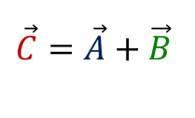
3. Sum or Resultant: $\vec{C}=\vec{A}+\vec{B}$
$\vec{C}$ formed by
Placing the initial point of $\vec{B}$ on the terminal point of $\vec{A}$
Joining the initial point of $\vec{A}$ to the terminal point of $\vec{B}$
$$\vec{A}$$
$$\vec{B}$$
$$\vec{A}$$
$$\vec{C}=\vec{A}+\vec{B}$$
$$\vec{B}$$

Slide 6
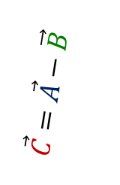
4. Difference: $\vec{C}=\vec{A}−\vec{B}=\vec{A}+\left(−\vec{B}\right)$
$\vec{C}$ formed by
Placing the initial point of $−\vec{B}$ on the terminal point of $\vec{A}$
Joining the initial point of $\vec{A}$ to the terminal point of $−\vec{B}$
$$−\vec{B}$$
$$\vec{A}$$
$$\vec{C}=\vec{A}−\vec{B}$$
$$\vec{A}$$
$$\vec{B}$$

Slide 7
5. Multiplication: The product of a vector $\vec{A}$by a scalarm
Denoted by $m\vec{A}$
Magnitude $│m│$times the magnitude of $\vec{A}$
Direction is same as or opposite to that of $\vec{A}$(according m is positive or negative)
If $m=0$then $m\vec{A}$ is the null vector.
Null vector or zero vector: Is a vector having $0$ magnitude and no specific direction.

Slide 8
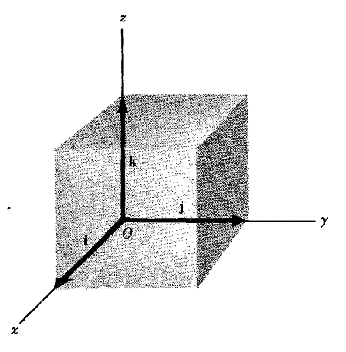
Unit Vector: Is a vector having unit magnitude
If $\vec{A}$ is a vector with magnitude $A≠0$ then
the unit vector of $\vec{A}$ is
Denoted by $\hat{a}$
Defined by $\hat{a}=\frac{\vec{A}}{│\vec{A}│}=\frac{vector}{magnitude}$
In 3-dimentions $\hat{i}$ ,$\hat{j}$$and\hat{ k}$are called rectangular unit vectorsin the positive $x,y and z$ directions respectively

Slide 9
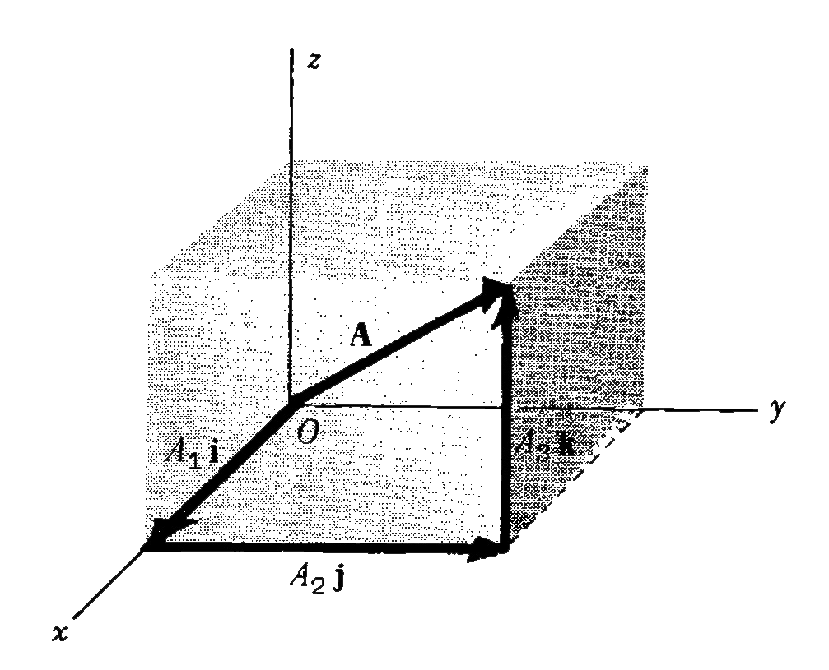
Components of a vector:
In 3-dimentions let $\left(A_{1},A_{2},A_{3}\right)$ be the rectangular coordinates of the terminal point of a vector $\vec{A}$ with initial point at the origin o. Then
The vectors $A_{1}\hat{i}$ ,$A_{2}\hat{j}$,$A_{3}\hat{k}$are called rectangular component vectors or component vectors of $\vec{A}$ in the $x,y and z$ directions respectively.
$A_{1}$ ,$A_{2}$, $A_{3}$are called rectangular components or simply components of $\vec{A}$ in the $x,y and z$ directions respectively.
$\vec{A}=A_{1}\hat{i}+A_{2}\hat{j}+A_{3}\hat{k}$
$A=│\vec{A}│=\sqrt{{A_{1}}^{2} +{A_{2}}^{2}+{A_{3}}^{2}}$ ( Magnitude of $\vec{A}$)

Slide 10
Position vector or radius vector:
In 3-dimentions let $\left(x, y, z\right)$ be the rectangular coordinates of the terminal point of a position vector $\vec{r}$ with initial point at the origin o. Then
$\vec{r}=x\hat{i}+y\hat{j}+z\hat{k}$
$r=│\vec{r}│=\sqrt{x^{2} +y^{2}+z^{2}}$ ( Magnitude of $\vec{r}$)

Slide 11
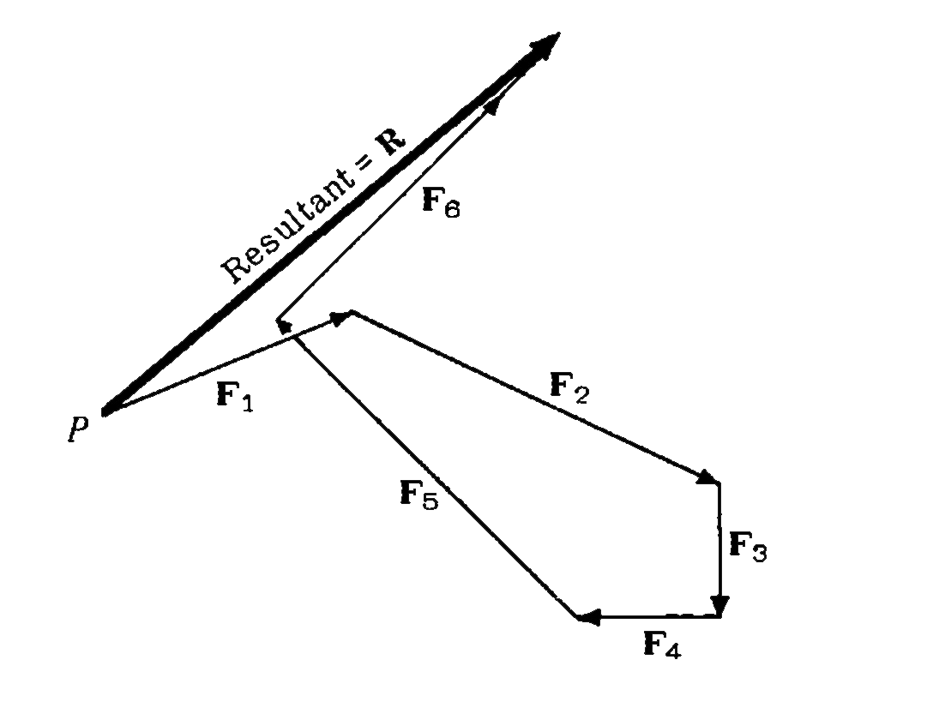
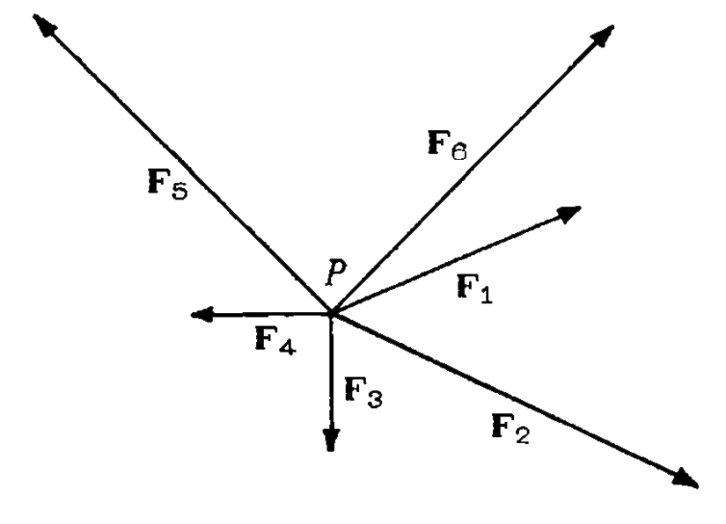
Problem: Find the Resultant of the following vectors.
Solution: The resultant is given below,

