Slide 1
The Future of Rural Development
Faisal Akber
Senior Lecturer
Department of Development Studies
Daffodil International University

Slide 2
Why we are studying about the future Now?
The future of rural areas is unpredictable, but it can be explored.
In today’s world, time holds an indefinite grasp over past, present and future.
What we are observing today as present, can certainly be influenced by the coming future.
Eight plausible transformations are identified and discussed. Some of them are already happening, others are in an embryonic stage in various places.

Slide 3
Transformation in Rural Development Thinking: Why Study Only Eight Transformations?
In recent times, rural development is highly influenced by technology and the ideas of disruptive innovation.
In Bangladesh, some young entrepreneurs are trying to establish the rural areas as the “Organic Agro-food Supply Center” for the urban areas.
These types of practices lead us to one specific question – what are and will be the dominating issues in the rural development practices?

Slide 4
Transformation 1: Globalization
Cross-border flows of money, goods, ideas and people, but also increase of pandemic diseases.
The world can be better protected against local hazards, but it can also be more sensitive to them.
Disruption may occur with more local and regional conflicts and interests prevailing, as a globalized world is competing for local resources.

Slide 5
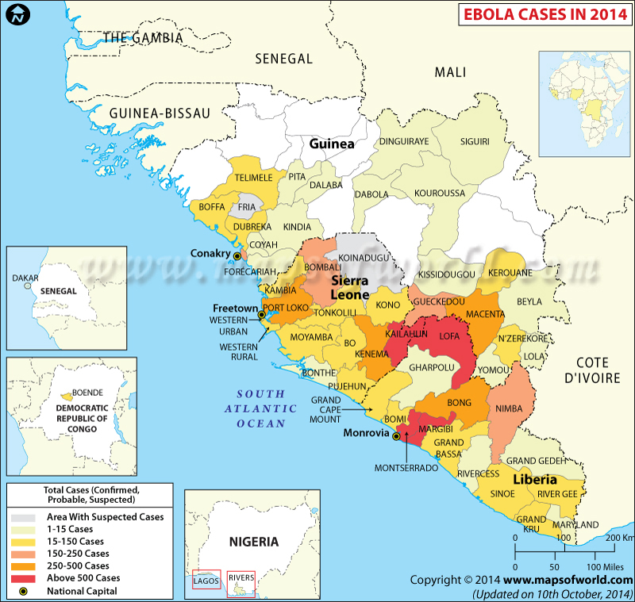
Globalization can bring dangerous diseases like Ebola and affect the rural areas

Slide 6
Transformation 2: Connectivity
It will become cheaper and easier for more individuals to be connected everywhere at all times, thus changing the meaning of remoteness and isolation.
Disruption may occur due to a divide in the quality and intensity of connectivity in accordance with the wealth of the users.

Slide 7
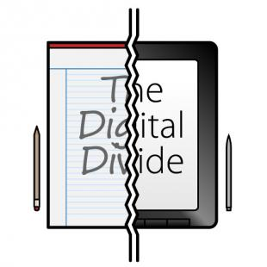
Digital Divide can create Digital inequality for the Rural Areas

Slide 8
Disruptive Innovation Might Improve Life in Rural Areas

Slide 9
Transformation 3: Consumption Patterns
We are now living beyond the means of the planet and will further do.
This leads to the decline and quality of the resources we use.
Threat on consumption can trigger changes towards more sustainable consumption patterns.

Slide 10
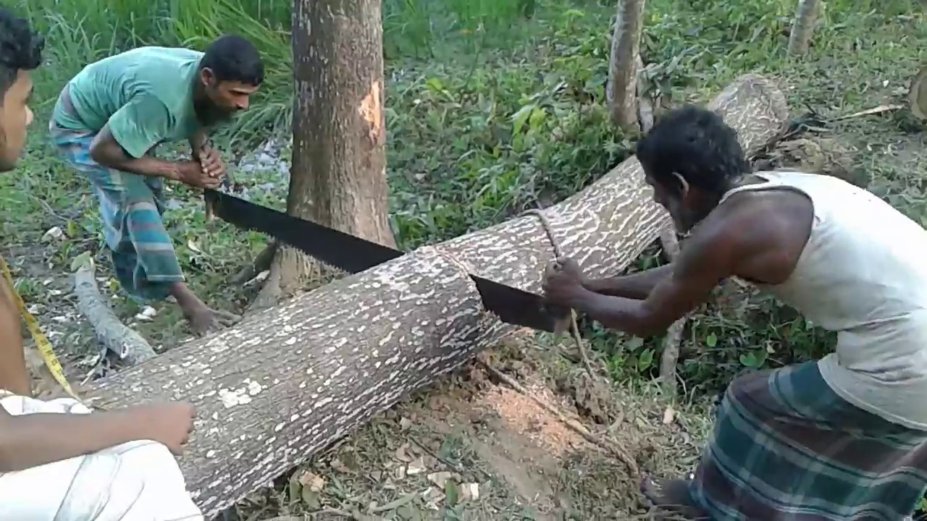
Over-consuming Forestry Resources in Rural Areas

Slide 11
Transformation 4: Ecological Decline & Resource Scarcity
Loss of biodiversity, declining quality of water and soils, decreased cost of and increase access to energy, and stronger and more frequent climatic hazards will continue to take place.
When combined with the growing numbers of global consumers, this would further deplete the world’s resources.
A still limited, yet growing, number of initiatives for a more sustainable use of resources through the emergence of more environment conscious behaviours can bend the trend.

Slide 12
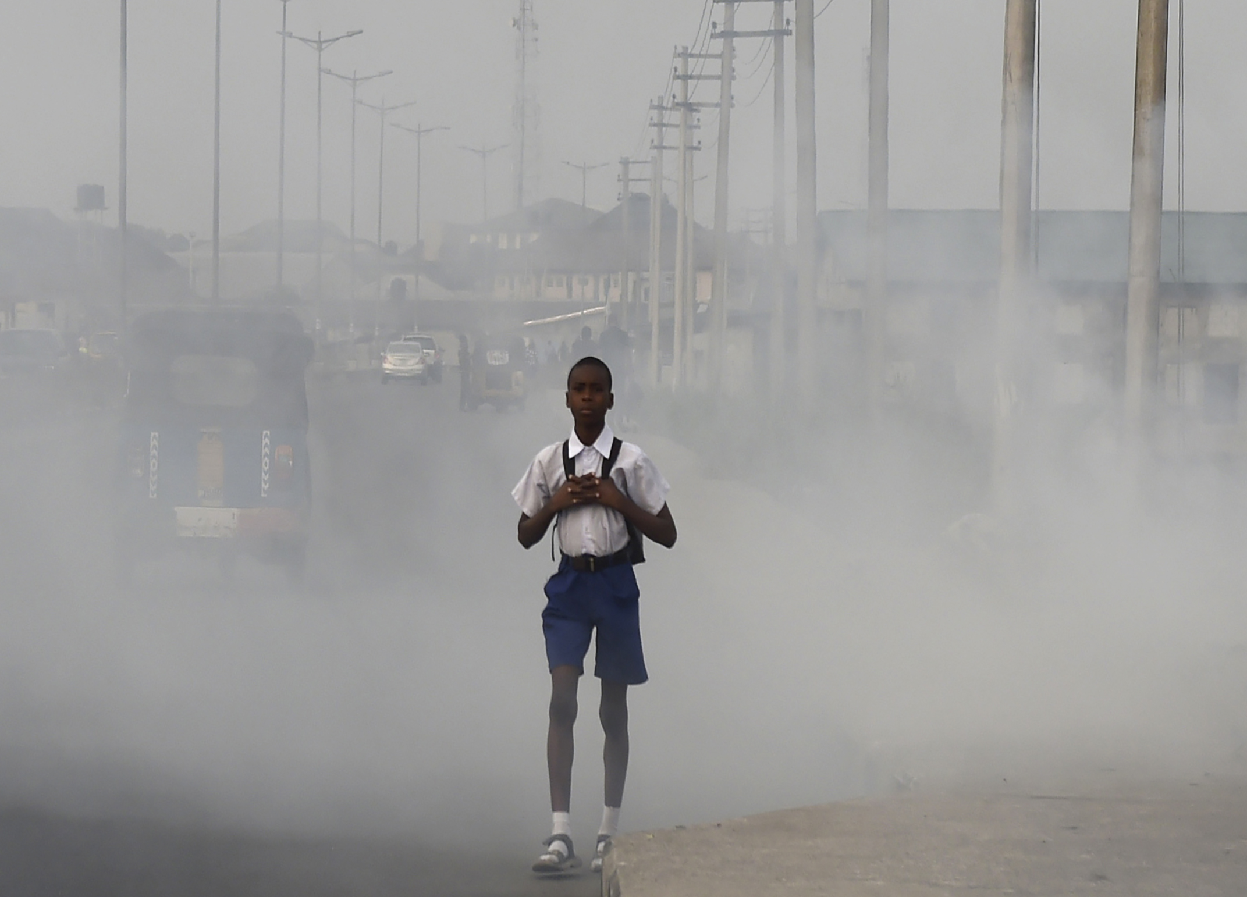

Slide 13
Transformation 5: Population Dynamics
There will be more people on earth. Older people will live in developed countries.
Countries with cohort of young population are less able to support them leading to cross country migrations.

Slide 14
Transformation 6: Urbanization
More people will live in the city where they find, or hope to find, a more attractive environment, including employment, services, entertainment and social life.
Urbanization can take different form such as the expansion of mega-cities, the development of medium size cities, but also unclear boundaries between what is urban, sub-urban and rural.
There are also signs of re-ruralization with people choosing to live in the countryside, villages or very small cities.

Slide 15
Transformation 7: Technology Development
The observation of a decline of productivity growth combined to projections on consumption patterns and demographic dynamics, pushes a new paradigm of ‘producing more with less’ in an increasingly resource-constrained environment.
Climate change is one of the drivers of technological change. Technologies tend to concentrate on a limited number of crops and products (major cereals, meat production).
A resilience based discourse in response to climate change and resource degradation proposes alternative technological options.

Slide 16
Transformation 8: Prosperity
While poverty globally declines, inequalities are rising and a new type of poverty emerges, including in developed countries.
Prosperity does not equally reach urban and rural areas and remains uneven between and within continents, as the product of the interplay of megatrends that differently affect areas and populations with different characteristics.

