Slide 1
Chapter -1: Introductory Food Hygiene
Dr. Arif Chowdhury Apou Assistant Professor Dept. of PH,DIU

Slide 2
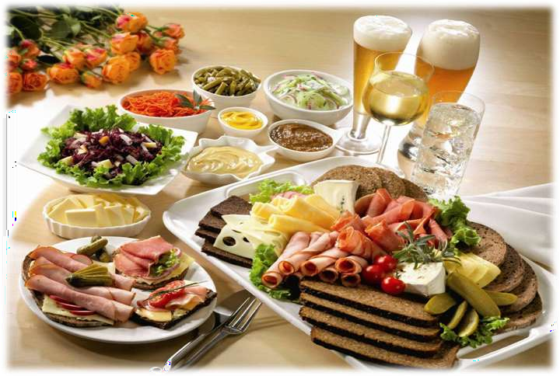
FOOD HYGIENE

Slide 3
Understanding Food Hygiene
Food hygiene is more than cleanliness ......
Protecting food from risk of contamination, including harmful bacteria, poison and other foreign bodies.
Preventing any bacteria present multiplying to an extent which would result in the illness of consumers or the early spoilage of the food.
Destroying any harmful bacteria in the food by thorough cooking
or processing.
Discarding unfit or contaminated food.

Slide 4
The cost of poor food hygiene
Food poisoning outbreaks and sometimes death
Food contamination, customer complaints and brand image
Pest infestations
Waste food due to spoilage
The closure of food premises
Fines and costs of legal action taken because of contraventions in
hygiene legislation, or because of the sale of unsatisfactory food.
Civil action taken by food poisoning suffers
Loss of production and food which has to be destroyed
Decontamination cleaning and replacement of equipment.
unfit or
damaged

Slide 5
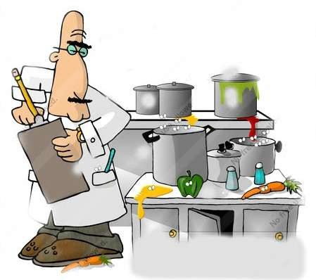
The benefits of good food hygiene
Satisfied customers, a good reputation, increased business and brand protection
Compliance with food safety legislation
Less food wastage
Good working conditions, higher staff morale and lower staff turnover, which promote increased productivity

Slide 6
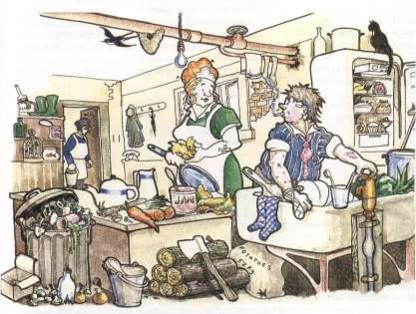
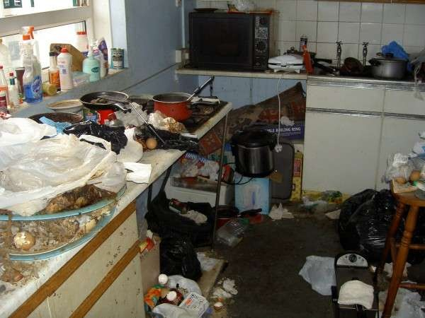
Bacteria
Bacteria are microscopic organisms, often referred to as germs, which are found everywhere, including on and in man, on food ,in water, soil and air.
Most Bacteria are harmless and some essential.
Bacteria exit everywhere

Slide 7
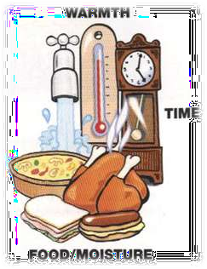
Requirements for bacterial growth
Warmth
37⁰ C - Best temperature for the growth of most poisoning bacteria( body temperature)
20⁰ C - 50⁰ C - Bacteria growth quit quickly
5⁰ C 63⁰ C - Danger Zone 1⁰ C - 4⁰ C - Sleepy
-18⁰ C – No growth
Food and moisture
Time

Slide 8
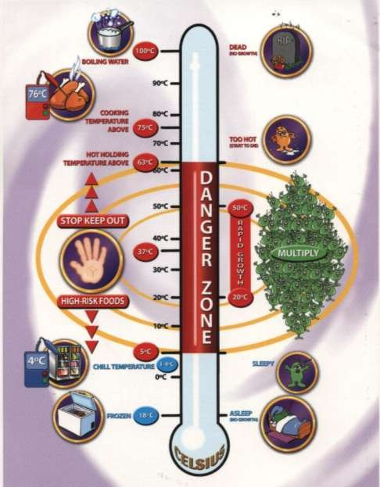
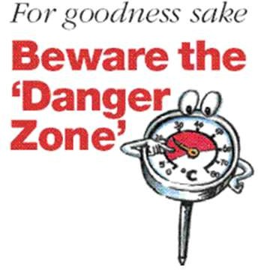

Slide 9
High risk Food
High risk foods are ready –to eat foods , which support the multiplication of harmful of harmful bacteria and are intended for consumption without treatment, such as cooking, which would destroy such organisms.
These foods are usually proteins.
Require refrigerated storage.
They must be kept separate from raw foods.
Example....
Cooked meat and cooked poultry.
Cooked meat product including paste, gravy, stews.
Milk, cream, artificial cream, custards, and dairy produce.
Eggs and products made from raw eggs.
Shellfish and other sea foods including oysters, prawns, and crabs

Slide 10
Ready – to – eat raw food
Raw foods such as lettuce or fruit may be contaminated with low dose pathogens and must always be double washed in running water before eating.

Slide 11
Food Poisoning
Food poisoning is an acute illness, which usually occurs within 1 to 36 hours of eating contaminated or poisonous food.
Symptoms normally last from 1 to 7 days and include one or more
of the following
Abdominal pain diarrhea vomiting
fever collapse

Slide 12
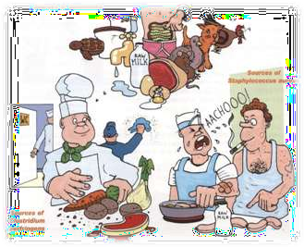
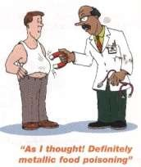
Food poisoning may be caused by:
Bacteria or their toxins
Moulds (mycotoxins)
Chemicals such as insecticides, cleaning agents and weed killers.
metals such as lead, copper and mercury
Poisonous plants such as deadly nightshade and toadstools
Poisonous fish or shellfish

Slide 13
The Prevention of food poisoning
Food poisoning rarely occurs of a single isolated mistake. Food poisoning results from management failing to identify hazards and
/or failing to control these hazards.
The food poisoning chain consists of 3 major hazards.
The contamination high – risk food
The multiplication of bacteria within the food
The survival of bacteria within the food
controlling these hazards breaks the chain and prevents food poisoning .

Slide 14
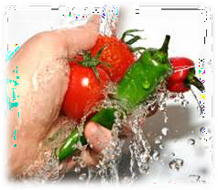
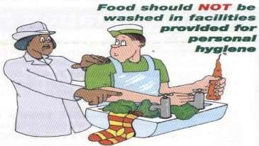
How to Protected food from contamination
Purchasing food from reputable supplier
Effective instruction, supervision and training of food handlers
Maintaining high standard of personal hygiene and good hygiene practices
Well designed and constructed food premises and food rooms
Effective pest control
The separation of raw and high – risk food at all stages of delivery
, storage, preparation , serving and distribution.
Effective storage and disposal of waste and unfit food
Well – designed and proper use of suitable equipment/utensils

Slide 15
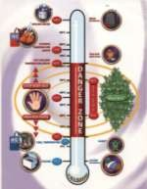
How to prevent bacteria within food from multiplying
Storing food out of the danger Zone. -
Food should be kept below 5⁰ C or kept above 63⁰ C
Cooling food as rapidly as possible
Not allowing dried foods to absorb moisture
Using suitable preservatives - Salt, Sugar , Vinegar (Acid)
Fermentation - Yoghurt , Curd

Slide 16
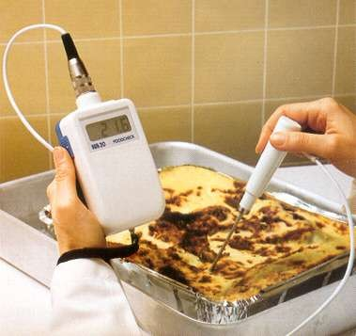
How to destroy bacteria within food
Through Cooking
Heat processing - Pasteurization , Sterilization or Canning

Slide 17
Food spoilage and preservation
Food spoilage
Spoilage commences in food as soon as it is harvested , taken from the sea or slaughtered.
Spoilage results from the action of
Bacteria Moulds Yeasts
Poor Hygiene Practices
Poor temperature control Unsuitable packing Rough handling
result in damage and accelerates spoilage

Slide 18
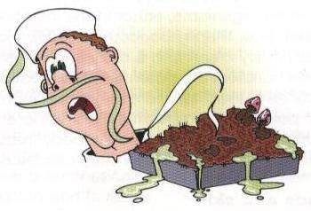
Signs of spoilage
Off odors
Discoloration
Slime / Stickiness
Mould growth (whiskers)
Change s in texture – e.g. dry or spongy
Unusual taste
The production of gas
Blown cans or packs

Slide 19
Food preservation
Preservation is the treatment of food prevent or delay spoilage and destroy or inhibit the growth of pathogenic organism.
Main ways to preserving foods
High temperature , pasteurization ,ultra –heat treatment
, sterilization , cooking , canning and bottling
Low temperatures , refrigeration and freezing
Dehydration (the removal of moisture) - e.g. Soup, Vegetables and Meet
Chemicals – e.g. salt, sugar, and Sulphur dioxide
contd/.

Slide 20
Vacuum packing - e.g. Fish & Meet
Irradiation - e.g. Spices
Smoking fish and meet
Packaging is very important to extend the life of preserved foods.
e.g. – cans, tetra packs , bottles, and pouches

Slide 21
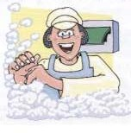
Personal Hygiene
Hands and Skins
(Food handlers must wash their hands especially)
After visiting the toilet
On entering the food room, after a break and before handling any food.
After putting on or changing a dressing
After dealing with an ill customer or a baby’s nappy
After handling raw food Including eggs, and before handling ready – to eat food.
After cleaning up animal faces or handling boxes contaminated by bird dropping.
After combing or touching the hair, face, nose, mouth or ears
After handling waste food.
After cleaning , or handling dirty cloths, crockery .etc.
After handling external packaging, flowers or money.

Slide 22
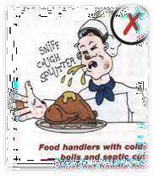
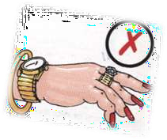
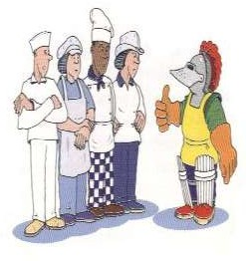
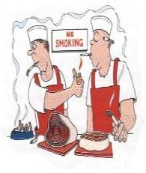
The nose, mouth and ears
Cuts, boils, whitlows and septic spots. Jewellery and perfume
The hair Smoking
Protective clothing
Hygiene training

