Slide 1
Global and National Power Sector Overview

Slide 2
Importance of energy
Energy is an important parameter for socio-economic development
Poverty alleviation is a global challenge and access to modern energy to all is one of the necessary conditions to achieve this goal
About 1.4 billion people do not have access to electricity and 2.6 billion people rely on traditional biomass
Access to modern energy helps to improve the conditions to achieve global development goals
(Sources: MoWIE, 2012 and 2013; G.T. Tucho et al., 2104)
Notes:
The measure of development in any society of today is synonymous with the level of energy consumption
Energy is therefore recognized as a critical input parameter for national economic development
Energy demands are still met largely (80%) from fossil fuels such as coal, oil and natural gas
About 41% of total CO₂ emission comes from power generation based on fossil fuels
A warming of about 0.2°C per decade is projected by IPCC for a range of emission scenarios

Slide 3
General/background on Energy: Global (cont.)
If the current rate of energy consumption continues, the limited reserves of coal, oil and natural gas may only last 118, 46 and 59 years, respectively
About 78% of total GHG emissions related to energy activities and 41% of total CO₂ emissions come from power generation based on fossil fuels
Global warming of about 0.2°C per decade is projected by IPCC for a range of emission scenarios
(Sources:, BP, 2012; EIA, 2014; IPCC, 2007 and 2014)
Notes:
Therefore, the sustainable development issue is more than ever raised, stimulating the need to search for sustainable development paths

Slide 4
General/background on Energy: Global
Energy is recognized as a critical input parameter for national economic development
Total energy demands are still met largely by fossil fuels such as coal, oil and natural gas (80%)
About 69% power generation from fossil fuels
In the next 20 years, expected demand for electricity would require the installation of the same power generation capacity that was installed over the entire 20th century
(Sources: WEO, 2010; ; EIA, 2014; Lior, 2012)
Notes:
The measure of development in any society of today is synonymous with the level of energy consumption
Energy is therefore recognized as a critical input parameter for national economic development
Impact of climate change on agriculture sector (from review paper)
we have seen the impacts of climate change on agriculture is huge.

Slide 5
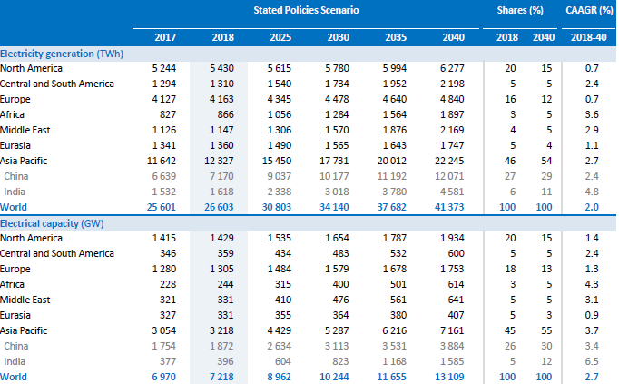
Global Power Sector Overview
18 TWh
18 TWh
(Source: WEO, 2019)
Notes:
The measure of development in any society of today is synonymous with the level of energy consumption
Energy is therefore recognized as a critical input parameter for national economic development
Impact of climate change on agriculture sector (from review paper)
we have seen the impacts of climate change on agriculture is huge.

Slide 6
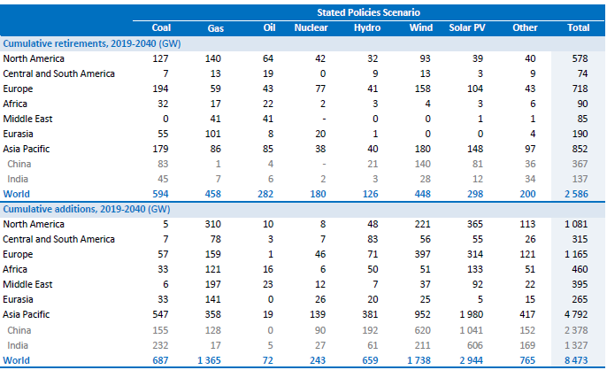
Global Power Sector Overview
(Source: WEO, 2019)
Notes:
The measure of development in any society of today is synonymous with the level of energy consumption
Energy is therefore recognized as a critical input parameter for national economic development
Impact of climate change on agriculture sector (from review paper)
we have seen the impacts of climate change on agriculture is huge.

Slide 7
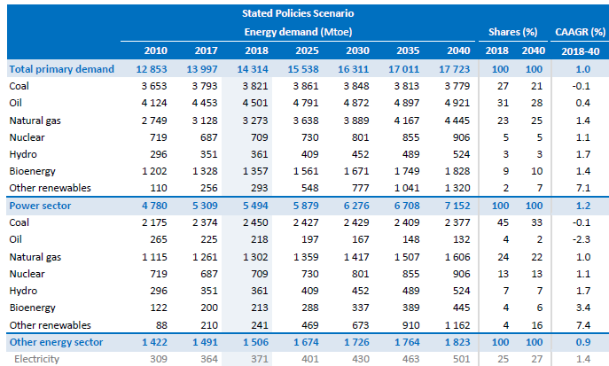
Global Energy Demand
(Source: WEO, 2019)
Notes:
The measure of development in any society of today is synonymous with the level of energy consumption
Energy is therefore recognized as a critical input parameter for national economic development
Impact of climate change on agriculture sector (from review paper)
we have seen the impacts of climate change on agriculture is huge.

Slide 8
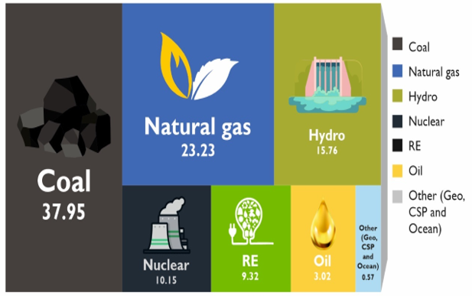
World Electricity Generation Share by Fuel
(Source: IRENA, 2019 and REN21, 2019)
Notes:
The measure of development in any society of today is synonymous with the level of energy consumption
Energy is therefore recognized as a critical input parameter for national economic development
Impact of climate change on agriculture sector (from review paper)
we have seen the impacts of climate change on agriculture is huge.

Slide 9
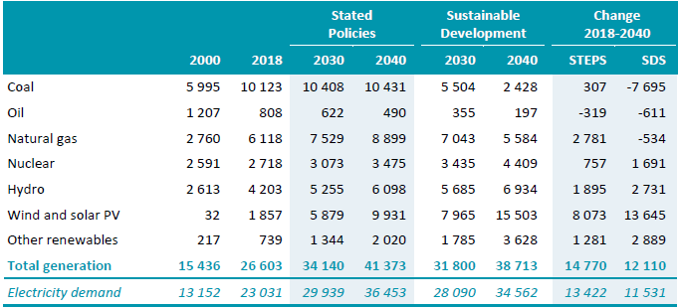
World electricity generation by fuel, technology and scenario (TWh)
(Source: WEO, 2019)
Notes:
The measure of development in any society of today is synonymous with the level of energy consumption
Energy is therefore recognized as a critical input parameter for national economic development
Impact of climate change on agriculture sector (from review paper)
we have seen the impacts of climate change on agriculture is huge.

Slide 10
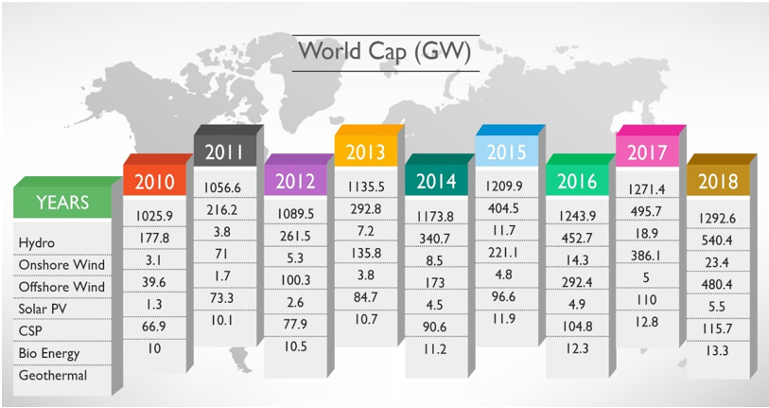
World Renewable Energy Capacity
( IRENA, 2019 and REN21, 2019)
Notes:
The measure of development in any society of today is synonymous with the level of energy consumption
Energy is therefore recognized as a critical input parameter for national economic development
Impact of climate change on agriculture sector (from review paper)
we have seen the impacts of climate change on agriculture is huge.

Slide 11
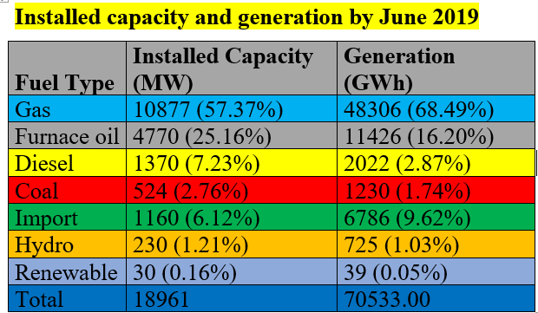
Bangladesh Power Generation Overview: Energy-mix for power generation
(Source: BDB 2019 and SREDA 2020)
Notes:
The measure of development in any society of today is synonymous with the level of energy consumption
Energy is therefore recognized as a critical input parameter for national economic development
Impact of climate change on agriculture sector (from review paper)
we have seen the impacts of climate change on agriculture is huge.

Slide 12
Bangladesh Power Generation Overview: Installation Capacity Share (Total 19922 MW)
(Source: BDB 2019 and SREDA 2020)
Notes:
The measure of development in any society of today is synonymous with the level of energy consumption
Energy is therefore recognized as a critical input parameter for national economic development
Impact of climate change on agriculture sector (from review paper)
we have seen the impacts of climate change on agriculture is huge.

Slide 13
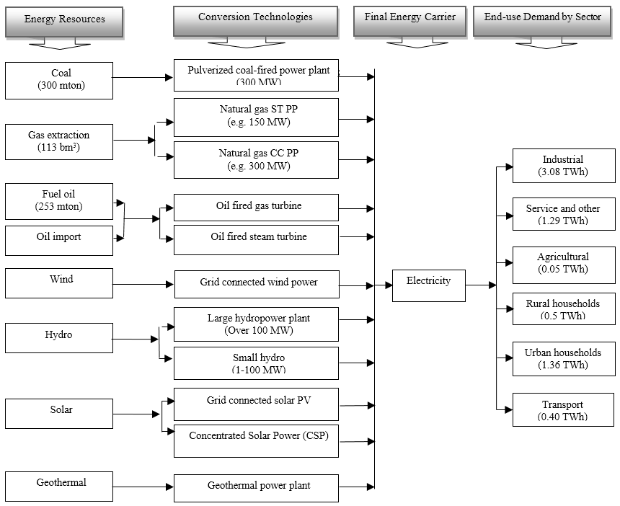
Energy system (Example for Bangladesh)
Notes:
The reference energy system represents the activities and technologies of an energy system, depicting energy (flows from the source of origin to the end use) demands, energy conversion technologies, fuel mixes, and the resources required to satisfy the energy demand
Technology learning effects on cost
Growth bound and resource availability

Slide 14
Power demand-supply gaps in Bangladesh
Introduction/methodology
Renewable potential
Demand projection
MARKAL - Bangladesh
Bangladesh is facing daunting energy challenges: Security concerns over growing fuel imports, limited domestic energy resources, and projected demands for electricity that will exceed domestic supply
Conclusions/remarks
Notes:
The figure shows the power demand-supply gaps in Bangladesh in recent years and the gap is increasing year by year
The country has been facing a severe power crisis for about a decade
Known reserves (e.g., natural gas and coal) of commercial primary energy sources in Bangladesh are limited
Only about 42 % of the total population have been connected to electricity
81% power from gas
Coal is expected to be the main fuel for electricity generation
By acknowledging the potential of renewable energy resources, the country could possibly meet its unprecedented energy demand, thus increasing electricity accessibility to all and enhancing energy security

Slide 15
Results
Introduction/methodology
16 times
11 times
Renewable potential
7.5 times
Demand projection
18 TWh
MARKAL- Bangladesh
Conclusions/remarks
Notes:
1) Total electricity consumption was about 18 TWh in 2005 and is projected to increase 7.5 times to 132 TWh by 2035 in the LG scenario .
2) In the AG and HG scenarios, the demand in 2035 shows an increase that is about 11 and 16 times the base-year value, respectively

Slide 16
Thank You
Contact: dralam.eee@diu.edu.bd

