Slide 1
Descriptive Writing
October 25, 2005

Slide 2
WHAT IS DESCRIPTIVE WRITING?
The moon with its wisps of white light hung suspended in the frosty air over the still, quiet countryside. He could see in all directions, from the majestic outcrop of mountains to the vast ocean on the other.
Descriptive writing focuses on observation, is static, and paints pictures with words.

Slide 3
In a descriptive paragraph,
Begin with an idea.
(You can write about what a person, object, place and so on)
Think about that idea.
Think in specific words and phrases as you write, using descriptive words.
Ask yourself questions about your idea, relating to the five senses.
What does it look like?
What does it sound like?
What does it smell like?
What does it taste like?
What does it feel like?
Examples:
1/ a paragraph describing what an alligator or a bat looks like.
2/ a paragraph about an special person in your life.
3/ a paragraph about a place that is worth seeing

Slide 4
Using Descriptive Language
Plant vivid images in your reader’s mind
Describe images to your reader as if they have never seen the person, place, or thing before
Make your reader see the image through your eyes (the same way you saw it when you wrote it)

Slide 5
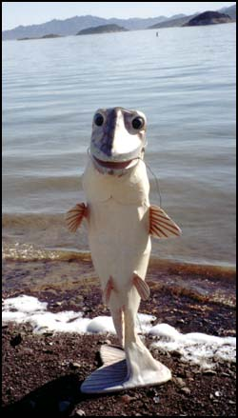
Similes
Comparisons using the words “like” or “as” ( simile)
The surface of the moon is like crumpled sandpaper
I felt as nervous as a fish out of water
As clear as crystal

Slide 6
Metaphors
Comparisons minus cue words
My tears were a river
I died with embarrassment
Her heart was on fire
He hit the wall of exhaustion

Slide 7
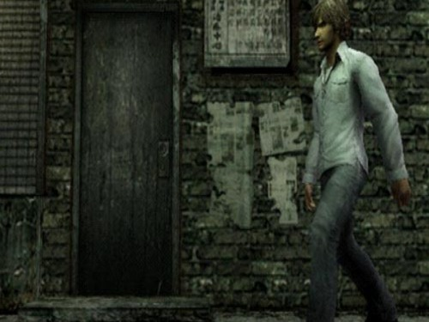
Adjectives
Words which describe or modify nouns
The tall, thin man entered the spooky room with measured steps. Inside the room deep shadows crouched in wait for him.

Slide 8
Adverbs
Words which describe or modify verbs
The jets dived steeply out of the sky, tumbling rapidly as they maneauvered gracefully past each other.
USE ADVERBS TO DESCRIBE A FIREWORKS DISPLAY.
(1 – 2 SENTENCES)

Slide 9
Organizing Your Description
Organization helps your reader to imagine what you are describing.
Order of importance
Most important to least or least to most
Spatial order
From far to near or near to far
From top to bottom or bottom to top
From left to right or right to left

Slide 10
Writing a Descriptive Paragraph
To write a descriptive paragraph, observe carefully and choose specific details.
1st – Decide on the most important images to describe and make a list
2nd – Write one or two descriptive words after each item on the list
3rd – Use the details from your list to write your descriptive paragraph
To start, think of a topic sentence that gives a clue to your overall description. Then follow it with detailed sentences that support it.

Slide 11
Descriptive Worksheet
House, Room
1. Size large, square
2. Carpet wine-colored
3. Wallpaper, walls faded, bare
4. Chandelier dusty, crystal
5. Windows foggy
6. Furniture old, threadbare
7. Your impression of it empty-looking, too large

Slide 12
Descriptive Worksheet
Woman
1. Eyes small. Blue
2. Ears hidden under hair
3. Hair short, white
4. Nose narrow
5. Skin wrinkled
6. Voice raspy
7. Your impression of her very old, lonely

Slide 13
Sample Descriptive Paragraph
My brother Michael’s bedroom shows his big interest in fantasy and science fiction. Glow-in-the-dark stars are pasted on the ceiling where, at night, they glow in the dark. Other stars can be seen covering the ceiling during the day, giving the appearance of a starry sky. Movie posters line the walls. There is a poster of The Matrix in a shiny frame. Below the posters are two black steel bookcases crowded with old books. Old videos like Raiders of the Lost Ark and Alien are also stacked on the bookshelves. Anyone entering my brother’s room knows at once that Michael likes to escape to fantastic places.

Slide 14
Describing People
Adjectives to describe yourself, your family, another student, your teacher.
Height | Build | Age
tall, short, medium height | , slim, thin, overweight, fat, skinny, | young, elderly, middle-aged, teenager, in 20s, 30s
Face | Eyes | Hair Type/Color
round, oval, square, with scars, wrinkles, sun-tanned, pale | big round blue eyes, large, small, bright, narrow | bald, straight, curly, spiky, wavy, short, long dyed, blonde hair, red hair, black hair
Clothes: casual, formal , neat , messy
John is a tall, slim man in his mid forties. He has a thin face,
blue eyes and a large nose. His short hair is turning white
He is usually casually dressed. He is a smart man, but
he is very messy. He doesn’t keep his office tidy.

Slide 15
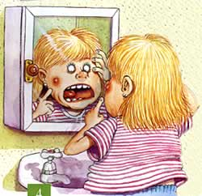
CLASS ACTIVITY
Type of complexion
He is Asian.
He has light-brown skin.
She is black.
She has dark skin.
She is white.
She has slightly tanned skin.
She is white. She has very pale skin.
Type of hair
She has long, straight, black hair.
She has short, straight, black hair.
She has medium length,
straight, blonde hair.
She has short, curly, blonde hair.
She has medium length, wavy, red hair.
He has no hair. (Bald)

Slide 16
Describing Character - What is he like? Is he nice???
careful, hard-working, worried, cheerful, active, curious, | generous, aggressive, careless, sensible, independent | creative boring, imaginative sensitive, gentle, loyal, | trusting, friendly stubborn, patient moody, optimistic, | energetic, confident, selfish, shy,
Examples:
1/Our new teacher is so patient. If we don't understand something, she goes over it
again and again until we do.
2/Our English teacher at school is so creative. He is always coming up with new
games that help make learning fun.
3/Tim is so generous. He always helps out the poor
people in our community.

Slide 17
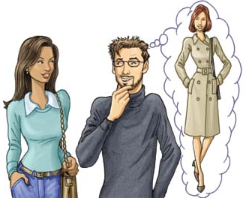
APPEARANCE
Medium-Height
Skinny
Brown Eyes
CHARACTER
Reserved
Hard-Working
Patient
Mild
PERSON
(JUDY)
WHAT
HE/SHE DOES?
a student
part-time cashier
math tutor
HOBBIES
Listening to
pop music
Reading novels
Sewing
Painting

Slide 18
Worksheet Paragraph
As I looked around the room, I wasn’t sure if I felt frightened or sorry for the old woman. The few pieces of threadbare furniture emphasized the largeness of the room. The walls were bare and the wallpaper faded. The only item of any value was a crystal chandelier, now covered with dust, hanging in the center of the square ceiling.
She sat beside me and slowly brushed her white hair away from her small, blue eyes with her wrinkled-looking fingers. I listened as her raspy voice told her story

Slide 19
