Slide 1
Data Mining
Classification [Decision Tree]

Slide 2
Classify a phenomenon in a predefined class
The phenomenon is usually presented in the form of an observation record(tuple).
The classifier is an algorithm that carries out the classification, and the classifiers are typically presented as decision trees. In these trees the nodes are labelled by conditions that allow the decision making.
There are two typical methods of classification:
Decision trees
Neural networks

Slide 3
Decision trees
A decision tree is a structure that includes a root node, branches, and leaf nodes. Each internal node denotes a test on an attribute, each branch denotes the outcome of a test, and each leaf node holds a class label. The topmost node in the tree is the root node.
The benefits of having a decision tree are as follows −
It does not require any domain knowledge.
It is easy to comprehend.
The learning and classification steps of a decision tree are simple and fast.

Slide 4
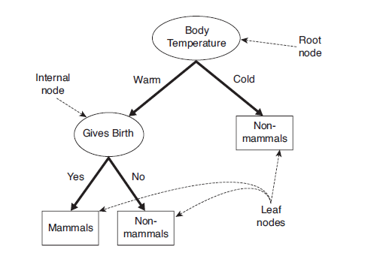
Structure of Decision Tree

Slide 5
Decision Tree Algorithm
There are many Decision Tree Algorithm. Like as..
Hunt’s Algorithm [for Binary Splitting]
Tertiary Tree [Multiway Splitting]
CART
ID3, C4.5
SLIQ,SPRINT

Slide 6
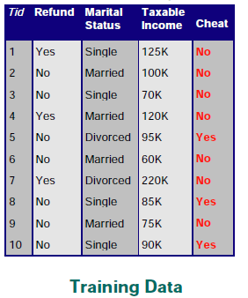
Hunt’s Algorithm [for Binary Splitting]
Refund | Marital Status | Taxable Income | Cheat
No | Married | 80K | ?
No | Single | 60K | ?
No | Divorced | 120K | ?
Test Set

Slide 7
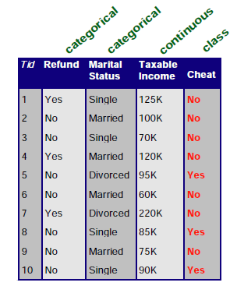
Attributes of Training Set

Slide 8
Create Decision tree for Training Set
Refund
Yes
No
No
Marital Status
{Single, Divorced }
Married
Taxable Income
No
<= 80 K
> 80 K
No
Yes

Slide 9
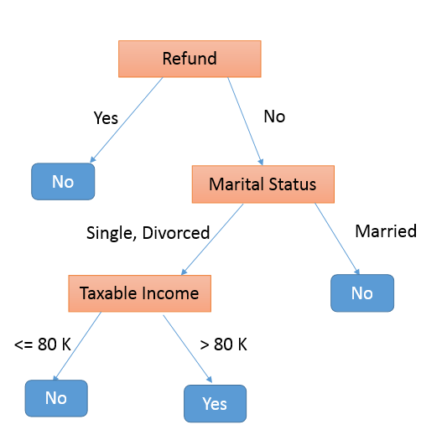
Implement Test Set on this Tree
Refund | Marital Status | Taxable Income | Cheat
No | Married | 80K | ?
No | Single | 60K | ?
No | Divorced | 120K | ?
Refund | Marital Status | Taxable Income | Cheat
No | Married | 80K
No | Single | 60K
No | Divorced | 120K
No
No
Yes

Slide 10
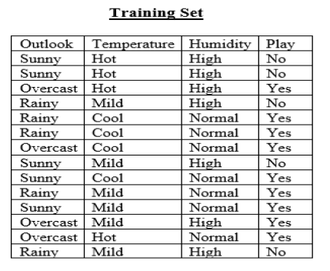
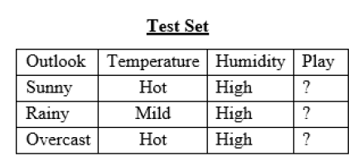
Tertiary Tree [Multiway Splitting]

Slide 11
Create Decision tree for Training Set
Outlook
Overcast
{Sunny, Rainy}
Play
Temperature
Mild
Cool
Hot
Humidity
Play
Don’t Play
High
Normal
Don’t Play
Play

Slide 12
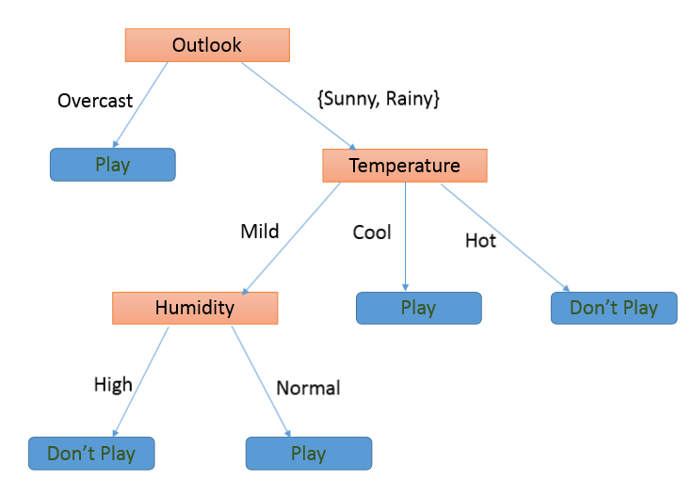
Implement Test Set on this Tree
Outlook | Temperature | Humidity | Play
Sunny | Hot | High | Don’t Play
Rainy | Mild | High | Don’t Play
Overcast | Hot | High | Play

Slide 13
Any Questions?
Thank You.....

