Slide 1
https://www.slideshare.net/sarabdulaziz/notes-preface-to-shakespeare-by-samuel-johnson

Slide 2
Preface to Jhonson

Slide 7
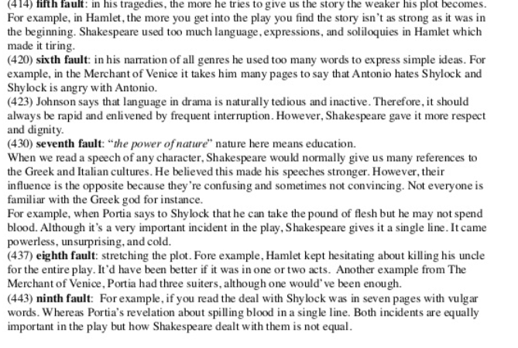

Slide 8
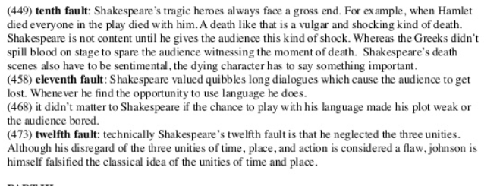

Slide 9
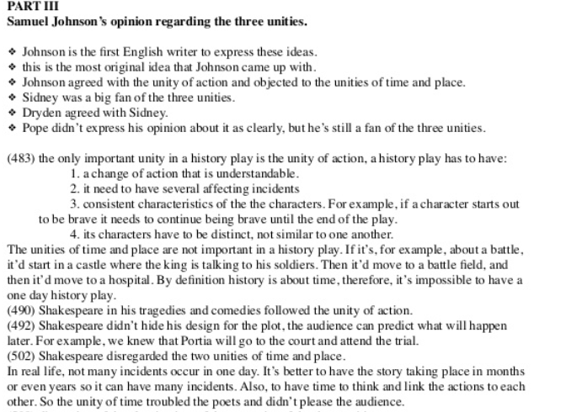

Slide 10
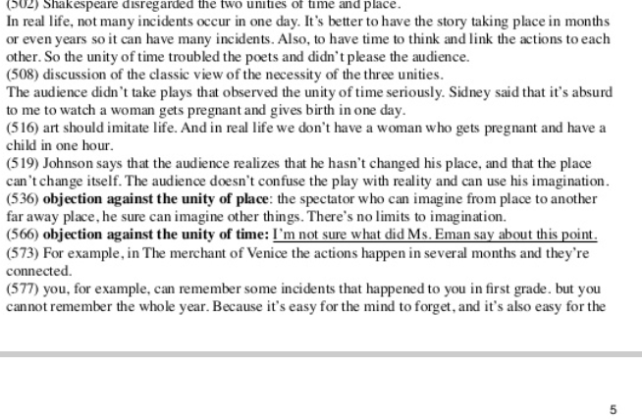

Slide 11
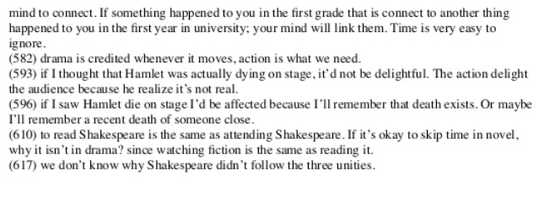

Slide 12
