Slide 1
Boolean Algebra and Logic Circuits
Zannatul Mawa koli
Lecturer
Department of CSE
Daffodil International University

Slide 2
Learning Objectives
In this chapter you will learn about:
Boolean algebra
Fundamental concepts and basic laws of Boolean algebra
Boolean function and minimization
Logic gates
Logic circuits and Boolean expressions
Combinational circuits and design

Slide 3
Boolean Algebra
An algebra that deals with binary number system
George Boole (1815-1864), an English mathematician, developed it for:
Simplifying representation
Manipulation of propositional logic
In 1938, Claude E. Shannon proposed using Boolean algebra in design of relay switching circuits
Provides economical and straightforward approach
Used extensively in designing electronic circuits used in computers

Slide 4
Fundamental Concepts of Boolean Algebra
Use of Binary Digit
Boolean equations can have either of two possible values, 0 and 1
Logical Addition
Symbol ‘+’, also known as ‘OR’ operator, used for logical addition.
Follows law of binary addition
Logical Multiplication
Symbol ‘. ’, also known as ‘AND’ operator, used for logical multiplication.
Follows law of binary multiplication
Complementation
Symbol ‘-’, also known as ‘NOT’ operator, used for complementation.
Follows law of binary compliment

Slide 5
Operator Precedence
Each operator has a precedence level
Higher the operator’s precedence level, earlier it is evaluated
Expression is scanned from left to right
First, expressions enclosed within parentheses are evaluated
Then, all complement (NOT) operations are performed
Then, all ‘⋅’ (AND) operations are performed
Finally, all ‘+’ (OR) operations are performed

Slide 6
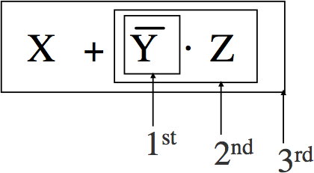
Operator Precedence

Slide 7
Postulates of Boolean Algebra
Postulate 1:
①A = 0, if and only if, A is not equal to 1
②A = 1, if and only if, A is not equal to 0
Postulate 2:
①x + 0 = x
②x ⋅ 1 = x
Postulate 3: Commutative Law
①x + y = y + x
②x ⋅ y = y ⋅ x
Postulates - are the basic structure from which lemmas and theorems are derived.
Theorem - a mathematical statement that is proved using rigorous mathematical reasoning. Lemma - a minor result whose sole purpose is to help in proving a theorem. It is a stepping stone on the path to proving a theorem.

Slide 8
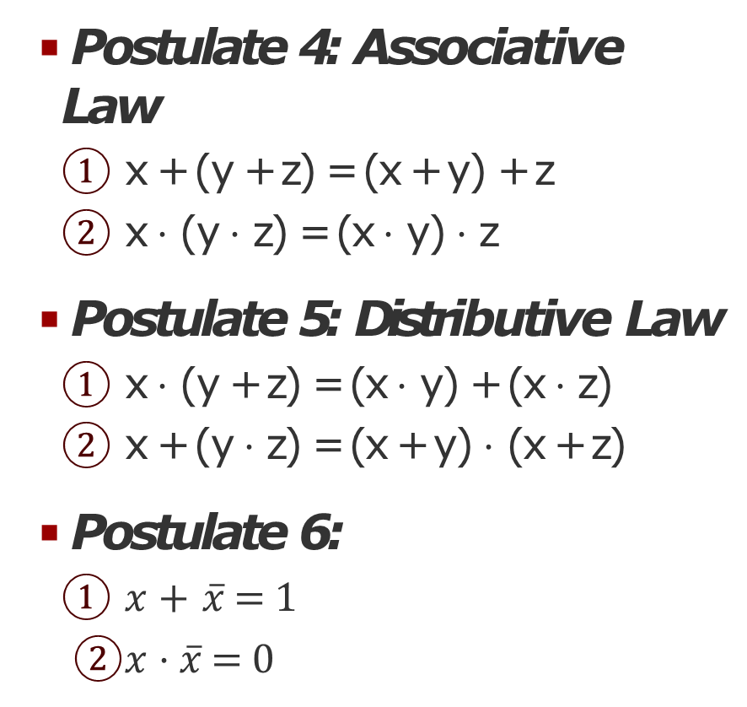
Postulates of Boolean Algebra
Postulate 4: Associative Law
① x + (y + z) = (x + y) + z
② x ⋅ (y ⋅ z) = (x ⋅ y) ⋅ z
Postulate 5: Distributive Law
① x ⋅ (y + z) = (x ⋅ y) + (x ⋅ z)
② x + (y ⋅ z) = (x + y) ⋅ (x + z)
Postulate 6:
① $x + \overline{x}= 1$
② $x ⋅\overline{x}= 0$

Slide 9
The Principle of Duality

Slide 10
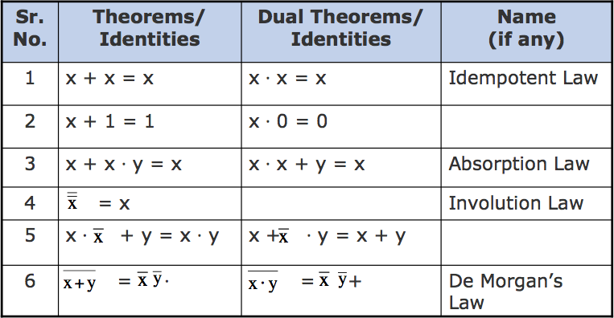
Some Important Theorems of Boolean Algebra

Slide 11
Methods of Proving Theorems
The theorems of Boolean algebra may be proved by using one of the following methods:
① By using postulates to show that L.H.S. = R.H.S
② By Perfect Induction or Exhaustive Enumeration method where all possible combinations of variables involved in L.H.S. and R.H.S. are checked to yield identical results
③ By the Principle of Duality where the dual of an already proved theorem is derived from the proof of its corresponding pair

Slide 12
Proving a Theorem by Using Postulates (Example)
Theorem:
Proof:
L.H.S.
x + x · y = x
= x + x ⋅ y
= x ⋅ 1 + x ⋅ y
= x ⋅ (1 + y)
= x ⋅ (y + 1)
= x ⋅ 1
= x
= R.H.S.
by postulate 2(b)
by postulate 5(a)
by postulate 3(a)
by theorem 2(a) by postulate 2(b)

Slide 13
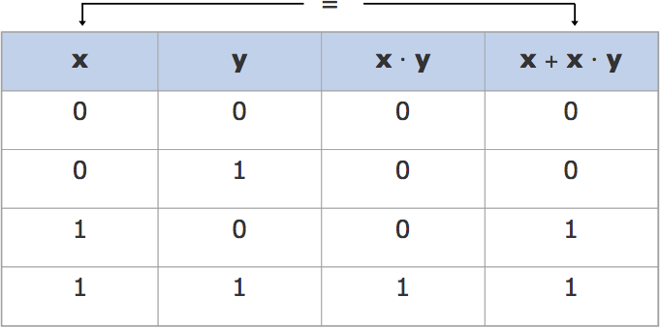
Proving a Theorem by Perfect Induction (Example)
Theorem: x + x · y = x

Slide 14
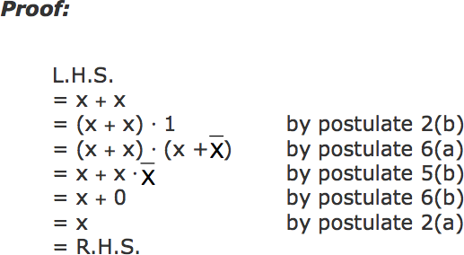
Proving a Theorem by Perfect Induction (Example)
Theorem: x + x = x

Slide 15
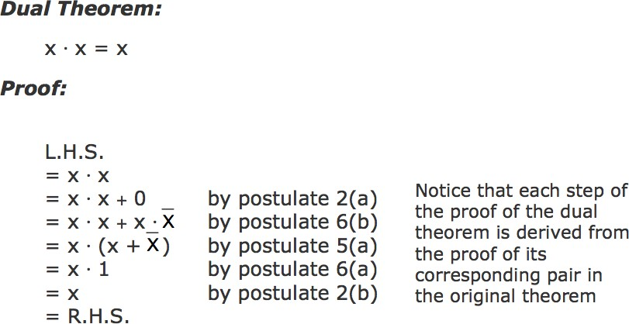
Proving a Theorem by Perfect Induction(Example)

Slide 16
Boolean Functions
A Boolean function is an expression formed with:
Binary variables
Operators (OR, AND, and NOT)
Parentheses, and equal sign
The value of a Boolean function can be either 0 or 1
A Boolean function may be represented as:
An algebraic expression, or
A truth table

Slide 17
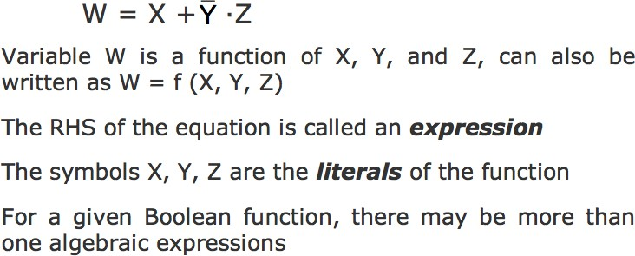
Representation as an Algebraic Expression

Slide 18
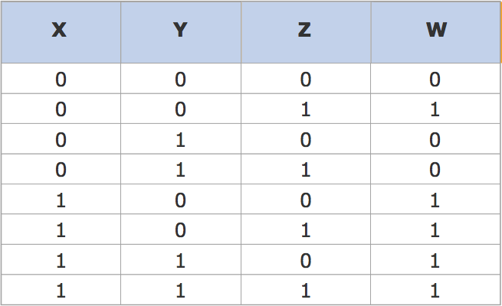
Representation as a Truth Table
The number of rows in the table is equal to 2^{n}, where n is the number of literals in the function

Slide 19
Minimization of Boolean Functions
Minimization of Boolean functions deals with
Reduction in number of literals
Reduction in number of terms
Minimization is achieved through manipulating expression to obtain equal and simpler expression(s) (having fewer literals and/or terms)

Slide 20
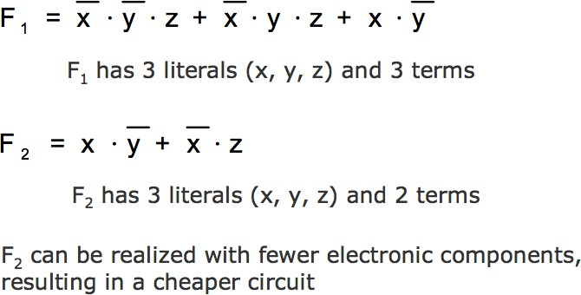
Minimization of Boolean Functions

Slide 21
Minimization of Boolean Functions
x | y | z | F₁ | F₂
0 | 0 | 0 | 0 | 0
0 | 0 | 1 | 1 | 1
0 | 1 | 0 | 0 | 0
0 | 1 | 1 | 1 | 1
1 | 0 | 0 | 1 | 1
1 | 0 | 1 | 1 | 1
1 | 1 | 0 | 0 | 0
1 | 1 | 1 | 0 | 0
Both F₁ and F₂ produce the same result

Slide 22
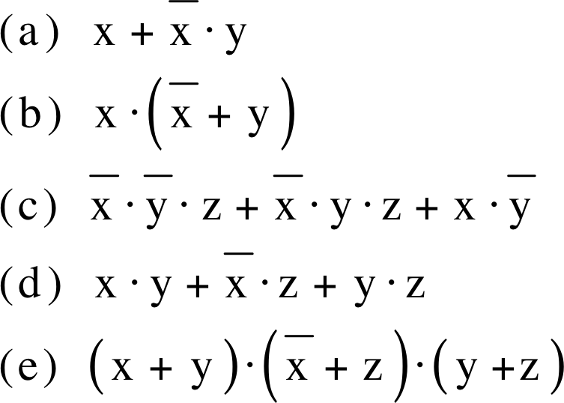
Try out some Boolean Function Minimization

