Slide 1
ALKALOIDS
Alkaloids are a group of nitrogen-containing bases. Most of them are drugs.
In addition to carbon, hydrogen and nitrogen, alkaloids may also contain oxygen, sulfur and, more rarely, other elements such as chlorine, bromine, and phosphorus.
Only a few (like caffeine) are derived from purines or pyrimidines, while the large majority is produced from amino acids.

Slide 2
Medicinal action of various alkaloids
Alkaloid | Action
Ajmaline | antiarrhythmic
Atropine, scopolamine, hyoscyamine | anticholinergic
Caffeine | stimulant, adenosine receptor antagonist
Codeine | cough medicine, analgesic
Colchicine | remedy for gout
Emetine | antiprotozoal agent
Ergot alkaloids | sympathomimetic, vasodilator, antihypertensive
Morphine | analgesic

Slide 3
Nicotine | stimulant, nicotinic acetylcholine receptor agonist
Physostigmine | inhibitor of acetylcholinesterase
Quinidine | antiarrhythmic
Quinine | antipyretics, antimalarial
Reserpine | antihypertensive
Tubocurarine | muscle relaxant
Vinblastine, vincristine | antitumor
Vincamine | vasodilating, antihypertensive
Yohimbine | stimulant, aphrodisiac

Slide 4
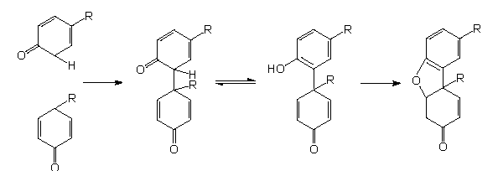
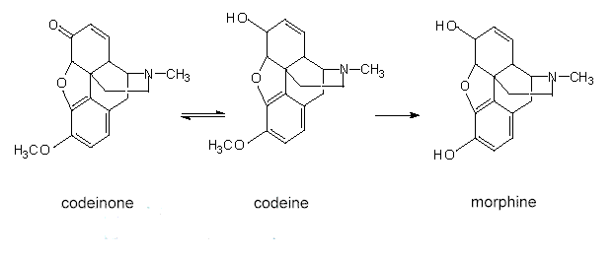
Morphine synthesis: Two tyrosine rings condense and form the basic structure of morphine that is subsequently modified.

Slide 5
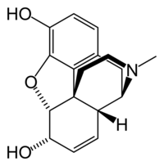
Morphine - SAR
Phenolic OH →
Required
← Aromatic ring
Required
← N-methyl group
Ether bridge →
Required
Not Required
6-alcohol →
← Double bond at 7-8
Not Required
Not Required

Slide 6
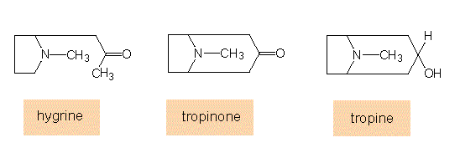
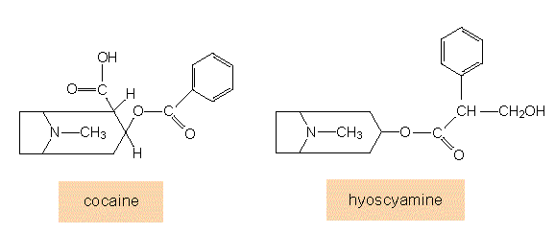
Biosynthesis of Tropane: The starting compound of this synthesis is ornithine, methylornithine is the first intermediate.

Slide 7
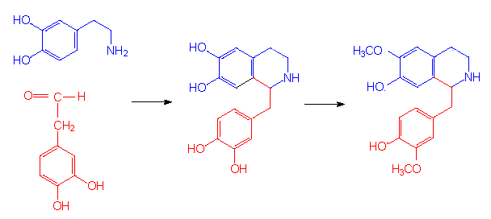
Tyrosine derivatives: Synthesis of Benzylisoquinolines, Starting with two molecule of Tyrosine
Benzylisoquinoline

