Slide 1
Entity-Relationship Model
Fabliha Haque
Dept. of CSE, DIU

Slide 2
Entity-Relationship Model
An entity relationship diagram (ERD) is a representation of data within a domain. It consists of entities as well as relationships between entities.
A graphical representation of entities and their relationships to each other
A logical data model of the real world.

Slide 3
Modeling
A database can be modeled as:
a collection of entities,
relationship among entities.
An entity is an object that exists and is distinguishable from other objects.
Example: specific person, company, event, plant
Entities have attributes
Example: people have names and addresses
An entity set is a set of entities of the same type that share the same properties.
Example: set of all persons, companies, trees, holidays

Slide 4
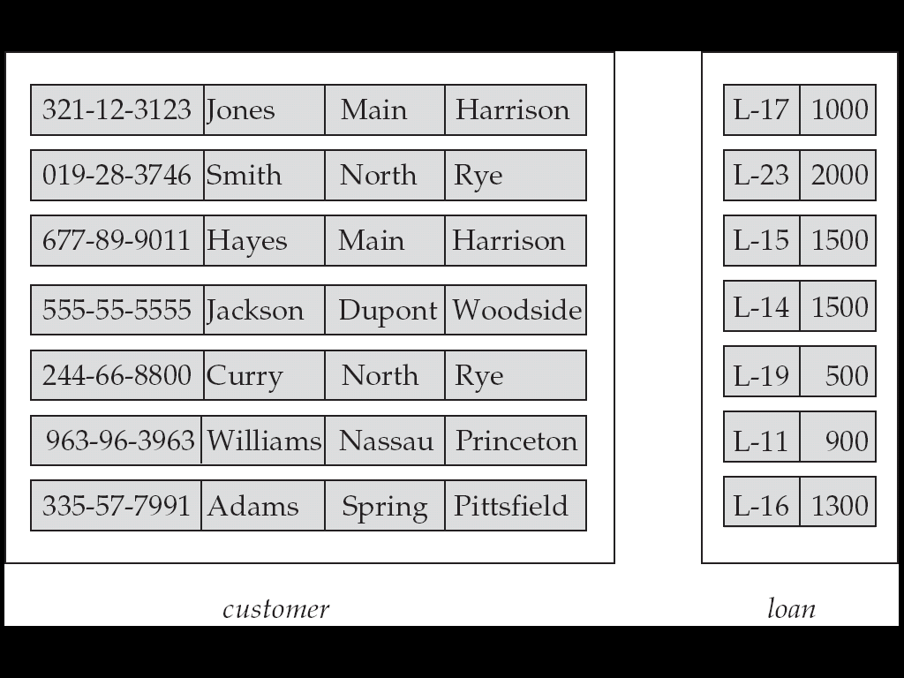
Entity Sets customer and loan
customer_id customer_ customer_ customer_ loan_ amount name street city number

Slide 5
Attributes
An entity is represented by a set of attributes, that is descriptive properties possessed by all members of an entity set.
Domain – the set of permitted values for each attribute
Attribute types:
Simple and composite attributes.
Single-valued and multi-valued attributes
Example: multi valued attribute: phone_numbers
Derived attributes
Can be computed from other attributes
Example: age, given date_of_birth
Example: customer = (customer_id, customer_name, customer_street, customer_city ) loan = (loan_number, amount )

Slide 6
Composite Attributes

Slide 7
Relationship Sets
A relationship is an association among several entities
Example: Hayes depositor A-102 customer entity relationship set account entity
A relationship set is a mathematical relation among n ≥ 2 entities, each taken from entity sets
{(e₁, e₂, … e_{n}) | e₁ ∈ E₁, e₂ ∈ E₂, …, e_{n} ∈ E_{n}} where (e₁, e₂, …, e_{n}) is a relationship
Example:
(Hayes, A-102) ∈ depositor

Slide 8
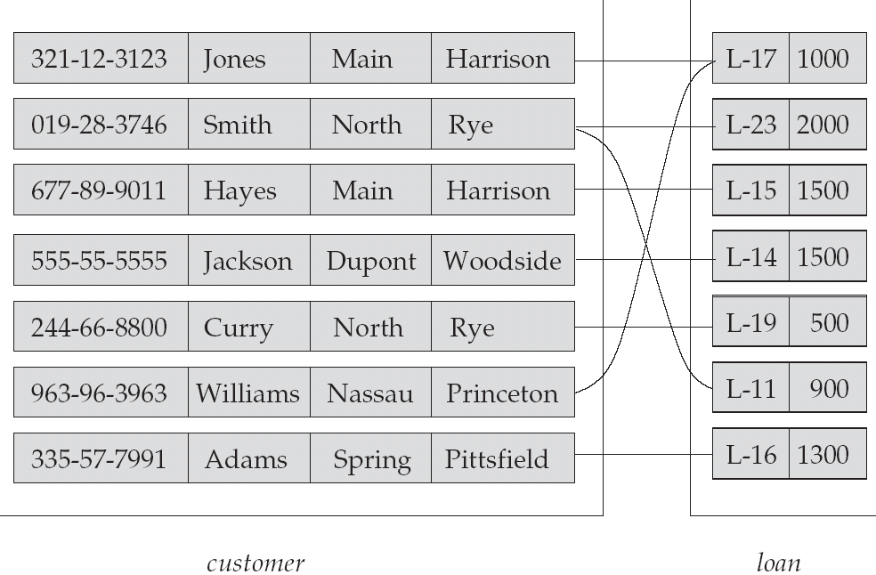
Relationship Set borrower

Slide 9
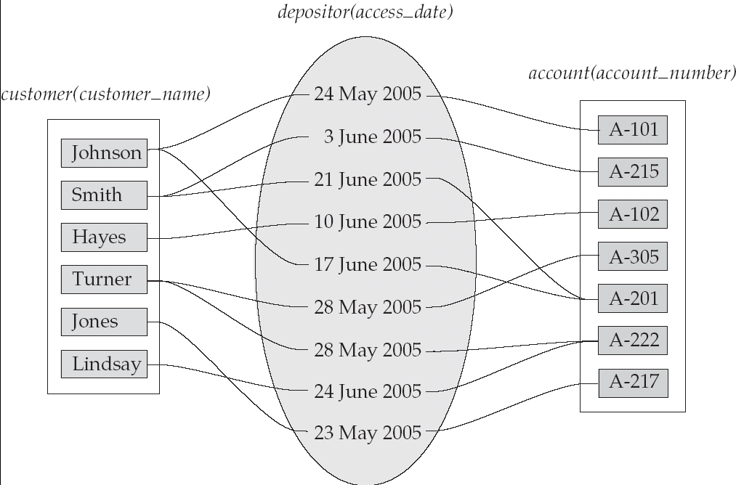
Relationship Sets (Cont.)
An attribute can also be property of a relationship set.
For instance, the depositor relationship set between entity sets customer and account may have the attribute access-date

Slide 10
Degree of a Relationship Set
Refers to number of entity sets that participate in a relationship set.
Relationship sets that involve two entity sets are binary (or degree two). Generally, most relationship sets in a database system are binary.
Relationships between more than two entity sets are rare. Most relationships are binary.

Slide 11
Mapping Cardinality Constraints
Number of entities to which another entity can be associated via a relationship set.
Most useful in describing binary relationship sets.
For a binary relationship set the mapping cardinality must be one of the following types:
One to one
One to many
Many to one
Many to many

Slide 12
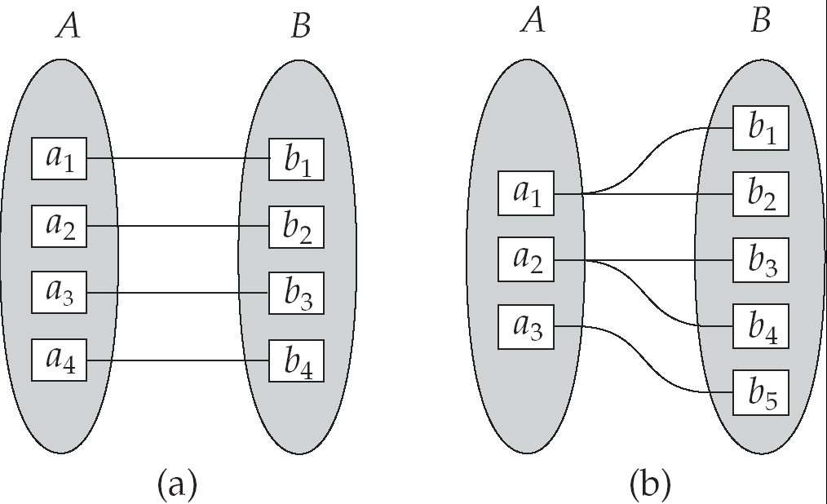
Mapping Cardinalities
One to one
One to many

Slide 13
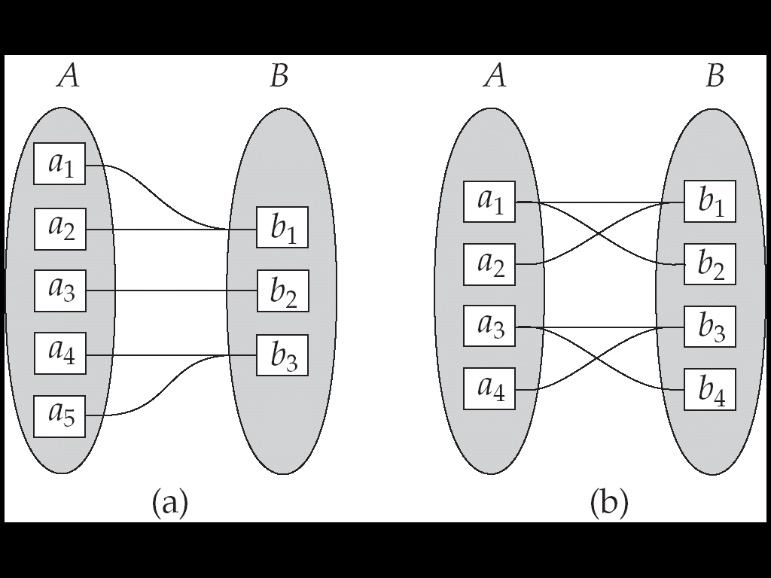
Mapping Cardinalities
Many to one
Many to many
The appropriate mapping cardinality depends on real world situation that the relationship is modelling

Slide 14
Keys
A super key of an entity set is a set of one or more attributes whose values uniquely determine each entity.
A candidate key of an entity set is a minimal super key
Customer_id is candidate key of customer
account_number is candidate key of account
Although several candidate keys may exist, one of the candidate keys is selected to be the primary key.

Slide 15
Keys for Relationship Sets
The combination of primary keys of the participating entity sets form a super key of a relationship set.
(customer_id, account_number) is the super key of depositor
Must consider the mapping cardinality of the relationship set when deciding what are the candidate keys
The primary key is the union of both entity set if the relationship is m:m otherwise the one side primary key is the primary key of relationship set.

Slide 16
E-R Diagrams
Rectangles represent entity sets.
Diamonds represent relationship sets.
Lines link attributes to entity sets and entity sets to relationship sets.
Ellipses represent attributes
Double ellipses represent multivalued attributes.
Dashed ellipses denote derived attributes.
Underline indicates primary key attributes

Slide 17
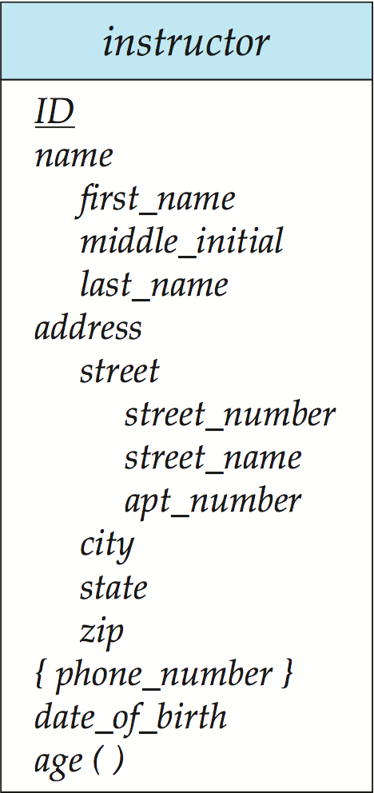
Entity With Composite, Multivalued, and Derived Attributes

Slide 18
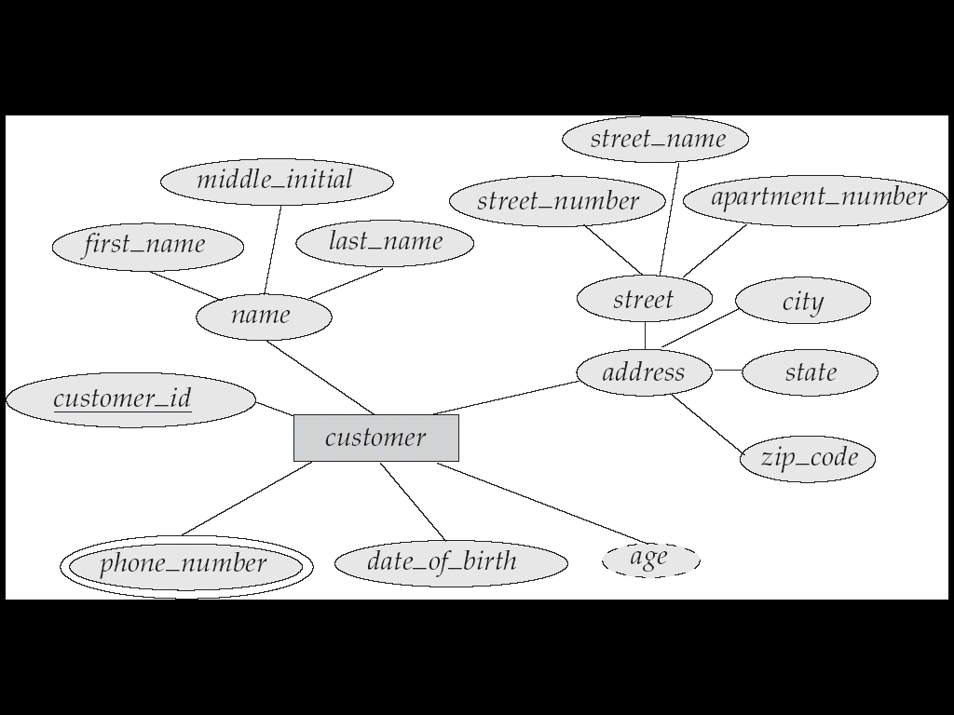
E-R Diagram With Composite, Multivalued, and Derived Attributes

Slide 19
Relationship Sets with Attributes

Slide 20
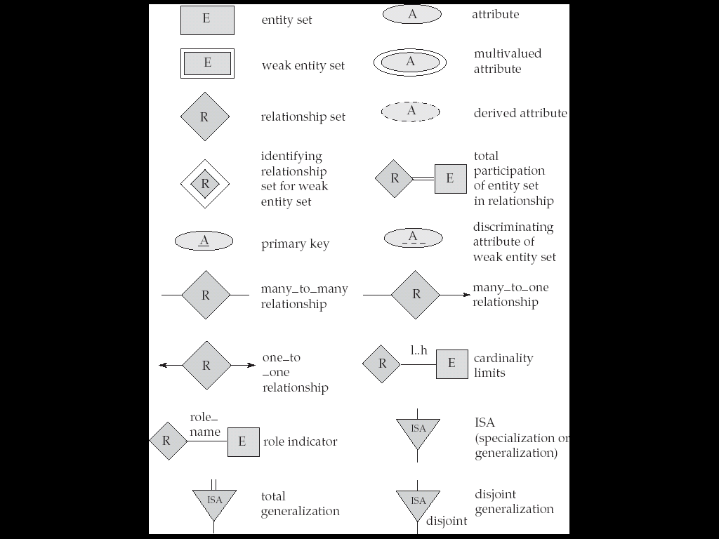
Summary of Symbols Used in E-R Notation

Slide 21
Cardinality Constraints
We express cardinality constraints by drawing either a directed line (→), signifying “one,” or an undirected line (—), signifying “many,” between the relationship set and the entity set.
One-to-one relationship:
A customer is associated with at most one loan via the relationship borrower
A loan is associated with at most one customer via borrower

Slide 22
One-To-Many Relationship
In the one-to-many relationship a loan is associated with at most one customer via borrower, a customer is associated with several (including 0) loans via borrower

Slide 23
Many-To-One Relationships
In a many-to-one relationship a loan is associated with several (including 0) customers via borrower, a customer is associated with at most one loan via borrower

Slide 24
Many-To-Many Relationship
A customer is associated with several (possibly 0) loans via borrower
A loan is associated with several (possibly 0) customers via borrower

Slide 25
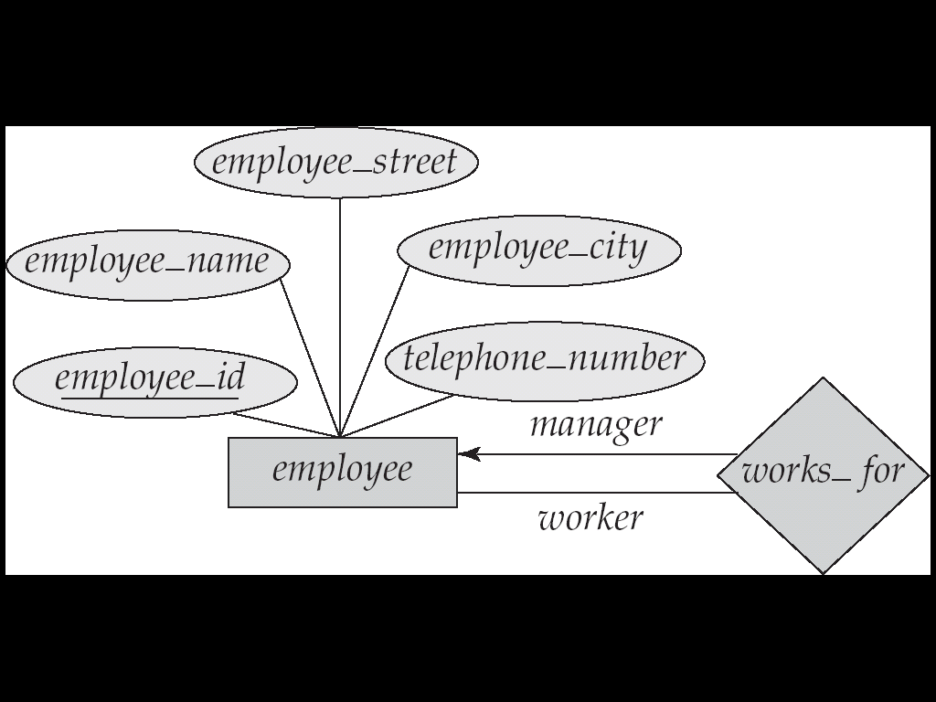
Roles
The function that an entity plays in a relationship is called role.
It indicates how an entity interact via a relationship.
The labels “manager” and “worker” are called roles; they specify how employee entities interact via the works_for relationship set.
Roles are indicated in E-R diagrams by labeling the lines that connect diamonds to rectangles.
Role labels are optional, and are used to clarify semantics of the relationship

Slide 26
Participation of an Entity Set in a Relationship Set
Total participation (indicated by double line): every entity in the entity set participates in at least one relationship in the relationship set
E.g. participation of loan in borrower is total; every loan must have a customer
Partial participation: some entities may not participate in any relationship in the relationship set
Example: participation of customer in borrower is partial

Slide 27
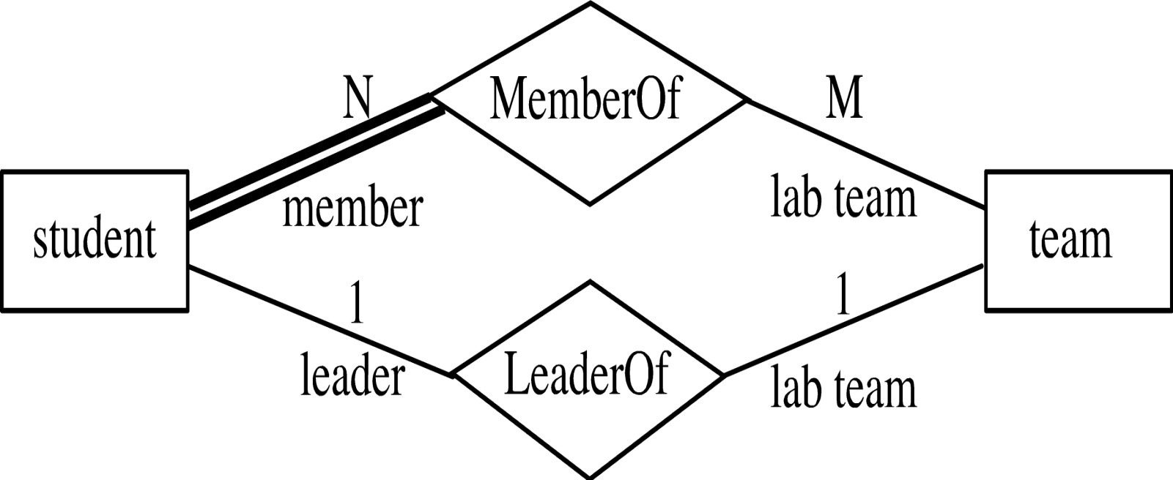
Participation of an Entity Set in a Relationship Set
Every student must be a member of a team
The participation of student in LeaderOf is partial, because only one student might be a team leader.

Slide 28
Alternative Notation for Cardinality Limits
Cardinality limits can also express participation constraints

Slide 29
E-R Diagram with a Ternary Relationship

Slide 30
Example ER
major
Department
offers
faculty
Courses
Professor
teaches
advisor
enrollment
Students
Notes:
2

Slide 31
Weak Entity Sets
An entity set that does not have a primary key is referred to as a weak entity set.
The existence of a weak entity set depends on the existence of a identifying entity set
weak entity set relate to the identifying entity set via a total, one-to-many relationship
Identifying relationship depicted using a double diamond

Slide 32
Weak Entity Sets
The discriminator (or partial key) of a weak entity set is the set of attributes that distinguishes among all the entities of a weak entity set.
The primary key of a weak entity set is formed by the primary key of the strong entity set on which the weak entity set is existence dependent, plus the weak entity set’s discriminator.

Slide 33
Weak Entity Sets (Cont.)
We depict a weak entity set by double rectangles.
We underline the discriminator of a weak entity set with a dashed line.
Primary key for payment – (loan_number, payment_number)

Slide 34
Extended E-R Features: Specialization
Top-down design process; we designate sub groupings within an entity set that are distinctive from other entities in the set.
Depicted by a triangle component labeled ISA (E.g. customer “is a” person).
Attribute inheritance – a lower-level entity set inherits all the attributes and relationship participation of the higher-level entity set to which it is linked.

Slide 35
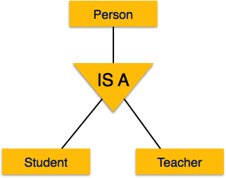
Specialization
A group of entities is divided into sub-groups based on their characteristics

Slide 36
Extended ER Features: Generalization
A bottom-up design process – combine a number of entity sets that share the same features into a higher-level entity set.
Specialization and generalization are simple inversions of each other; they are represented in an E-R diagram in the same way.
The terms specialization and generalization are used interchangeably.
The ISA relationship also referred to as superclass - subclass relationship

Slide 37
Generalization
Process of generalizing entities. The generalized entities contain the properties of all the generalized entities called generalization

Slide 38
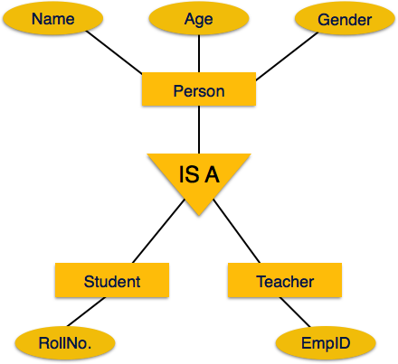
Specialization/Generalization Example

Slide 39
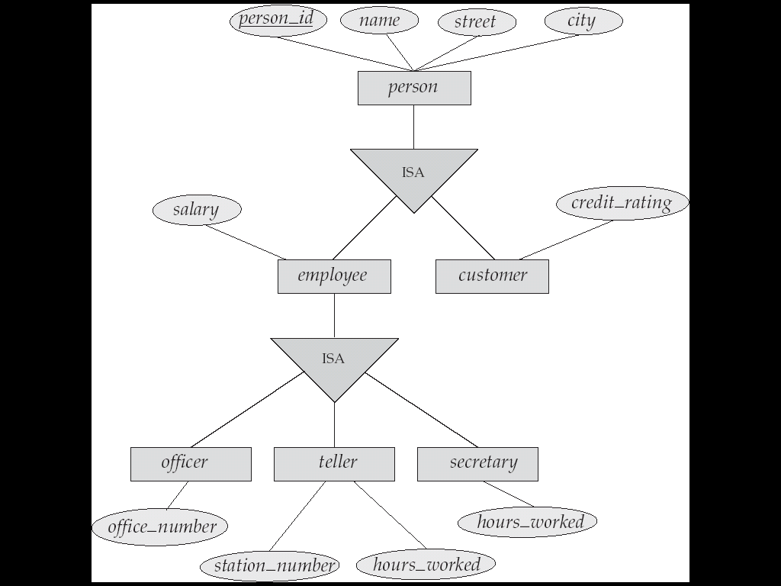
Specialization/Generalization Example

Slide 40
Transforming E-R Diagrams into Relations
To transform the conceptual data model into a set of normalized relations
Steps
Represent entities
Represent relationships
Normalize the relations
Merge the relations

Slide 41
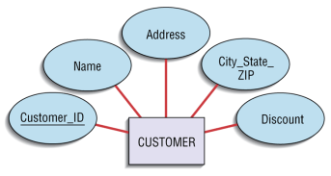
Transforming E-R Diagrams into Relations
Customer(Customer_ID, name, Address, City_State_ZIP, Discount)

Slide 42
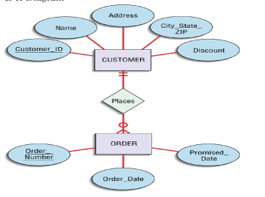
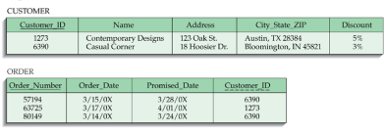
Transforming E-R Diagrams into Relations
Represent Relationships
Binary 1:N Relationships
Add the primary key attribute of the entity on the one side of the relationship as a foreign key in the relation on the many side

Slide 43
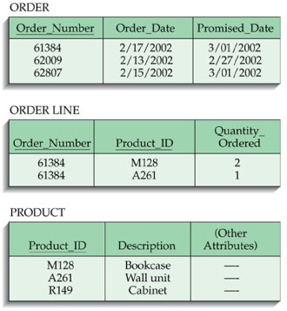
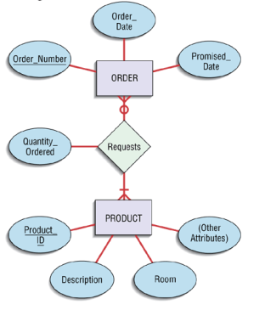
Transforming E-R Diagrams into Relations

Slide 44
Transforming E-R Diagrams into Relations
Binary 1:1 relationship
Three possible options
Add the primary key of A as a foreign key of B
Add the primary key of B as a foreign key of A
Both

Slide 45
Transforming E-R Diagrams into Relations
Represent Relationships (continued)
Binary and higher M:N relationships
Create another relation and include primary keys of all relations as primary key of new relation

Slide 46
Special Thanks to
Dr. K. M. Azharul Hasan
Dept. of CSE, KUET

