Slide 1
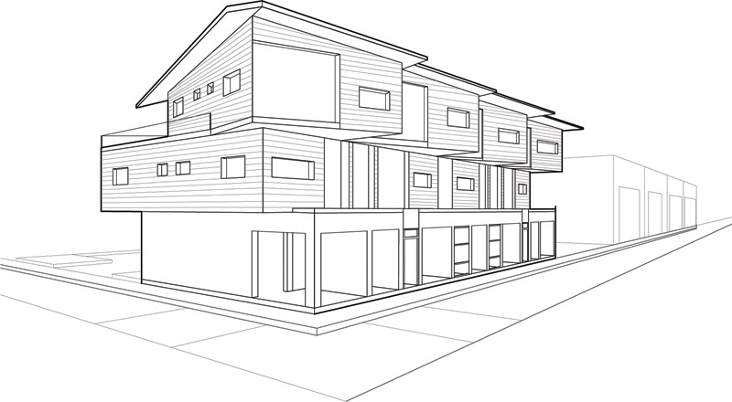
Projection

Slide 2
Projection
In general, projections transform points in a coordinate system of dimension n into points in a coordinate system of dimension less than n.
We shall limit ourselves to the projection from 3D to 2D.
We will deal with planar geometric projections where:
The projection is onto a plane rather than a curved surface
The projectors are straight lines rather than curves

Slide 3
Projections – key terms
The projection of a 3D object is defined by straight projection rays (called projectors) emanating from a center of projection, passing through each point of the object, and intersecting a projection plane to form the projection.

Slide 4
Planer Geometric Projection
2 types of projections
perspective and parallel.
Key factor is the center of projection.
if distance to center of projection is finite : perspective
if infinite : parallel -> so needs direction of projection vector
Perspective projection
Parallel projection

Slide 5
Perspective v Parallel
Perspective:
visual effect is similar to human visual system...
has 'perspective foreshortening'
size of object varies inversely with distance from the center of projection.
Parallel lines do not in general project to parallel lines
angles only remain intact for faces parallel to projection plane.

Slide 6
Perspective v Parallel
Parallel:
less realistic view because of no foreshortening
however, parallel lines remain parallel.
angles only remain intact for faces parallel to projection plane.

Slide 7
Perspective Projection-Anomalies
Perspective foreshortening The farther an object is from COP the smaller it appears
Y
Z
C
Perspective foreshortening

Slide 8
Perspective Projection-Anomalies
Vanishing Points: Any set of parallel lines not parallel to view plane (or not perpendicular to view plane normal) appear to meet at some point.
Vanishing point

Slide 9
Perspective Projection - types
Based on vanishing points
If a set of lines are parallel to one of the three axes, the vanishing point is called an axis vanishing point (Principal Vanishing Point).
There are at most 3 such points, corresponding to the number of axes cut by the projection plane
One-point / two-point / three-point perspective:
One / two / three principle axis cut by projection plane

Slide 10
Perspective Projections
1-Vanishing Point
2-Vanishing Point
3-Vanishing Point
View plane cuts only one axis
Line parallel to that axis appears to meet a point

Slide 11
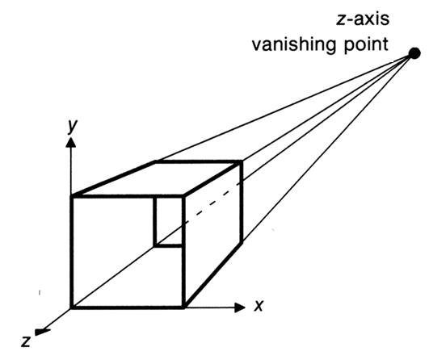
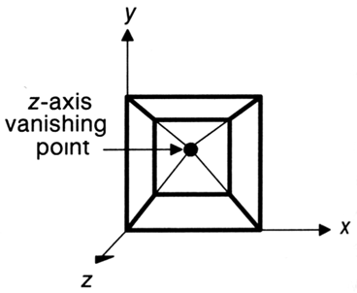
Perspective Projection
One point perspective projection of a cube
X and Y parallel lines do not converge

Slide 12
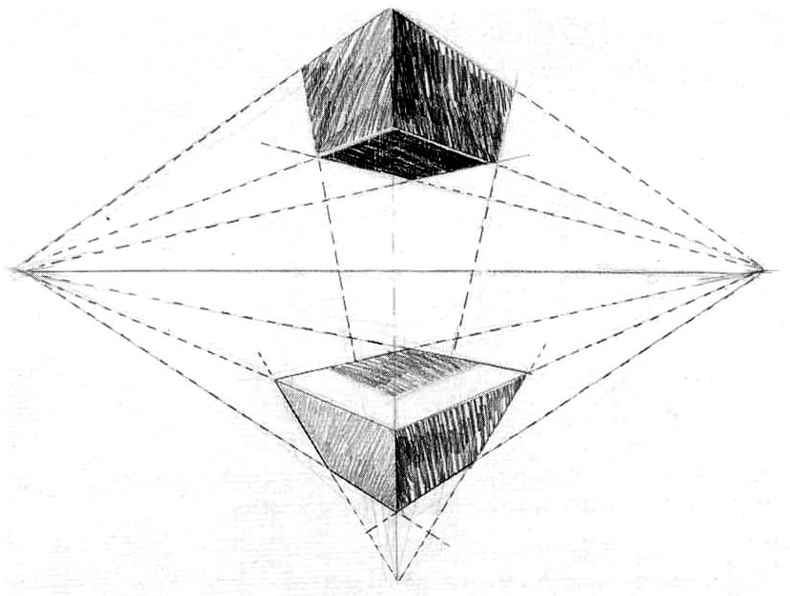
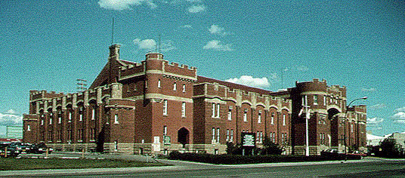
Perspective Projection
Two-point perspective:
often used in architectural, engineering and industrial design drawings.
Three-point is used less frequently as it adds little extra realism to that offered by two-point perspective projection.
VP₁
VP₂
VP₃

Slide 13
Perspective Projections

Slide 14
Parallel projection - Types
2 principle types:
on the basis of DOP, V and projection plane normal N)
Orthographic :
V and N are the same or the reverse of each other, i.e. V is perpendicular to view plane
Oblique :
direction of projection != normal to the projection plane.
z
N
Orthographic
Oblique
y
x

Slide 15
Orthographic projection
Orthographic (or orthogonal) projections:
front elevation, top-elevation and side-elevation.
all have projection plane perpendicular to a principle axes.
Useful because angle and distance measurements can be made...
However, As only one face of an object is shown, it can be hard to create a mental image of the object, even when several view are available

Slide 16
Orthographic Projections
Projection plane is perpendicular to any of the principal axis. i.e. view plane normal N = I / J / K = V
Orthographic parallel projections

Slide 17
Axonometric projection
A kind of orthographic projection
Uses projection planes that are not normal to a principal axis. On the basis of projection plane normal N = (dx, dy, dz) subclasses are:
Isometric : | dx | = | dy | = | dz | i.e. N makes equal angles with all principal axes.
Dimetric : | dx | = | dy |
Trimetric : | dx | != | dy | != | dz |

Slide 18
Axonometric projection
y
N = V
x
z

Slide 19
Oblique parallel projection
Objects can be visualized better than orthographic projections
Can measure distances, but not angles
Can only measure angles for faces of
objects parallel to the plane
Two types
Cavalier and Cabinet
Projection Plane
Projector
Projection
Plane Normal

Slide 20
Oblique Projections
α : is the angle the projection makes with x-axis
β : angle between view plane and direction of projection
l : original length of a line perpendicular to view plane
l′ : projected length of a line perpendicular to view plane
Z
V
l
y
O
β
α
l′
X

Slide 21
Oblique parallel projection
Cavalier:
l´ = l ; β = 45°
The direction of the projection makes a 45 degree angle with the projection plane.
There is no foreshortening
Length of any line perpendicular to view plane is l
The Length of projected line is also l

Slide 22
Oblique parallel projection
Cabinet:
l´ = l/2 ; β = 63.4°
The direction of the projection makes a 63.4 degree angle with the projection plane.
This results in foreshortening of the z axis, and provides a more “realistic” view

Slide 23
Oblique parallel projection
Cavalier, cabinet and orthogonal projections can all be specified in terms of (α, β) or (α, λ) since
tan(β) = 1/λ
λ sin(α)
P׳(λ cos(α), λ sin(α),0)
β
λ
α
P=(0, 0, 1)
λ cos(α)

Slide 24
Oblique parallel projection
λ=1 | β = 45 | Cavalier projection | α = 0 - 360
λ=0.5 | β = 63.4 | Cabinet projection | α = 0 – 360
λ=0 | β = 90 | Orthogonal projection | α = 0 – 360

Slide 25
Planner Geometric Projections taxonomy
N
V
Planar geometric
projections
y
Projection
Plane
COP = α
COP = d
x
COP
Parallel
Perspective
z
V = ±N
N ≠V
N, V
One-point
Orthographic
Oblique
Top
Cavalier
Axonometric
tan⁻¹(1)
Front
Two-point
Side
Cabinet
N=axis
Three-point
tan⁻¹(2)
Isometric
Trimetric
Other
Dimetric
Subclasses of planar geometric projections

