Slide 1
Sales settings
Chapter 4

Slide 2
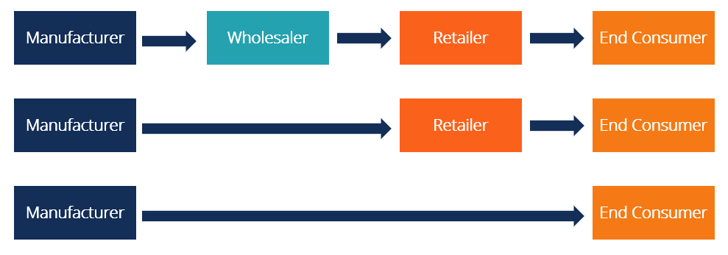
Channels of distribution
A distribution channel is a chain of businesses or intermediaries through which a good or service passes until it reaches the final buyer or the end consumer. Distribution channels can include wholesalers, retailers, distributors, and even the internet

Slide 3
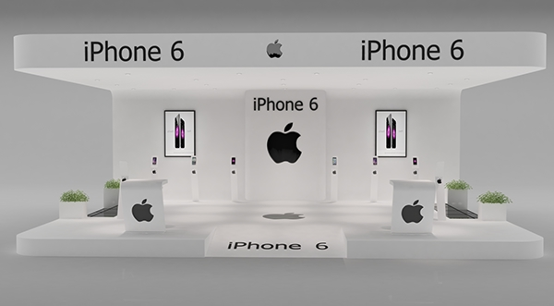
Buy class
Exhibitions are tangentially related to sales settings as the objective is not to sell from display stands, although in some circumstances (e.g. glassware and decorative ware sales from importers and manufacturers to the trade) exhibitions and trade fairs are where most business takes place. Generally speaking, their function is to build up goodwill and prepare the way for future sales.

Slide 4
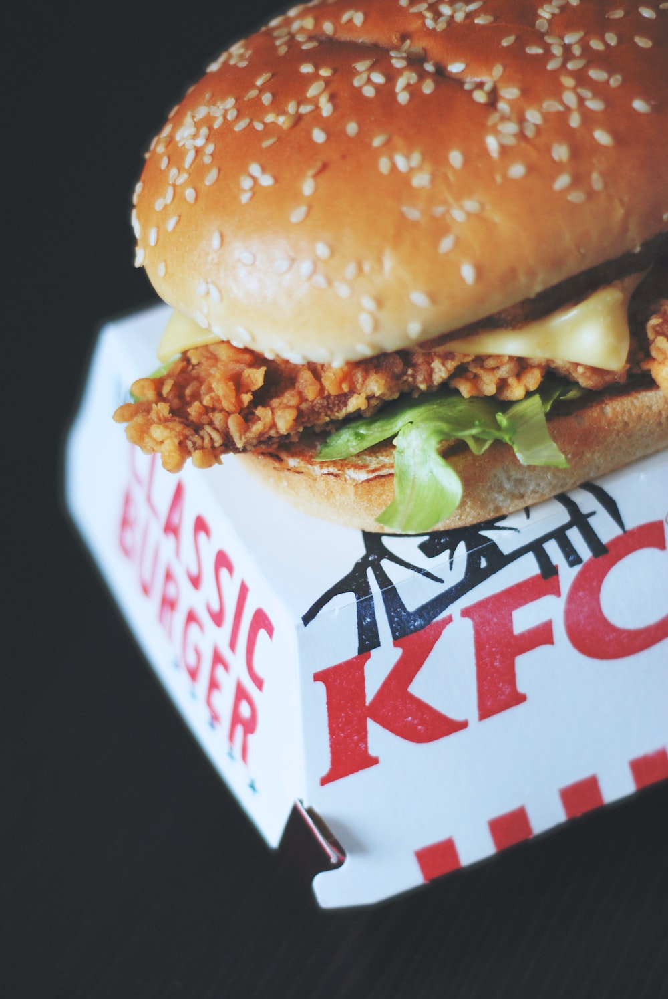
Franchising
Franchising is an arrangement where franchisor (one party) grants or licenses some rights and authorities to franchisee (another party). Franchising is a well known marketing
strategy for business expansion.
Examples of Franchising
McDonald’s, Dominos, KFC, Pizza Hut, Subway

Slide 5
Vertical marketing system
A vertical marketing system is when producers, wholesalers and retailers work in unison to meet their customers' needs. It allows one company to have control over the entire process of producing and selling a product.
Let’s take Zara, for example. The brand has complete control over all activities of the supply chain. This prevents the company from having any conflicts. Zara owns all stores, so they follow the same marketing strategy. Complete integration of all activities removes reasons for conflict between channels and stimulates maximum efficiency..

Slide 6
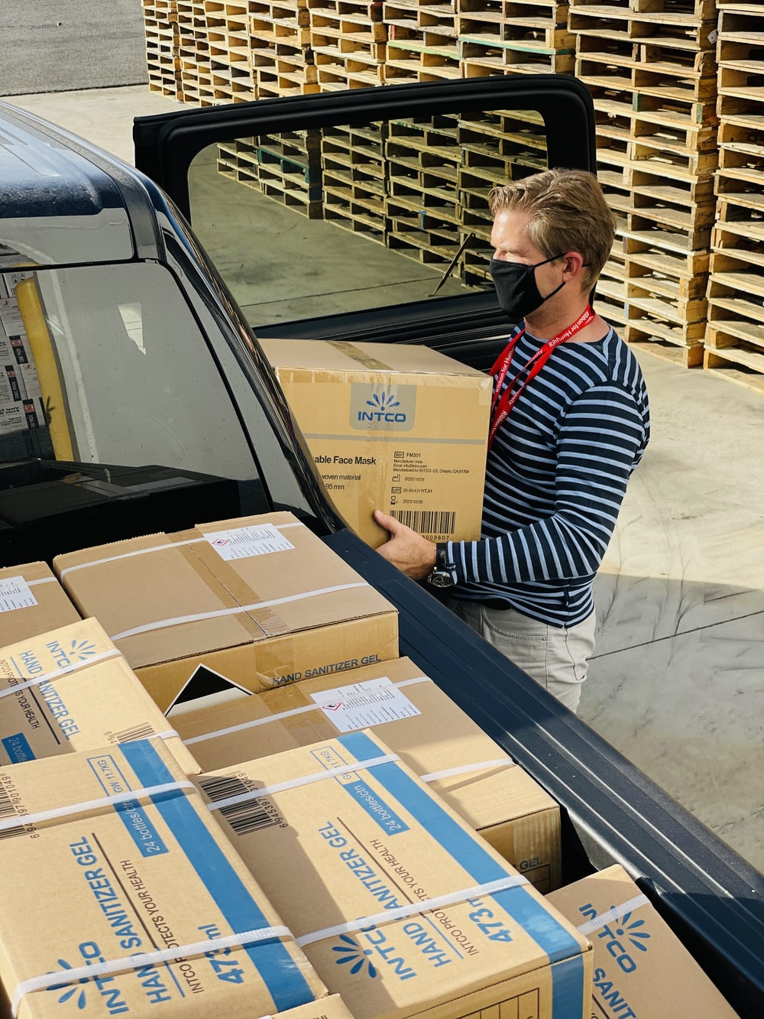
physical distribution management
Physical distribution is the science of Business Logistics where by the proper amount of the right kind of product is made available at the place where demand for its exists. Viewed in this light, physical distribution is key link between manufacturing and demand creation

Slide 7
PR is short for "public relations" and refers to the strategic communication from an organization to the public to maintain or cultivate public image and/or respond to public discourse.
public relations

Slide 8
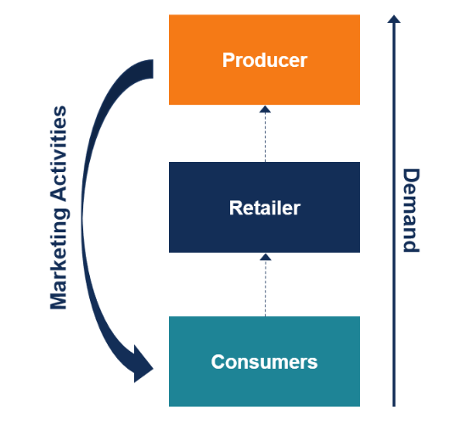
Pull techniques
A pull marketing strategy, also called a pull promotional strategy, refers to a strategy in which a firm aims to increase the demand for its products and draw (“pull”) consumers to the product. Pull marketing strategies revolve around getting consumers to want a particular product.

Slide 9
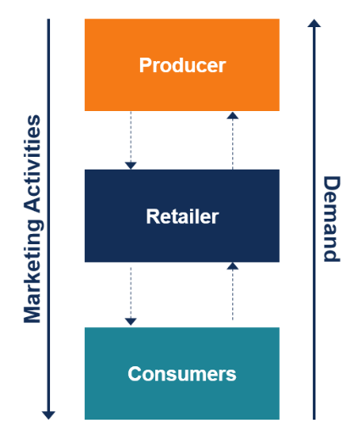
Push techniques
A push marketing strategy, also called a push promotional strategy, refers to a strategy in which a firm attempts to take its products to consumers – to “push” them onto consumers. In a push marketing strategy, the goal is to use various active marketing techniques to push their products to be seen by consumers, sometimes right at the point of purchase
Examples
Direct selling to customers – e.g., a car salesman who meets customers in the company’s auto showrooms

Slide 10
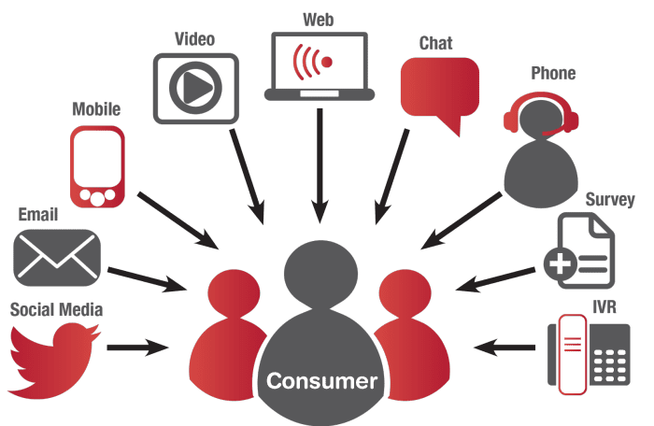
Sales channels
Sales channels are methods a business uses for selling a product or service. While some companies use a single sales channel, like third-party retail, others use a variety of channels to offer their products and services to potential customers. For example, a shoe manufacturer might sell their sneakers in black and white in shoe stores, with additional color options available on their website.

Slide 11
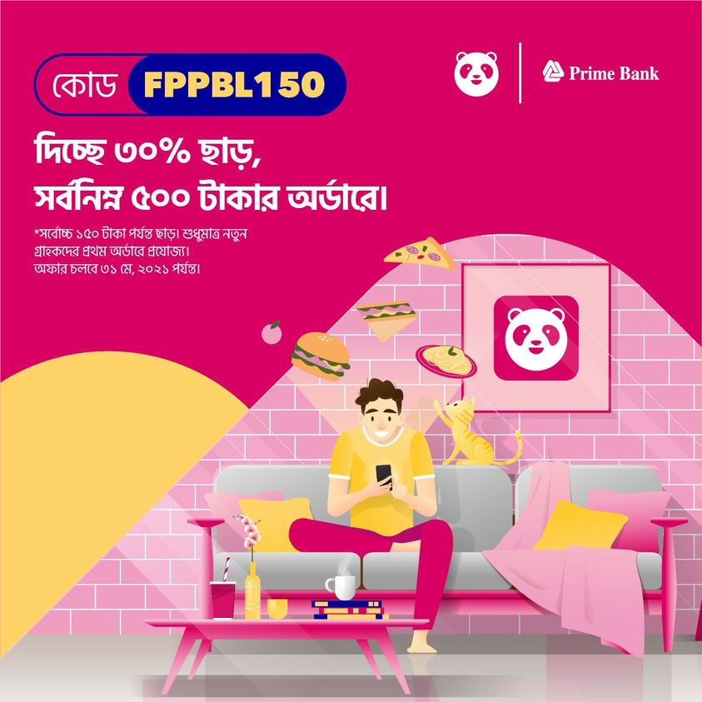
Sales promotions
A sales promotion is a marketing strategy in which a business uses a temporary campaign or offer to increase interest or demand in its product or service.
● price reductions;
● vouchers or coupons;
● gifts;
● competitions;
● lotteries;
● cash bonuses.

Slide 12
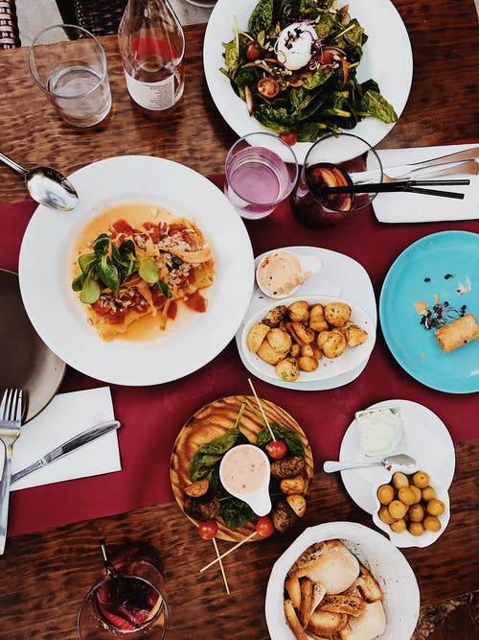
Services
Service is a transaction in which the non-physical goods are transferred from the seller to the buyer. When we talk about service, people often refer to the processes and not physical products.
● Transportation – air, sea, rail and road;
● Power – electricity, gas and coal;
● Hotels and accommodation;
● Restaurants;
● Television and radio services;
● Banking;
● Architectural;
● Cleaning;

Slide 13
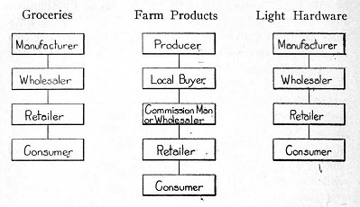
Supply chain integration
Supply chain integration denotes the process of incorporating all parties and activities involved in the delivery of the final product to the customer into one system

Slide 14
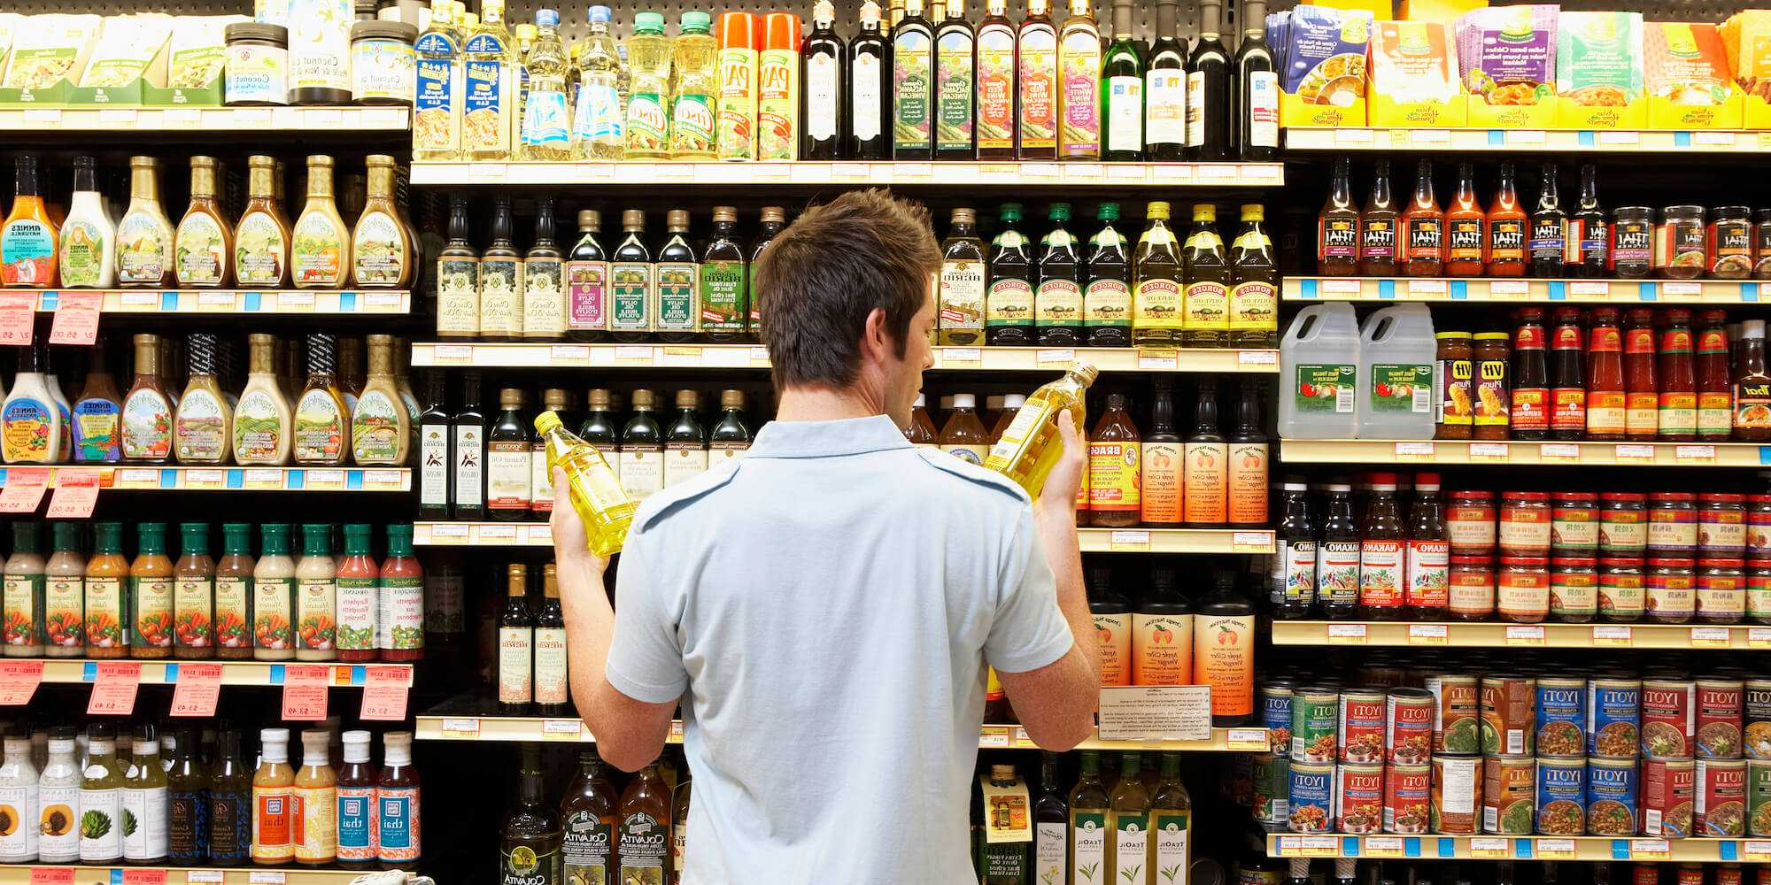
Trade marketing
Trade marketing is a wider marketing discipline that aims to increase demand with supply chain partners such as wholesalers, retailers, or at the distributor level, rather than just at the customer level.
For products which doesn't require any human intervention for effective sale such as toothpaste, batteries, etc. (where alternatives of the product are more), here the manufacturer has to give some discounts, or better margins, some freebies to ensure availability of the product.

Slide 15
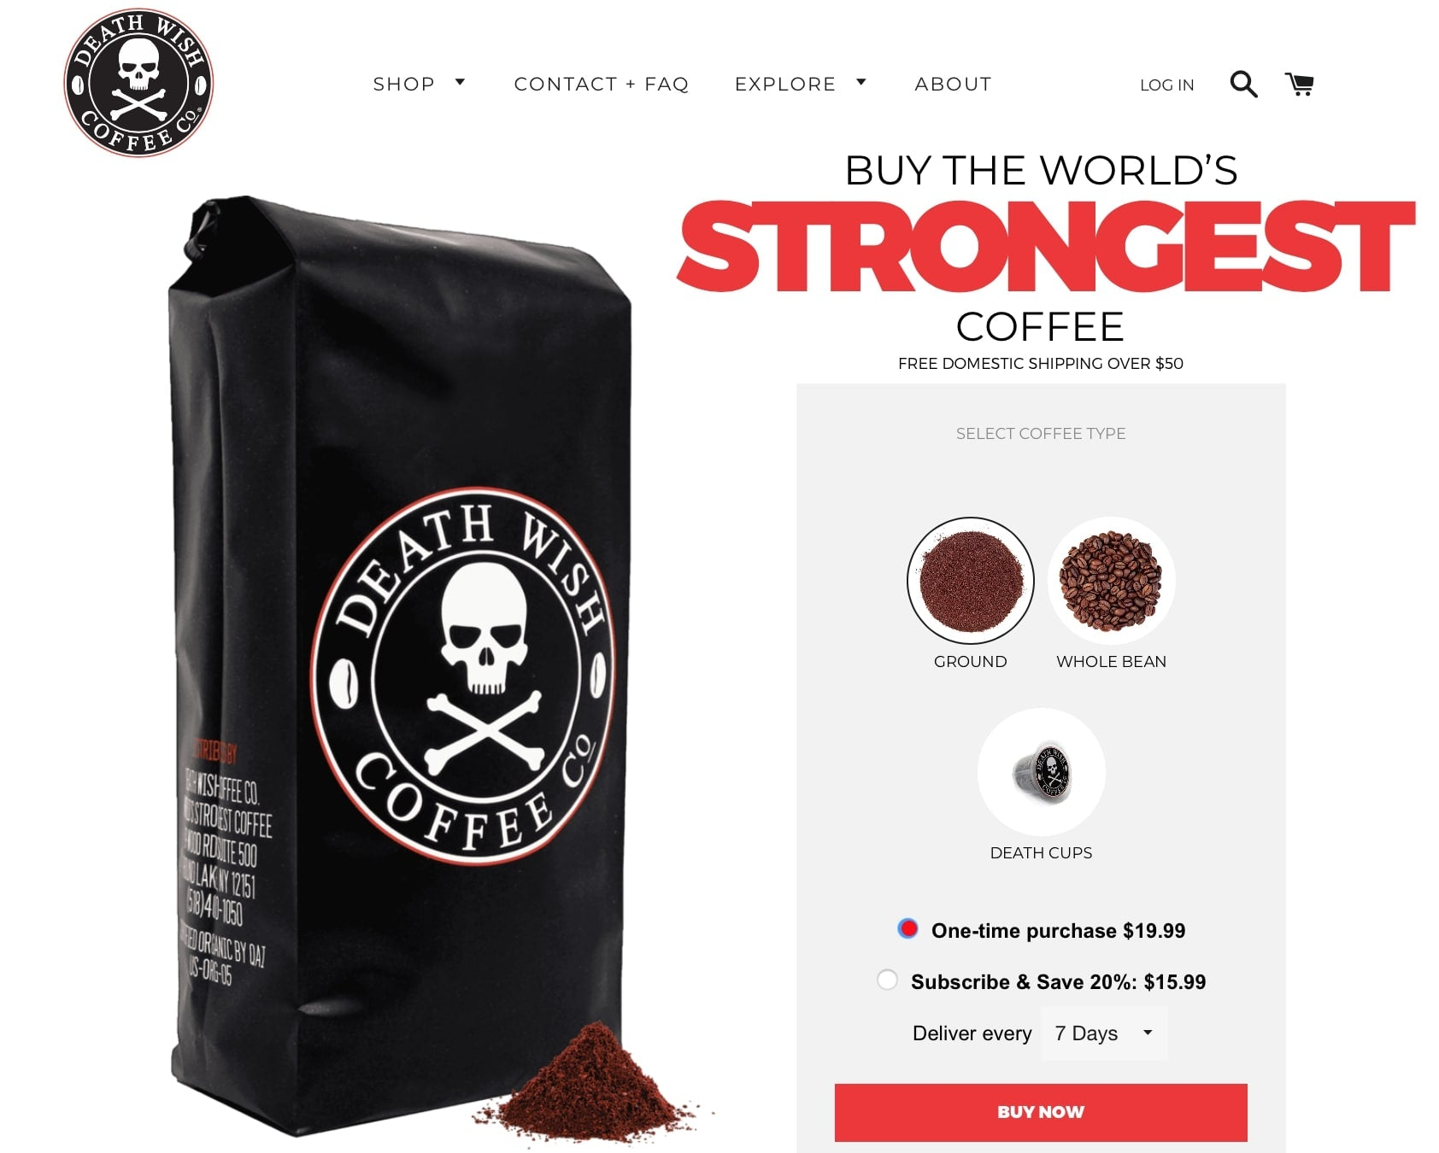
Unique sales proposition
Unique Selling Proposition or USP is the one feature or the perceived benefit of a good which makes it unique from the rest of the competing brands in the market. It is that very reason which motivates a buyer to purchase that product even though it might be costlier than other products.
A lot of coffee shops and roasters lay claim to having the “smoothest” or “richest” cup of coffee out there. Death Wish Coffee, however, chose to cater to those who need an extra kick in their cup of joe by instead selling the “world’s strongest coffee”

Slide 16
Environmental and managerial forces that impact on sales
A number of major environmental (behavioral and technological) and managerial forces impact on how selling and sales management are and will be carried out.
Behavioral forces
Technological forces
Managerial forces
Behavioral forces
Rising consumer and organizational buyer expectations;
Customer avoidance of buyer–seller negotiations;
Expanding power of major buyers;
Globalization of markets;
Fragmentation of markets.

Slide 17
Technological forces
Managerial forces
Salesforce automation;
Virtual sales offices;
Electronic sales channels.
Employing direct marketing techniques;
Improving cooperation between sales and marketing;
Encouraging salespeople to attend training programs and acquire professional qualifications.

Slide 18
Strategic customer management.
SCM is therefore an approach that allows companies to create value in key customer relationships and distribute this value through negotiation
Strategic customer management requires three activities to be performed:
Intelligence
Interfaces
Integration
Sales channels
Distribution channels involve two separate, yet closely connected, activities:
Logistics, or physical distribution management (PDM),
Channels of distribution.

Slide 19
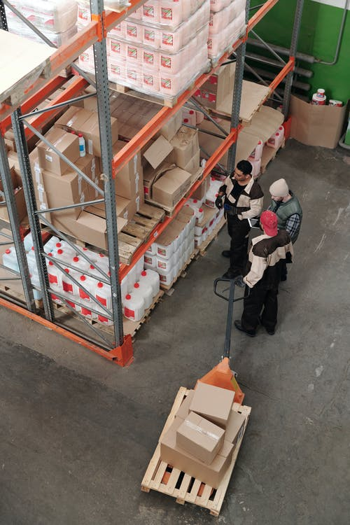
Logistics or physical distribution management (PDM)
Order processing
Materials handling
Warehousing
Inventory control
Transportation
Packaging

Slide 20
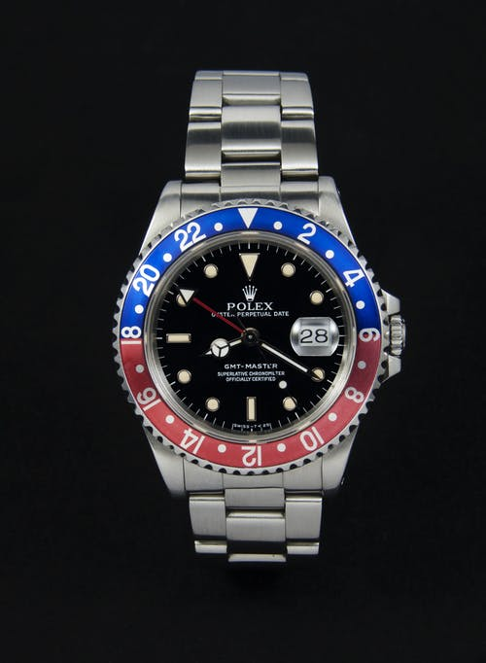
Channels of distribution
Appraising sales channels
When selecting or reappraising channels, the company must take into consideration:
The market;
Channel costs;
The product;
Profit potential;
Channel structure;
Product life-cycle;
Non-marketing factors

Slide 21
Characteristics of sales channels
A manufacturer has the choice of one of four types of distribution
Direct
Selective
Intensive
Exclusive

Slide 22
Industrial/commercial/public authority selling
Fewer customers
Concentrated markets
Complex purchasing decisions
Complex purchasing decisions
Reciprocal trading
A number of characteristics in these types of market distinguish them from consumer markets.

Slide 23
Types of production
Job (or unit or project) production:
An item is produced or constructed to individual customer requirements. Examples are ships, tailor-made suits and hospital construction.
Batch production:
A number of products or components are made at the same time, but not on a continuous basis. Product examples are books, furniture and clothes.
Flow (or mass or line) production:
This is continuous production of identical or similar products that are made in anticipation of sales. Examples are motor cars, video recorders and washing machines.
Process (or continuous) production
the production unit has raw materials coming into the manufacturing process and a finished product emerging at the end. Examples are chemicals, brewing and plastic processes.

Slide 24
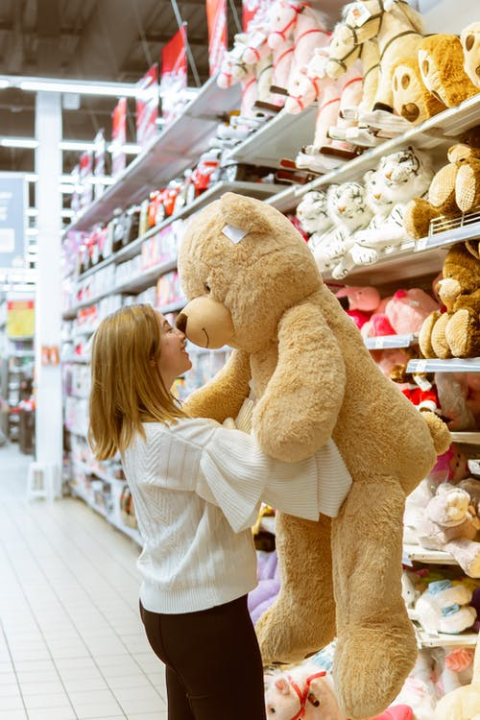
Selling for resale
Seven different types of selling outlet
Multiples
Variety chains
Co-operative societies
Department stores
Independents
Mail order
Direct selling

Slide 25
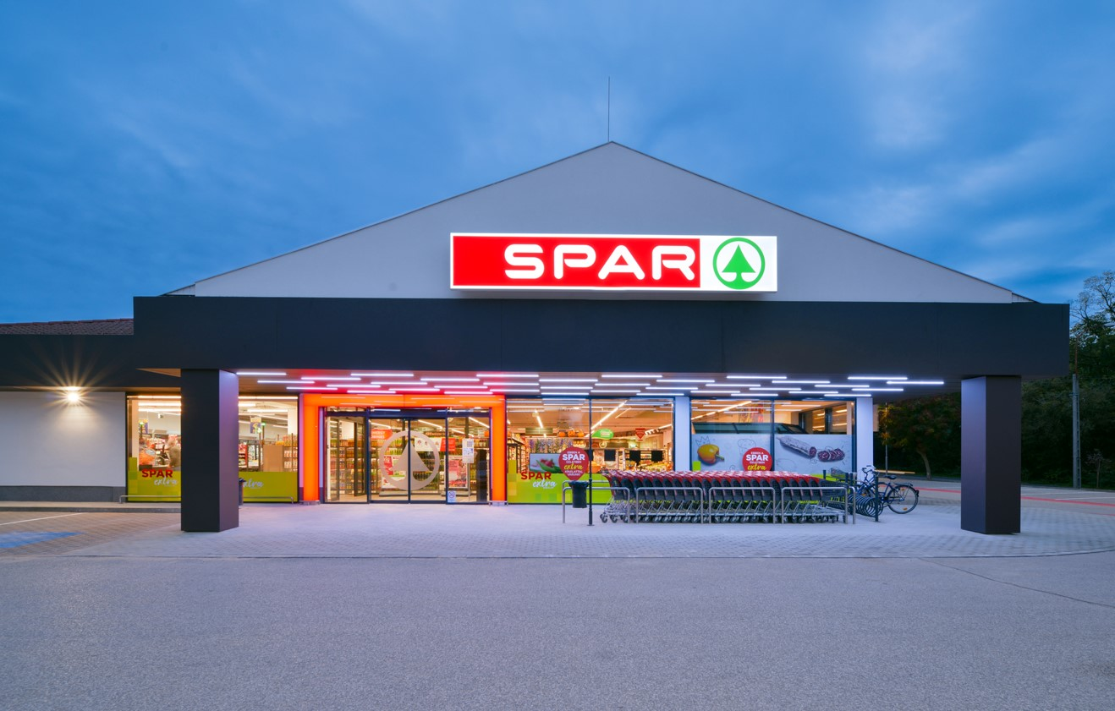
Franchising
Manufacturers to retailers
A car manufacturer (the franchisor) licenses car distributors (franchisees) to sell its products.
From manufacturers to wholesalers
Popular in the soft drinks industry, here manufacturers sometimes supply concentrate (i.e. the ‘secret recipe’) which wholesalers then mix with water and bottle for distribution to local retail outlets (e.g. Pepsi Cola, Coca-Cola).
From wholesalers to retailers
The most successful example is the voluntary group ‘SPAR’, which does not manufacture, but its large wholesale buying power means it can pass on cost savings to independent retailers who join the group and display the SPAR logo. ‘SPAR – your eight ’till late shop’.

Slide 26
Service firm sponsored franchises to retailers
This area has achieved the largest growth over recent years. Examples are found in the fast food business (e.g. Burger King, McDonald’s, Little Chef, KFC, Spud-U-Like, Pizza Hut)
Franchising arrangements have a common set of procedures:
The franchisor offers expert advice on such matters as location, finance, operational matters and marketing.
he franchisor promotes the image nationally or internationally and this provides a well recognized name for the franchisee.
Many franchise arrangements have a central purchasing system where franchisees buy at favorable rates or where a successful ‘formula’ is central to the operation of the franchise (e.g. KFC).
The franchisor often provides initial start-up and then continuous training to the franchisee.
A franchise arrangement normally requires the franchisee to pay a royalty or franchise fee to the franchisor.

Slide 27
Trade promotions
The aim is usually to push products through the channel towards the customer. Incentives are offered through extra rewards such as discounts, increased margins on sales, dealer competitions, exhibitions, provision of demonstrators and free holidays (often in the guise of a conference or product launch).
The objectives of retailer–distributor promotions are:
To achieve widespread distribution of a new brand;
To move excess stocks onto retailers’ shelves;
To achieve required display levels of a product;
To encourage greater overall stockholding of a product;
To encourage salespeople at distributor levels to recommend the brand – particularly in the case of non-consumer products;
To encourage support for overall promotional strategy.

Slide 28
Personnel motivation
These are promotions to the salesforce, but some apply to distributors and retailers. The most widely used salesforce promotion is the sales incentives scheme. Rewards are offered to participants on an equal basis which are over and above normal sales compensation. They can be prizes in a competition to individuals or groups who perform best against specific objectives.
When establishing a salesforce incentive scheme one must consider objectives, timing, scoring methods and prizes/rewards. Typical objectives of such schemes include:
Introduction of a new product line;
Movement of slow-selling items;
To obtain wider territory coverage;
Development of new prospects;
To overcome seasonal sales slumps;
To obtain display;
Development of new sales skills.

Slide 29
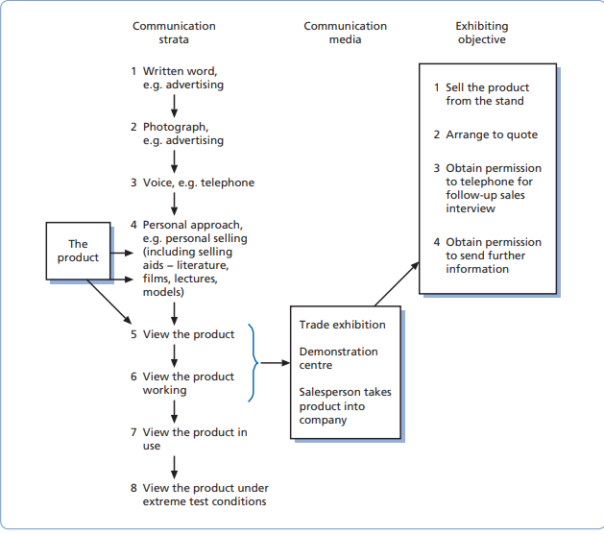
A model of the exhibition communication process

Slide 30
Objectives of public relations
Attract sales inquiries;
Reinforce customer loyalty;
Attract investors;
Attract merger partners or smooth the way for acquisition;
Attract better employees;
Minimize competitor advantage while you catch up;
Open a new market;
Launch a new product;
Reward key people with recognition;
Bring about favorable legislation;
Change perceptions about the company;
Alter the image that the company projects about itself.

Slide 31
External PR activities can be grouped as follows
Freelance writers/consultants: who are generally technical authors able to produce PR feature articles.
PR departments of advertising agencies: these can vary from a small press office handling product publicity to augment an advertising campaign, to a large comprehensive PR department not unlike the agency set-up itself.
PR subsidiary of an advertising agency: where there is a desire to permit a fuller development of PR activity on the part of the advertising agency and, indeed, whose clients will provide a useful source of potential business.
Independent PR consultants: who usually specialize in a particular class of business, which clients can take advantage of for ad hoc or short-term assignments.

