Slide 1
Artificial Intelligence and Job Market : Preparing Students for the Future

Slide 2
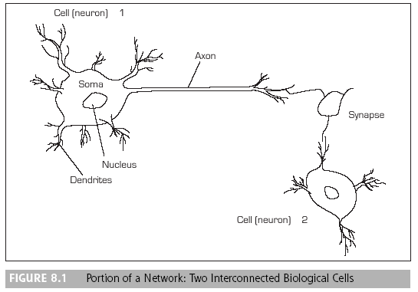
Artificial Neural Network
Computer technology that attempts to build computers that will operate like a human brain. The machines possess simultaneous memory storage and works with ambiguous information
Figure: Portion of a Network of Two Interconnected Biological Cells
Figure: Portion of a Network of Two Interconnected Biological Cells

Slide 3
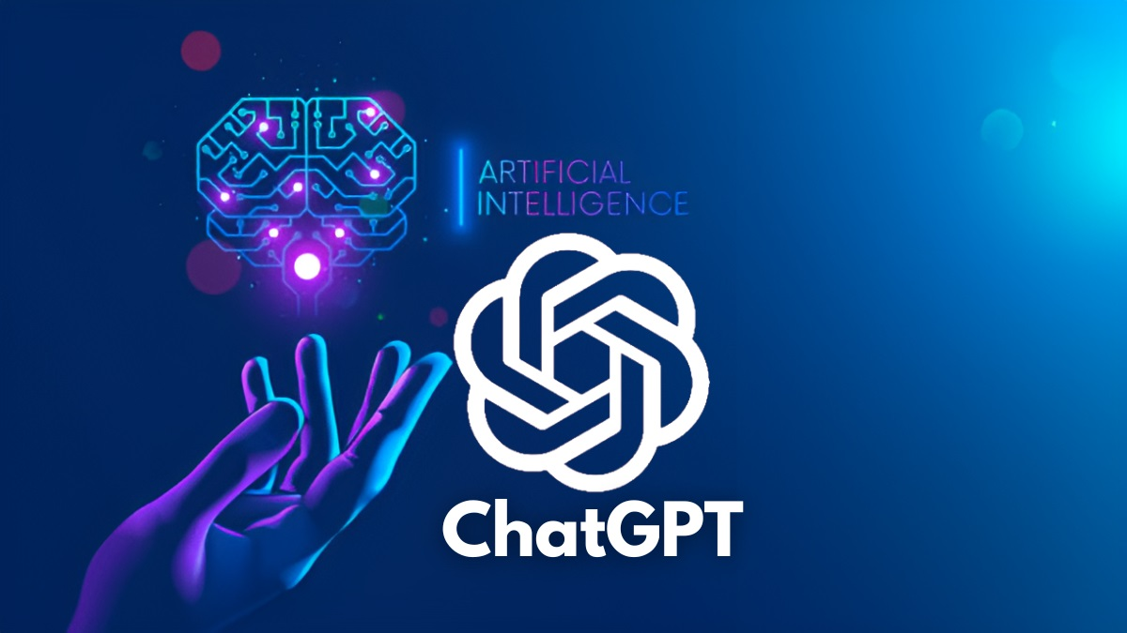
Introducing ChatGpt

Slide 4
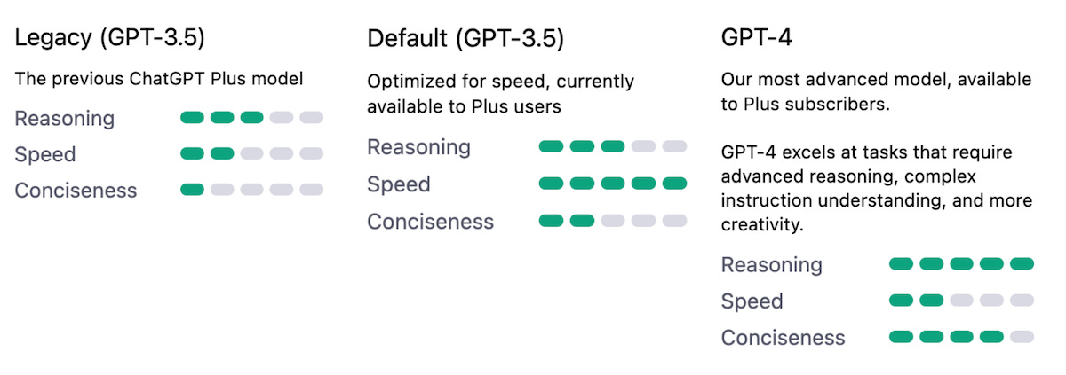

Slide 5
Introducing Bing

Slide 6
Bing Speech
Converting Speech to Text and Vice Versa
Speech to Text: Convert spoken words into text
Bing AI uses machine learning to recognize and transcribe speech
Text to Speech: Convert text into spoken words
Bing AI uses natural language processing to generate human-like speech
Applications: Personal assistants, customer service, and more

Slide 7
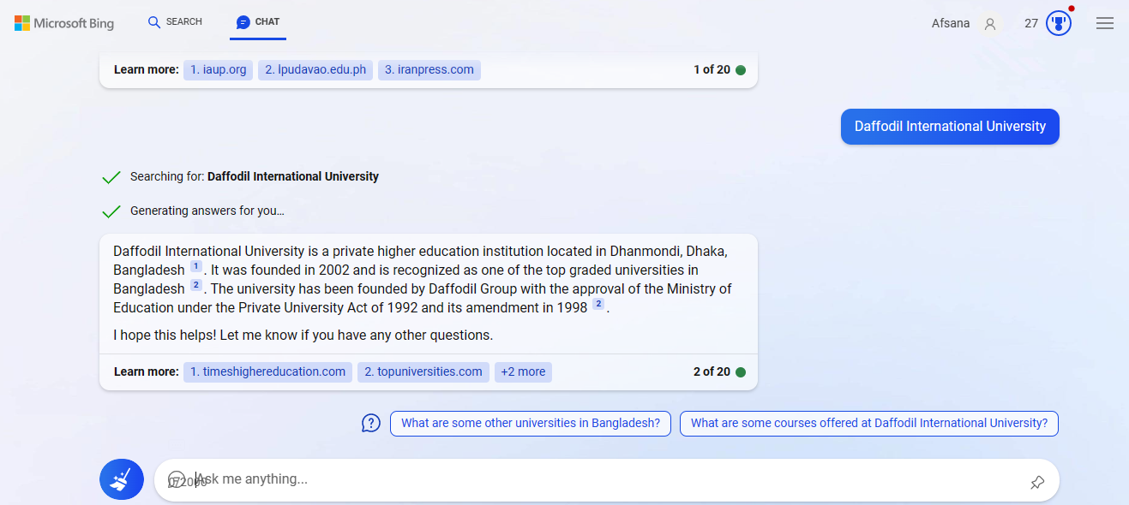
Bing Autosuggest
Suggesting Search Terms
Search Suggestions: Suggest search terms as users type
Bing AI uses machine learning to suggest relevant search terms
Query Expansion: Expand queries to improve search relevance
Bing AI can analyze user behavior to improve search results
Applications: Improving search relevance and efficiency

Slide 8
Bing vs ChatGPT
Notes:
In this presentation, we will compare and contrast the search engines Bing and ChatGPT. We will examine their functionality, user experience, search algorithms, search results, user interface, language support, advertising options, voice search capabilities, image search functionality, integration with other services, security and privacy features, and user feedback. By the end of this presentation, you will have a better understanding of the differences between these two search engines and which one is best for different use cases.

Slide 9
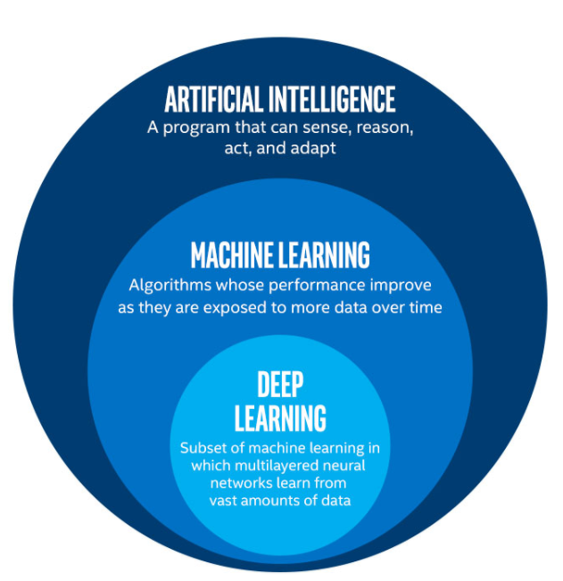
Search Algorithms
How do search algorithms work?
Bing: Uses a combination of machine learning and human curation to deliver search results
Bing's algorithm is designed to prioritize high-quality content and authoritative sources
ChatGPT: Uses a deep learning model to generate search results
ChatGPT's algorithm is designed to understand natural language queries and provide relevant results
‎
Notes:
Search algorithms are the backbone of any search engine. Bing and ChatGPT use different approaches to generate search results, with Bing relying on a combination of machine learning and human curation, and ChatGPT using a deep learning model. Understanding how these algorithms work can help you to better understand the search results you receive and how to optimize your content for search engines.

Slide 10
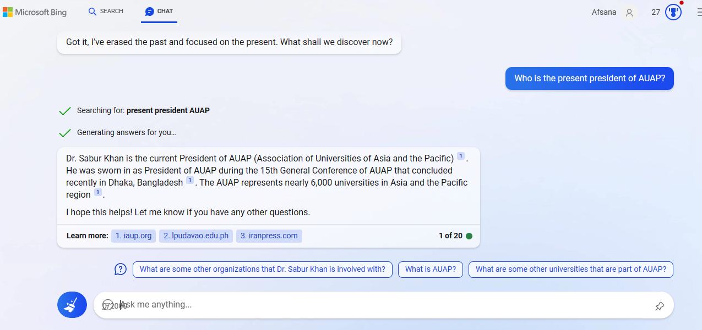
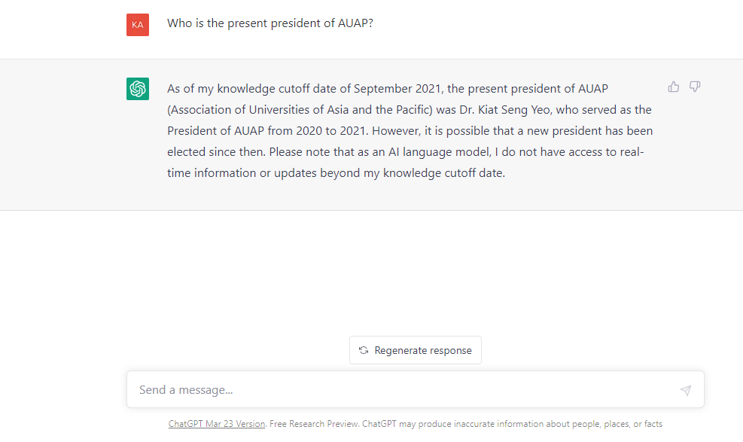
Current Issues

Slide 11
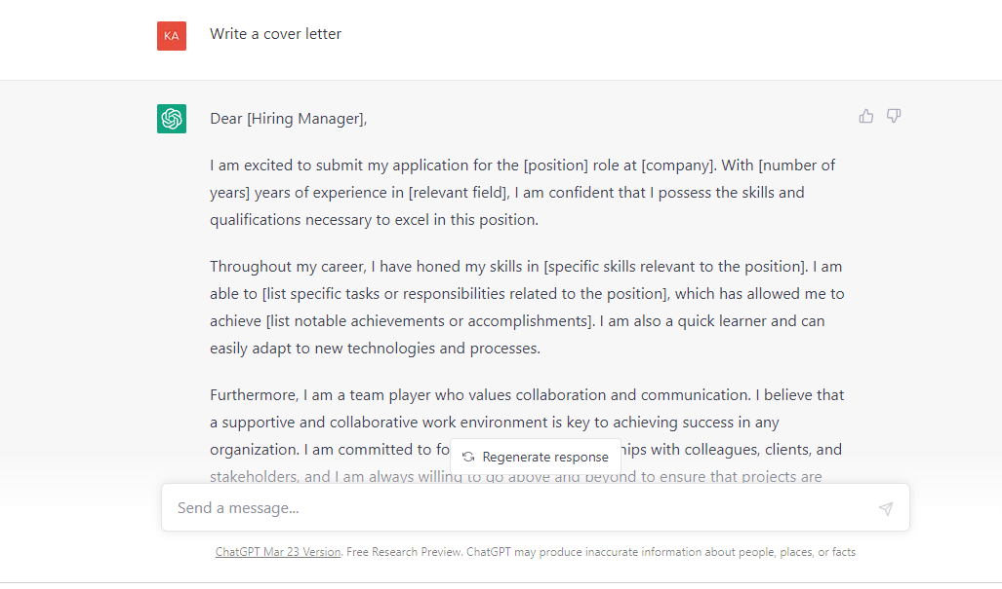
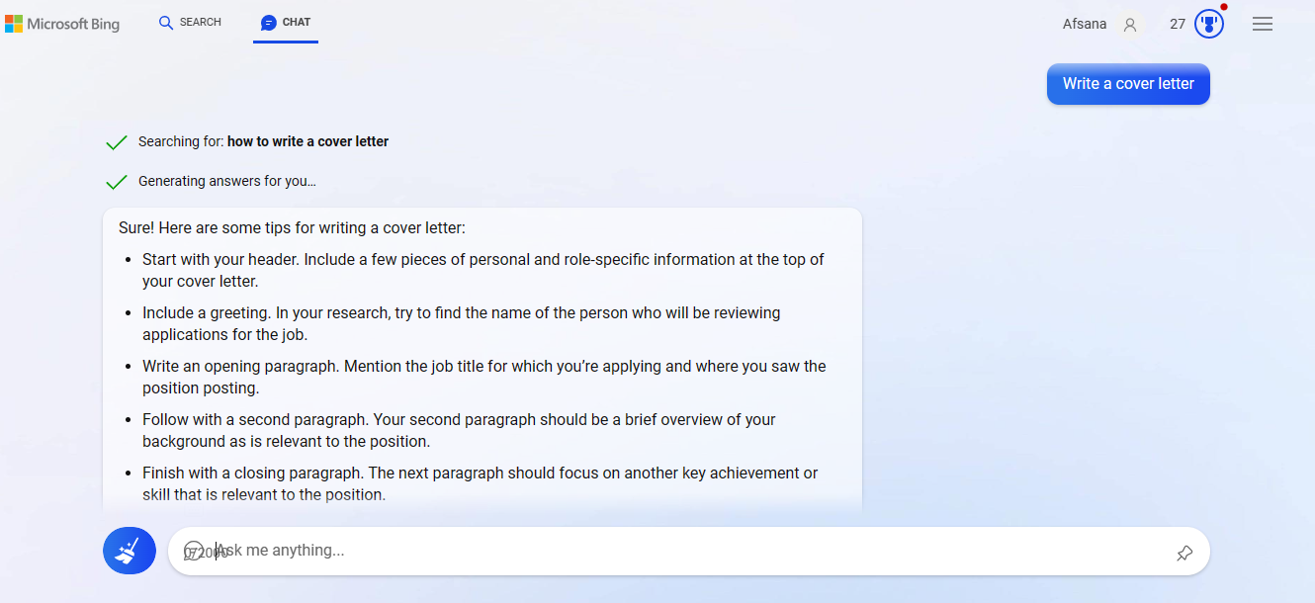
Conversation Types

Slide 12
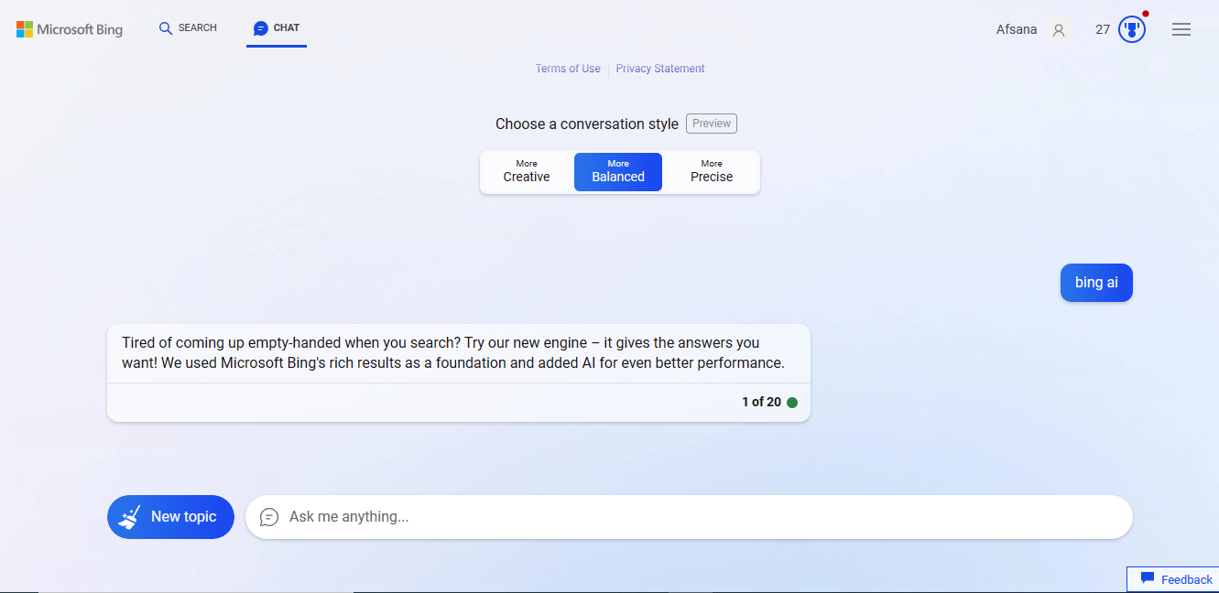
Conversation Style

Slide 13
Language Support
How do Bing and ChatGPT compare in terms of language support?
Bing: Supports over 100 languages and offers translation services for many of them
Bing's translation services are powered by Microsoft Translator
ChatGPT: Supports multiple languages and can generate search results in different languages
ChatGPT's language support is based on its deep learning model, which can understand and generate natural language in multiple languages
‎
Notes:
Language support is an important consideration for users who need to search for content in different languages. Bing and ChatGPT both offer language support, with Bing supporting over 100 languages and offering translation services, and ChatGPT using its deep learning model to understand and generate natural language in multiple languages. Understanding the differences between these language support options can help you to choose the search engine that best meets your needs.

Slide 14
Advertising
How do Bing and ChatGPT compare in terms of advertising options?
Bing: Offers a range of advertising options, including search ads, display ads, and shopping ads
Bing's advertising platform is designed to be easy to use and offers targeting options based on location, device, and demographics
ChatGPT: Does not currently offer advertising options
‎
Notes:
Advertising is an important consideration for businesses that want to reach potential customers through search engines. Bing and ChatGPT have different approaches to advertising, with Bing offering a range of advertising options and ChatGPT not currently offering any advertising options. Understanding the differences between these advertising options can help you to choose the search engine that best meets your business needs.

Slide 15
Voice Search
How do Bing and ChatGPT compare in terms of voice search capabilities?
Bing: Offers voice search capabilities through its mobile app and Microsoft's virtual assistant, Cortana
Bing's voice search is designed to be fast and accurate, with support for natural language queries
ChatGPT: Offers voice search capabilities through its conversational interface
ChatGPT's voice search is designed to be more conversational and interactive than traditional voice search
‎
Notes:
Voice search is becoming an increasingly popular way for users to interact with search engines. Bing and ChatGPT both offer voice search capabilities, with Bing offering voice search through its mobile app and virtual assistant, Cortana, and ChatGPT offering voice search through its conversational interface. Understanding the differences between these voice search options can help you to choose the search engine that best meets your needs.

Slide 16
Image Search
How do Bing and ChatGPT compare in terms of image search functionality?
Bing: Offers a range of image search options, including image search by color and image search by license
Bing's image search is designed to be fast and accurate, with support for natural language queries
ChatGPT: Does not currently offer image search functionality
‎
Notes:
Image search is an important consideration for users who need to find images for their projects or presentations. Bing and ChatGPT have different approaches to image search, with Bing offering a range of image search options and ChatGPT not currently offering any image search functionality. Understanding the differences between these image search options can help you to choose the search engine that best meets your needs.

Slide 17
Which search engine is best for different use cases?
Bing: Best for users who prioritize accuracy and relevance in their search results, and who value a clean and simple user interface
ChatGPT: Best for users who prefer a conversational and interactive search experience, and who value natural language processing and understanding
Notes:
In conclusion, Bing and ChatGPT are both powerful search engines with different strengths and weaknesses. By understanding the differences between these search engines in terms of search algorithms, search results, user interface, language support, advertising options, voice search capabilities, image search functionality, integration with other services, security and privacy, and user feedback, you can choose the search engine that best meets your needs. Whether you prioritize accuracy and relevance, or prefer a conversational and interactive search experience, there is a search engine that is right for you.

Slide 18
Introducing Pictory AI

Slide 19
Types of Videos
Product demos: Videos that showcase the features and benefits of a product or service
Explainer videos: Videos that explain complex concepts or processes in a simple and engaging way
Social media ads: Short videos designed to capture attention and drive engagement on social media platforms

Slide 20
Pictory.AI Features
Customizable templates: Choose from a variety of templates to create a professional-looking video
Auto-synced captions: Automatically add captions to your video for improved accessibility and engagement
Voice-over options: Record your own voice-over or choose from a selection of pre-recorded options
Significance of music and sound effects: Music and sound effects can help to create a specific mood or emotion
Tips for selecting appropriate tracks: Choose tracks that are appropriate for your audience and message

Slide 21
Editing Techniques
Adjusting video speed: Speed up or slow down your video to create a specific effect
Adding transitions: Use transitions to create a smooth flow between different scenes or shots

Slide 22
Introducing SlidesGPT

Slide 23
Customization
Templates: SlidesGPT offers a range of templates to choose from, including different styles and designs.
Styles: SlidesGPT allows you to customize the style of your slide deck, including fonts, colors, and backgrounds.
Layouts: SlidesGPT offers a range of layouts to choose from, including different arrangements of text and images.

Slide 24
Use cases
Business: SlidesGPT offers a range of templates for business presentations, including sales pitches and investor decks.
Education: SlidesGPT offers a range of templates for educational purposes, including lesson plans and student presentations.
Personal: SlidesGPT offers a range of templates for personal projects, including wedding slideshows and family photo albums.

Slide 25
Content Creation
Text: SlidesGPT can generate text for your slide deck, including headlines, bullet points, and captions.
Images: SlidesGPT can generate images for your slide deck, including charts, graphs, and diagrams.
Graphs: SlidesGPT can generate graphs for your slide deck, including bar charts, line charts, and pie charts.

Slide 26
Integrations
Google Drive: SlidesGPT can be integrated with Google Drive, making it easy to access and share your slide decks.
Dropbox: SlidesGPT can be integrated with Dropbox, making it easy to access and share your slide decks.
Microsoft Office: SlidesGPT can be integrated with Microsoft Office, making it easy to import and export your slide decks.

Slide 27
Pricing
Free: SlidesGPT offers a free plan with limited features.
Pro: SlidesGPT offers a pro plan with additional features, including more templates and customization options.
Enterprise: SlidesGPT offers an enterprise plan with additional features, including custom branding and dedicated support.

Slide 28
Introducing Dall-E 2

Slide 29
How Dall-E 2 Works
Dall-E 2 uses the GPT-3 language model to understand textual descriptions
It then generates images at high resolution using a transformer-based neural network
The model is trained on a large dataset of images and textual descriptions

Slide 30
Applications of Dall-E 2
Art: Dall-E 2 can be used to generate unique and creative images for art projects
Design: The model can be used to create product designs and prototypes quickly and efficiently
Advertising: Dall-E 2 can be used to generate images for advertising campaigns that are tailored to specific audiences

