Slide 1
Topic-6
Time, Stress & Productivity Management

Slide 2
The Pareto Principle’s (80/20 rule) Dynamics
The 80 20 rule, otherwise known as the Pareto Principle, is one of the most helpful concepts for life and time management.
The Pareto Principle states that 20 percent of your activities will account for 80 percent of your results.
The key to following the 80/20 rule is to identify that roughly 20 percent of your actions or most productive tasks lead to the most success.
This can apply to any area of your professional and personal life.

Slide 3
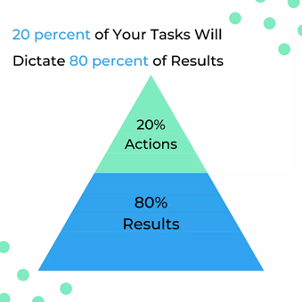

Slide 4
Pareto Principle in Time Management
Entrepreneurs, small business owners, and self-employed individuals often feel they must work excessive hours to produce profits and avoid working for someone else. This type of behavior creates a skewed work-life balance that can become unhealthy, lead to burnout, decrease productivity, and even give up on goals that once seemed so important.
To avoid this cycle, it is better to identify the 20 percent of tasks related to creating income that leads to the highest payoff. This includes what pays well now as what will pay off the highest dividends down the road. With the time you save on your work tasks by using the 80 20 principles, you have more time to devote to personal enrichment, relaxation, exercise, mental health, and relationship building.

Slide 5
Pareto Principle in Business Management
When you manage a business, team, or project, it is possible that 80 percent of the work that is completed gets done by 20 percent of the people involved.
Use the principles of Pareto analysis to determine who your most productive workers are. Task them with the most important items. Put them in leadership positions so they can teach others the same principles they follow.
Observe and interview these team members. Identify the unique traits, skills, and habits they have that lead to their productivity. Use this knowledge to train other staff members and thus improve the productivity of your entire team.

Slide 6
Pareto Principle in Goal Setting
Thinking about using the Pareto Principle when it comes to goal setting? Smart choice! Here is what you should do in order to effectively apply the Pareto Principle to setting SMART goals that will boost your overall productivity.
First, take a piece of paper and write down ten goals. Then ask yourself: If you could only accomplish one of the goals on that list today, which one goal would have the greatest positive impact on your life?
Then pick the second most important goal. What you will find is, after you complete this exercise, you will have determined the most important 20 percent of your goals that will help you more than anything else. You should continue to work at those goals that you have chosen as the most valuable of all time.

Slide 7
80/20 Rule in Problem Solving
Use these steps and key tools when applying the Pareto Principle to problem-solving:
Create a list of problems you are facing in your situation.
Determine what is causing each problem, particularly the root cause.
Give a score to each problem by listing them in order of importance. Those that are impacting your progress the most are the most important ones (the 20 percent) to solve first.
Organize your list of problems in groups according to those that have the same causes.
Add up the scores in each group. The group that has the highest score is your highest priority.
Start brainstorming solutions to this problem group and act.

Slide 8
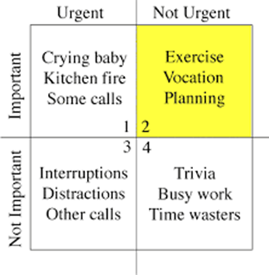
Covey's Urgency versus Importance matrix
The Covey Time Management Matrix is a framework for prioritizing your time and tasks for optimized efficiency and productivity. Created by Steven Covey, author of The Seven Habits of Highly Effective People, this model uses a four-quadrant system to help you categorize each task, responsibility and facet of your life based on:
Urgency: Tasks and responsibilities requiring immediate action or attention
Importance: Those with high significance or value to goals

Slide 9
Quadrant 1: Urgent and important
Q1 involves responsibilities or tasks related to critical results and require urgent attention. The items in this quadrant may also be stressors due to their urgency and importance, so being aware of these tasks and categorizing them accordingly can ensure you focus the necessary time and effort on them. Items that fall into Q1 have the following qualities:
Impending deadlines
Direct relation to time-sensitive goals
Involve alleviating immediate risk

Slide 10
Quadrant 2: Not urgent but important
Q2 involves focusing on activities to develop a sense of discipline and commitment, as well as identifying and working on things you can control. Some Q2 items may have the following qualities:
Require planning or additional steps
Direct relation to overall goals

Slide 11
Quadrant 3: Urgent but not important
Activities in Q3 are urgent and assume some form of importance in the moment. These are likely items that can be reduced or removed from your workflow. They likely have some of the following qualities:
Result of poor planning of items in Q1 and Q2
Interrupting productivity
Distraction

Slide 12
Quadrant 4: Not urgent and not important
Tasks in Q4 are more likely able to be removed completely or reduced. It is important to identify which items belong in this quadrant so you know which tasks to classify as lowest priority. These items typically have the following qualities:
Cause the least amount of stress
Not directly related to overall or time-sensitive goals
This quadrant is located bottom right in the matrix.

Slide 13
How to use the Covey Time Management Matrix
List the tasks you need to complete:
Include deadlines
Identify the most urgent tasks
Organize by importance
Place tasks in the correct quadrant
Assess your productivity

Slide 14
Discovering Self-Time Management Personality Profile

Slide 15
The Firefighter
Are you the type of person who runs towards a crisis while others are fleeing? Do you rush from fire-to-fire while glued to your phone? And, do loathe wasting time? If this type of rushing sounds like you, then you are a firefighter personality. When everything feels like a “crisis,” it can cause you some personal difficulty.
The solution: Identify and prioritize your tasks by urgency and importance

Slide 16
The Multitasker
Multitaskers believe they can juggle multiple things at once. They honestly believe that they can seamlessly bounce from task-to-task quickly and cross-off items on their to-do-list faster. Trying to multitask leads to many incomplete tasks, many mistakes, and more than likely less will be accomplished.
The solution: Single-tasking

Slide 17
The Over-Committer
The over-committer type personality is the person who does not know how to say “no” to others — and they have trouble establishing boundaries. As a result, they are continually putting other people’s priorities ahead of their own.
The solution: Stop saying “yes.”

Slide 18
The Underestimator
Are your famous last words “this will only take a minute.” Next thing you know, you have just spent several hours on something that you thought would only take you under an hour to complete. At first this underestimating may not seem like the end of the world. Eventually, however, underestimating postpones or pushes back each commitment you have planned. Now you are missing deadlines, asking others to reschedule their calendar to accommodate you — and you will always playing catch-up.
The Solution: Realize that things take longer than planned.

Slide 19
The Perfectionist
There is a big difference between giving a 110 percent and being compulsive about how you cross every “t'” and dot each “i.” Eventually, because you are obsessed with perfection, you will end up spending way too much time on a specific task. Like the under-estimators, you start missing deadlines and delaying other priorities.
Perfectionists do not merely struggle with time management — they also experience feelings of being burned-out mentally and emotionally exhausted.
The Solution: Overcome your perfectionism.

Slide 20
The Wild Procrastinator
Are you indecisive or get a thrill out of pushing things off until the 11th hour? Regardless of the reason, procrastinators wait until the last minute to get things done. They even go so far as to say that this is beneficial. Some procrastinators claim that working under pressure makes them more efficient, reduces unnecessary efforts, and gives you more time to develop ideas. It also does not tie you down to scheduling every second of your calendar. However, there are significant costs to procrastination.
The Solution: Don’t procrastinate

Slide 21
Thank you!

