Slide 1
WAP(Wireless Application Protocol)
Md Assaduzzaman Lecturer, CSE DIU

Slide 2
Content
The WAP Architecture
Wireless Application Environment

Slide 3
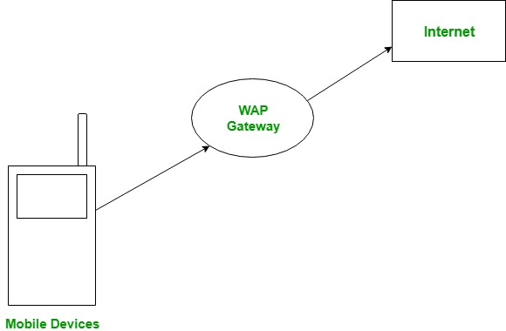
WAP
A Wireless Application Protocol (WAP) is a specification for a set of communication protocols to standardize the way wireless devices, such as mobile phones and radio transceivers, can be used for internet access, including email, the web, newsgroups and instant messaging.
While internet access was possible before the introduction of WAP, different manufacturers have used varying technologies; WAP promised interoperability between these technologies

Slide 4
WAP Model:
The user opens the mini-browser in a mobile device. He selects a website that he wants to view. The mobile device sends the URL encoded request via network to a WAP gateway using WAP protocol.
The WAP gateway translates this WAP request into a conventional HTTP URL request and sends it over the internet. The request reaches to a specified Web server and it processes the request just as it would have processed any other request and sends the response back to the mobile device through WAP gateway in WML file which can be seen in the micro-browser.

Slide 5
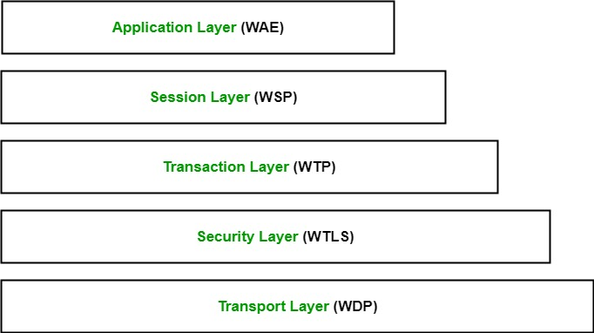
WAP Protocol stack:

Slide 6
WAP Protocol stack:
Wireless Application Environment (WAE) for mobile device specifications and programming languages such as WML;
Wireless Session Protocol (WSP), which manages connection suspensions and reconnections;
Wireless Transaction Protocol (WTP), which manages transaction support for requests and responses to servers;
Wireless Transport Layer Security (WTLS) for managing privacy, authentication and data integrity through public key cryptography; and
Wireless Datagram Protocol (WDP), which is an adaptation layer for consistent data formats in the other layers, and it defines how data flows to the sender, from the receiver

Slide 7
Wireless Application Environment (WAE)
Wireless Application Environment (WAE), the uppermost layer in the WAP stack, provides an environment that enables a wide range of applications to be used on the wireless devices. The following specifications are part of the W AE: Wireless Markup Language (WML): A lightweight markup language designed to meet the constraints of a wireless environment with low bandwidth and small handheld devices. The Wireless Markup Language is WAP's analogy to HTML used on the WWW. WML is based on the Extensible Markup Language (XML). WAP Binary XML Format (WBXML) - a specification for the binary encoding and transfer of XML documents in a W AP environment with the goal of reducing the actual amount of data transferred over the wireless connection WML Script: It can be used for enhancing services written in WML in the way that it to some extent adds intelligence to the services; for example, procedural logic, loops, conditional expressions, and computational functions. Wireless Telephony Application (WT A) - a collection of telephony specific features for call and feature control mechanisms. Content formats - the data formats supported by a W AP environment, like calendar entries, images, and address book records.

Slide 8
Thank You
Notes:
In Slide Show mode, select the arrows to visit links.

