Slide 1
NGOs and the Aid System
Mohammad Faisal Akber
Assistant Professor
Department of Development Studies
Daffodil International University

Slide 2
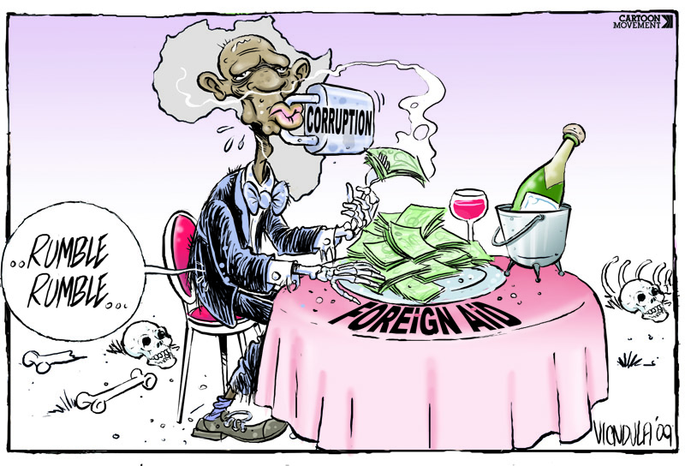

Slide 3
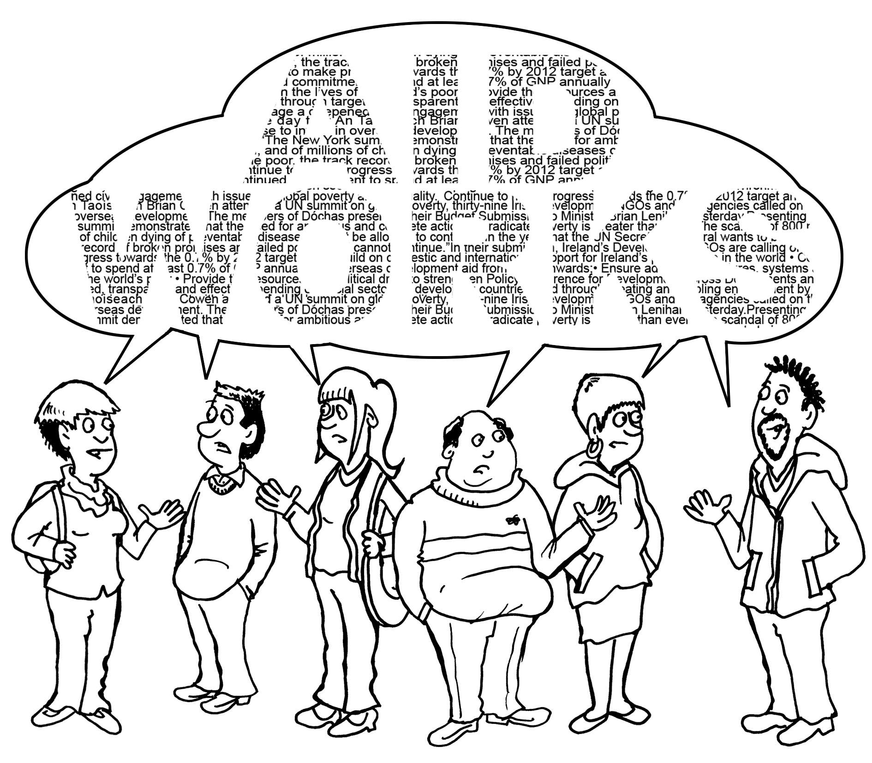

Slide 4
International Development System
The International Development System includes multilateral institutions such as the World Bank, the European Union and the United Nations and the bilateral donors such as the UK Department for International Development (DFID) or the United States Agency for International Development (USAID) are also part of the International Development System.
Many NGOs receive funds from development donors, while others try to operate under the system.
Both types of organizations may seek to influence the way in which the international aid system operates.
The precise relationship of NGOs to the aid system is therefore complex and highly contested.
Source: Lewis, D., & Kanji, N. (2009). Non-governmental organizations and development. Routledge.

Slide 5
Development Aid/Foreign Aid
Development Aid
(development assistance, technical assistance, international aid, overseas aid, official development assistance (ODA), foreign aid)
Financial aid given by governments and other agencies to support the economic, environmental, social, and political development of developing countries
Distinguished from humanitarian aid by focusing on alleviating poverty in the long-term
Bilateral (70%) and Multilateral (30%)
80-85% of global development aid comes from governments as official development assistance (ODA). $135 billion total ODA in 2014
Remaining 15-20% comes from private sources: non-governmental organisations (NGOs), foundations, remittances, etc.

Slide 6
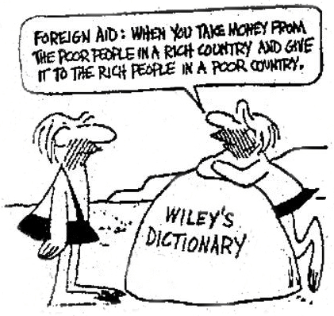
Harsh Reality!

Slide 7
Aid in Historical Perspective
The history of development assistance can be traced back to the colonial period. [Kothari 2005]
After the Second World War, international aid became a prominent part of international relations, mainly based around a set of bilateral and multilateral relationships between governments.
Financial Assistance and Technology Transfers were the disguises of Aid back then.
Aid was channeled into large-scale, government-organized projects around the developing world following the Cold War political priorities.
Source: Kothari, U. (2005) ‘From colonialism to development: oral histories, life geographies, and traveling cultures’.

Slide 8
Neo-liberalism: Emergence and Failure

Slide 9
Aid in Historical Perspective
In the 1980s, neoliberalism emerged in the world canvas. It is characterized by free-market trade, deregulation of financial markets, privatization, individualization, and the shift away from state welfare provision. "Neo-liberalism" is contemporarily used to refer to market-oriented reform policies such as "eliminating price controls, deregulating markets, lowering trade barriers" and reducing state influence in the economy, especially through.
Critics have argued that neoliberal policies have increased economic inequality and exacerbated global poverty. It encourages or covers for imperialism.
State’s role was reduced and competitive markets were encouraged to function. That too resulted in drastic failure. The donors then decided to help strengthen the role of the developing country governments by giving aid.

Slide 10
Poverty Reduction Strategy

Slide 11
Aid in Historical Perspective
Poverty Reduction Strategies (PRSs) were introduced in the late 1990s as mechanisms which aimed to provide coherent and coordinated donor support to developing-country governments in their efforts to tackle poverty. It provides a framework for low-income countries to articulate their development priorities and to specify the policies, programs, and resources needed to meet their goals.
A process was created at the national level across ministries, the private sector and civil society which aimed to generate a single plan that could then be ‘owned’ by the recipient government and its citizens rather than imposed by donors.
From late 1999 to 2005, 49 countries prepared national poverty reduction strategies. Just over half of these countries are in sub-Saharan Africa; a similar proportion is heavily-indebted poor countries. Countries have been implementing their strategies, on average, for just over two and a half years.

Slide 12
Sector Wide Approaches

Slide 13
Aid in Historical Perspective
The introduction of ‘Sector-Wide Approaches’ (known as SWAPs) was designed to bring donors together in support of national health or education policies in ways that could provide both resources and consistency throughout the policy-making process. It had long been a criticism of the way in which donors work that they found it difficult to coordinate their efforts effectively.
In 2005, the Paris Declaration on Aid Effectiveness created an international agreement which committed the DAC (Development Assistance Committee) countries to a renewed effort to increase harmonization, alignment and ‘managing aid for results’, setting out actions and indicators which could be monitored.

Slide 14
Emergence of Non-DAC Countries
in the Aid Regime

Slide 15
Aid in Historical Perspective
Aid is now also provided, and has become more visible, through a range of ‘non-DAC’ nations that includes China, the Gulf states, areas of Central Asia and Central Europe, India, South Africa and some Latin American countries.
There is a realization among Western donors that regional groups of donors such as League of Arab States, the Association of South-East Asian Nations (ASEAN) and the African Union are playing important roles and that previous policy dialogue between the DAC, the UN and the EU needs to be substantially widened.

Slide 16
Securitization of Aid

Slide 17
Aid in Historical Perspective
9/11 Attacks on the US and “War on Terror”
Securitization of Aid refers to the renewed engagement by Western donors with ‘failed states’ in order to reduce security threats, as opposed to the previous selective approach of investing in those states that were willing to embrace reform.
It has also meant an increased linking up of military, political and humanitarian responses to instability. In Iraq, for example, food aid has come to be seen as an integral part of the reconstruction and stabilization process, requiring arrangements to be made by the agencies involved in distribution, including NGOs, to engage with occupation forces.

Slide 18
Aid Flows to NGOs
OECD figures showed that by the second half of the 1990s about 5 percent of all official aid was being channeled through NGOs. The proportion of total NGO funds in a country that is drawn from official sources varies vary greatly, from 85 percent in Sweden to about 10 percent in Britain.
The rate of increase of official aid flowing to NGOs grew dramatically during the later years of the twentieth century.
NGOs received about $23 billion in aid money in 2004, constituting 30 percent of all overseas development assistance.

Slide 19
Aid Flows to NGOs: WHY
In addressing the needs of the population, NGOs are identified as possible alternative institutions to the public sectors (Brown and Korten, 1991). The following factors have contributed to the rapid growth of the NGOs all over the world in the last decade.
Changed Global Environment: The traditional dominant realist approach has lost a great deal of its explanatory power with the development of political economy based on internationalization of trade, production and finance. The transformation of the world environment have enabled the emergence of the notion of “international non-state actor”. [Mansbach 1976; Taylor 1984]
Changed International Political Philosophy: Economist Milton who was an advisor to the U.S. President Regan Administration, advocated to give up emphasize on less-government concept, which encouraged the flourishing of non-governmental sector. The same philosophy was fostered by the British Prime Minister M. Thatcher.

Slide 20
Aid Flows to NGOs: WHY
Attraction and Trust of major donor agencies: As a result of changed global Political and economic environment, the policies of the major donor agencies gradually changed. In that situation the NGO sector was able to attract the attention of bilateral and multi-lateral donor agencies, who in the past, were little concerned with such local organizations. [World Bank, 1992]
Failure of Governments and Search for Alternative Model: In the situation of the inappropriateness of governmental efforts led to search for alternative models and approaches to development in the context of frustration at the failure of conventional approaches to achieve the goals set by development planners and policy makers. [Peggy, 1987]

Slide 21
Strengths of NGOs
In the present world, the NGOs are treated as promoters of alternative development strategies [Drabek: 1987].
The strengths of NGOs are:
Capacity to reach the poor and the remote areas: The NGOs focus on the poor segment of the society which in many cases don’t benefit from governmental services.
Capacity to promote local participation: The prime purpose of the NGOs is to encourage and develop local potentials. [Wilson, 1983].
Capacity to work with other agencies: Many NGOs are ready and able to assist governments, local government departments and local agencies.
Capacity to act quickly: Speed of action and a minimum of bureaucratic tangle is one of the greatest assets of Development NGOs.

Slide 22
Strengths of NGOs
Capacity to work with flexibility: Due to their small size the NGOs tend to be more flexible than government programs or local government programs.
Capacity to take risks and experiments: NGOs normally undertake pilot projects in order to experiment or act as a catalyst. To attain their objectives they take risk much more readily than government agencies.
Capacity of innovate and adopt: Through their continuous search for new approaches and experimentation the NGOs become creative and experienced especially in micro level planning of development activities. [Sultan, 1990]
Capacity to operate on low costs: Some large NGOs are able to implement national programs that are cost effective.

Slide 23
Strengths of NGOs
Capacity to facilitate local resource mobilization and ensure local development: The NGOs have demonstrated their ability to facilitate resource mobilization by promoting local participation and their willingness to adapt to local need and conditions in the support hey provide to these groups.
Capacity to advocacy: The NGOs have the capacity to press the public sector to be more responsive. Their successful initiatives make them able to influence national policies and give them the advocacy power to governmental organizations.
Besides-
NGOs have capacity to developing a sound management System
NGO sector uses bottom-up planning approaches.
NGOs provide an effective alternative to public agencies.
NGOs are administratively and fiscally stronger than a weak govt.

Slide 24
Types of Aids
The type of aid given may be classified according to various factors, including its intended purpose, the terms or conditions under which it is given, its source, and its level of urgency.
Intended purpose: Aid is given generally intended for use by a specific end. From this perspective it may be called:
Project aid: Aid is given for a specific purpose
Program aid: Aid is given for a specific sector
Budget support: The financial system of the recipient country.
Sector-wide Approaches : A combination
Technical assistance: Technical Support
Food aid: Food is given to countries in urgent need of food supplies.
Terms or conditions of receipt: Aid can also be classified according to the terms agreed upon by the donor and receiving countries. Aid can be a gift, a grant, a low or no interest loan.

Slide 25
Types of Aids
Sources: Aid can be classified according to its source. While govt. aid is generally called foreign aid, aid that originates in institutions of a religious nature is often termed faith-based foreign aid.
Urgency or Emergency: Aid may be classified based on urgency into emergency aid and development aid. Emergency aid is rapid assistance given to a people in immediate distress by individuals, organizations, or governments to relieve suffering, during and after man-made emergencies (like wars) and natural disasters.
Development aid: Development aid is given by governments through individual countries' international aid agencies and through multilateral institutions such as the World Bank, and by individuals through development charities.

Slide 27
Extent of Aids
Most official development assistance comes from the 30 members of the Development Assistance Committee (DAC).
Top 10 Aid Recipient Countries (2012)
Top 10 Aid Donor Countries (2012)
Country | Billion USD
Afghanistan | 6.72
Vietnam | 4.11
Ethopia | 3.26
Turkey | 3.03
Congo | 2.85
Tanzania | 2.83
Kenya | 2.65
Côte d'Ivoire | 2.63
Bangladesh | 2.15
Mozambique | 2.09
Country | Billion USD
U.S | 31.55
U.K | 17.88
Germany | 14.06
Japan | 11.79
France | 11.38
Sweden | 5.83
Norway | 5.58
Netharlands | 5.44
Canada | 4.91
Australia | 4.85

Slide 28
Mechanisms

Slide 29
Mechanisms of NGO Funding
Official funding for NGO projects and programs can follow several different routes.
One is the ‘grant’ model. NGOs propose projects and programs and receive funding from donors.
The second is through ‘contracting’, in which NGOs are engaged by bilateral donors to undertake specific roles and tasks in particular contexts, within donors’ or governments’ own projects and programs.
One popular model with the DFID is the ‘local fund’, in which an NGO or a mixed consortium of organizations ‘manages’ a fund on behalf of donors, allowing other organizations to compete for funding on specified work themes.
Another is the Program Partnership Agreement (PPA), introduced in 1999 in which an NGO is given responsibility for a set of tasks that contribute to the DFID’s overall objectives in a particular country or sector for a specific time period.

Slide 30
How NGOs Are Funded
NGOs rely on a variety of sources for funding projects, operations, salaries and other overhead costs. Because the annual budget of an NGO can be in the hundreds of millions of dollars, fundraising efforts are important for the NGO's existence and success. Funding sources include membership dues, the sale of goods and services, philanthropic foundations, grants from local, state agencies, and private donations.
Individual private donors comprise a significant portion of NGO funding. Some of these donations come from wealthy individuals.
Many NGOs rely heavily on government funding to function. Some governmental NGO funding may be viewed as controversial because the funding may support certain political goals.
As non-profits, NGOs rely on a variety of sources for funding, including:
Membership dues - Private donations - Government funding
the sale of goods and services - Grants from other non-profits
Despite their independence from government, some NGOs rely significantly on government funding.

Slide 31
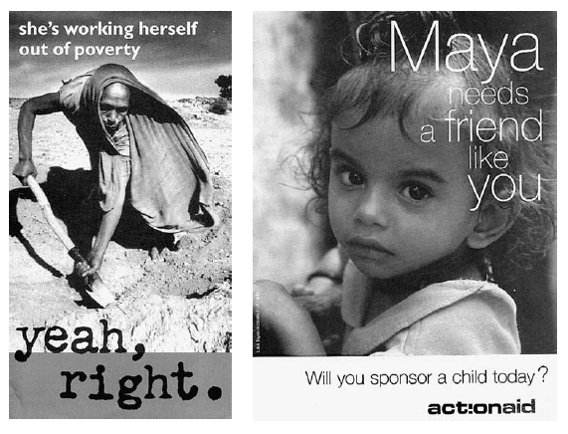

Slide 32
NGOs- Donors Relationships
Donor support for NGOs to work on policy development should include support to NGOs’ role in building policy influence from the grassroots.
Donor funding for advocacy work should have longer timeframes, and expectations of what can be achieved should be realistic and context-specific.
Donors should consider funding NGOs core staff and administration costs to decrease staff stress.
Impact assessments funded by donors should maximize learning and not be directly tied to funding cycles.
Qualitative assessments of advocacy work, using simple frameworks and informed by local political realities, should supplement more quantitative output-oriented assessment.

Slide 33
Foreign Aid by NGOs: Trap or Helpful?

Slide 34
References
Lewis, D., & Kanji, N. (2009). Non-governmental organizations and development. Routledge.
Kothari, U. (2005) ‘From colonialism to development: oral histories, life geographies, and traveling cultures’.
"Net official development assistance and official aid received (current US$) - Data". data.worldbank.org.
Any Question?

