Slide 1
Industrial Sector in Bangladesh

Slide 2
Objectives of this Class
Investigate the contribution of the industrial sector of Bangladesh.
Explore the food processing industrial scenario in BD.
Identify the strengths, weaknesses, opportunities, and threats of food industries in Bangladesh.
Develop some measures to address the challenges of food industries in Bangladesh.

Slide 3
Concept of Industrialization
Industrialization is the process in which a society or country transforms itself from a primarily agricultural society into an industrial one based on the manufacturing of goods and services. Characteristics of industrialization include the use of technological innovation to solve problems as opposed to superstition or dependency upon conditions outside human control such as the weather, as well as more efficient division of labor and economic growth.
Industrialization is part of a process where people adopt easier and cheaper ways to make things. Using better technology, it becomes possible to produce more goods in a shorter amount of time.
Modernization and structural transformation of the economy and diversification of the economic base, increasing returns and economies of scale, technological progress and productivity increase, accelerated economic growth and employment creation, increase in incomes and standard of living of the people are the universally recognized dynamic benefits arising from industrial development.

Slide 4
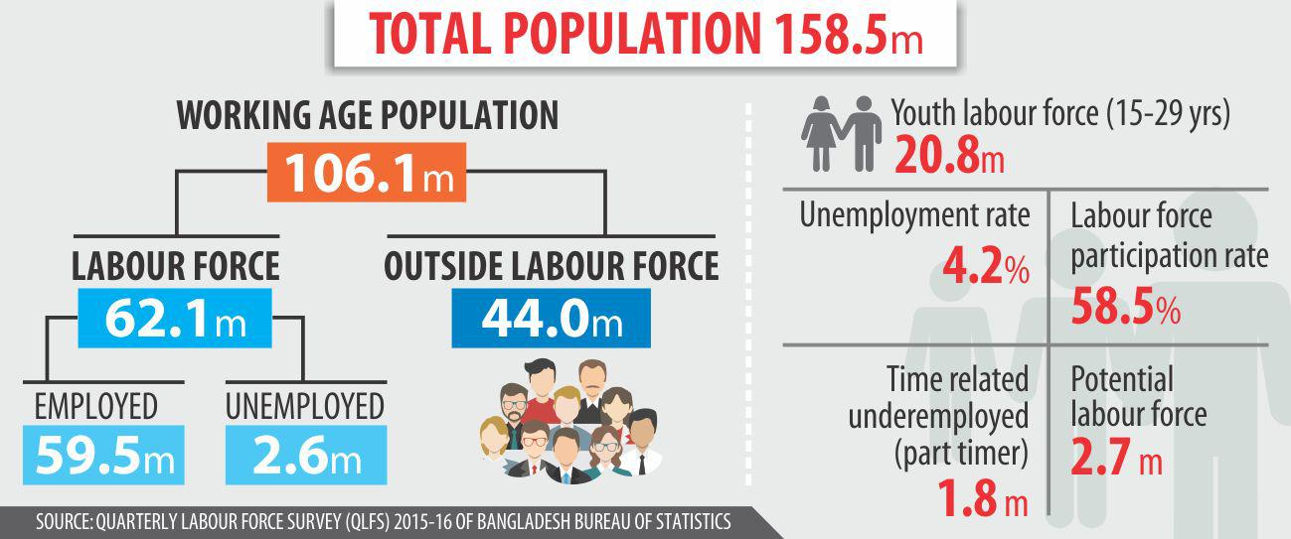
Demographic Dividend
Labor Force
Demographic Dividend is a phenomenon which occurs when the proportion of working population out of the total population is high. Since 2007 Bangladesh has had more people of working age than non-working, known as demographic dividend. Demographic dividend usually continues for 30 to 35 years. We have to transform it into economic dividend.
The labor force or work force is the population of able-bodied, willing people who are currently employed or looking for work. Labor Force is one of the most important indicators for development of a country. The total labor force of Bangladesh is 62.1 million in 2015, according to BBS Statistics. Labor force, total in Bangladesh was reported at 66.6 million in 2017, according to the World Bank Statistics.

Slide 5
Objectives of Industrialization
Macro objectives of industrialization are-
Play a major role in economic development
To increase GDP
Provide a secure basis for a rapid of growth of income.
Help in raising the standard of living
Provide employment, meeting high income demands
Brings in technological progress and change in the outlook of the people
Decrease the dependency on foreign resources
Micro objectives of industrialization are-
To provide employment to working labor force
To supply consumer, capital and intermediary goods
To support agriculture and service sectors
To improve balance of payment positive by promoting export industry and import substitute industries

Slide 6
Contribution of Industrial Sectors
Industrial Sector in GDP
Industrial Sector has given the opportunity of employment to millions of unemployed, especially innumerable uneducated women of the country. It is making significant contribution in the field of our export income.
The contribution of the industry sector to the economy of Bangladesh has been increasing day by day.
Contribution of Industrial sector in GDP is 35.36% (Fiscal year 2020-2021)
Year | Contribution of Industrial sector in GDP (%)
1941-1950 | 4
1951-1960 | 5
1961-1970 | 10
1971-1980 | 11
1981-1990 | 12
1991-2000 | 15
2001-2011 | 30
2020-2021 | 35.36
Source: World Bank Report and Ministry of Finance, Bangladesh

Slide 7
Focused Industry: Food Processing Industries in Bangladesh

Slide 8
Background
The food processing industry is the fastest-growing industry in Bangladesh since 2000. The food processing industry in Bangladesh has witnessed significant growth in recent years. In 2019-2020, the sector contributed 10.08% to the country's GDP and employed approximately 2.46 million people.
The export earnings from processed food products reached USD 687 million in the same period, showing a growth of 10% compared to the previous year.
The government of Bangladesh has implemented supportive policies and initiatives to promote the industry's development, including tax incentives and the establishment of food processing zones.
With a large population and increasing demand for processed foods, Bangladesh offers investment opportunities in sectors like agro-processing, dairy, fruits and vegetables, fisheries, and ready-to-eat food.

Slide 9
Impacts on Bangladesh GDP and Employment Opportunities in Food Processing Industries
There is a vast and quickly developing food and beverage industry in Bangladesh, which has turned out to be one of the fundamental potential employment economies regarding employment and included value.
The food processing sector in Bangladesh, though in the nascent stage, has a market size of $ 500 million. The sector accounts for over 22% of all manufacturing production and employs about 20% of labor forces. All food processing enterprises account for 2% of the national GDP.

Slide 10
Segments of Food Industries in Bangladesh
The Food Industries in Bangladesh can be broadly classified into four segments.
Primary Agriculture: Bangladesh’s agriculture sector is the backbone of the country’s food industry, contributing significantly to both GDP and employment. The sector produces a wide range of crops, including rice, wheat, jute, tea, and vegetables.
Food Processing: The food processing industry in Bangladesh is rapidly growing and includes a variety of segments, such as dairy, meat, fish, snacks, confectionery, and beverages. The sector has experienced significant investment in recent years, with new players entering the market and established companies expanding their operations.
Packaging: The packaging industry in Bangladesh is an essential component of the food industry, providing a range of products and services, including packaging materials, equipment, and labeling.
Retail: The retail industry in Bangladesh is undergoing significant transformation, with modern retail formats such as supermarkets and hypermarkets gaining popularity.

Slide 11
Prospects of Food Industries in Bangladesh
Growing Market Size: Bangladesh has a large population of over 166 million people, which provides a significant consumer base for the food processing industry (World Bank, 2021).
Contribution to GDP: The food processing industry plays a vital role in the country's economy. The food processing sector accounted for 10.08% of the country's GDP in the fiscal year 2019-2020 (BBS, 2020).
Employment Generation: The food processing industry has the potential to create employment opportunities, particularly in rural areas. The sector employed approximately 2.46 million people in 2019-2020 (BBS, 2020).
Export Potential: Bangladesh has been gradually increasing its export of processed food products. According to the Export Promotion Bureau (EPB) of Bangladesh, the export earnings from the processed food sector reached USD 687 million in the fiscal year 2019-2020, showing a growth of 10% compared to the previous year (EPB, 2020).
Government Support and Initiatives: These include tax incentives, subsidies, and the establishment of food processing zones.
Investment Opportunities: Bangladesh offers investment opportunities in the food processing sector. The government has identified agro-processing, dairy, fruits and vegetables, fisheries, and ready-to-eat food as potential areas for investment (BIDA, 2021).

Slide 12
SWOT Analysis of Food Processing Industries of Bangladesh

Slide 13
Strengths
Fast developing industry
Complete government support
Huge availability of labour force
Densely populated country
Availability of products by mass distribution throughout the nation Easy-going legal system
Unique advertisement ideas

Slide 14
Weaknesses
Unskilled Labor force
Lack of food and beverage safety acts
Lack of experience in the global market
Lack of quality of the products
Corruption
Unethical practices by several companies

Slide 15
Opportunities
High demand in local market
High profitability in food market
Diversified product industry has high growth opportunities
High opportunity to enter in international business
Cheap lands and salary packages to set up industry

Slide 16
Threats
Existence of several Strong MNCs Such as Unilever, Nestle
Unethical Practice to the competitors
Poor Legal System
No quality standards maintained by the food companies
Consumer preference for foreign food products

Slide 17
Three Major Barriers to Food Industries: A Developing Country Perspectives
Infrastructure: One of the most significant challenges facing the food industry in Bangladesh is the lack of adequate infrastructure, particularly in transportation and storage. The poor road network and insufficient storage facilities lead to significant post-harvest losses and lower-quality products.
Regulatory Framework: The regulatory framework for the food industry in Bangladesh is also a challenge, with fragmented regulations and inadequate enforcement. The lack of proper regulation has led to issues such as food adulteration, misbranding, and food safety concerns.
Supply Chain Management: Supply chain management is another significant challenge facing the food industry in Bangladesh. The sector is highly fragmented, with small-scale producers and processors lacking access to modern technology and market information.

Slide 18
The Role of a Food Engineer
Food Product Development: Work on developing innovative food products that cater to the nutritional needs and preferences of the local population..
Quality Control and Food Safety: Ensure compliance with food safety regulations and standards in food processing, packaging, and storage. Implement quality control measures to maintain the integrity and safety of food products.
Nutritional Analysis and Labeling: Conduct nutritional analysis of food products to provide accurate information about their nutritional content. Assist food companies in labeling their products with relevant nutritional information, including ingredients, allergens, and dietary guidelines.
Research and Development: Engage in research activities to address specific challenges faced by the food industry in Bangladesh. This can include studying the nutritional status of the population, analyzing food consumption patterns, exploring sustainable food production techniques, and investigating the impact of food processing on nutritional value.
Food Processing Optimization: Improve food processing techniques to enhance the nutritional quality and safety of processed foods. Explore methods such as fortification, preservation, and minimal processing to retain the nutritional value of raw materials.
Consumer Education and Awareness: Educate the public about the importance of nutrition and healthy eating habits. Organize awareness campaigns, workshops, and seminars to disseminate knowledge about food choices, balanced diets, and the impact of nutrition on health.

Slide 19
Challenges of Food and Other Industrial Sector
High Competition and impact of free market economy
Malpractices in providing industrial loan
Highly dependency on jobs in place of entrepreneur mind
Lack of FDI and capital for investment and reinvestment mind
Workers do not receive their right benefits
Labor unrest due to some needs
Poor presence of labor rights advocacy
Instable political situation
High rate of corporate tax
Lack of raw materials in various industries
Uncertainly of power and fuels
Lack of well trained up manpower
Lack of technological knowledge and skills
Lack of disruptive thinking
Red Tapism (Bureaucratic behavior)
Absences of compliances
Inadequate port facilities
Withdrawn quota advantage
Lack of research and innovation
Imbalance trade and business

Slide 20
Things to do for development
Removals of export problems etc.
Removing infrastructural bottlenecks
Building additional supply capacity,
Use of cost reduction strategy, and
Increase in value-addition through backward integration
Production of sufficient raw materials in the country.
Assurance of safety, salary and other facilities of the workers
More advanced of EPZ
Technology and efficiency
Friendship to all, business to all…………………………..
Role of policy-makers
Capacity-building of the workforce.
Prepare FTP, Bi-lateral, Multi-lateral Business alliance.
Imparting training to make skilled workers.
Stabling the Political Situation.
Private sectors development
Reducing High Rate of Corporate Tax
Conducting more research works for developing telecom sector
Use of cost reduction strategy of internet

Slide 21
Chapter Related Questions
What do you mean by industrialization?
Mention the contribution of food industries in Bangladesh.
What are the major challenges of the food industries of Bangladesh?
How to address the challenges?
Thank You

Slide 22
References
Shetty, P., James, S., & Radhakrishnan, A. (2019). Role of food technologists in nutrition and public health. Indian Journal of Medical Research, 149(6), 723–725.
Hossain, M. A., & Rauf, M. A. (2017). The food processing industry in Bangladesh: Challenges and prospects. Journal of Food Technology Research, 4(1), 1–10.
Bangladesh Bureau of Statistics (BBS). (2020). National Accounts Statistics 2020. Retrieved from http://bbs.portal.gov.bd/sites/default/files/files/bbs.portal.gov.bd/page/c017114e_732e_4c60_a34b_4f4e28c17a5d/Statistical%20Yearbook%20of%20Bangladesh%202020%20-%20Final%20with%20cover.pdf
Bangladesh Beverage Industry | Bangladesh beverage company list. [online] Available at: http://www.bangladeshtrades.com/bd-company-list/ bangladeshbeverage- company-list.html [Accessed 9 Jul. 2020].
Businesshabit.com, (2017). Top 10 beverage companies in Bangladesh. [Online] Available at: http://www.businesshabit.com/2014/12/top-10beverage-company-in-bangladesh.html [Accessed 15 april. 2016].
European Commission, (2018). ICT and electronic business in the Food and Beverage industry. [Online] Available at: http://ec.europa.eu/enterprise/archives/ebusinesswatch/studies/sectors/food/documents/Food_2005_I.pdf [Accessed 9 Jul. 2017]. Hg.org, (2015). Food and Beverages Law –
Akter, M. (2019). Internship report on a study of Food Products and Beverage Industry

