Slide 1
Daffodil International University Dept. of CSE Information Security
Lecture 5
Incident Management, Handling and Response

Slide 2
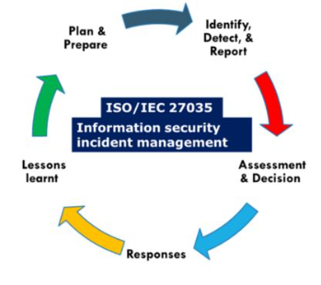
What is Incident
The definition of an incident is something that happens, possibly as a result of something else.
A security incident is an event that may indicate that an organization's systems or data have been compromised or that measures put in place to protect them have failed.
Incident Response Process

Slide 3
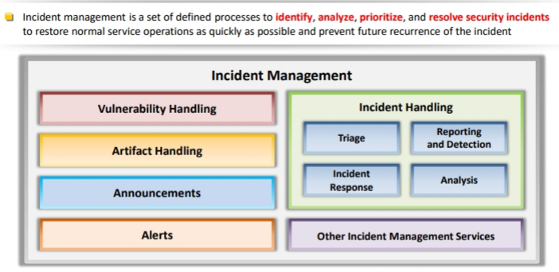
Incident Management
Incident Management is a set of defined processes to identify, analyze, prioritize, and resolve security incidents to restore normal service operations as quickly as possible and prevent future recurrence of the incident.
Fig:1 Block Diagram of Incident Management

Slide 4
Incident Management (Contd.)
Incident Management includes the Following:
Vulnerability Analysis
Artifacts Analysis
Security Awareness Training
Intrusion Detection
Public or Technology Monitoring
The Incident Management Process is designed to:
Improve service quality
Resolve problems proactively
Reduce the impact of incidents on an organization or its business
Meet service availability requirements
Increase staff efficiency and productivity
Improve user and customer satisfaction
Assist in handling future incidents

Slide 5
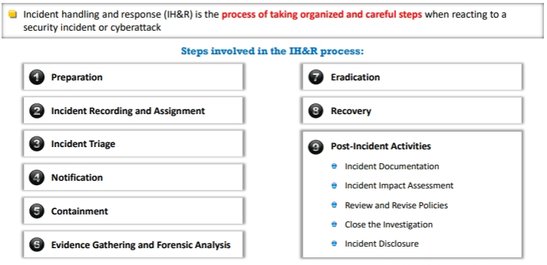
Incident Handling and Response
Incident handling and response(IH&R) is the process of taking organized and careful steps when reacting to a security incident or cyberattack. It’s a set of procedures, actions and measures taken against an unexpected event occurrence.
Fig:1 Incident Handling and Response Process

Slide 6
Thank You

