Slide 1
Keys in Relational Model
Presented By
Md. Zahid Hasan
Zahid.cse@diu.edu.bd

Slide 2
এই Lesson এ কি শিখব?
What is Key?
Super Key
Candidate Key
Primary Key and
Foreign Key

Slide 3
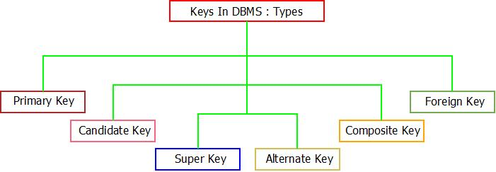
Key in DBMS
A DBMS key is an attribute or set of an attribute which helps you to identify a row (tuple) in a relation (table).
Keys help you uniquely identify a row in a table by a combination of one or more columns in that table.

Slide 4
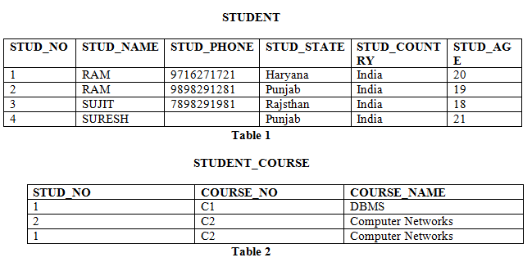
Super Key
The set of attributes which can uniquely identify a tuple is known as Super Key.
For Example, STUD_NO, (STUD_NO, STUD_NAME)

Slide 5
Candidate Key
The minimal set of attribute which can uniquely identify a tuple is known as candidate key.
For Example, STUD_NO in STUDENT relation.
The candidate key can be simple (having only one attribute) or composite as well.
For Example, {STUD_NO, COURSE_NO} is a composite candidate key for relation STUDENT_COURSE.

Slide 6
Primary Key
There can be more than one candidate key in relation out of which one can be chosen as the primary key.
For Example, STUD_NO, as well as STUD_PHONE both, are candidate keys for relation STUDENT but STUD_NO can be chosen as the primary key (only one out of many candidate keys).

Slide 7
Foreign Key
For Example, STUD_NO in STUDENT_COURSE is a foreign key to STUD_NO in STUDENT relation.

Slide 8
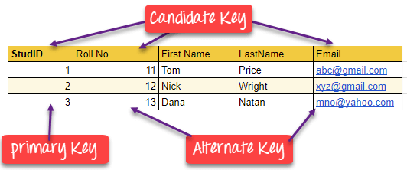
Alternate Key
The candidate key other than the primary key is called an alternate key.

Slide 9
“Opportunities don’t happen, you create them.”
– – Chris Grosser

