Slide 2
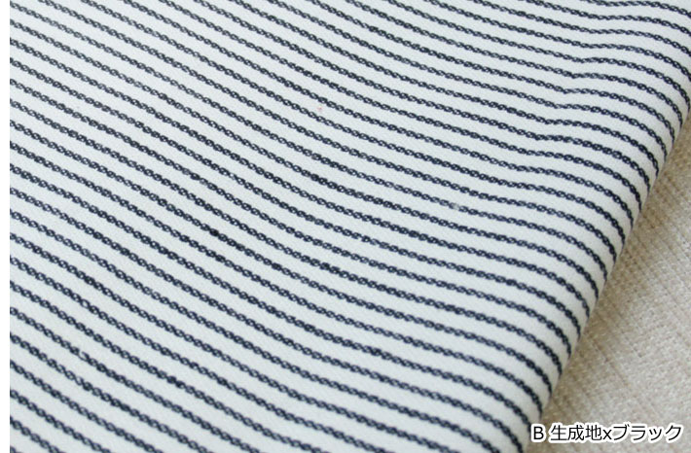
The History of Denim
A popular conception of the entomology of the denim is that it is a contraction or derivative of the French term SERGE DE NIMES. Denim was traditionally colored blue with indigo dye to make blue “Jeans“.
Though “Jean“ then denoted a different , lighter cotton textile ; the contemporary use of jean comes from the French word for Genoa ,Italy,(Genes ) , from which the first denim trousers were made .
Similarly woven traditional American cotton textile is the diagonal warp-striped hickory cloth that was once associated with railroad men’s overalls, in which blue or black contrasting with un dyed white threads from the woven pattern .
Records of a group of New Yorkers headed for the California gold fields in 1849 show that they took along four “hickory shirts “ apiece. Hickory cloth would later furnish the material for some “fatigue” pantaloons and shirts in the American civil war.

Slide 5
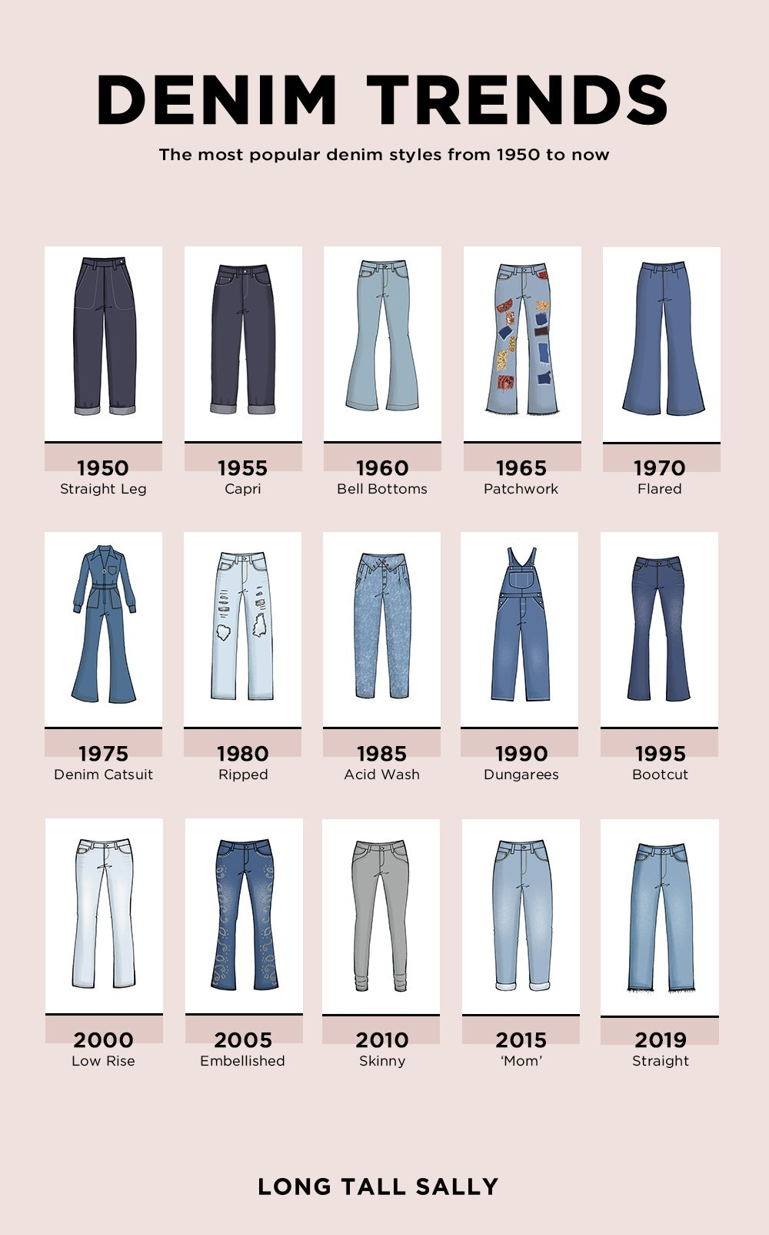

Slide 6
Denim
Definition:
Denim is a rugged twill textile, in which the weft passes under the two or more warp yarns, producing the familiar diagonal ribbing identifiable on the revere of the fabric.
Characteristics of denim fabric:
Warp yarns are colored (usually with indigo, vat, blue or sulphur black );
Structure : right hand or left hand twill, i.e. z/s-twill of 2/1 or 3/1construction;
Usually made of cotton yarns of coarser count (7^{s}, 10^{s}, 14^{s}, 16^{s}, etc )
Coarser cloth ( weight lies between 6-14 oz/sq.yds ) and used for pant and warm jackets;
Rotor yarn are usually used.

Slide 7
Classification of denim fabric
1.As per weight /unit area
Light weight : 4.5 to 7 oz/sq.yd
Medium weight : 7 to 10 oz/sq.yd
Heavy weight: 11 and above.
2. As per hue and color
Indigo vat.
Sulphur black.
Pigment.
3.As per slub yarns
Warp yarns are slub only.
Weft yarn are slub only.
Cross Hatch : both way slub i.e. both warp and weft yarn are slub
4.As per fabric structure /design
Plain (1/1)
Twill (S-twill, Z-twill, herringbone or zigzag twill, broken, stripe, dobby)
Knit
5.As per dyed yarn
Black
Blue Black
Black Blue
Grey
Indigo/Blue
6.As per Composition
100% Cotton
Cotton + Polyester
Cotton + Polyester + Spandex
Polyester +Spandex
Cotton + Spandex

Slide 8
Jeans
Jeans:
Jeans are pants or trousers, jackets made from denim mainly designed for work, they became popular among teenagers starting in the 1950. Historic brands include Levi’s American population spent more than $14 billion on jeans in 2004.

Slide 9
Denim
Denim Vs Twill

