Slide 1
Computer Networks
GAA
Global Access Asia
Subnetting
Professor Dr. A.K.M Fazlul Haque
Department of Electronics and Telecommunication Engineering(ETE)
Daffodil International University

Slide 2
Borrowing Bits to Grow a Subnet
The key concept in subnetting is borrowing bits from the host portion of the network to create a subnetwork.
Rules govern this borrowing, ensuring that some bits are left for a Host ID.
The rules require that two bits remain available to use for the Host ID & that all of the subnet bits cannot be all 1s or 0s at the same time.
For each IP address class, only a certain number of bits can be borrowed from the host portion for use in the subnet mask.

Slide 3
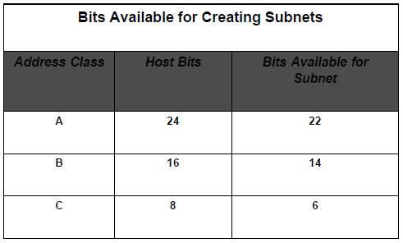
Borrowing Bits to Grow a Subnet (Cont.)

Slide 4
Subnetting a Class A Network
The default subnet mask for a class A network is 255.0.0.0 which allows for more than 16,000,000 hosts on a single network.
The default subnet mask uses only 8 bits to identify the network, leaving 24 bits for host addressing.
Keep in mind that each of the 8-bit octets has binary place values.
When you borrow bits from the Host ID portion of the standard mask, you don’t change the value of the bits.

Slide 5
Subnetting a Class A Network (Cont.)
To subnet a Class A network, you need to borrow a sufficient number of bits from the 24-bit host portion of the mask to allow for the number of subnets you plan to create, now & in the future.
Example: To create 2 subnets with more than 4 millions hosts per subnet, you must borrow 2 bits from the 2nd octet & use 10 masked (value equals one) bits for the subnet mask (11111111.11000000) or 255.192 in decimal.

Slide 6
Class A Subnet Masks
All subnet masks contain 32 bits; no more, no less.
However a subnet mask cannot filter more than 30 bits. This means 2 things:
– One, that there cannot be more than 30 ones bits in the subnet mask.
– Two, that there must always be at least 2 bits available for the Host ID.

Slide 7
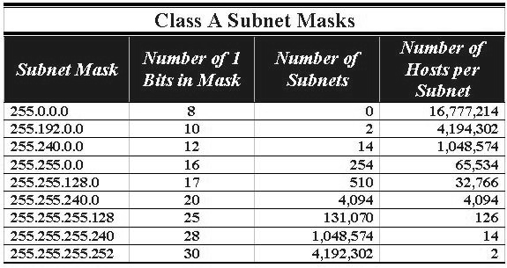
Class A Subnet Masks (Cont.)
A sample of subnet mask options available for Class A addresses.

Slide 8
Class A Subnet Masks (Cont.)
The subnet mask with the highest value (255.255.255.252) has a binary representation of:
11111111.11111111.11111111.11111100
The 2 zeroes in this subnet mask represent the 2 positions set aside for the Host address portion of the address.
Remember that the addresses with all ones (broadcast address) & all zeroes (local network) cannot be used as they have special meanings.

Slide 9
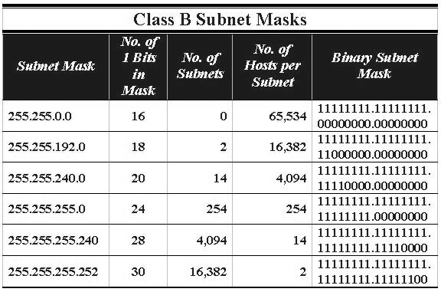
Subnetting Class B
A sample of the subnet masks available for Class B networks.

Slide 10
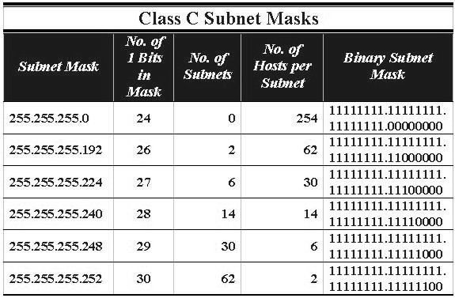
Subnetting Class C
A list of the subnet masks available for Class C networks.

Slide 11
END

