Slide 1
1. Yarn Contamination

Slide 2
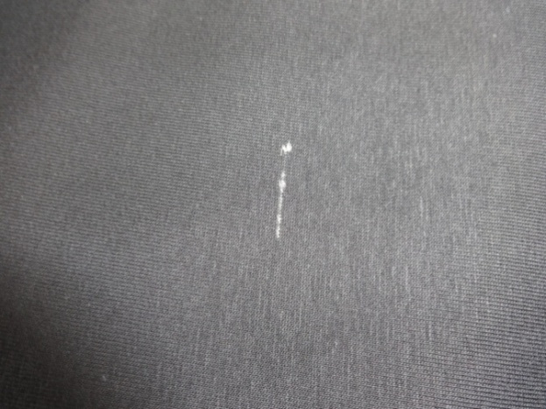
2. Slub

Slide 3
3. Hole

Slide 4
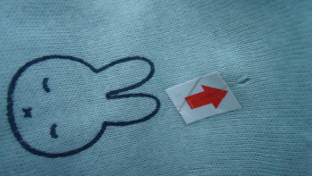
3. Hole

Slide 5
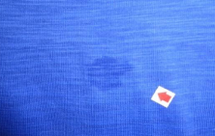
4. Oil Mark

Slide 6
5. Spot/Stain

Slide 7
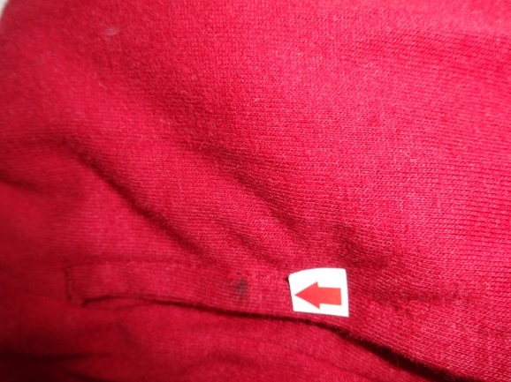
5. Spot/Stain

Slide 8
6. Missing Yarn

Slide 9
7. Broken Stitch

Slide 10
7. Broken Stitch

Slide 11
8. Open Seam

Slide 12
9. Uneven Stitch

Slide 13
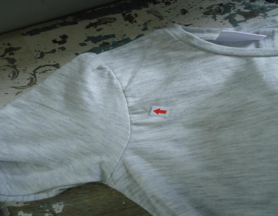
10. Puckering at Arm hole

Slide 14
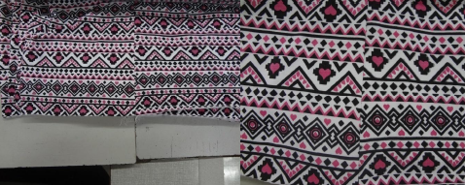
11. Mismatched Stripe

Slide 15
12. Dyeing Spot

Slide 16
12. Dirty Spot

Slide 17
13. Print Spot

Slide 18
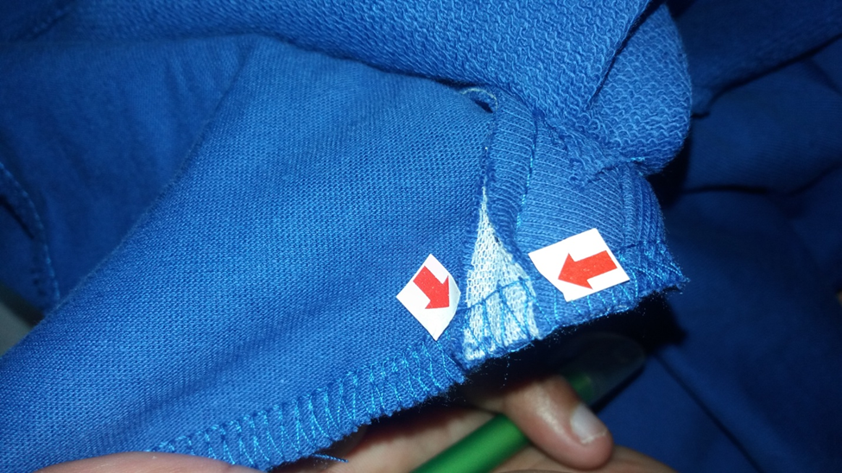
15. Improper match during sewing

Slide 19
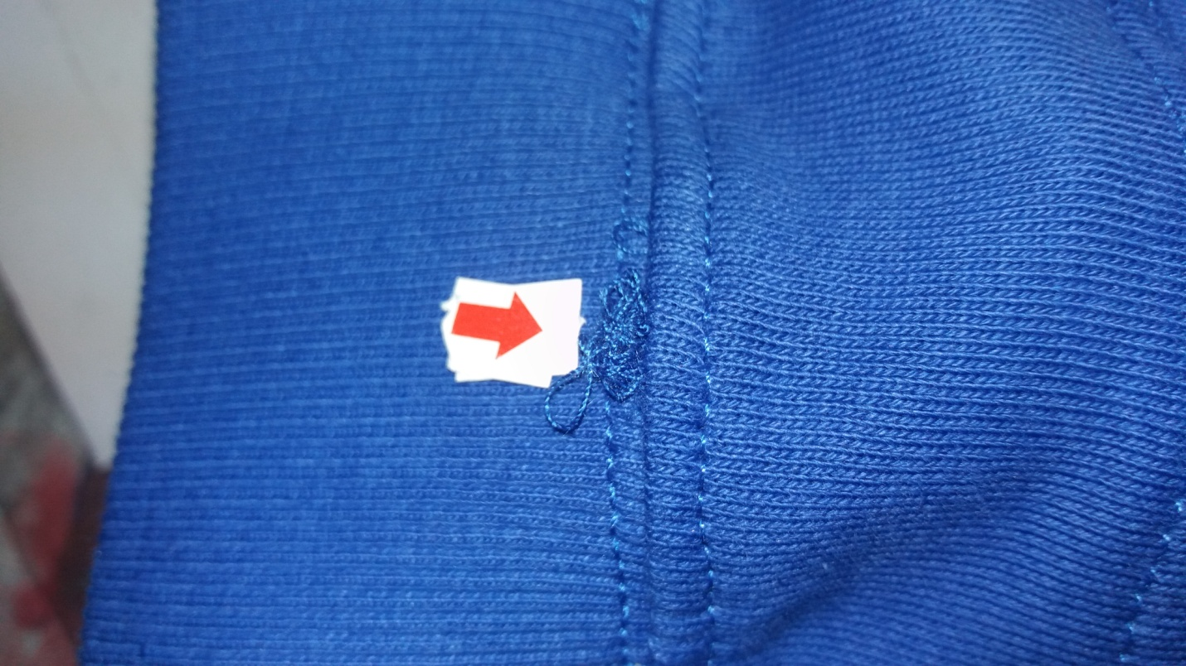
16. Thread Snagging out

Slide 20
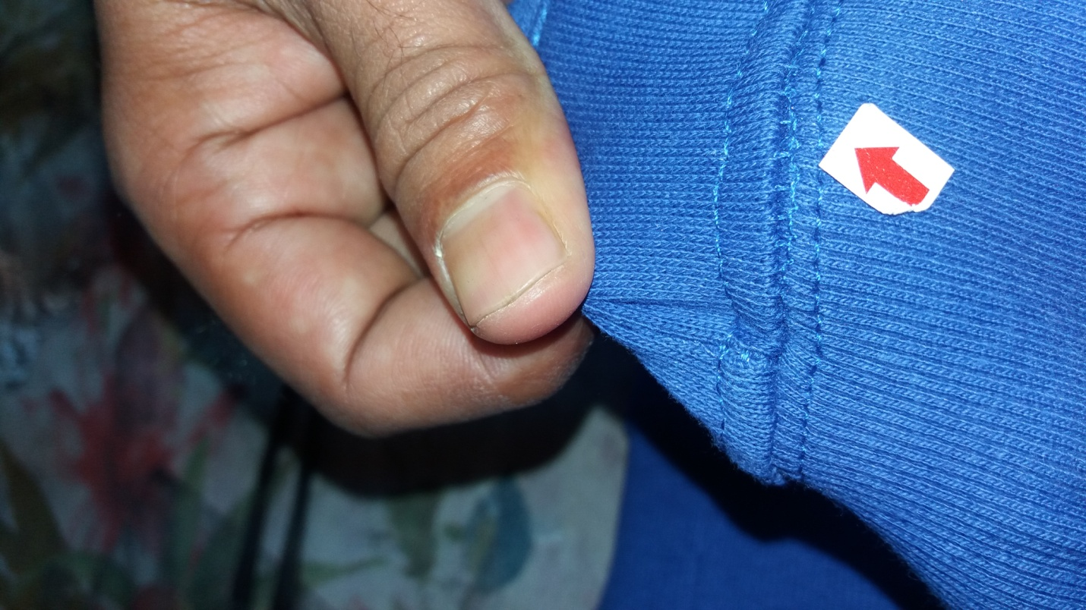
17. Staggered Stitch

Slide 21
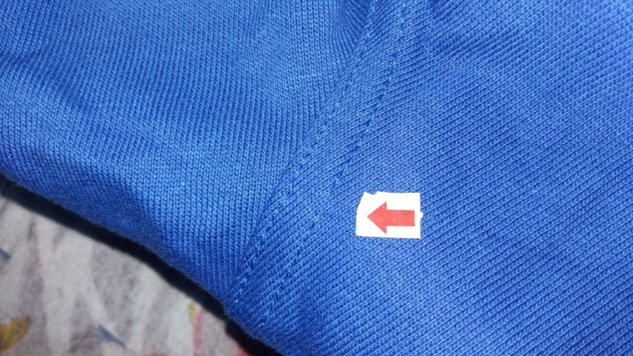
17. Skipped Stitch

Slide 22
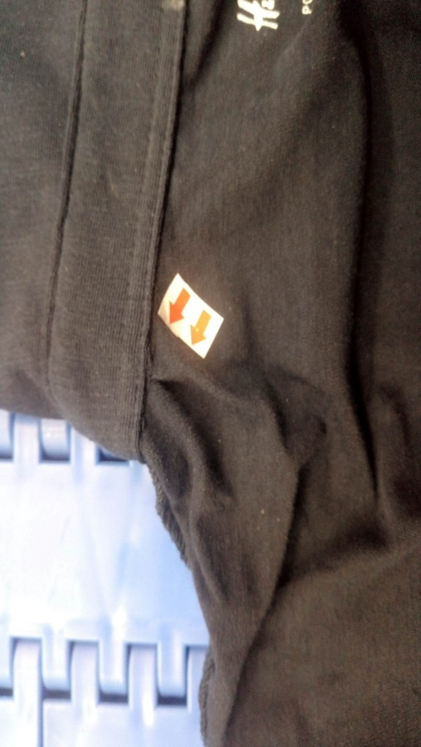
Pleat

