Slide 2
Value, Moral and Ethics
Juwel Rana
Lecturer
Dept. of Nutrition & Food Engineering
Daffodil International University

Slide 3
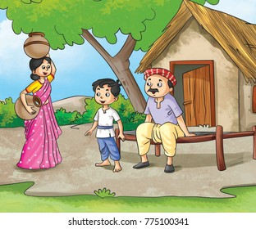

Slide 4
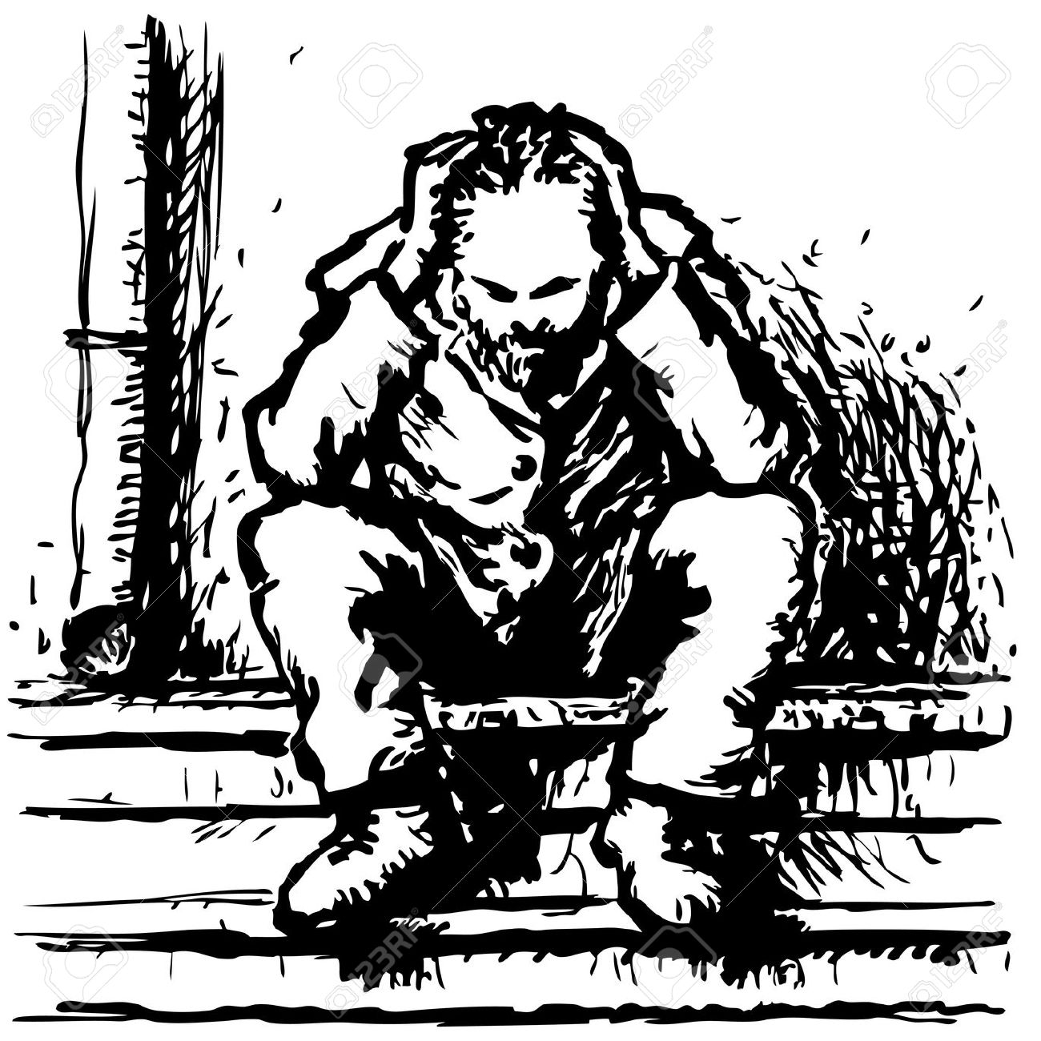

Slide 6
Counselling !!!!!!!!!!

Slide 10
What are Values?
Values are the foundation of a person's ability to judge between right and wrong.
Values include a deep-rooted system of beliefs.
This system allows each individual to determine what should and shouldn't be.
Formulation of Our Value:
40% value is genetically determined
Balance is given by the environmental factors
Culture
Parental dictates
Teachers
Friends and other situations

Slide 11
How Value affect personality?
Values are principles or standards of behavior.
They describe personal standards of what is valuable or important.
It is the values that help us to make decisions about right and wrong, important and less important, etc.
Values can be comprised of likes, dislikes, perspectives, prejudices, and judgment. They are basically the main principles that shape a person’s behavior.
Therefore, they provide the basic foundation for understanding a person’s personality, behavior, attitudes, and perceptions.
It is also important to note that values depend on individuals; each individual has different values.
Value
Behavior interest and personality
Beliefs
Perception
Attitudes

Slide 12
Personal Value
Personal values denote a sense of right or wrong, good or bad, and other judgmental criteria based on our strong sense of what the ideal ought to be.
Personal values serve five purposes in organizations
Value serve as standards of behavior
Guidelines for decision making and conflict resolution
Value effect our thought & action
Influence on employee motivation & perception
Influence on attitude and behavior

Slide 13
সৎ সঙ্গে স্বর্গবাস, অসৎ সঙ্গে সর্বনাশ!!!!!!!!

Slide 14
Workforce Value/ Workplace
These values you have to obey as instructed by the workplace
Workplace values drive the attitudes and behaviors that you want to see within your team. These values might include respecting others, keeping promises, showing personal accountability, or providing excellent customer service.
At the workplace
Old value: Hard work, conservative-traditional, loyalty to the employer organization.
Today value: Job satisfaction, leisure time, loyalty to relationship, flexibility to career
Negative value: Anger, ,meanness, arrogance (overconfidence),crookedness-wicked, greed/lust
Positive value: Integrity, honesty, truthfulness, kind heartedness, humility

Slide 15
Business Value
Scholars identified ten fundamental shared values for successful organization
Truth
Mentoring
Giving credit
Honesty
Caring
Trust
Openness
Risk taking
Social conscience
Responsibility & accountability

Slide 16
What Is Important or Valuable?
For example, if someone's value system is founded upon honesty, they would probably make a proper judgment between cheating on a college entrance exam (wrong) and studying hard to ace a college entrance exam (right).
Conversely, if someone valued achievement and success over honesty, that person may opt to cheat on the exam in order to achieve the desired result. This relates to which value is "worth more" to the individual.
These fundamental beliefs are the barometer that go on to guide a person's decisions.
Values don't necessarily need to be "system wide" in a group of people. Rather, they tend to be a personal, individual foundation that influences a particular person's behavior.

Slide 17
What are Morals?
Morals are formed out of a person's values.
Values are the foundation of a person's ability to judge between right and wrong.
Morals build on this to form specific, context-driven rules that govern a person's behavior. They're formed from a person's life experience and are subject to opinion.
For example, someone's morals might indicate they're opposed to murder. That's a pretty general rule of thumb.
But what about something more ordinary? While one person's morals might tell them not to gossip, another person's morals might be quite different. They might not consider gossip to be a bad thing.

Slide 18
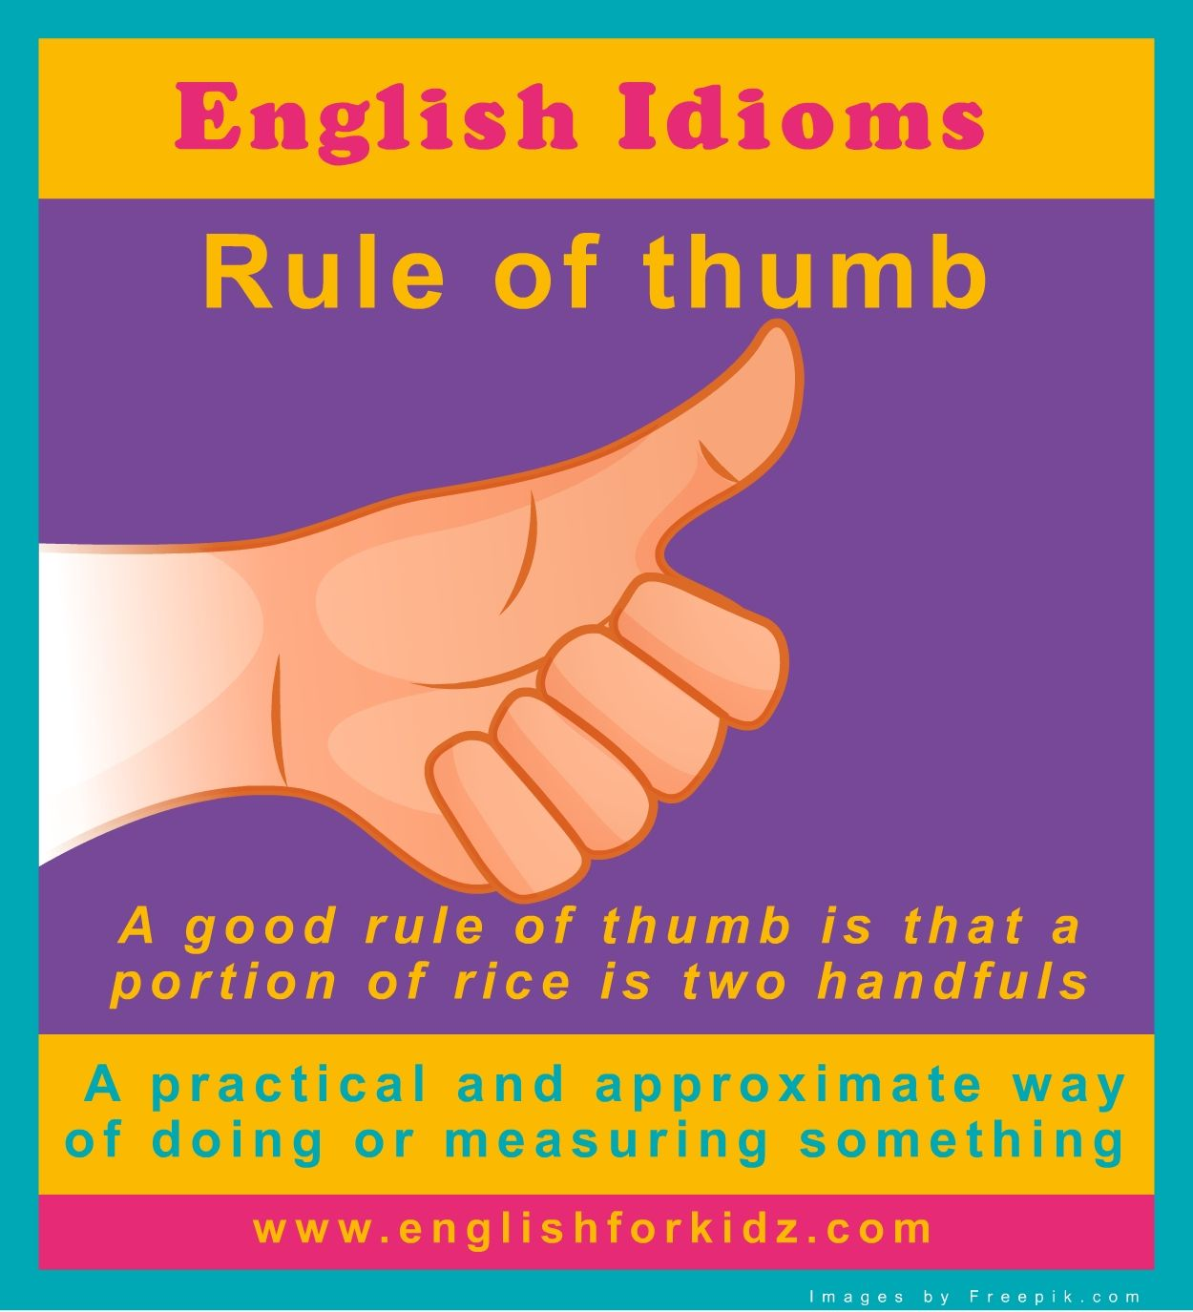
Rule of Thumb
The term rule of thumb refers to a general way of doing something that is not particularly precise of accurate but is the most common and known way to complete the task at hand.

Slide 19
Morals in Society
Is there really a standard moral code in society these days?
Yes, while most people follow society's laws, they also abide by certain social mores, which are governed by morals. While morals tend to be driven by personal beliefs and values, there are certainly some common morals that most people agree on, such as:
Always tell the truth
Do not destroy property
Have courage
Keep your promises
Do not cheat
Treat others as you want to be treated
Do not judge
Be dependable
Be forgiving
Have integrity
Take responsibility for your actions etc.

Slide 20
Social mores

Slide 21
Amoral vs. Immoral
Be careful with the terminology in this category.
Sometimes, the words "amoral" and "immoral" are interchanged.
However, they're quite different.
If someone is amoral, they have no sense of right and wrong. They don't have the foundation that comes with a sound set of values.
Meanwhile, if someone if immoral, you can be sure they know right from wrong. They're just choosing to do the wrong thing.

Slide 22
Any Question

Slide 23
To be continued………….

Slide 24
What are Ethics?
Ethics involves a discipline that examines good or bad practices within the context of a moral duty.
Ethics are set of moral principles, especially ones relating to or affirming a specified group, field, or form of conduct.
The term ethics is mostly related to professional context. They are also known as professional ethics or work ethics.
Ethics are the vehicle to your morals. They're our morals in action.
Ethics enact the system we've developed in our moral code. As such, someone will behave ethically or unethically.
For example, someone's ethics will prevent them from taking action and telling a bold-faced lie or stealing their mother-in-law's secret recipe for cornbread.
Honesty, integrity, punctuality, and loyalty are some examples of workplace ethics.

Slide 25
Professional Ethics
We tend to link morals to matters of religion and spirituality.
Meanwhile, ethics are closely linked to matters pertaining to law.
We know doctors are held to a strict code of ethics when they swear the Hippocratic Oath.
Similarly, an organization like PETA literally stands for "People for the Ethical Treatment of Animals."
Consider morals as the rulebook and ethics as the motivator that leads to proper or improper action.
Sound moral judgment is rooted in strong values and acted upon by our ethics.

Slide 26
Hippocratic Oath
The Hippocratic Oath is an oath of ethics historically taken by physicians.
“I will not give a drug that is deadly to anyone”

Slide 27
Formation of Personal Ethics
Fellow Workers
Opposites
Regions of Country
Family
The Individual Conscience
Profession
Friends
Employer
The law
Religious Beliefs
Society at large

Slide 28
Factors influencing ethical managerial behavior—the person, organization, and environment.

Slide 29
what is not ethics?
Ethics refers to standards of behavior that tell us how human beings ought to act in the many situations in which they find themselves-as friends, parents, children, citizens, businesspeople, teachers, professionals, and so on.
identify what is not ethics :
Ethics is not the same as feelings. Feelings provide important information for our ethical choices. Some people have highly developed habits that make them feel bad when they do something wrong, but many people feel good even though they are doing something wrong. And often our feelings will tell us it is uncomfortable to do the right thing if it is hard.
Ethics is not religion. Many people are not religious, but ethics applies to everyone. Most religions do advocate high ethical standards but sometimes do not address all the types of problems we face.
Ethics is not following the law. A good system of law does incorporate many ethical standards, but law can deviate from what is ethical. Law can become ethically corrupt, as some totalitarian regimes have made it. Law can be a function of power alone and designed to serve the interests of narrow groups. Law may have a difficult time designing or enforcing standards in some important areas, and may be slow to address new problems.

Slide 30
Cont..
Ethics is not following culturally accepted norms. Some cultures are quite ethical, but others become corrupt -or blind to certain ethical concerns (as the United States was to slavery before the Civil War). "When in Rome, do as the Romans do" is not a satisfactory ethical standard.
Ethics is not science. Social and natural science can provide important data to help us make better ethical choices. But science alone does not tell us what we ought to do. Science may provide an explanation for what humans are like. But ethics provides reasons for how humans ought to act. And just because something is scientifically or technologically possible, it may not be ethical to do it.

Slide 31
Ethical Dilemma
Ethical dilemmas, also known as a moral dilemmas, are situations in which there is a choice to be made between two options, neither of which resolves the situation in an ethically acceptable fashion. In such cases, societal and personal ethical guidelines can provide no satisfactory outcome for the chooser.
Ethical dilemmas assume that the chooser will abide by societal norms, such as codes of law or religious teachings, in order to make the choice ethically impossible.

Slide 32
Example of A Moral Dilemma
Given the personal nature of morals, someone might deem an action to be "good" even if it's breaking a law. For example, what if a daughter couldn't afford the life-saving medicine her dying mother needed but she, somehow, had access to the storeroom where the medicine was housed?
In this instance, her core values might tell her stealing is wrong. However, her morality would tell her she needs to protect her mother. As such, the daughter might end up doing the wrong thing (stealing, as judged by her values) for the right reasons (saving her mother, as judged by her morals).

Slide 33
MANAGEMENT TIPS for dealing with ethical dilemmas
Checklist for dealing with ethical dilemmas
Step 1. Recognize the ethical dilemma.
Step 2. Get the facts.
Step 3. Identify your options.
Step 4. Test each option: Is it legal? Is it right? Is it beneficial?
Step 5. Decide which option to follow.
Step 6. Ask the “Spotlight Questions”: To double check your decision
“How would I feel if my family found out about my decision?”
“How would I feel if the local newspaper printed my decision?”
Step 7. Take action.
Notes:
Ethical dilemmas become more apparent when others around you are behaving in an unethical manner.

Slide 34
Any Question

Slide 35
What are the differences among Ethics, Morals and Values?
Give your answer in forum for lecture 1……………………..

Slide 37
Case study 1: Information Access
Tony, a data analyst for a major casino, is working after normal business hours to finish an important project. He realizes that he is missing data that had been sent to his coworker Robert.
Tony had inadvertently observed Robert typing his password several days ago and decides to log into Robert's computer and resend the data to himself. Upon doing so,
Tony sees an open email regarding gambling bets Robert placed over the last several days with a local sports book. All employees of the casino are forbidden to engage in gambling activities to avoid any hint of conflict of interest.
Tony knows he should report this but would have to admit to violating the company's information technology regulations by logging into Robert's computer. If he warns Robert to stop his betting he would also have to reveal the source of his information.
What does Tony do in this situation?: write your answer in assignment 2.

Slide 38
Case study 2: Professional Life Versus Family Life
Alan works in the claims department of a major hospital. Paperwork on a recent admission shows that a traumatic mugging caused the patient to require an adjustment in the medication she is prescribed to control anxiety and mood swings.
Alan is struck by the patient's unusual last name and upon checking her employment information realizes she is one of his daughter's grade school teachers.
Alan's daughter seems very happy in her school and he cannot violate patient confidentiality by informing the school of a teacher's mental illness but he is not comfortable with a potentially unstable person in a position of influence and supervision over his eight year old daughter.
Can Alan reconcile these issues in an ethical manner?: write your answer in assignment 2.

