Slide 1
Yarn Crimp In Fabric
Chapter 13

Slide 2
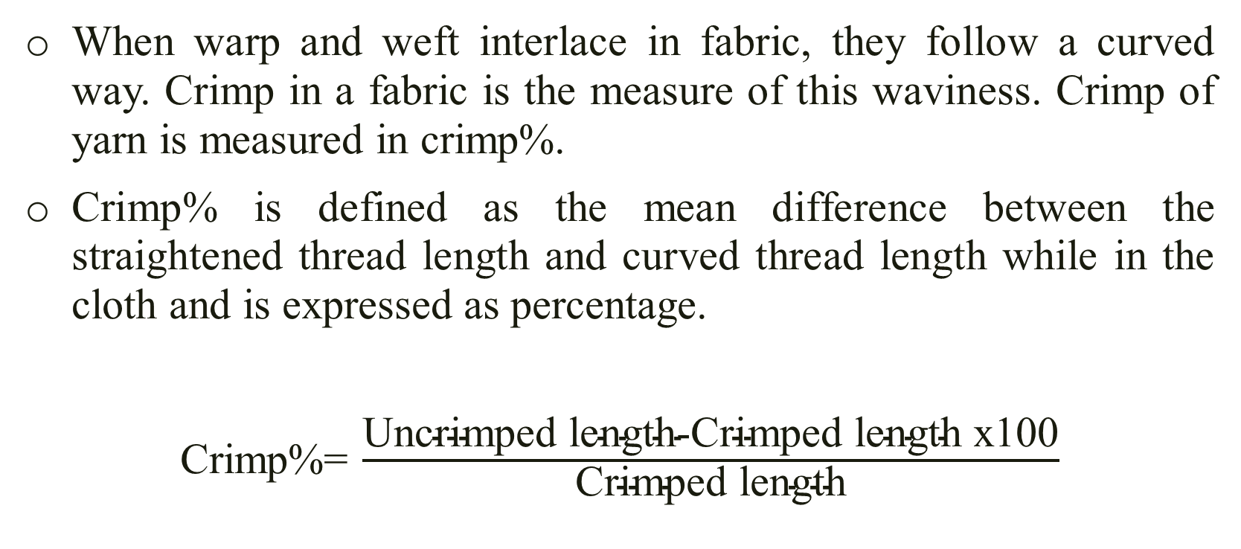
Yarn Crimp
When warp and weft interlace in fabric, they follow a curved way. Crimp in a fabric is the measure of this waviness. Crimp of yarn is measured in crimp%.
Crimp% is defined as the mean difference between the straightened thread length and curved thread length while in the cloth and is expressed as percentage.
Crimp%= $\frac{\text{Uncrimped} \text{length}\text{-}\text{Crimped} \text{length} \text{x}\text{100}}{\text{Crimped} \text{length}}$

Slide 3
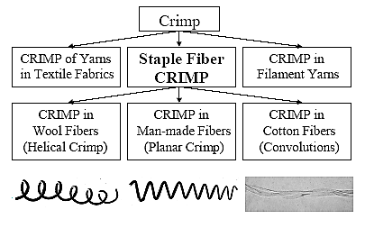
Types of Crimp

Slide 4
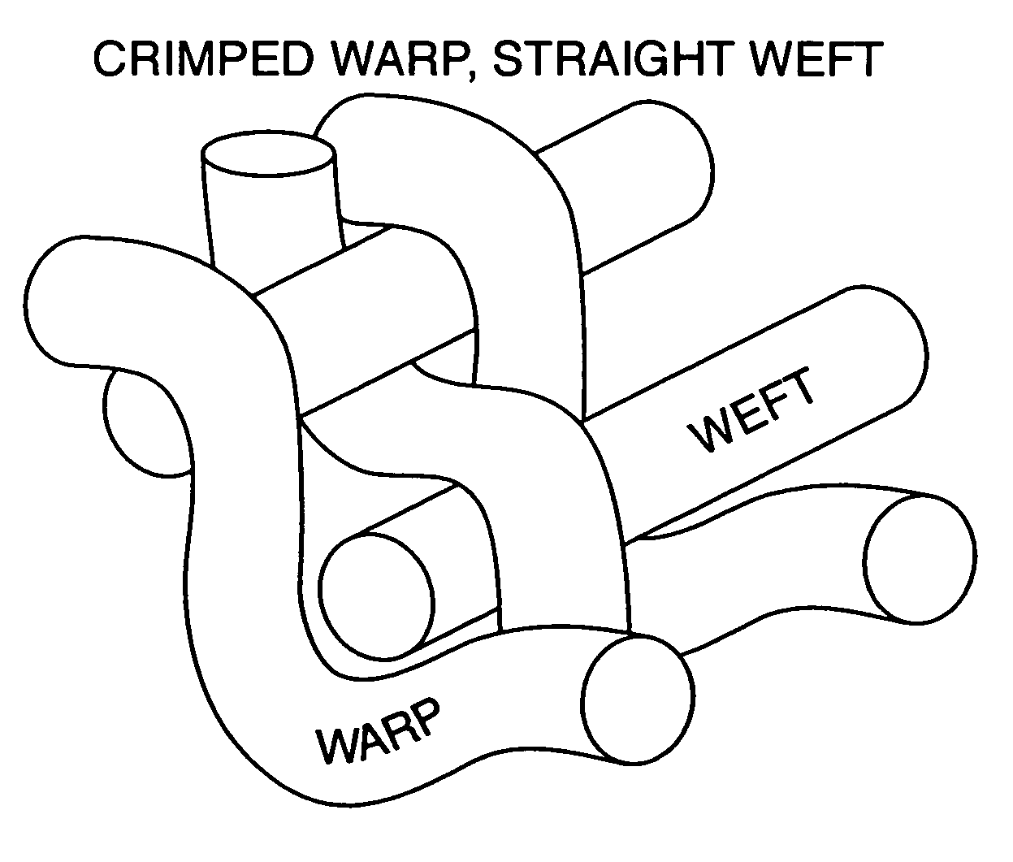
Crimp Amplitude
This refers to the extent to which the threads are deflected from the central plane of the cloth.

Slide 5
Crimp Interchange
When a fabric is subjected to uniaxial stress, the crimp in the direction of loading is gradually reduced and the crimp in the transverse threads increases. This is called crimp interchange.
Actually the reduction of crimp in warp yarns is equal to the increment of crimp in weft yarns. As a result, total crimp of yarn (Both warp and weft) in fabric remains constant.
That is, C_{warp} + C_{weft} = constant;
where, C_{warp}= Warp crimp and C_{weft}= Weft crimp

Slide 6
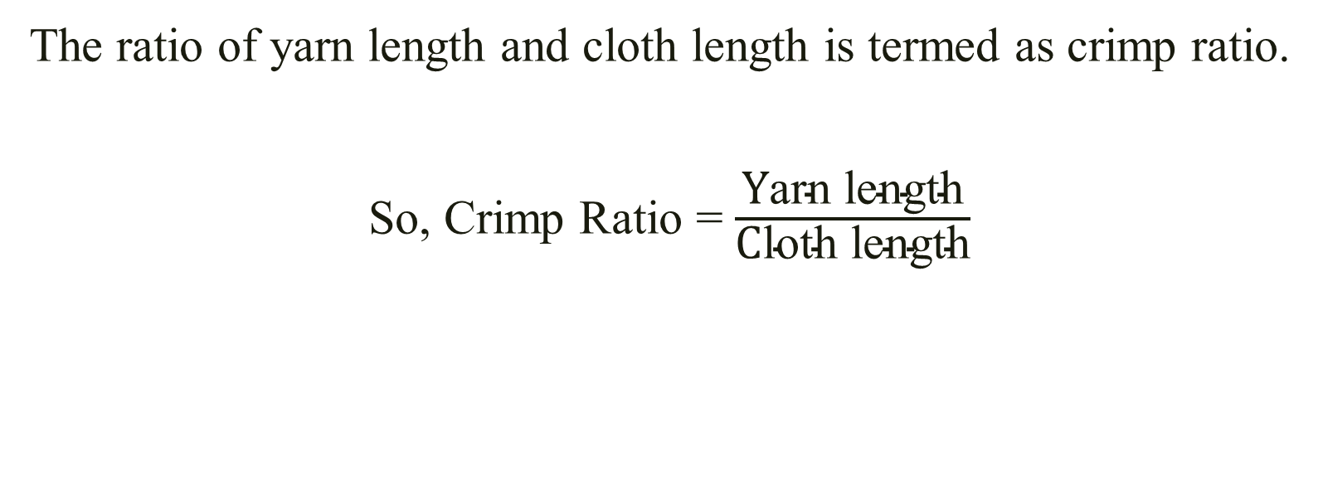
Crimp Ratio
The ratio of yarn length and cloth length is termed as crimp ratio.
So, Crimp Ratio = $\frac{\text{Y}\text{arn} \text{length}}{\text{C}\text{loth} \text{length}}$

Slide 7
Factors Affecting Crimp% of Yarn in the Cloth
EPI- Higher the EPI, higher will be the weft crimp%
PPI- Higher the PPI, higher will be the warp crimp%
Warp linear density- Higher the coarseness of warp, higher will be the weft crimp%
Weft linear density- Higher the coarseness of weft, higher will be the warp crimp%
Yarn tension- Higher the warp tension, higher will be the weft crimp%
Weave structure- Higher the interlacement no., higher will be the crimp%
Yarn twist- Higher the twist in warp than weft, lower will be the weft crimp%
Yarn extensibility- Higher the warp extensibility, lower will be the weft crimp%
Calendaring finish- Higher calendaring results lower crimp% of yarn

Slide 8
Thank You

