Slide 1
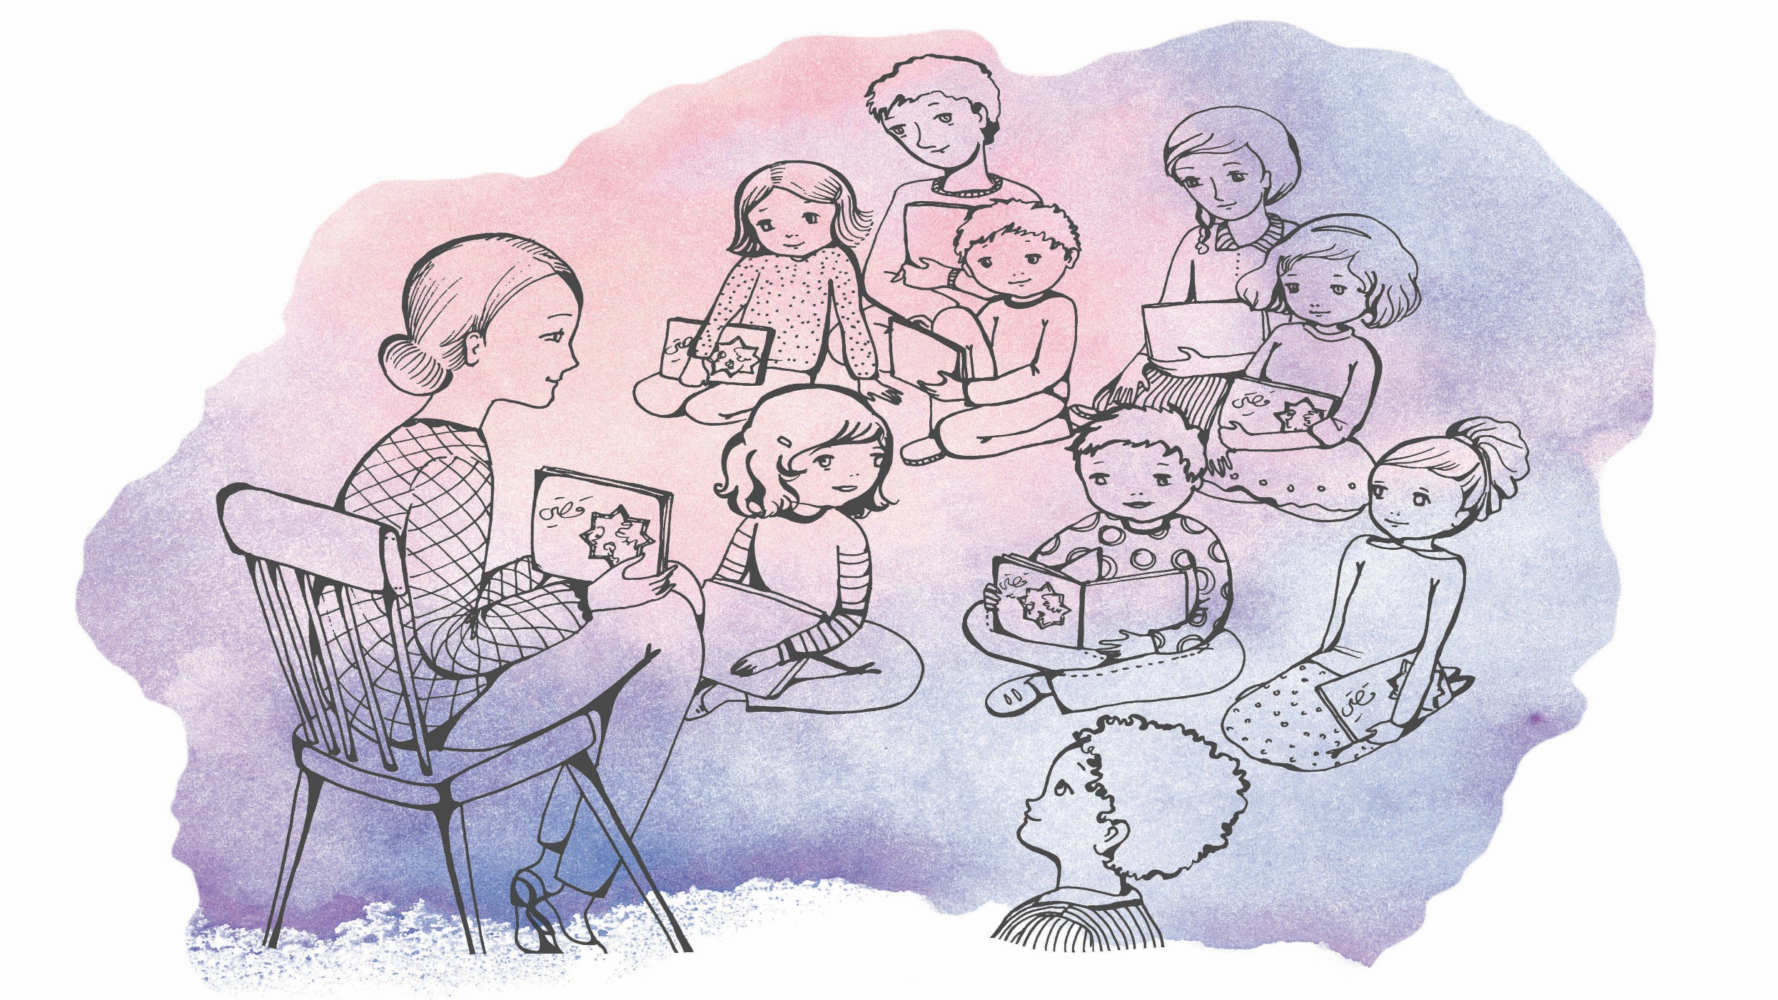
Psychosocial support

Slide 2
Psychosocial support is an approach to victims of
disaster, catastrophe or violence
to foster resilience of communities and individuals.

Slide 4
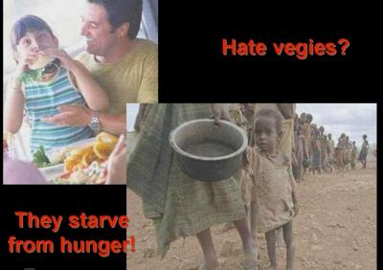

Slide 5
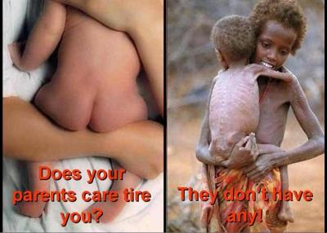

Slide 6
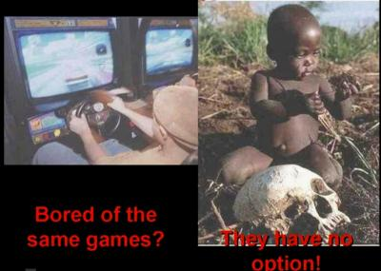

Slide 8
