Slide 1
Pharmaceutical Biotechnology (BPH 421) Galib Muhammad Abrar Ishtiaque Lecturer (Senior Scale) Department of Pharmacy Daffodil International University

Slide 2
Recombinant DNA Technology
CONTENTS
DNA Amplification (PCR)
DNA Fractionation (Gel Electrophoresis)
DNA Analysis (Blotting)
DNA Fingerprinting

Slide 3
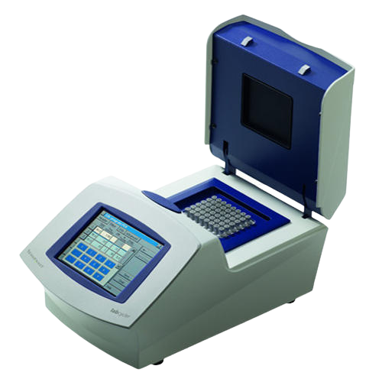
Polymerase Chain Reaction (PCR)
PCR is a technique that allows any piece of DNA to be quickly amplified (copied many times) in vitro.
Required Reagents for PCR:
Template DNA
Two flanking oligonucleotide primers & nucleotides
Heat-stable DNA polymerase
Thermocycler to automate process
(~6 minutes per cycle, ~3 hours for 30 cycles)

Slide 4
Three Steps of PCR
Denaturation: The two strands are heated at approximately 94°C. The heat breaks the hydrogen bonds between the nitrogenous base pairs. The two strands are just separated, not altered.
Annealing: DNA polymerase, 4-nitrogenous bases and an excess of DNA primers are added to the target DNA. The mixture is cooled to approximately 65°C to allow the primers to anneal, that is, to bind the appropriate complementary strand.
Extension: The temperature is now raised to approximately 72°C. In the presence of Mg²⁺, DNA polymerase extends the primers on both strands from 5′ to 3′ by its polymerase activity.

Slide 5
Polymerase Chain Reaction (PCR)
Once this cycle is finished, it can be repeated over and over until about 30 cycles are completed. This will generate over 1 billion copies of the DNA molecules.
This process is now automated using a Thermocycler.
Once the DNA Polymerase, the primers and the 4 nucleotides are supplied to this instrument, the target DNA is added and the machine is engaged, it will cycle the number of times programmed in & will go through the three temperature cycles to produce billions of copies of the target DNA.

Slide 6
Polymerase Chain Reaction (PCR)
For this mechanism to be carried out totally without any problem of destroying the DNA polymerase, the appropriate polymerase had to be used. Once that could not break down at 94°C.
The organism called Thermus aquaticus has the correct polymerase that could be used for this purpose. The enzyme is a catalyst, is not denatured and does not have to be replenished after each cycle.

Slide 7
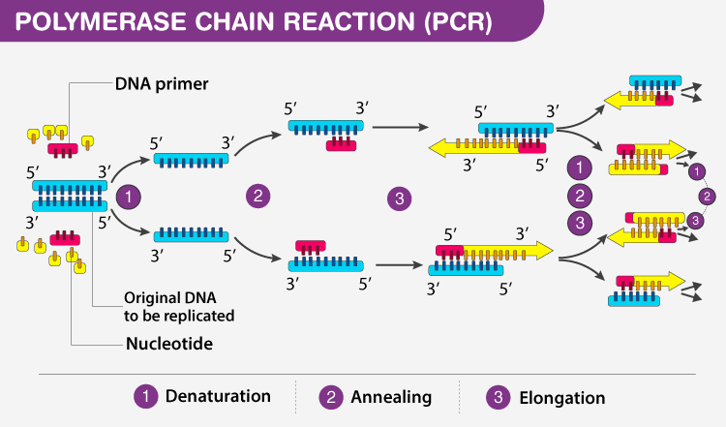
Three Steps of PCR

Slide 8
Gel Electrophoresis
DNA fractionation means the separation of DNA fragments in order to isolate and analyze DNA cut by restriction enzymes.
DNA fragments of different sizes are resolved according to their size and shape through gels made of polymeric materials such as polyacrylamide and agarose. For instance, agarose is a polysaccharide derived from seaweed and gels formed from between 0.5% to 2% can be used to separate DNA.
DNA is electrophoresed through the agarose gel from the cathode (negative) to the anode (positive) when a voltage is applied, due to the net negative charge carried on DNA.

Slide 9
Gel Electrophoresis
When the DNA has been electrophoresed, the gel is stained in a solution containing ethidium bromide.
This compound binds tightly to DNA (and called a DNA chelator) that fluoresces strongly under UV light, allowing the visualization and detection of the DNA.
Like any molecule that binds to DNA, ethidium bromide is hazardous. It is a mutagen.
The smaller DNA pieces move quickly because of their size and the larger ones move more slowly.

Slide 10
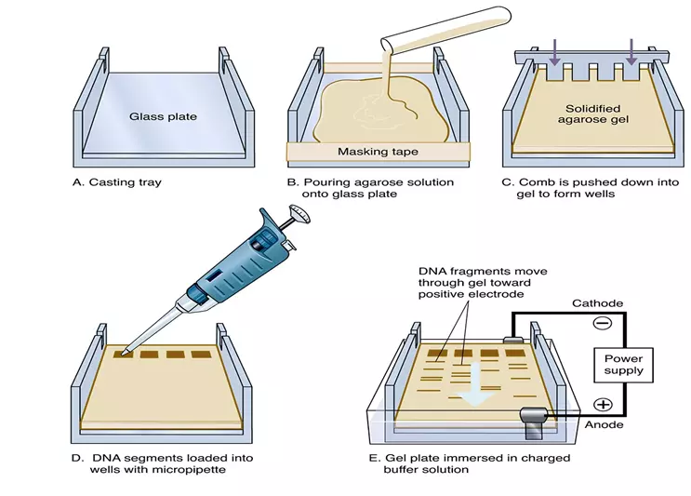
Gel Electrophoresis

Slide 11
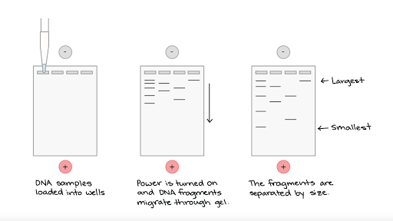
Gel Electrophoresis

Slide 12
Blotting
Southern Blotting allows the detection of a gene of interest by probing DNA fragments that have been separated by electrophoresis with a “labeled” probe (probe DNA on a gel with a DNA probe).
Northern Blotting allows the detection of a gene of interest by probing RNA fragments that have been separated by electrophoresis with a “labeled” probe (probe RNA on a gel with a DNA probe).
Western Blotting allows the detection of a gene of interest by probing proteins that have been separated by electrophoresis with an antibody (probe proteins on a gel with an antibody).

Slide 13
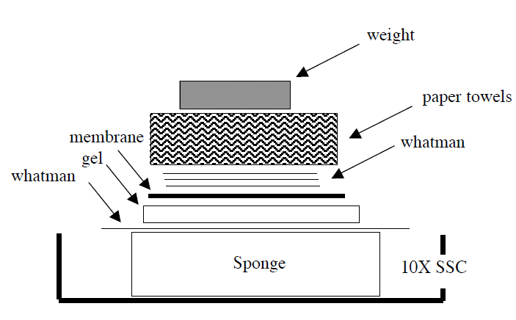
Southern Blotting

Slide 14
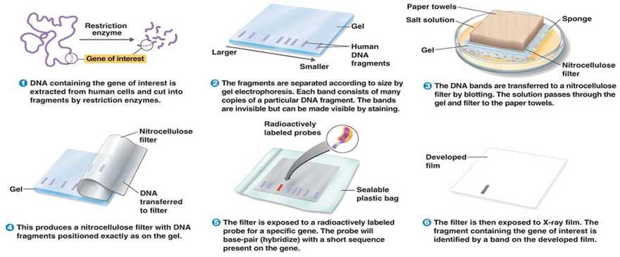
Southern Blotting

Slide 15
Southern Blotting
Samples of the DNA to be probed are cut with restriction endonucleases.
The fragments are separated by gel electrophoresis.
After soaking the gel in an alkaline solution to denature the DNA, the single-stranded DNA is transferred to a DNA-binding membrane for hybridization by making a sandwich of the gel, membrane, filter paper, and absorbent paper. The blot is held in place with a weight.
Capillary action draws the buffer through the gel, transferring the pattern of DNA fragments from the gel to the membrane.
The membrane is hybridized with a radioactively labeled probe and then washed to remove any nonspecifically bound probe.
The membrane is overlaid with a piece of X-ray film for autoradiography. The hybridized fragments show up as bands on the X-ray film.

Slide 16
DNA Fingerprinting
DNA fingerprinting is also known as DNA typing or DNA profiling.
DNA fingerprinting is a technique that is used to characterize biological samples for legal proceeding.
This technique has been used to establish both that some suspects committed a crime and that some individuals had been wrongly convicted of crimes that they did not commit.

Slide 17
DNA Fingerprinting
After a biological sample (e.g. blood, semen, skin, or hair) is collected, a portion is analyzed.
Firstly, the DNA of our sample is digested with a restriction enzyme, and the fragments are separated on an agarose gel and transferred by blotting onto a nylon membrane.
The membrane is hybridized sequentially with radiolabeled probes that each recognize a distinct DNA sequence.
After each hybridization reaction, the bands where the probe has bound to the digested DNA sample are visualized by autoradiography and the banding pattern for each sample is noted.
Before the next probe is used, the first probe is completely removed (stripped) from the membrane.

Slide 18
DNA Fingerprinting
​Applications:
To identify DNA sequence variability and polymorphism.
In forensic science, it is used to identify prospective criminal suspects.
To prove paternity and establish familial ties.
To identify and protect the commercial crop and livestock types.
To figure out an organism's evolutionary history and the relationships between different groupings of species.

Slide 19
The End

