Slide 1
Diesel Power Plant
Prepared By-
Nusrat Chowdhury
Dept. of Electrical & Electronic Engineering (EEE)
Daffodil International University (DIU)

Slide 2
Diesel Power Plant
When prime mover of the alternators is diesel engine, the power station is called diesel power station. Diesel burns in inside the engine and the products of this combustion act as the working fluid to produce mechanical energy.
The mechanical power required for driving alternator comes from combustion of diesel. As the diesel costs high, this type of power station is not suitable for producing power in large scale in our country. But for small scale production of electric power, and where, there is no other easily available alternatives of producing electric power, diesel power station are used.
Diesel power plants are also popularly used as standby supply of different industries, commercial complexes, hospitals, etc. During power cut, these diesel power generators are run to fulfill required demand.

Slide 3
Advantages
This is simple in design point of view.
Required very small space.
It has quick starting facility, the small diesel generator set can be started within few seconds.
It can also be stopped as when required stopping small size diesel power station, even easier than it’s starting
As these machines can easily be started and stopped as when required, there may not be any standby loss in the system.
Cooling is easy and required smaller quantity of water in this type power station.
Initial cost is less than other types of power station.
Thermal efficiency of diesel is quite higher than of coal.

Slide 4
Disadvantages
The cost of diesel is very high compared to coal. This is the main reason for which a diesel power plant is not getting popularity over other means of generating power. In other words the running cost of this plant is higher compared to steam and hydro power plants.
The plant generally used to produce small power requirement.
Cost of lubricants is high.
Maintenance is quite complex and costs high.
Plant does not work satisfactorily under overload conditions for a longer period.

Slide 5
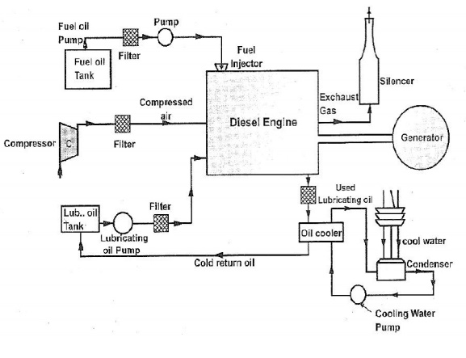
Layout of Diesel Power Plant

Slide 6
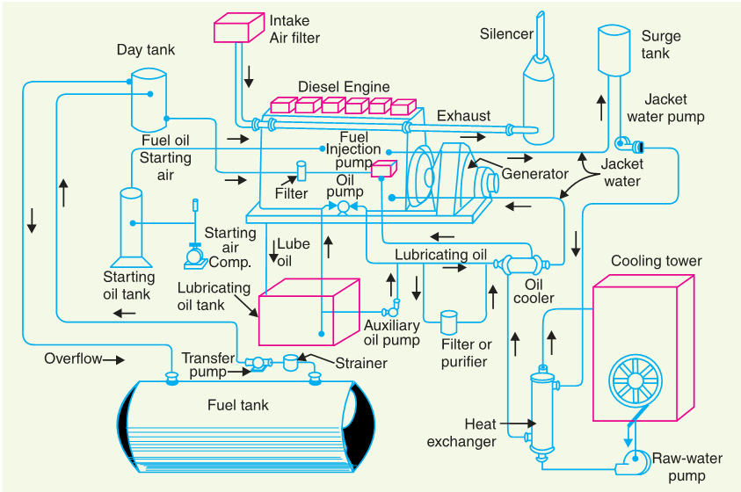
Layout of Diesel Power Plant

Slide 7
Different Components of Diesel Power Station
Fuel Supply System: In fuel supply system there are one storage tank strainers, fuel transfer pump and all day fuel tank. Storage tank where oil in stored. This oil then pump to all day tank, by means of transfer pump. During transferring from main tank to smaller all day tank, the oil passes through strainer to remove solid impurities. The clean oil is injected in the diesel engine by means of fuel injection pump. There is also an over flow pipe. This pipe connection is used to return the oil from dry tank to main tank in the event of over flowing.
Air Intake System: This system supplies necessary air to the engine for fuel combustion. It consists of a pipe for supplying of fresh air to the engine. Filters are provided to remove dust particles from air because these particles can act as an abrasive in the engine cylinder.

Slide 8
Different Components of Diesel Power Station
Exhaust System: The exhaust gas is removed from engine, to the atmosphere by means of an exhaust system. A silencer is normally used in this system to reduce noise level of the engine.
Cooling System: The heat produced due to internal combustion, drives the engine. But some parts of this heat raise the temperature of different parts of the engine. High temperature may cause permanent damage to the machine. Hence, it is essential to maintain the overall temperature of the engine to a tolerable level. Cooling system of diesel power station does exactly so. The cooling system requires a water source, water pump and cooling towers. The pump circulates water through cylinder and head jacket. The water takes away heat from the engine and it becomes hot. The hot water is cooled by cooling towers and is re-circulated for cooling.

Slide 9
Different Components of Diesel Power Station:
Lubricating System: This system minimizes the wear of rubbing surface of the engine. Here lubricating oil is stored in main lubricating oil tank. This lubricating oil is drawn from the tank by means of oil pump. Then the oil is passed through the oil filter for removing impurities. From the filtering point, this clean lubricating oil is delivered to the different points of the machine where lubrication is required the oil cooler is provided in the system to keep the temperature of the lubricating oil as low as possible.
Engine Starting System: For starting a diesel engine, initial rotation of the engine shaft is required. Until the firing start and the unit runs with its own power. For small station, the initial rotation of the shaft is provided by handles but for large diesel power station, compressed air is used for starting.

Slide 10
Example 2.14. A diesel power station has fuel consumption of 0·28 kg per kWh, the calorific value of fuel being 10,000 kcal/kg. Determine (i) the overall efficiency, and (ii) efficiency of the engine if alternator efficiency is 95%.

Slide 11
Example 2.15. A diesel power station has the following data : Fuel consumption/day = 1000 kg Units generated/day = 4000 kWh Calorific value of fuel = 10,000 kcal/kg Alternator efficiency = 96% Engine mech. efficiency = 95% Estimate (i) specific fuel consumption, (ii) overall efficiency, and (iii) thermal efficiency of engine.

Slide 12
Example 2.16. A diesel engine power plant has one 700 kW and two 500 kW generating units. The fuel consumption is 0·28 kg per kWh and the calorific value of fuel oil is 10200 kcal/kg. Estimate (i) the fuel oil required for a month of 30 days and (ii) overall efficiency. Plant capacity factor = 40%.

Slide 13
Thank You

