Slide 3
Tannins

Slide 4
Introduction
Tannins are secondary metabolites of plants, non-nitrogenous, phenolic in nature.
They have a property to tan animal skin to convert to leather or hide.
Conversion imparts resistance to water, heat, abrasives.
They can be extracted using water-acetone/alcohol mixture.
They have a property to precipitate gelatin & heavy metals.

Slide 5
Introduction ….
Tannins: Pale yellow to light brown-red amorphous substances widely distributed in plants and used chiefly in tanning leather, dyeing fabric, and making ink.
Their solutions are acid and have an astringent taste.
They are isolated from oak bark, sumac, and galls.

Slide 6
Introduction ….
Tannins give tea astringency, colour, and flavour.
Tannins are used industrially to clarify wine and beer, reduce viscosity of oil-well drilling mud, and they have also had medical uses
Tannins are mainly found in the cell vacuoles or in the cuticle (here cells don’t interfere with plant processes: only after death and cell breakdown so they become active in metabolic processes).
Tannins are phenolic glycosides.

Slide 7
Introduction ….
Historically, the importance of tannin-containing drugs is linked to their tanning properties (ability to transform fresh hides into leather).
Today, tanning is achieved with mineral compounds, but for several millennia, it had required exclusively the used of plant products.

Slide 8
Introduction ….
These included chestnut tree tannin (Castanea sativa L.), oak tannin (Quercus robar L) in Europe, but also, in other parts of the world, tannins from Anacardiacea (Quebracho – Schinopsis spp), sumacs (Rhus spp),
Legumes (acacias – Acacia spp) or Combretaceae (myrobalans – Terminalia spp).

Slide 9
Tannins - Tanning
The consequence of tanning: formation of bonds between the collagen fibres of the hide (imparts resistance to water, heat and abrasion.)
This capability of tannins to combine with macromolecules explains why they precipitate cellulose, pectins and proteins; it also explain their characteristic astringency and tartness: by precipitating the glycoproteins contained in saliva, tannins make the latter lose its lubricating power.

Slide 10
Tannins - Tanning
The combination between tannins and macromolecules is established by hydrophobic interactions and hydrogen bonds between the phenolic groups of tannins and the proteins or other polymers.
Other types of linkages (irreversible) must also be involved to ensure the lasting stability of the combination between tannins and collagen structures.
These include the covalent bonds established after oxidation of the phenols to quinones.

Slide 11
Tannins - Tanning
The condition necessary for the formation of these linkages is the tannin’s molecular weight must fall within a well defined range. If it is too high, the molecule cannot insert itself into the interfibrillar spaces of the macromolecule. If it is too low, the molecule can insert itself but cannot form enough bonds to stabilize the combination.

Slide 12
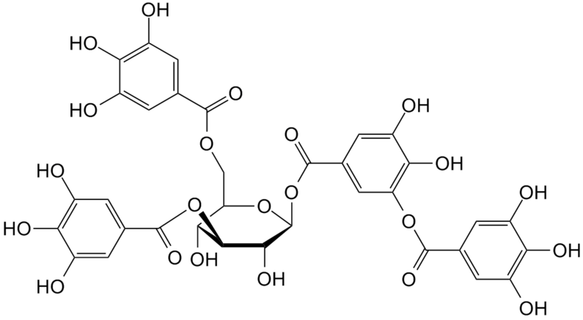
Tannins - Definition
“Water-soluble phenolics of molecular weight between 500 and 3000, which, in addition to displaying the classic reactions of phenols, can precipitate alkaloids, gelatine, and other proteins.”
A more recent definition of tannins: “Phenolic natural products that precipitate proteins from their aqueous solutions”.
Tannic Acid

Slide 13
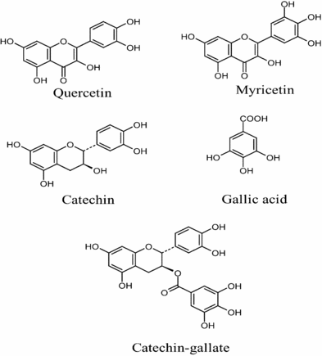
True Tannins Vs Pseudo-Tannins
True tannins: Molecular weights of 1000-5000. e.g. –Tannic acid
Pseudo-tannins: Gallic acid, catechins and chlorogenic acid are similar phenolic compounds have a low molecular weight.

Slide 14
Tannin Function
Tannins are of wide occurrence in plants and are usually found in greatest quantity in dead or dying cells.
They exert an inhibitory effect on many enzymes due to protein precipitation and, hence, may contribute a protective function in barks and heartwoods.

Slide 15
Tannin Incompatibilities
Clove and cinnamon contain tannins and also other principal therapeutic constituents.
This may complicate extraction or produce imcompatibilities with other drugs.
E.g. Many alkaloids for example are precipitated by tannins.

Slide 16
Tannin Extraction
Tannins are extracted using water and acetone.
Optimal yields are obtained from fresh tissues or freeze-dried tissues.
Optimal yields are not obtained from dried tissues (tannins are irreversibly combined with other polymers).
After eliminating the acetone (distillation), the pigments and lipids are removed from the aqueous solution by a solvent extraction.
Ethyl acetate extraction of the aqueous solution separates the dimeric proanthrocyanidins and most gallotannins.
Polymeric proanthrocyanidins and high molecular weight gallotannins remain in the aqueous phase.

Slide 17
Tannin Extraction…
To obtain pure compounds, the appropriate chromatographic techniques are used (most often one of the gel filtrations).
Followed by reverse-phase chromatography (in water and alcohol, or water, alcohol and acetone mixtures).

Slide 18
Medicinal Properties of Tannins
Therapeutic/medicinal activities result due to the astringency properties.
Tannin containing herbs (drugs) will precipitate proteins.
Externally: waterproof the external layers of the skin and mucosa: Protect underlying layers.
Vasoconstrictor effects – on small superficial vessels.

Slide 19
Medicinal Properties of Tannins
Limits fluid loss – enhance tissue regeneration in superficial wounds and burns
Internally: Anti-diarrhoeal
Anti-septic effects (anti-bacterial/anti-fungal) → used to Rx infectious diarrhoeas and dermatitis.

Slide 20
Anti-oxidant Activity of Tannins
Hydrolysable tannins (more so than condensed tannins) are free-radical scavengers.
Inhibit superoxide ion formation.
Some inhibit lipoxygenase
They do not inhibit cyclo-oxygenase.
Anti-oxidant flavonols and proanthrocyanidins from grape juice and wine are widely considered to be the main principles responsible for the preventative effect of CVD.

Slide 21
Enzymatic Inhibition Action
Tannins may act as enzyme inhibitors.
They block 5-lipoxygenase, inhibit angiotensin converting enzyme, hyaluronidase activation, glucosyltransferases (of microorganisms involved in cavity formation).

Slide 22
New (Hydrolysable) Tannin Potential
Tannins, including gallo and ellagic acid (epigallitannins), are inhibitors of HIV replication.
1,3,4-Tri-O-galloylquinic acid
3,5-di-O-galloyl-shikimic acid,
3,4,5-tri-O-galloylshikimic acid
punicalin
Punicalagin inhibited HIV replication in infected H9 lymphocytes with little cytotoxicity.
Two compounds, punicalin and punicacortein C, inhibited purified HIV reverse Transcriptase.

Slide 23
Physical Properties
Color:
Dark brown or reddish brown
Taste:
Puckering taste
State:
Non-crystalline
Solubility:
Soluble in water, alcohol, dilute alkalis, glycerols and acetone.

Slide 24
Chemical properties
(i) Precipitation
(ii) Anti-oxidizing properties
(iii) Astringent
(iv) Carcinogenicity
(v) Reaction with salts
(vi) Reaction with potassium ferricyanide and ammonia

Slide 25
(i) Precipitation
Tannins have ability to precipitate solutions of;
Gelatin
Alkaloids
Glycosides
Heavy metals
Proteins
(ii) Anti-oxidizing properties
Because of accumulation of OH group on small size nucleus, these agents have anti-oxidant nature.

Slide 26
(iii) Astringent
Tannins have property to react with protein of mucous membrane and cause precipitation.
(iv) Carcinogenicity
Prolong use of tannin containing plant material is hazardous because it causes cancer. Habitual use of Areca catechu can cause oral and esophageal cancer.

Slide 27
(v) Reaction with salts
(vi) Reaction with potassium ferricyanide and ammonia

Slide 28
Importance of tannins
Medicinal Uses:
Antidote
Antiseptic
Algicidals
Astringents
Anti-carcinogenic
Biological Activities:
Inhibition of lipid per oxidation
Decrease in blood urea nitrogen content
Inhibition of plasmin
Lipolysis in fat cells
Industrial Uses:
Ink manufacture
Vegetable tanning
Preservatives

Slide 29
Chemical Classification
Based on identity of phenolic nuclei involved and on the way they are joined.
Tannins
Hydrolysable tannins
Condensed tannins
Complex tannins

Slide 30
(i) Hydrolysable tannins
These tannins are hydrolyzed by enzymes or acids.
Precursors:
Phenolic acid (Gallic acid, Ellagic acid)
Glucose residue
Between phenolic acids and glucose sugar, there is ester linkage

Slide 31
Properties:
Types:
Hydrolysable tannins
Gallitannins
Ellagitannins

Slide 32
Ellagitannins | Gallitannins
Pomegranate Eucalyptus | Rhubarb Clove Hamamelis | Occurrence
Upon acid hydrolysis of Ellagitannins, Ellagic acid is produces. | Upon acid hydrolysis of Gallitannins, Gallic acid is produces. | Hydrolysis
* Slowly soluble in water. * Present in plants in open and ring forms as Hexa hydroxy diphenic acid. | * Rapidly soluble in water. * Free Gallic acid, in plant, is converted to gluco Gallitannins. | Properties

Slide 33
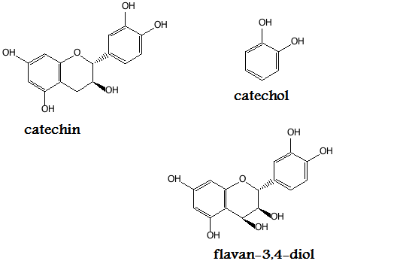
(ii) Condensed tannins
These tannins are derivatives of Flavonoid, catechin, flavonol-3-4-diol.
Precursors:
Flavonoid
Catechin
Flavonol-3-4-diol

Slide 34
Properties:
When heated with acids, these are self condensated, polymerized and converted to insoluble red colored complexes, called Phlobaphenes.
Examples:
Hamamelis
Cinchona
Cinnamon

Slide 35
(iii) Complex tannins
These tannins are mixtures of both, hydrolysable and condensed tannins
Examples:
Tea
Quercus
Castanea

Slide 36
2nd Classification
Tannin is a substance which is detected qualitatively by tanning test (The Gold beater’s skin test) and quantitatively by its adsorption on standard hide powder.
Depending upon this, tannins are of two types;
True tannins
Pseudo tannins
Tannins
True tannins
Pseudo tannins

Slide 37
Pseudo tannins | True tannins
Phenolic compounds of plant origin that don't convert animal hide to leather but do give positive Gold beater’s skin test, are called pseudo tannins. | Polyhydroxy phenolic compounds which convert animal hide to leather by precipitating proteins and give positive Gold beater’s skin test, are called true tannins.
Molecular weight is less than true tannins. | Molecular weight is 1000-5000

Slide 38
Identification tests
Color reaction:
Tannins give color reaction with iron.

Slide 39
Identification tests
Matchstick test:
Dip matchstick in plant extract.
Dry it.
Moisten it with hydrochloric acid. And warm near flame.
Wood will turn pink or red in color due to phloroglucinol.
Gelatin test:
Solution of tannin (0.5%-1%) precipitates 1% solution of gelatin containing 10% sodium chloride.

Slide 40
Identification tests
Phenazone test:
Take 5ml of aqueous extract of drug.
Add 0.5grams of sodium acid phosphate.
Warm it and cool.
Filter solution.
To the filtrate, add 2%solution of Phenazone.
Tannins will be precipitated.
Precipitates will be bulky and colored.

Slide 41
Identification tests
Gold beater’s skin test:
Gold beater’s skin is a membrane prepared from intestine of Ox and I behaves similarly to un tanned skin.
Soak a small piece of Gold beater’s skin in 2% hydrochloric acid.
Rinse it with distilled water.
Place it in solution to be tested for 5 minutes.
Wash in water and transfer to 1% solution of ferrous sulphate.
Black or brown color of skin indicates presence of tannins.
It is a quantitative test and +ive only for true tannins

Slide 42
Identification tests
Catechin test:
Catechin when heated with acid produce phloroglucinol. Phloroglucinol can be detected with matchstick test.
Test for chlorogenic acid:
Treat extract containing chlorogenic acid with aqueous ammonia and expose it to air. Green color will appear gradually.

Slide 43
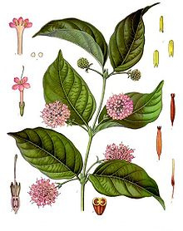
Catechu
Botanical origin:
Uncaria gambir
Family:
Rubiaceae
Part used:
Dried aqueous extract from leaves and young twigs
Collection:
Boil leaves and twigs in water. Evaporate to a pasty consistency. Paste is put in cubes and dried in sun.

Slide 44
Constituents:
Catechin
Catechutannic acid
Catechu red
Quercitin
Gambir flourescin
Uses:
Astringent
Dying
Tanning industry

Slide 45
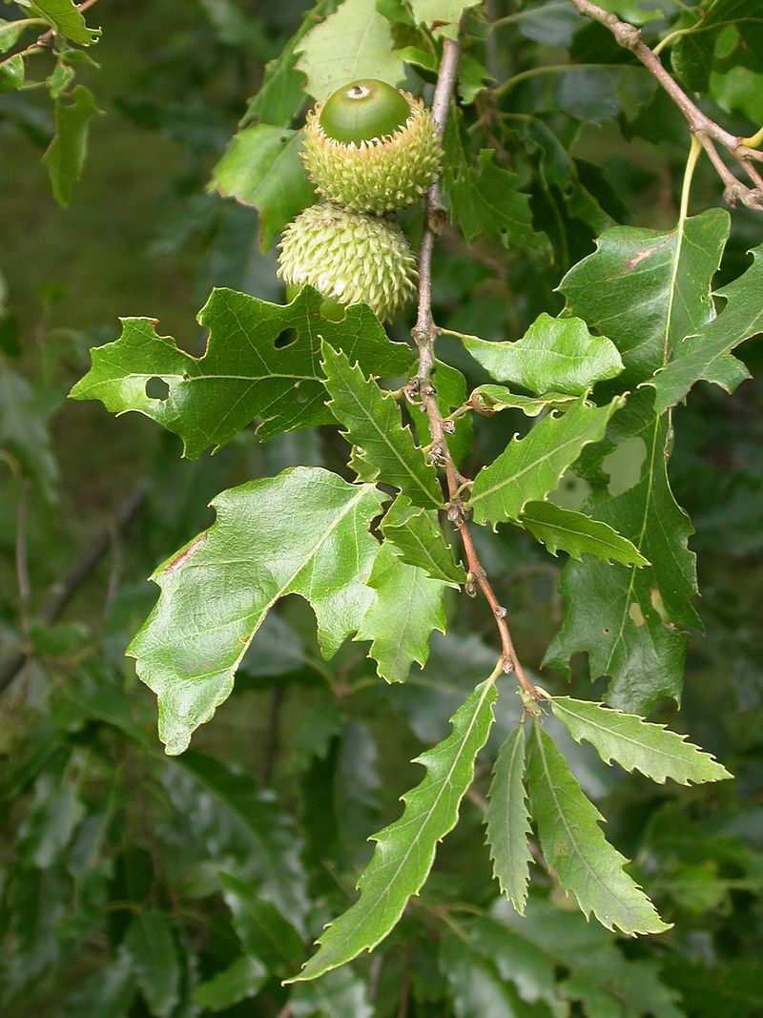
Nutt gall
Botanical origin:
Quercus infectoria
Family:
Fagaceae
Part used:
Galls obtained from twigs

Slide 46
Formation of galls:
Galls are pathological outgrowth formed on twigs of tree. Galls arise due to deposition of eggs by small insect Adleria galactinctoria.
Steps are:
Early summers, insects lay eggs on twigs
Larvae come out from eggs and enter soft epidermis.
Larvae secretes enzyme that stimulates abnormal growth around larvae.
Starch in the tissue gets converted to sugars and stimulate cell division.
Disappearance of starch causes cell shrinkage.
Central cavity is formed in which larvae and pupae grows. Larvae remains in gall for 5-6months.
Mature insect bores the covering of gall and escapes away. Galls are collected before escaping of insect.

Slide 47
Constituents:
Tannic acid
Gallic acid
Ellagic acid
Roburic acid
Syringic acid
Calcium oxalate crystals
Uses:
Haemostatic
Antidote for alkaloidal poisoning
Astringent

