Slide 1
Introduction to Pervasive Computing
Md. Ferdouse Ahmed Foysal
Daffodil International University
CSE334

Slide 2
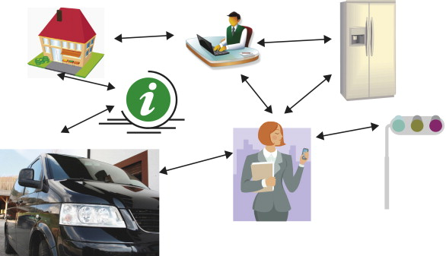
Definition
Ubiquitous computing, also called pervasive computing, is a field of study based on the concept of what happens when computers move away from the desktop and become immersed in the surrounding environment.

Slide 3
Importance
Because pervasive computing systems are capable of collecting, processing and communicating data, they can adapt to the data's context and activity. That means, in essence, a network that can understand its surroundings and improve the human experience and quality of life.

Slide 4
History
Ubiquitous computing was first pioneered at the Olivetti Research Laboratory in Cambridge, England, where the Active Badge, a "clip-on computer" the size of an employee ID card, was created, enabling the company to track the location of people in a building, as well as the objects to which they were attached.
Mark Weiser, largely considered the father of ubiquitous computing.

Slide 5
Pervasive Computing and the Internet of Things
The internet of things (IoT) has largely evolved out of pervasive computing. Though some argue there is little or no difference, IoT is likely more in line with pervasive computing rather than Weiser's original view of ubiquitous computing.
Ubiquitous computing is all about having computational capability in many different (perhaps all) objects in our environment. Things like stoves Fridges, TV, Cars etc all having some computational power. The Internet of Things (IoT) is about having these objects in our environment all connected to an internet.

Slide 6
Applied Pervasive Computing

Slide 7
Pervasive Computing Today
Today's emerging Pervasive Computing technology faces serious technical issues.
Most devices have strong limitations on memory usage and processor performance as well as tight constraints on power consumption.
The footprint of operating systems and software need to be reduced as much as possible.
In information technology, a footprint is the amount of space a particular unit of hardware or software occupies.
Mobile devices must handle power shortages and their applications must be able to resume again after a shutdown.
Pervasive applications need to take care of various hardware and software platforms, as well as of very different form factors and user interfaces.

Slide 8
Pervasive Computing Tomorrow
All the manifold devices will so on outnumber personal computers as network connected information processing entities.
Pervasive Computing will have a strong impact on our society.
There will be a flexible and productive new work style.
Lifestyle will be influenced by incredible communication possibilities, staying in touch with everyone from anywhere.
There is endless demand for exchanging and sharing information.
Information is accessed and used wherever it is needed in a convenient manner.

Slide 9
Pervasive Computing Principles
Decentralization
Diversification
Connectivity
Simplicity

Slide 10
Decentralization
The shift from a centralized view to a strongly decentralized computing landscape is the first paradigm of Pervasive Computing.

Slide 11
Decentralization
Distributed Systems
Pervasive Computing goes even one step further and distributes the responsibilities between manifold small devices, which take over specific tasks and functionality.
Each of these autonomous entities contribute to a heterogeneous overall computing landscape.
They cooperate in an open mutual community establishing a dynamic network of relationships.

Slide 12
Decentralization
Synchronizing Information
The ability to use applications and information on mobile devices and synchronize any updates with network based systems or other devices is a new task arising from that decentralization.
Information sources and destinations are widely distributed in a pervasive world. Popular mobile devices, like handheld computers, cellular phones, pagers or laptops have to synchronize their data on the fly between each other as well as with desktop applications, such as calendars or address books.
Databases on devices with different capabilities and storage capacities have to be kept consistent.

Slide 13
Decentralization
Managing Applications
Pervasive devices and applications are often embedded into a service infrastructure, like a cellular phone network.
Decentralization makes it necessary for service providers to administer their deployed software and deliver updates to the customer's devices from remote.
They have to keep track of individual user profiles and different device capabilities. To deploy applications and manage devices in such an environment, the server software must be highly scalable and flexible.
Back-end systems have to face millions of manifold pervasive devices travelling around the world instead of just thousands of traditional PCs resting peacefully in their offices.

Slide 14
Diversification
The second paradigm of Pervasive Computing affects the functionality of computer systems.
Targeting specific needs
Alternatives

Slide 15
Connectivity
The third paradigm of Pervasive Computing is the strong demand towards connectivity.
Wire (Data cable)
Infrared
Bluetooth
Wi-Fi
NFC

Slide 16
Connectivity
Real-life obstacles
Platform specific issues are a major obstacle for application and information exchange
Different processors induce different restrictions on performance and memory usage

Slide 17
Connectivity
Agreeing on common standards
One approach for achieving connectivity and interoperability is to base the applications on common standards.

Slide 18
Simplicity
The flexibility of an all-purpose personal computer is certainly a technical achievement, but it has its price: Those computers we are used to, are becoming more and more complicated. Many of the features a state-of-the-art word processor offers confuse the majority of users and reduce ease-of-use.
In spite of plug-and-play the installation of new software is often a challenge for those, who are not trained computer experts.
Pervasive devices are very specialized tools, which cannot do many different things.

Slide 19
Simplicity
Convenient, intuitive, self-evident
The magic words are availability, convenience, and ease of use. Information access and management must be applicable without spending significant time learning how to use technology.

Slide 20
Simplicity
Mature human computer interfaces
Simple must not be confused with primitive. Pervasive Computing postulates a holistic approach: Hardware and software should be seamlessly integrated and target the very specific needs of an end user.
Complex technology is hidden behind a friendly user-interface. Achieving the intended easy usage requires substantial efforts for application design and development.

Slide 21
Pervasive Information Technology
A pervasive solution can be simplified as a three tier vertical structure:
Device
Workstation
Server

Slide 22
Pervasive Information Technology
Device
The front-end of information technology is the wide range of pervasive devices, designed for creating and accessing information on the fly.
These devices are the most visible interfaces to the user and penetrate our business and all day life.

Slide 23
Pervasive Information Technology
Workstation
Workstations form an optional middle tier. The traditional Personal Computer offers capabilities for working with complex information and managing local personal devices.
Often, this layer is even omitted, since most pervasive appliances are able to access their provider's networks directly.
Devices like set-top boxes can replace or complement the personal workstation as a gateway between personal devices and public networks.

Slide 24
Pervasive Information Technology
Server
Web servers, enterprise servers and mainframes mainly focus on storing and processing large amounts of information using their strong computing power.
Pervasive Computing introduces significant changes on software products.

Slide 25
Pervasive Information Technology
Behind this hierarchy of computing systems two underlying layers can be identified, which are of increasing importance:

Slide 26
Pervasive Information Technology
Services
Numerous kinds of services complete the Pervasive Computing landscape.
They establish the infrastructure for the widespread usage of computing, since information is intrinsically combined with the accompanying services to provide them.

Slide 27
Pervasive Information Technology
Standards
There is a broad basis of common standards on which the information technology is based upon.
Standards ensure interoperability and connectivity of systems as well as information and application exchange.
Since standards are an important issue for Pervasive Computing, they will be ubiquitous throughout this book.

Slide 28
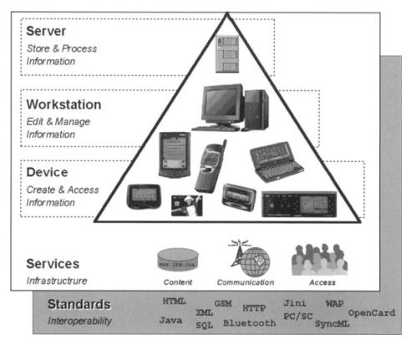

Slide 29
Acknowledgements
These slides contain material developed and copyright by:
Pervasive Computing Handbook - Uwe Hansmann

