Slide 1
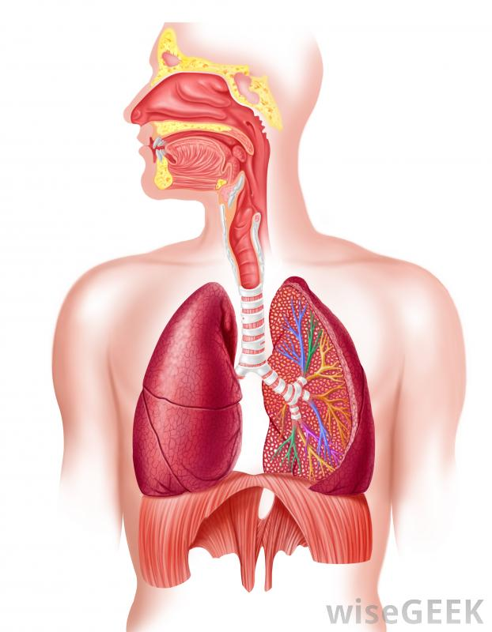
Respiratory system

Slide 2
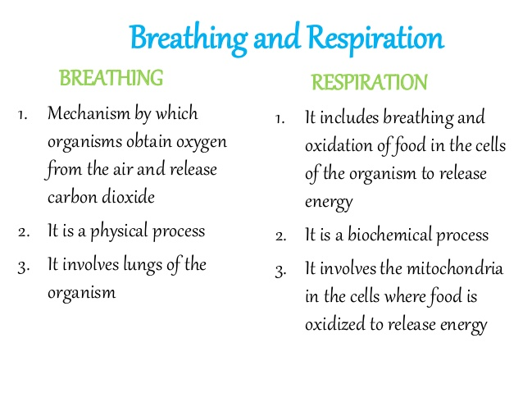

Slide 3
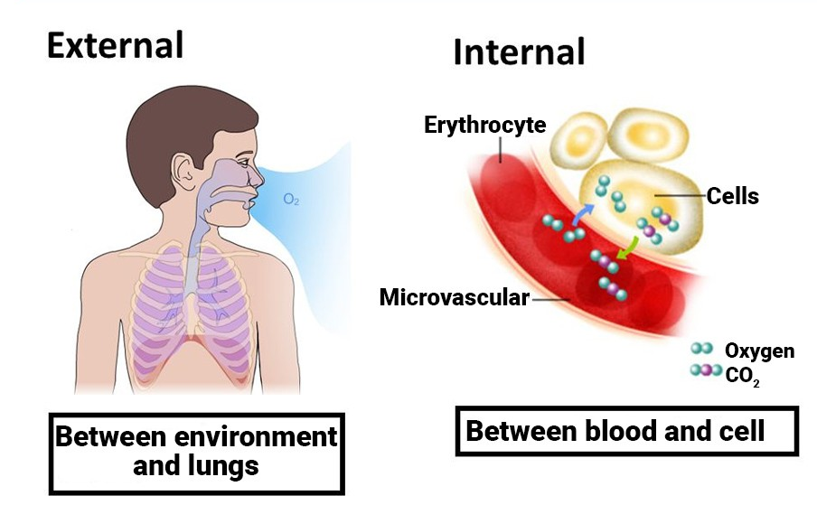
Respiration
A physiological process which means the transport of oxygen from atmosphere to the body cell for oxidation of the ingested food materials and elimination of carbon dioxide and other volatile metabolic end products from the cell to the atmosphere.
Types:
Cellular
Rates: 10-18 per minute

Slide 4
A.

Slide 5
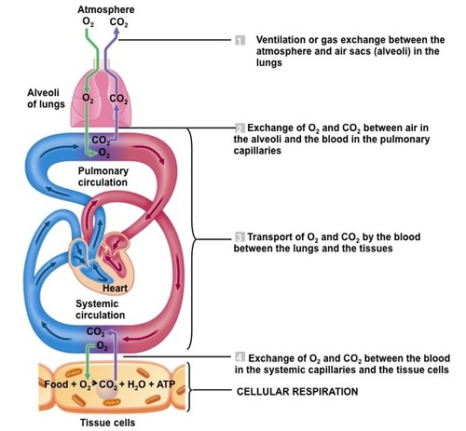

Slide 6
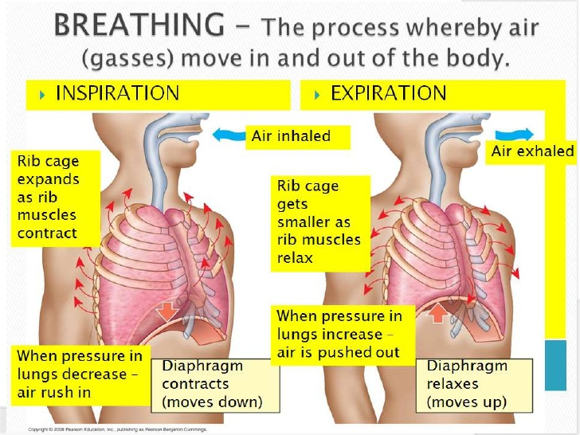
1. Pulmonary ventilation Inspiration and Expiration

Slide 7
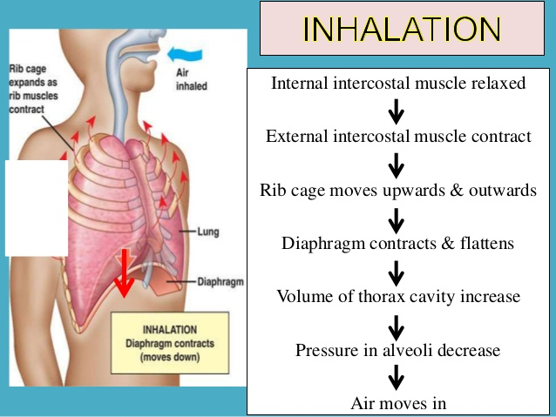
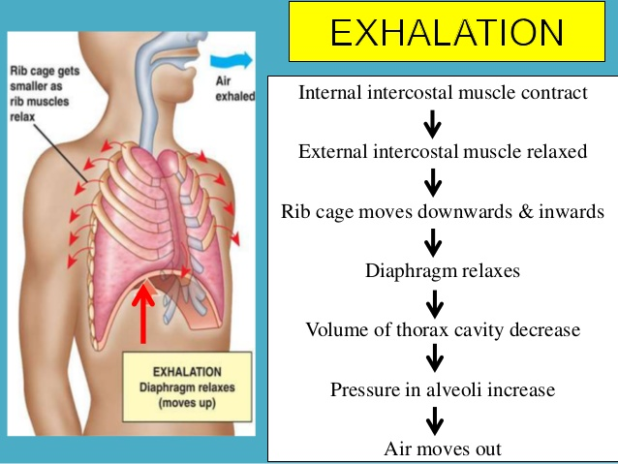

Slide 8
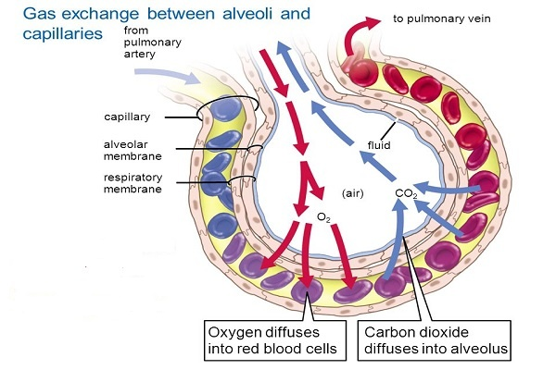
2.
3. Transport of respiratory gases

Slide 9
2
3
Types

Slide 10
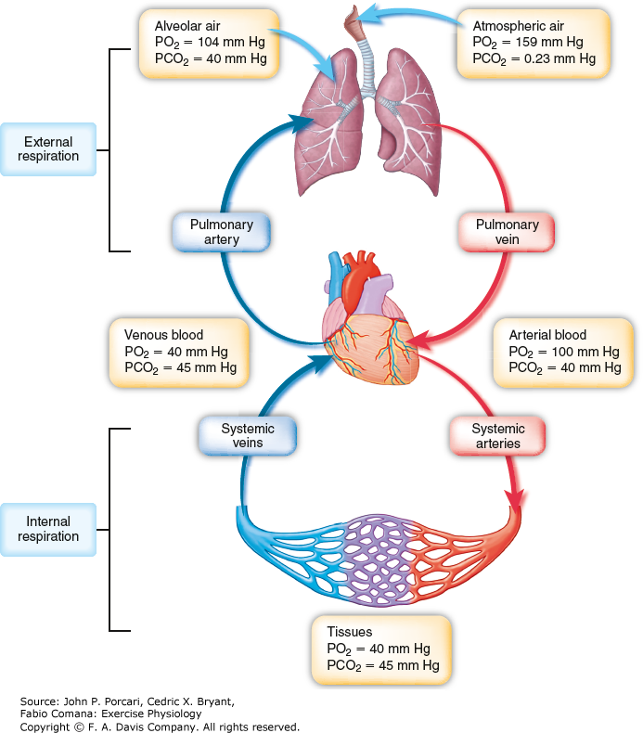

Slide 16
Carbon dioxide transport mechanism
Carbon dioxide produced in the tissue cells diffuses into the blood plasma.
The largest fraction of carbon dioxide diffuses into the red blood cells. The carbon dioxide in the red blood cells is transported as: dissolved CO₂, combined with hemoglobin, or as bicarbonate,(largest fraction).
The formation of bicarbonate ions, (HCO₃⁻ ) takes place by the following reactions:
Hydration of CO₂: CO₂ + HOH ⬄ H₂CO₃ Dissociation of H₂CO₃: H₂CO₃ ⬄ H⁺ + HCO₃⁻
Bicarbonate diffuses out of the red blood cells into the plasma in venous blood and visa versa in arterial blood.
The change in pH in arterial blood caused by the diffusion of CO₂ out of the blood into the lungs.

Slide 17
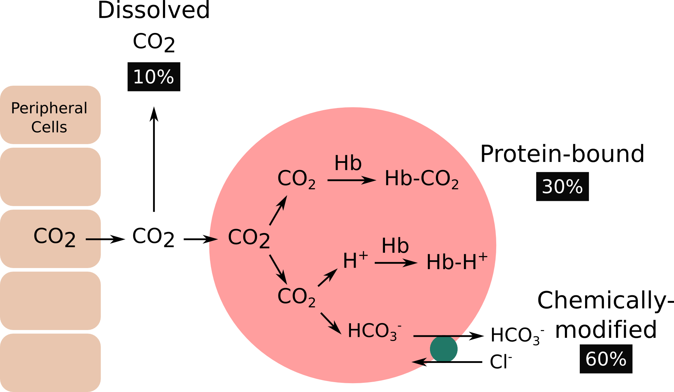

Slide 18
TYPES

