Slide 1
Chapter 2: Laws of Probability
Shanjida Chowdhury

Slide 2
Learning Objectives When you have completed this chapter, you will be able to: LO1 Calculate probabilities using the rules of addition. LO2 Define the term joint probability. LO3 Calculate probabilities using the rules of multiplication. LO4 Define the term conditional probability. LO5 Compute probabilities using a contingency table.

Slide 3
Recall about Probability
Probability is a measure of the likelihood that an event in the future will happen.
A value near zero means the event is not likely to happen. A value near one means it is likely.
Value of probability lies in between 0 to 1.
Sum of all probability is equal to 1.

Slide 4
Math problem

Slide 5
Mutually Exclusive Events: Events are mutually exclusive if the occurrence of any one event means that none of the others can occur at the same time. Collectively Exhaustive Events: Events are collectively exhaustive if at least one of the events must occur when an experiment is conducted.

Slide 6
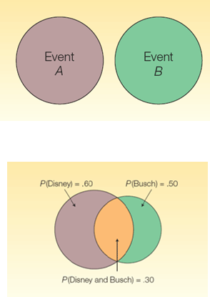
Rules for Computing Probabilities
Rules of Addition
Special Rule of Addition - If two events A and B are mutually exclusive, the probability of one or the other event’s occurring equals the sum of their probabilities.
P(A or B) = P(A) + P(B)
The General Rule of Addition - If A and B are two events that are not mutually exclusive, then P(A or B) is given by the following formula:
P(A or B) = P(A) + P(B) - P(A and B)
Joint probability

Slide 7
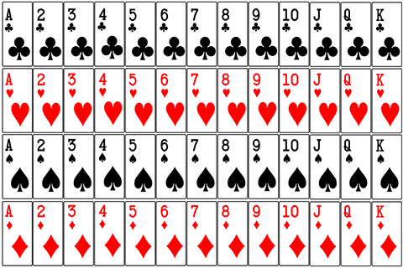
Card Game
Kkk

Slide 8
Contd..
King=4
Queen=4
Spade=13
Club=13
Dice =13
Heart=13

Slide 9
Problem 1 : A card is drawn at random from a well shuffled pack of 52 cards. What is the probability that the drawn card is king ?

Slide 10
Problem 2 : A card is drawn at random from a well shuffled pack of 52 cards. Find the probability that the drawn card is not king.

Slide 11
Addition Rule - Example
What is the probability that a card chosen at random from a standard deck of cards will be either a king or a heart?
P(A or B) = P(A) + P(B) - P(A and B)
= 4/52 + 13/52 - 1/52
= 16/52, or .3077

Slide 12
The Complement Rule-
The complement rule is used to determine the probability of an event occurring by subtracting the probability of the event not occurring from 1.
P(not occurring) = 1 – P(occurring)

Slide 13
FOR ANYEVENT:-
0 ≤ P(E) ≤ 1
P(E) + P(E ) = 1
P(E) = 1− P(E )
P(E ) = 1− P(E)

Slide 16
Special Rule of Multiplication
The special rule of multiplication requires that two events A and B are independent.
Two events A and B are independent if the occurrence of one has no effect on the probability of the occurrence of the other.
This rule is written: P(A and B) = P(A)P(B)

Slide 17
Multiplication Rule-Example
A survey by the American Automobile association (AAA) revealed 60 percent of its members made airline reservations last year. Two members are selected at random. What is the probability both made airline reservations last year?
Solution:
The probability the first member made an airline reservation last year is .60, written as P(R₁) = .60
The probability that the second member selected made a reservation is also .60, so P(R₂) = .60.
Since the number of AAA members is very large, you may assume that
R₁ and R₂ are independent.
P(R₁ and R₂) = P(R₁)P(R₂) = (.60)(.60) = .36

Slide 18
Conditional Probability
A conditional probability is the probability of a particular event occurring, given that another event has occurred.
The probability of the event A given that the event B has occurred is written P(A|B).

Slide 19
General Multiplication Rule
The general rule of multiplication is used to find the joint probability that two events will occur.
Use the general rule of multiplication to find the joint probability of two events when the events are not independent.
It states that for two events, A and B, the joint probability that both events will happen is found by multiplying the probability that event A will happen by the conditional probability of event B occurring given that A has occurred.

Slide 20
General Multiplication Rule - Example
A golfer has 12 golf shirts in his closet. Suppose 9 of these shirts are white and the others blue. He gets dressed in the dark, so he just grabs a shirt and puts it on. He plays golf two days in a row and does not do laundry.
What is the likelihood both shirts selected are white?

Slide 21
General Multiplication Rule - Example
The event that the first shirt selected is white is W₁. The probability is P(W₁) = 9/12
The event that the second shirt selected is also white is identified as W₂. The conditional probability that the second shirt selected is white, given that the first shirt selected is also white, is P(W₂ | W₁) = 8/11.
To determine the probability of 2 white shirts being selected we use formula: P(AB) = P(A) P(B|A)
P(W₁ and W₂) = P(W₁)P(W₂ |W₁) = (9/12)(8/11) = 0.55

Slide 22
Example
We have a box with 10 rolls of film, of which 3 are defective. What is the probability of getting a defective roll the first time we draw, followed by a defective roll the second time we draw (assuming there are no replacements)?
1st film being defective: P(D1)=3/10 (3 out of 10 are defective)
2nd film being defective: P(D2|D1)= 2/9 (now 2 out of 9 are defective)
P(D1 and D2)= P(D1)P(D2|D1)=(3/10)(2/9)=6/90=.07

Slide 23
Contingency Tables
A table used to classify sample observations according to 2 or more identifiable characteristics.
Is a cross tabulation that simultaneously summarizes 2 or more variables of interest and their relationship.

Slide 24
Example of Contingency Table
ATM withdrawals per week | Male | Female | Total
0 | 20 | 40 | 60
1 | 40 | 30 | 70
2 or more | 10 | 10 | 20
Total | 70 | 80 | 150
0 | 20 | 40 | 60

Slide 25
Tree Diagram
A graph that is helpful in organizing calculations involving several stages.
The branches of a tree diagram are weighted by probabilities.

