Slide 1
ESDM 403: Research Method (Project Design)
Dr. Mahfuza Parveen

Slide 2
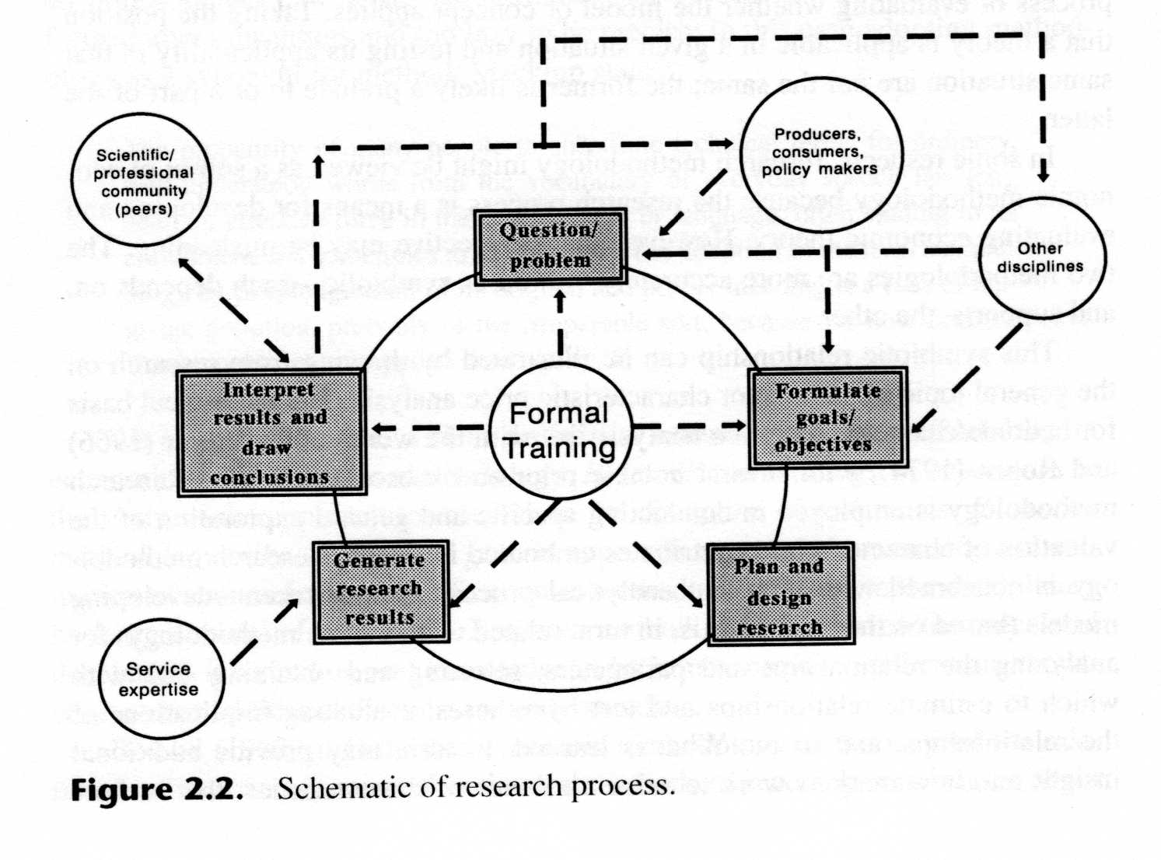
The Process of Research
1
2
5
4
3

Slide 3
The Process of Research
The process is initiated with a question or problem (step 1)
Next, goals and objectives are formulated to deal with the question or problem (step 2)
Then the research design is developed to achieve the objectives (step 3)
Results are generated by conducting the research (step 4)
Interpretation and analysis of results follow (step 5)

Slide 4
ESSENTIAL QUALITY OF RESEARCH
A good research must meet the validity and reliability that are most important in evaluating a measurement tool of a research.
Validity
It can be stated that a research has highly validity if the study only contains what one wants to study and nothing else. Validity refers to how well the data collection and data analysis of the research captures the reality being studied.
Reliability
Reliability demonstrates that the operation of a study, such as the data collection procedures, can be repeated with the same outcome. The objective is to ensure that if a later researcher followed exactly the same procedures as described by an earlier research and conducted the same case study all over again; the later researcher should arrive at the same.

Slide 5
Methodology Defined & Described
Methodology and Method are often (incorrectly) used interchangeable
Methodology – the study of the general approach to inquiry in a given field
Method – the specific techniques, tools or procedures applied to achieve a given objective
Research methods in economics include regression analysis, mathematical analysis, operations research, surveys, data gathering, etc.

Slide 6
Research methodology
The term "research methods" typically refers to the strategy or plan that a researcher has devised in order to gather data.
While "research methodology" sounds similar to "research method," research methodology refers to the body of practices that govern the acquisition of knowledge within a given field.
Research methodology deals with a range of ways to make the most out of solving key research problems. It is a composite of philosophies, ideals, and foundations that drive the actions, the methods, that will be used.

Slide 7
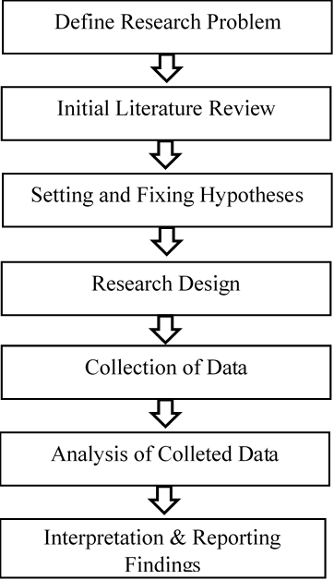
ESEARCH PROCESS

Slide 8
RESEARCH PROBLEM
Research problem is a statement that wants to know what relation exist among some variables.
The first step in a research after determining the area for research is defining the problem under the study, so the time period of research, unit of analysis, variables and estimation of relationship (to set up the next step that is formulating the problem or setting up the hypothesis) are to be facilitated.

Slide 9
RESEARCH PROBLEM
Problem under the study and need for the project
Objectives of the study
Scope of the study
Data for the study
Period for the study

Slide 10
ESEARCH PROCESS

Slide 11
INITIAL LITERATURE REVIEW
Anderson et al. (1971)4say, “The review of literature is a task that continues throughout the duration of the thesis. It begins with a search for a suitable topic. Since a thesis aims to be a contribution to knowledge, a careful check should be made that the proposed study has not previously been carried out.
Although completely new and original problems are rare, a previous study should not be exactly replicated unless the techniques used had been faulty or the findings and conclusions doubtful to shed new light on the problem. A good test is whether the problem still requires solution”.

Slide 12
Hypothesis
A research hypothesis is a specific, clear, and testable proposition or predictive statement about the possible outcome of a scientific research study
a hypothesis struggles to set up a relationship between two or more variables.
Observation,
concepts and
Proposition/proposal are the basis of a hypothesis.
In other words a hypothesis is a proposition that is put to test in research.

