Slide 1
Chapter 2: Macronutrients (B)
1

Slide 2
Macronutrients
Carbohydrates
Classification
Monosaccharides
Disaccharides
Polysaccharides
Simple and complex carbs
Good and bad carbs
Differences between good and bad carbs
Glycemic Index
Digestion and Absorption of Carbohydrates
Functions
Deficiency
Recommendations
2

Slide 3
Introduction
Why protein is so important?
Protein Chemistry
Types of protein
Sources of protein
Requirement & Protein Calories
Digestion of protein
Deficiency of Protein
Symptoms of protein deficiency
Diseases due to protein deficiency
Protein Health benefits
Conclusion
3

Slide 4
Lipids Introduction.
Dietary Composition.
Dietary sources.
Functions.
Classification.
Fatty Acids.
Biological Importance of lipids.
Digestion and Absorption.
Clinical Significance of lipids.
4

Slide 5
CARBOHYDRATES
5

Slide 6
MACRONUTRIENTS
A range of nutrients that provide energy and are essential for growth and maintenance
of the body.
essential for proper body functioning,
and the body requires large amounts of them.
All macronutrients must be obtained through diet; the body cannot produce macronutrients on its own.
three macronutrients are:
carbohydrates,
protein
and fats
Measured in grams.
6

Slide 7
CARBOHYDRATES
Key component of the diet.
sugars, starches and fibers found in fruits, grains, vegetables and milk products.
one of the basic food groups — are important to a healthy diet.
body's main source of energy.
recommended daily amount (RDA) of carbs for adults is 135 grams.
should be between 45% and 65% of total calories.
One gram of carbohydrates equals about 4 calories.
7

Slide 8
CLASSIFICATION
contain carbon, hydrogen and oxygen.
3 main groups:
Monosaccharide
Disaccharide
Polysaccharide
Starch polysaccharide: polysaccharide containing starch. Examples: amylose, amylopectin.
Non-starch polysaccharide: polysaccharide other than starches. Examples: cellulose,
hemicellulose.
8

Slide 9
CONTD.
Monosaccharides:
smallest possible sugar unit.
Empirical formula: (C-H₂O)_{n}
Examples include glucose, galactose, or fructose.
Glucose is a major source of energy for a cell.
In human nutrition, these include:
galactose, most readily available in milk and dairy products
fructose, mostly in vegetables and fruit
9

Slide 10
CONTD.
Disaccharides:
two monosaccharide join and there is the removal of water molecule.
for example, lactose, maltose, and sucrose.
Glucose+ galactose → lactose (commonly found in milk)
Glucose+ fructose → sucrose (found in table sugar)
Glucose + glucose → maltose (key structural motif of starch)
10

Slide 11
CONTD.
Polysaccharides
formed by the joining of many monosaccharide molecule.
act as food stores in plants and animals.
play a structural role in the plant cell wall and the tough outer skeleton of insects.
The chain in polysaccharides may be:
branched, so that the molecule looks like a tree with branches and twigs
unbranched, where the molecule is a straight line
Examples:
Glycogen, that humans and animals store in the liver and muscles.
Starches, not water soluble, Humans and animals digest them using amylase enzymes.
Cellulose, main structural constituents of plants.
11

Slide 12
SIMPLE AND COMPLEX CARBS
Monosaccharides and disaccharides are simple carbohydrates, and polysaccharides are
complex.
Simple carbohydrates are sugars.
consist of just one or two molecules.
provide a rapid source of energy, but the consumer soon feels hungry again.
Examples include white bread, sugars, and candies.
Complex carbohydrates consist of long chains of sugar molecules.
Whole-grains and foods that still have their fiber in are complex carbs.
They tend to fill you up for longer, and
they are considered more healthful, as they contain more vitamins, minerals, and fiber.
Examples include fruits, vegetables, pulses, and wholemeal pasta.
12

Slide 13
GOOD CARBS VS. BAD CARBS
Bad Carbs:
carbs commonly considered bad include pastries, sodas, highly processed foods, white rice, white bread and other white-flour foods.
These are foods with simple carbs. Good Carbs:
Carbs usually considered good are complex carbs, such as whole grains, fruits, vegetables, beans and legumes.
These are not only processed more slowly, but they also contain a bounty of other nutrients.

Slide 14
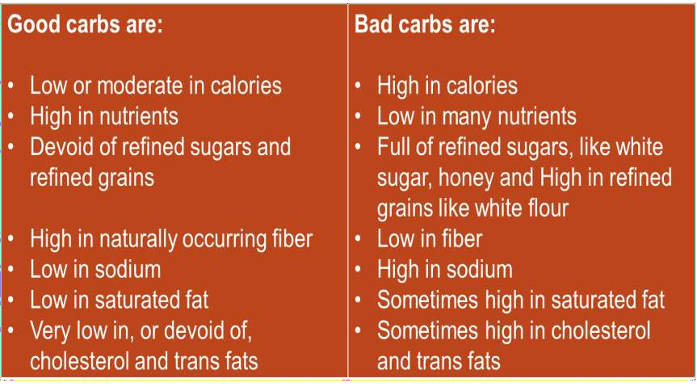
CONTD. (DIFFERENCES)

Slide 15
GLYCEMIC INDEX
not the type of carbohydrate, but rather the carb's glycemic index,
relative ranking of carbohydrate in foods according to how they affect blood
glucose levels.
High-glycemic foods like pastries raise blood sugar highly and rapidly;
low-glycemic foods, raise it gently and to a lesser degree.
high GI carbohydrates are those which are rapidly digested, absorbed and metabolized and result in marked fluctuations in blood sugar (glucose) levels.
Low GI carbohydrates – the ones that produce smaller fluctuations in your blood
glucose and insulin levels – is one of the secrets to long-term health, reducing
your risk of type 2 diabetes and heart disease.
15

Slide 16
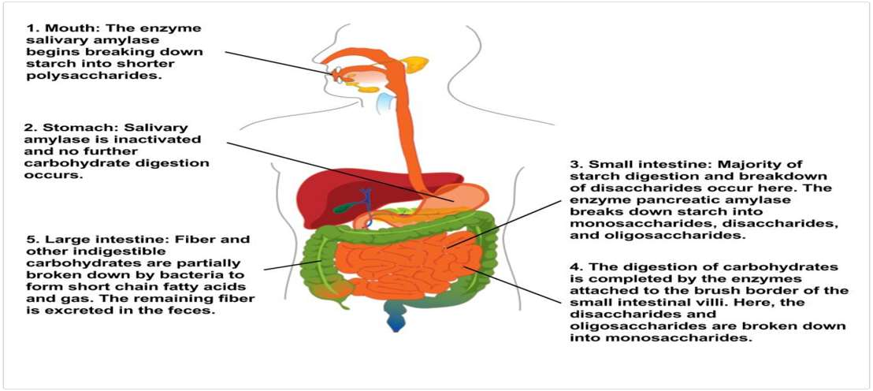
DIGESTION AND ABSORPTION OF CARBOHYDRATES
16

Slide 17
FUNCTIONS
Provide the body with energy.
provide fuel for the central nervous system (influence heat health and diabetes)
and energy for working muscles.
Sparing the use of protein for energy.
Avoiding ketosis from the breakdown of fatty acids
Cellular and protein recognition (biological recognition)
Promote digestive health
17

Slide 18
DEFICIENCY
Without enough fuel, the body gets no energy.
without enough glucose, the central nervous system suffers, which may cause
dizziness or mental and physical weakness,
hypoglycemia.
If the body has insufficient carbohydrate intake or stores, it will consume protein
for fuel. This is problematic because the body needs protein to make muscles.
Using protein for fuel instead of carbohydrates also puts stress on the kidneys, leading to the passage of painful byproducts in the urine.
People who don't consume enough carbohydrates may also suffer from insufficient
fiber, which can cause digestive problems and constipation.
18

Slide 19
RECOMMENDATIONS
We need carbohydrates for health, but they must be the right kind of
carbohydrate.
Following a well-balanced diet that includes unprocessed carbohydrates and getting enough sleep and physical activity is more likely to lead to good health and an appropriate body weight than focusing on or eliminating a particular nutrient.

Slide 20
PROTEINS

Slide 21
INTRODUCTION:
Proteins are essential nutrients, building blocks & fuel source for body
Proteins & carbohydrate provide 4 kcal (17 KJ) per gram; lipids provide 9 kcal (37 kJ) per gram.
Proteins are polymer of amino acids linked by peptide bonds.

Slide 22
WHY SO IS PROTEIN IMPORTANT?
Proteins are fundamental structural and functional elements within body and are involved in a wide range of metabolic interactions.
All cells and tissues contain protein therefore protein is essential for growth and repair and the maintenance of good health.
Protein provides the body with approximately 10 to 15% of its dietary energy and it is the second most abundant compound in the body, following water.
•
A large proportion of protein is present in muscle then blood & skin.
22

Slide 23
TYPES OF PROTEIN:
Complete proteins: These foods contain all the essential amino acids. They mostly occur in animal foods, such as meat, dairy, and eggs.
Incomplete proteins: contain at least one essential amino acid, so there is a lack of balance in the proteins, such as peas, beans, and grains
Complementary proteins: refer to two or more foods containing incomplete proteins that people can combine to supply complete protein. Examples are rice and beans or bread with peanut butter.

Slide 24
SOURCES:
Meat, | Fish
Products from milk, Eggs Soy and its products | Whole grains Cereals Pulses
 | Legumes

Slide 25
RECOMMENDED DIETARY ALLOWANCE:
The FDA recommend that adults consume 50 grams of protein a day, as part of a 2,000- calorie diet.
Depends upon range of factors like Aging, Gender, Activity level & status for example pregnancy.
Protein provides calories. One gram of protein contains 4 calories. One gram of fat has 9 calories.
25
High intake of protein also result in weight loss (so highly recommendation)

Slide 26
INTAKE & DIGESTION OF PROTEIN:
Protein digestion occur by two ways
Mechanical digestion (physical breakdown)
Chemical digestion (by digestive enzymes)
Food enters through mouth where saliva provides lubrication and salivary gland involved in digestion.
Next step is Stomach where pepsinogen released activated by HCL converts protein into polypeptides & dipeptides

Slide 27
CONTINUED..
In intestine trypsin, chymotrypsin act on the precursors & convert them into peptides Amino acid residues that are absorbed into blood stream.
This is crucial for the absorption of the essential amino acids that cannot be biosynthesized by the body.

Slide 28
DEFICIENCY OF PROTEIN:
Protein deficiency occur due to low protein intake in diet.
Lack of protein diet is of major concern especially for growing children.
It can lead to malnutrition & even life threatening.
A deficiency can also arise if a person has a health condition, such as:
an eating disorder (anorexia nervosa)
certain genetic conditions
the later stages of cancer
difficulty absorbing nutrients, due to gastric bypass surgery
28

Slide 29
Weak and sore muscles | Weight loss
Increased water | Anxiety
retention | Nausea
Dry skin and rashes | Skin ulcers Bed sores

Slide 30
DISEASES DUE TO PROTEIN DEFICIENCY:
Marasmus
Kwashiorkor
Protein C and Protein S deficiency
Cachexia
Mental Retardation

Slide 31
CONTINUED..
1. Marasmus:
Marasmus is a disease caused by a severe deficiency of protein and calories.
Affect infants and very young children, often resulting in weight loss and dehydration.
Marasmus can develop into starvation and cause death because of a lack of
essential nutrients.
People with marasmus appear bony with little muscle tissue.

Slide 32
CONTINUED..
2. Kwashiorkor:
Kwashiorkor is a disease caused by a severe deficiency of protein in diets that contain calories mostly from carbohydrates such as yams, rice and bananas.
It usually affects older children. People with kwashiorkor appear puffy in the abdomen area from retention of fluid.
Common symptoms of kwashiorkor include fatigue, irritability, diarrhea, stunted growth and impairment of cognition and mental health.

Slide 33
CONTINUED..
3. Protein C & protein S deficiency:
Deficiencies of protein C and protein S are inherited conditions that cause
abnormal blood clotting.
Symptoms for these deficiencies include redness, pain, swelling in the affected area.
People with these protein deficiencies need to be careful about activities that increase risk of blood clots, such as prolong bed rest etc.

Slide 34
TREATMENT OF PROTEIN DEFICIENCY:
1. Protein supplements
Protein shakes
Protein based medicine (vaccines)
2. Protein rich foods
Liver, Meat, Eggs, potatoes, yoghurt, Oats, Seeds Peanuts

Slide 35
BENEFITS OF PROTEIN:
Prevents diabetes
Saves form cardiovascular diseases
When protein level is high fat will be low
Cholesterol content decreased

Slide 36
CONCLUSION:
Protein is very important because of various functions it plays
Optimum and balanced amount is recommended.
Its deficiency can cause severe diseases.
Excess of everything is bad, High level of Animal protein is major cause of
mortality more than CVD and Cancer.
36

Slide 37
LIPIDS
Kanwal Zeb (16-ARID-2552)

Slide 38
LIPIDS
The lipids are a heterogeneous group of compounds, including fats, oils, steroids, waxes and related compounds, that are related more by their physical than by their chemical properties.
They have the common property of being
relatively insoluble in water.
soluble in nonpolar solvents such as ether and chloroform.

Slide 39
DIETARY FAT COMPOSITION
More than 95% are triglycerides,
The others are:-
Cholesterol Cholesteryl esters Phospholipids, and
Unesterified fatty acids.

Slide 40
DIETARY SOURCES OF LIPIDS
Animal Sources:-
Dairy products- Meat, butter, ghee Meat and fish, pork and eggs.
Vegetable Sources:-
Cooking oils- Sunflower oil, Mustard oil, Ground nut oil
Fats from other vegetable sources.

Slide 41
FUNCTION OF LIPIDS
storage form of energy.
Important dietary components because of their high energy value and also because of fat-soluble vitamins and the essential fatty acids contained in the fat natural food.
Structural components of bio membranes.
Serve as thermal insulators in the subcutaneous tissue around certain organs.
Nonpolar lipids act as electrical insulators, allowing rapid propagation of
depolarization waves along myelinated nerves.
41

Slide 42
FUNCTIONS OF LIPIDS(CONTD.)
Provide shape and contour to the body.
Act as metabolic regulators.
Combination of lipid and protein(lipoprotein) are important cellular, constituents , occurring both in cell membrane and in the mitochondria, and serving also as the mean of transporting lipids in the blood.

Slide 43
CLASSIFICATION OF LIPIDS
1:- Simple Lipids:- Esters of fatty acids with various alcohols.
Fats:- Esters of fatty acids with glycerol. Oils are fats in liquid state.
Waxes:- Esters of fatty acids with high molecular weight monohydric alcohol.

Slide 44
CONTINUED
2:- Complex Lipids:- Esters of fatty acids containing groups in addition to an alcohol and a fatty acid.
Phospholipids:- Lipids containing in addition to fatty acid and alcohol, a phosphoric acid group.
Glycolipid:- Lipid containing a fatty acid, sphingosine and carbohydrate.
Other complex lipids such as sulfo-lipids and amino lipids. Lipoproteins may also consider in this group.

Slide 45
CONTINUED
3:- Precursor and Derived lipids:- These are:-
Fatty acids.
Glycerol.
Steroids.
Other alcohols.
Fatty aldehyde.
Ketone bodies.
Hydrocarbon, lipid-soluble vitamins, and hormones.

Slide 46
FATTY ACIDS
Fatty Acids are aliphatic carboxylic acids.
Have the general formula R-(CH2)n-COOH.
They occur mainly as esters in natural fats and oils but do occur in the unesterified form as free fatty acid, a transport form found in the plasma.
Fatty acids that occur in natural fats are usually straight-chain derivatives containing an even number of carbon atoms.
The chain may be saturated (containing no double bonds) or un saturated
(containing one or more double bonds).
46

Slide 47
CLASSIFICATION OF FATTY ACID
Fatty acids can be classified in many ways:-
According to the nature of hydrophobic chain
Saturated fatty acids.
Unsaturated fatty acids.
Branched chain fatty acids.
Substituted fatty acids.
Saturated fatty acids do not contain double bond, while unsaturated fatty acids contain double bond.
47

Slide 48
BIOLOGICAL IMPORTANCE OF FATTY ACIDS
Fatty acids are the building blocks of dietary fats. The human body stores such
fats in the form of triglycerides.
Fatty acids are also required for the formation of membrane lipids such as phospholipids and glycolipids
They are required for the esterification of cholesterol to form cholesteryl esters.
They act as fuel molecules and are oxidized to produce energy.

Slide 49
DIGESTION IN SMALL INTESTINE
Major site of fat digestion.
Effective digestion due to the presence of pancreatic lipase and bile salt.
Bile salts act as effective emulsifying agents for fats.
Secretion of pancreatic lipase is stimulated by:-
Passage of acid gastric contents into the duodenum.
By secretion of secretin, Cholecystokinin and Pancreozymin, the gastro intestinal hormones.

Slide 50
ABSORPTION OF LIPIDS
Glycerol, short and medium chain fatty acids ( Chain length less than 14 carbons) are directly absorbed from the intestinal lumen in to the portal vein and taken to liver for further utilization.
Long chain fatty acids, free cholesterol and beta acyl glycerol together with bile salts form micelles.

Slide 52
CLINICAL SIGNIFICANCE OF LIPIDS
Following diseases are associated with abnormal chemistry or metabolisms of
lipids-
Obesity.
Atherosclerosis.
Diabetes mellitus.
Hyperlipoproteinemia.
Fatty liver.
Lipid storage diseases.

Slide 53
CONCLUSION:
Lipids is very important because of various functions it plays
Optimum and balanced amount is recommended.
Its deficiency can cause severe diseases.
Excess of everything is bad, High level of lipids is major cause of obesity, high blood pressure and CVDs.
54

