Slide 1
Gateways
CSE326
Md. Ferdouse Ahmed Foysal
Daffodil International University

Slide 2
Gateways
Gateways are the point of entry into a server network. They isolate the individual communication channels and their specific requirements from the rest of the back-end systems. Gateways, like a WAP Gateway convert TCP/IP to protocols optimized for wireless data transmission.

Slide 3
Connectivity Gateway
Pervasive Computing is dominated by a variety of non-IP network protocols, which are either proprietary or specific to a particular industry. As soon as devices want to access the Internet or other computer networks a protocol conversion is required. This task is done by a connectivity gateway.

Slide 4
WAP Gateway
In order to connect WAP phones to the Internet the standard HTTP Internet protocol used by web servers must be converted into W AP's Wireless Session Protocol (WSP). this task is done by a WAP gateway, Additionally the content, which must be provide in the Wireless Markup Language (WML) format is translated into a binary content representation (WBXML) to optimize transmission.

Slide 5
WAP Gateway
Besides content and protocol transformation, the server initiated client notification needs to be supported, which was introduced with WAP 1.2. This "push"-mechanism is a bit circumstantial, since normal HTTP servers can only respond to requests received from clients. The initiator of a push acts as a HTTP client of the WAP Gateway, which takes the role of a Web server, referred to as Push Proxy Gateway (PPG). The PPG forwards the push notification to the WAP client over WSP. Each push message consists of two components: the content to be pushed to the WAP client and a control entity, which holds information, like the message expiration date.
Since WAP is an open standard and independent from a specific telecommunication network any gateway should work with any W AP compliant phone

Slide 6
Nokia WAP Server
Among the available commercial gateway products is Nokia’s WAP Server. Connections from WAP clients to the gateway can base on the bearers Short Message Text (SMS) and Circuit Switched Data (CSD). It is possible to implement other protocols than HTTP on the server side, for instance, when legacy systems need to be supported. An application programming interface (API) enables a service provider to develop particular stand-alone applications, like servlets, directly on top of the gateway. Additional backend server systems can be omitted this way.

Slide 7
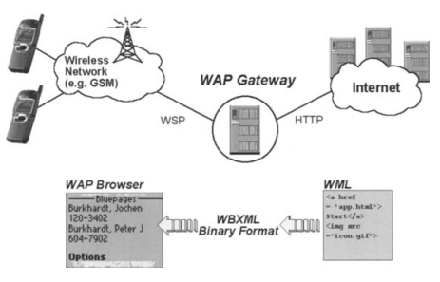
WAP Gateway

Slide 8
Wireless Gateway
The IBM SecureWay Wireless Gateway tunnels the IP protocol through a diverse set of wireless and wireline networks. Applications on client systems can communicate with enterprise networks based on TCP/IP, although this protocol is actually not supported by the communication bearer. Any application developed for the standard TCP/IP interface, will run on top of SecureWay Wireless without modifications.

Slide 9
Wireless Gateway
Client:
The Secure Way Wireless Client is the counterpart of the gateway and must be installed on the user's client system. A user interface allows to initiate the communication to the gateway. The mobile user can select the network type, which meets best his current needs, without making any changes to the installed applications.

Slide 10
Wireless Gateway
Efficient:
Besides the simple IP-based communication between client and gateway, SecureWay Wireless optimizes the network traffic using data compression mechanisms. Increasing efficiency is extremely important for low speed wireless networks. The benefits of less data traffic are better response times and often lower network fees. Additionally, an idle connection can be disconnected automatically and will resurne as soon as communication continues. The user will not notice that interrupt (short-hold mode).

Slide 11
Wireless Gateway
Secure
For reliable data privacy, all data transmitted through public networks from the client device to the gateway can be encrypted with RSA. Two way client/gateway authentication mechanisms prevent unwanted access

Slide 12
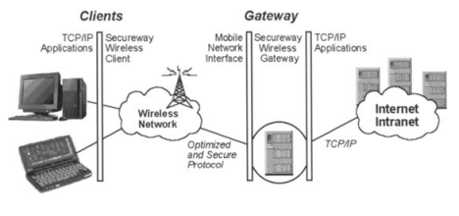
Wireless Gateway

Slide 13
Transcoding
Transcoding is a content adaptation technology, which tailors information for a specific device by transforming its format and representation. Multimedia data as it can be found on Web pages, is filtered, converted, and reformatted, until it matches the capabilities of the displaying device.

Slide 14
Why transcoding?
The purpose is obvious: When providers deliver content to various pervasive clients, they need to accommodate device specific constraints such as limited memory, slow data transmission, and small screens. Transcoding automatically translates content into different representations for each class of receiving client systems. This simplifies authoring, deployment, and maintenance dramatically! An arbitrary multimedia web page can be provided to Internet TV s, handhelds, and W AP phones without change. It is even possible to adapt content from legacy systems into a standardized Internet representation, or transcode Web pages to the proprietary format of a specific client device.
Besides adapting content according to particular device capabilities, another aspect of transcoding gains importance: information is personalized for a particular user, depending on his preferences and organizational policies. For instance, content of interest can be transcoded into individual user interface styles or a preferred language.

Slide 15
Residential Gateway
The residential gateway is a computer that acts as a central bridge between the outside world and the networked devices in the home. There are two major aspects to the residential gateway.
On one hand, the residential gateway integrates "traditional" communication media - telephone and cable TV - into the home audio-visual system. Through a caller 10 function such a system could, far example, announce a caller's identity through the home audio system. The resident could then decide whether or not to get out of his jacuzzi to pick up the phone.

Slide 16
Residential Gateway
On the other hand, work is carried out to define the gateway as a bridge between the home and the Internet. Valid services should be able to access the home systems. For example, the refrigerator repair center should be able to access the appliance in the home for diagnostic purposes. However, unauthorized access must be blocked - it must not be possible far unauthorized persons to determine information about the residents.

Slide 17
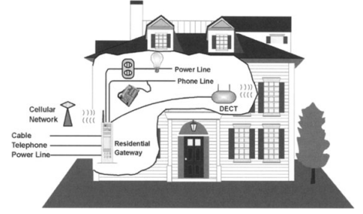
Residential Gateway

Slide 18
Acknowledgment
These slides contain material developed and copyright by:
Pervasive Computing Handbook - Uwe Hansmann

