Slide 1
Gas Turbine Power Plant

Slide 2
Gas Turbine Power Plant:
In gas turbine power plant we use high pressure and temperature air instead of high pressure and temperature steam to rotate the turbine.
The fundamental working principle of a gas turbine power plant is same as that of a steam turbine power plant. The only difference is there that in steam turbine power plant we use compressed steam to rotate the turbine, but in gas turbine power plant we use compressed air to turn the turbine.
It is generally used as a standby power plant for hydroelectric power plant.

Slide 3
Advantage:
Construction wise a gas turbine power plant is much simpler than a steam turbine power plant.
The size of a gas turbine power plant is smaller than that of a steam turbine power plant.
A gas turbine power plant does not have any boiler like component, and hence, the accessories associated with the boiler are absent here.
It does not deal with steam hence it does not require any condenser hence no cooling tower like structure is needed here.
As design and construction wise gas turbine power plants are much more straightforward and smaller, the capital cost and running cost are quite less than that of an equivalent steam turbine power plant.
The constant loss is quite smaller in gas turbine power plant compared to a steam turbine power plant because in the steam turbine power plant boiler has to run continuously even when the system does not supply load to the grid.
A gas turbine power plant can more instantly be started than an equivalent steam turbine power plant.

Slide 4
Disadvantages:
The mechanical energy created in the turbine is also utilised to run the air compressor. Since a major portion of mechanical energy created in the turbine is utilised to run the air compressor the overall efficiency of gas turbine power plant is not as high as an equivalent steam turbine power plant.
Not only have that, the exhaust gases in gas turbine power plant curries significant heat from the furnace. This also causes the efficiency of the system low further.
To start power plant pre-compressed is required. So before actual starting of the turbine air should be pre-compressed which requires an auxiliary power supply for starting a gas turbine power plant. Once the plant is started there is no more need of supplying external power but at starting point external power is essential.
The temperature of the furnace is quite high in a gas turbine power plant. This makes the system lifespan smaller than that of an equivalent steam turbine power plant.
Because of its lower efficiency, a gas turbine power plant cannot be utilized for commercial production of electricity

Slide 5
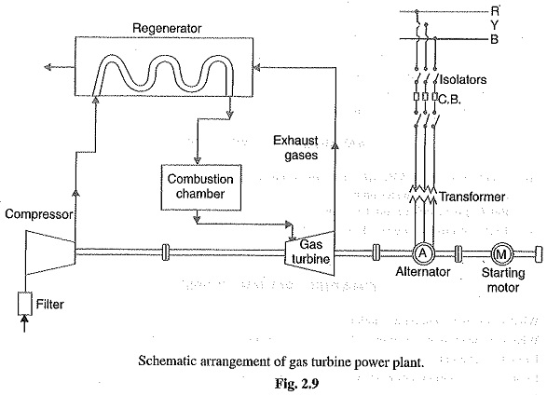
Schematic Diagram of Gas Turbine Power Plant:
Fuel
air

Slide 6
Different Components of Gas Turbine Power Plant:
Compressor: Air compressor used in a gas turbine power plant is mainly of the rotary type. The air filter is attached at the inlet of the compressor where air gets filtered from dust. The rotary blades attached to the shaft push the air between stationary blocks, and consequently, the pressure of the air is increased. High pressure air is available at the outlet of the compressor.
Regenerator: There is always some heat presents in the exhaust gases in a gas turbine power plant. A portion of this heat is utilized in the regenerator. In regenerator, there is a net of fine tubes. The compressed air is passed through these fine tubes. The whole arrangement is enclosed in a vessel through which hot exhaust gases from turbine pass. During passing through the fine tubes, compressed air gets a portion of heat carried by exhaust gases. In this way, a significant portion of the heat of exhaust gases raises the temperature of the compressed air before it enters into the combustion chamber.

Slide 7
Different Components of Gas Turbine Power Plant:
Combustion Chamber: After passing through the regenerator, the hot compressed air enters into the combustion chamber. In the combustion chamber, there are burners through which fuel oil is injected in the form of oil spray. Due to combustion of this hot oil spray inside the combustion chamber, the air attends a very high temperature. The temperature is about 3000F. The compressed air mixed with combustion gases then cooled down to 1500ºF to 1300ºF before it is being delivered to the turbine for doing mechanical work there.
Turbine: The compressed air mixed with combustion gases then enters in the turbine through nozzles. Here, the mixture of gases is suddenly expanded and it gains required kinetic energy to do mechanical work to rotate the turbine shaft (main shaft). In the turbine the temperature of the gases comes down to 900ºF.

Slide 8
Different Components of Gas Turbine Power Plant:
Alternator: The rotor of an alternator is attached to the same shaft of the turbine hence the alternator rotates along with the turbine and produces electrical energy.
Starting Motor: In gas turbine power plant the compressor, alternator, and turbine are attached to the same shaft. For starting the system, the compressor has to deliver pre-compressed air at starting. The shaft has to rotate to produce required compressed air for starting purpose. Hence, an alternative arrangement is required to run the compressor before the system is being started. This is done by a starting motor connected to the same shaft. A motor coupled with the main shaft supplies the required mechanical power for compressing air before starting.

Slide 9
Combined Cycle Power Plant
A combined-cycle power plant uses both a gas and a steam turbine together to produce up to 50 percent more electricity from the same fuel than a traditional simple-cycle plant. The waste heat from the gas turbine is routed to the nearby steam turbine, which generates extra power.

Slide 10
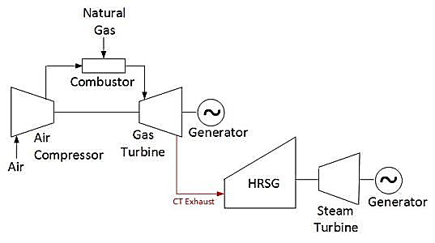
Schematic Diagram of Combined-cycle Power Plant :
Bryton cycle & rankine cycle =Combine cycle

Slide 11
How a Combined-cycle Power Plant Produces Electricity
1. Gas turbine burns fuel.
The gas turbine compresses air and mixes it with fuel that is heated to a very high temperature. The hot air-fuel mixture moves through the gas turbine blades, making them spin.
The fast-spinning turbine drives a generator that converts a portion of the spinning energy into electricity.
2. Heat recovery system captures exhaust.
A Heat Recovery Steam Generator (HRSG) captures exhaust heat from the gas turbine that would otherwise escape through the exhaust stack.
The HRSG creates steam from the gas turbine exhaust heat and delivers it to the steam turbine.
Steam turbine delivers additional electricity.
The steam turbine sends its energy to the generator drive shaft, where it is converted into additional electricity.

Slide 12
Thank You

